Slide 1




































counties
weeks
$$y_{1,1}$$
$$y_{2,1}$$
$$y_{3,1}$$
$$y_{5,1}$$
$$y_{4,1}$$
$$y_{5,1}$$
$$y_{6,1}$$
$$ρ$$
$$y_{2,2}$$
$$y_{1,2}$$
$$y_{2,2}$$
$$y_{3,2}$$
$$y_{7,1}$$
$$y_{8,1}$$
$$y_{9,1}$$
1
$$y_{4,2}$$
$$y_{5,2}$$
$$y_{6,2}$$
$$y_{4,2}$$
1
1
$$y_{5,2}$$
$$y_{6,2}$$
$$y_{7,2}$$
$$y_{8,2}$$
$$y_{9,2}$$
$$y_{1,t}$$
$$y_{2,t}$$
$$y_{3,t}$$
1
$$y_{4,2}$$
$$ρ$$
$$y_{4,t}$$
$$y_{5,t}$$
$$y_{6,t}$$
$$y_{5,3}$$
$$y_{7,t}$$
$$y_{8,t}$$
$$y_{9,t}$$

Slide 2

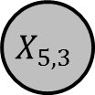
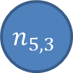

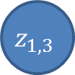
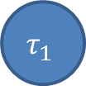
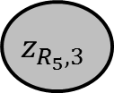

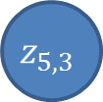
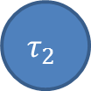
$$τ_{1}$$
$$τ_{2}$$
$$β$$
$$X_{5,3}$$
$$n_{5,3}$$
$$y_{5,3}$$
$$ε_{1}$$
$$z_{1,3}$$
$$z_{5,3}$$
$$z_{R_{5},3}$$

