Slide 1
Spatio-temporal prediction of epidemics through assimilation of information from diverse sources
For PPAML Challenge Problem
Technical point of contact: | Ssu-Hsin Yu, Ph.D. Email: syu@ssci.com Tel: 781-933-5355 x232

Slide 2
Problem Background
Predicting the spread of epidemics such as flu helps government agencies and organizations better prepare and allocate resources.
The most authoritative flu epidemic data comes from CDC:
It reports the weekly number of Influenza-like Illness (ILI) cases collected through the U.S. Outpatient Influenza-like Illness Surveillance Network (ILINet)
However, there are several drawbacks
Low spatial resolution
The data is aggregated to 10 regions, each of which consists of multiple states
Low temporal resolution
The data is reported on a weekly basis
Delay in reporting
One to two weeks of lag before the data becomes available
There is significant potential in achieving
Better spatial and temporal granularity
More timely flu activity awareness
Better forecasting flu activity

Slide 3
Data available to significantly improve flu prediction
Google Flu Trends augments CDC data with search data to estimate current flu activity; but much more can be done
More accurate estimation and prediction with better spatial granularity
Additional data is available
Social network data (e.g. Twitter)
ILI reports from select states
Vaccination data reducing susceptible population
Flu-related medicine sale (e.g. Walgreens Flu Index)
Local weather data (e.g. temperature and humidity affect transmission)
Demographics
Transportation data (e.g. how closely connected different regions are)
Flu is well studied and epidemic models are available
Models such as SIR (susceptible-infected-removal) further ground dynamics flu spread.

Slide 4
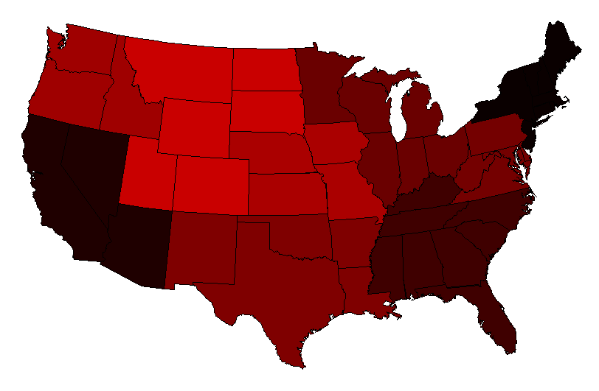
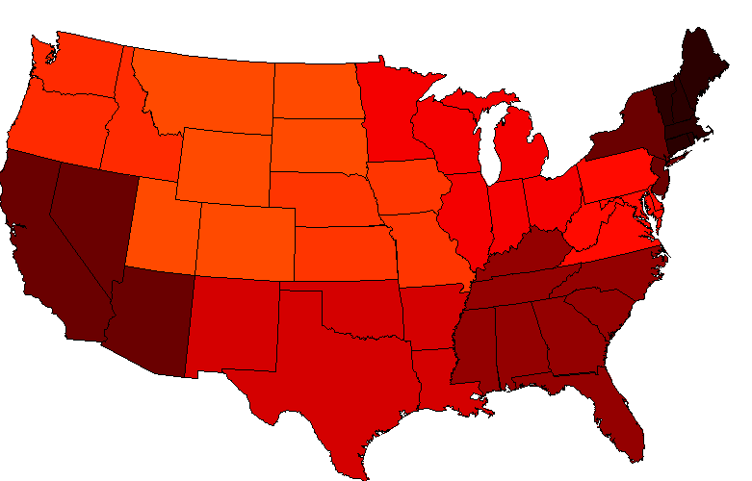
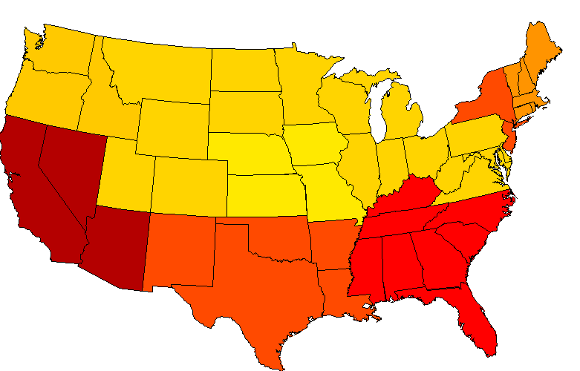
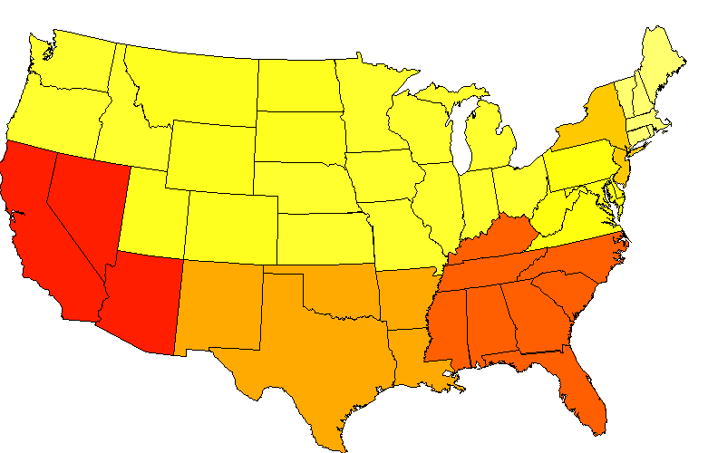
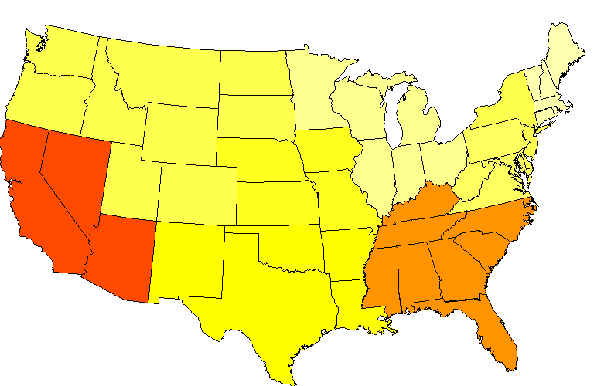
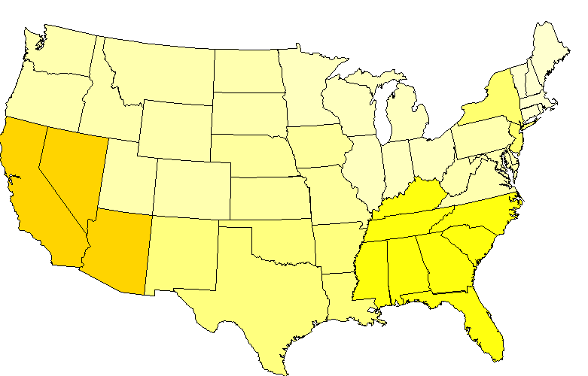
Supporting Data – CDC Seasonal Flu
CDC reports the weekly percentages of Influenza-like Illness (ILI) cases collected through the U.S. Outpatient Influenza-like Illness Surveillance Network (ILINet) with roughly 2 weeks of delay.
Highly authoritative and long history of data (from 1997 to current)
Data aggregated into 10 HHS regions
2009 Week 44
Week 45
Week 47
Week 50
2010 Week 10
Week 18

Slide 5
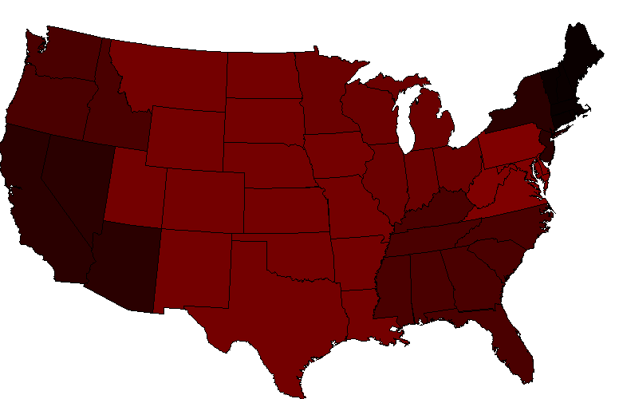
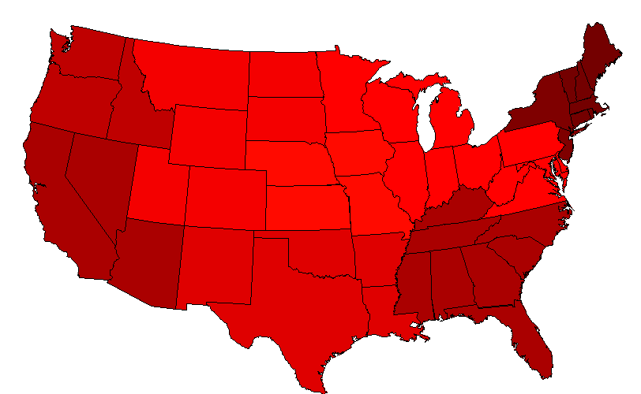
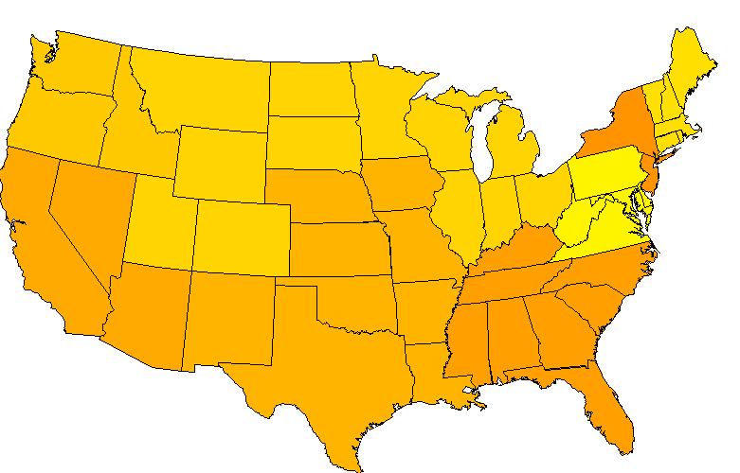
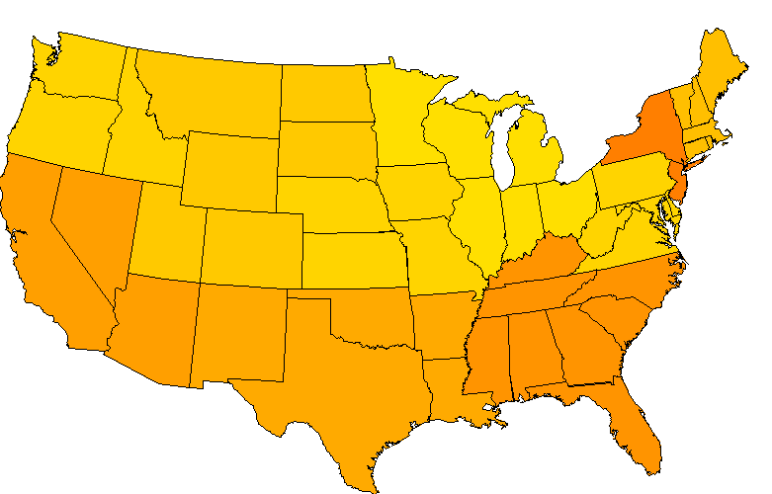
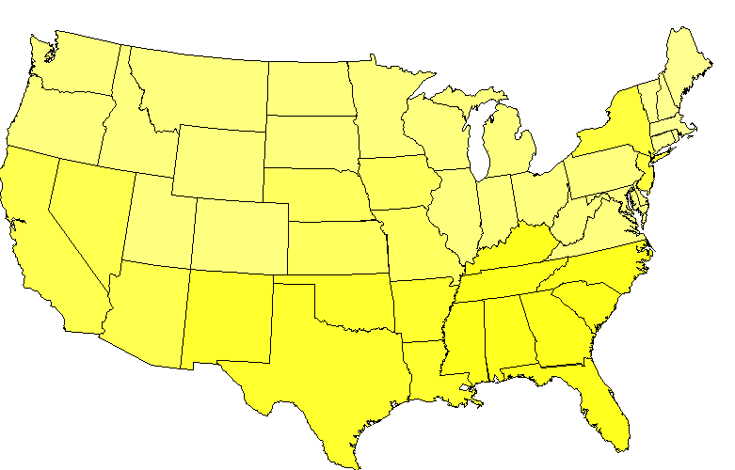
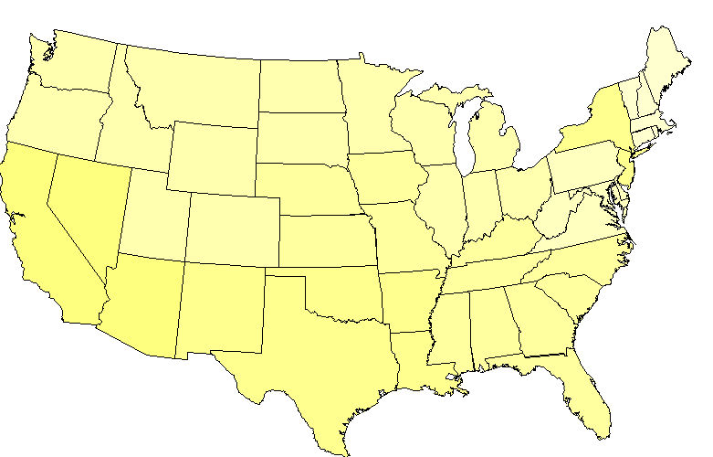
Supporting Data – Flu Related Tweets
The basic dataset contains the number of flu related tweets (i.e. keywords match) without retweets and not from the same user within syndrome elapsed time of 1 week.
More timely, better spatial granularity
Highly noisy, only indirect evidence of flu infection, biased toward certain demographics
2009 Week 44
Week 45
Week 47
Week 50
2010 Week 10
Week 18

Slide 6
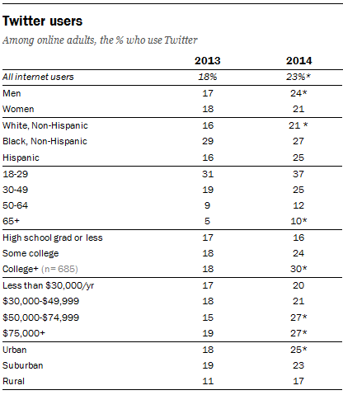
Supplementary Data – Demographics
Demographics of each county, including gender, race, education and income level from US Census Bureau (http://quickfacts.census.gov/qfd/download_data.html)
Demographics of Twitter users in terms of gender, race, education and income level is available from a study by Pew Research (http://www.pewinternet.org/2015/01/09/demographics-of-key-social-networking-platforms-2/)
Source: Pew Research Center

Slide 7
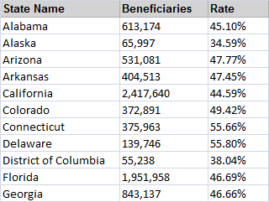
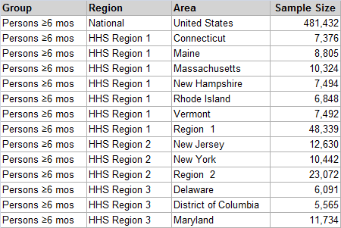
Supplementary Data – Flu Vaccination
HHS maintains flu vaccination claims data (2012-2015) for those covered by Medicare Fee-for-Service with about 2 weeks of delay for every state, county and zip code. (http://www.hhs.gov/nvpo/flu-vaccination-map/)
contains only Medicare claims, the majority of the claims are for Americans 65 and over
CDC collects flu vaccination data from for the general population divided by state and age group. It is conducted by surveys at the end of a flu season. (http://www.cdc.gov/flu/fluvaxview/reports/reporti1314/trends/index.htm)

Slide 8
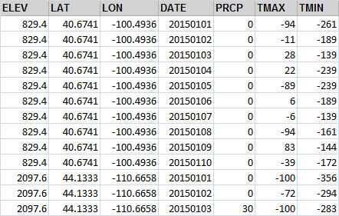
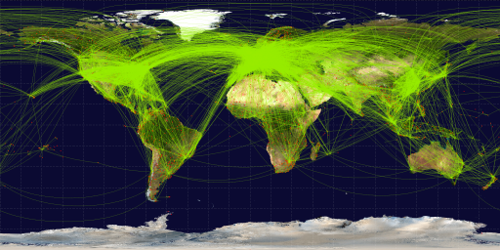
Supplementary Data – Weather and Travel Patterns
Local weather data such as temperature and humidity are related to flu transmission and hence flu cases
Weather data from thousands of stations around the country with records going back for decades are available from NOAA’s National Climatic Data Center (NCDC).
Connecting flights between airports are an indicator of connectedness between regions and indirectly influence how fast an epidemic may spread among regions.
Airline routes and airport locations are available (http://openflights.org/data.html)
Source: http://openflights.org/data.html

Slide 9
Supplementary Data – Retail
Retail data of people buying flu-related medicine or receiving vaccination from national chains
Walgreens publishes Walgreens Flu Index every week “by tallying the retail prescription data for the pharmacy’s antiviral medications” of the previous week.

Slide 10
Baseline Generative Model
There are latent flu cases that vary spatially and temporally.
Some factors that affects the number of flu cases are known
Vaccination rate, temperature, etc.
Other factors may not be known explicitly
However, their effects result in gradual spatial and temporal changes
What we observe are reports of flu cases from hospitals and individuals
Weekly reports of Influenza-like Illness (ILI) cases from CDC and states
People self reports on social media such as tweets
Retail sales of flu medication
A Bayesian hierarchical model relates the different types of observations and granularities through the latent flu risk variables
Capture the spatial and temporal dependency of observations of different nature
Easier to describe observations of various spatial and temporal granularity

Slide 11
Existing Baseline Spatio-temporal Generative Model
Fixed Effects |  | Covariates X_{s,t} consist of known factors (e.g. vaccination) that affect flu infection
Spatio-Temporal Effects |  | Gaussian Markov Random Field (GMRF) captures spatial and temporal dependency
Periodic Effects |  | GMRF describes periodic effects such as seasonal fluctuation
Link Functions |  | Relating latent flu risks to different types of observations (e.g. log, logit)
Observations |  | Observed CDC flu reports, flu related tweets, etc.. Link functions and distributions depend on the nature of the observations (e.g. Poisson)
Parameter Priors
s, t : space and time indices respectively Y_{s,t}, Z_{t} : random variables in GMRF for spatio-temporal and periodic (e.g. seasonal) effects respectively n, T: dimensions of Y_{s,t}, Z_{t} , respectively Q, P: sparse precision matrices for spatio-temporal and periodic effects respectively | l: dimension of the null space of Q m: period of the periodic effect; m-1 is the dimension of the null space of P (j): index for types (flu reports, tweets) of observations N(.,.) : Gaussian distribution G(.,.) : Gamma distribution

Slide 12
Spatio-temporal Effects
Use GMRF to describe spatio-temporal dependency for unknown risk factors Y_{s,t}
Defined by full conditional distributions
The resulting joint probability of Y_{s,t} is a multi-dimensional Gaussian
The neighbors Nbr_{s,t} of Y_{s,t} are those that are close spatially (e.g. neighboring counties) and temporally (e.g. previous and subsequent weeks).
Q is a sparse matrix with non-zero elements corresponding to neighbors of each random variable.

Slide 13
Periodic Effects
Flu epidemics have distinct seasonal fluctuations
Can also be described by GMRF
P is a sparse matrix with the number of non-zero elements determined by the period m.

Slide 14
Python Code for Baseline Spatio-temporal Model Available
Implemented in Python available for distribution
Can be modified for new data types and model components to achieve better predictions
Vary neighborhood structures (based on county, town/city, weekly, monthly, etc.) as needed
Incorporate different data types (e.g. number of tweets, percentage of flu hospitalization)
Inference and prediction computed with MCMC
PyMC is the current MCMC engine

Slide 15
Why we can do better
Assimilation of multiple sources of data
CDC reports for HHS regions
Individual reports from states
Twitter
Retail sales,…
Incorporate spatial dependency
Better spatial granularity
Sharing information spatially
Data available to better control bias
Twitter and local demographics
Data available to better predict dynamics of flu epidemic (e.g. SIR)
Local vaccination statistics
Current generative model can be extended to incorporate all those data
Estimate latent risks
Can incorporate epidemic models

