Slide 1
Aviation Risk Analysis Project Presentation
Presented by: Elizabeth Ogutu
Date: April 26, 2025

Slide 2
Executive Summary
Objective: To analyze aviation accidents and identify the safest aircraft for purchasing decisions.
Key Findings:
The trend of accidents over time shows significant improvements in aviation safety.
Aircraft models vary significantly in terms of fatality rates, with certain models showing consistently lower risks.
Accidents are most frequent during takeoff and landing phases.
Recommendation: Purchase aircraft models with lower fatality rates and prioritize aircraft with strong safety records.

Slide 3
Business Understanding
Problem: The company wants to join into the aviation industry and needs to choose the safest aircraft for commercial and private use.
Goal: To determine which aircraft are the lowest risk based on accident data.

Slide 4
Data Overview
Data Source: Aviation Accident Database & Synopses (NTSB, 2023)
Key Columns:
Aircraft Model
Accident Severity
Location & Date of Accidents
Aircraft Make
Fatalities & Injuries

Slide 5
Data Analysis
Key Insights:
Accident Trends Over Time: Line chart showing accident frequency over the years.
Top Countries by Accidents: Bar chart showing which countries report the most accidents.
Fatality Rates by Aircraft Model: Bar chart with the fatality rates of top aircraft models.

Slide 6
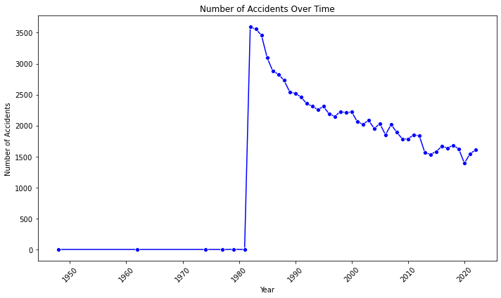
Visual 1: Accidents Over Time
Title: "Accidents Over Time: A Look at Safety Trends"
Insight: "Accidents have decreased over the years, indicating improvements in safety protocols."

Slide 7
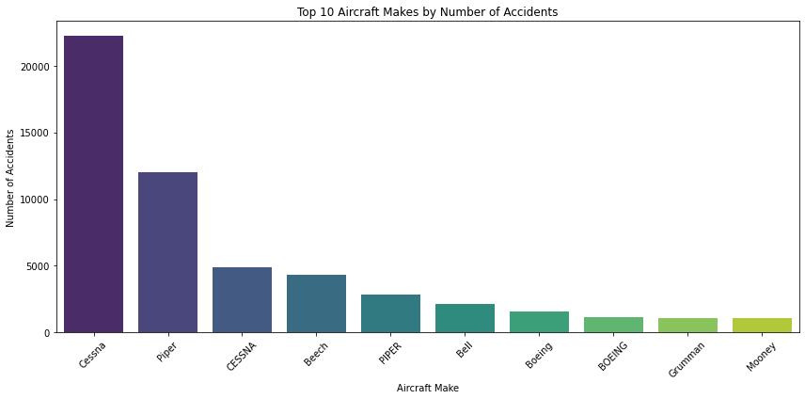
Visual 2: Top 10 Aircraft makes by number of Accidents
Title: "Top 10 Aircraft makes with the Most Accidents"
Insight: "Certain Aircrafts have a higher frequency of aviation accidents, which may influence international safety protocols."

Slide 8
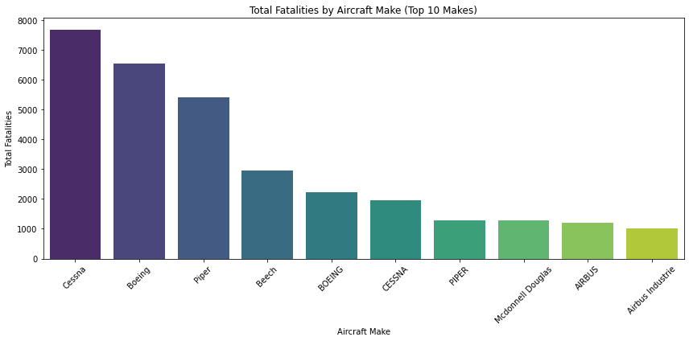
Visual 3: Fatality Rate by Aircraft Model
Title: "Fatality Rates by Aircraft Model"
Insight: "Aircraft models vary significantly in terms of safety. Models with higher fatality rates are riskier investments."

Slide 9
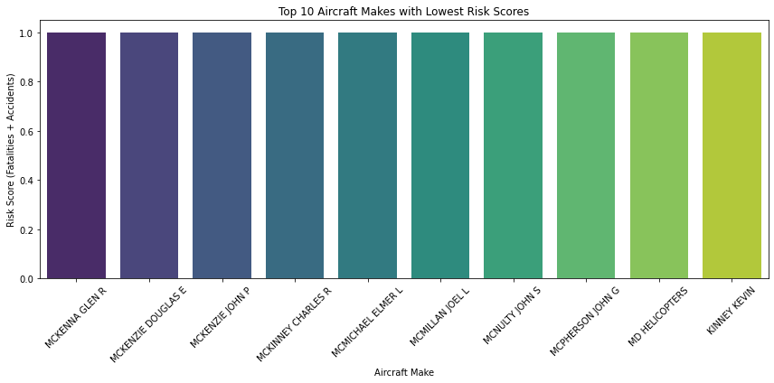
Visual 4: Top 10 Aircrafts models with Lowest Risk Score
Title: “Lowest Risk Score"
Insight: "Aircraft models with significantly low risk score in terms of Fatalities and Accidents are safer investments."

Slide 10
Recommendations
Aircraft Selection Criteria:
Low Fatality Rates: Choose aircraft with low fatality rates.
Proven Safety Record: Models with fewer accidents should be prioritized.
Weather & Flight Phase Considerations: Models performing well in diverse weather conditions and phases of flight are preferred.

Slide 11
Next Steps
Step 1: Present the analysis and recommendations to the head of the aviation division.
Step 2: Conduct a deeper investigation into specific aircraft models.
Step 3: Finalize purchasing decisions based on the safest models identified.

Slide 12
Questions & Discussion
Contact: Elizabeth Ogutu
https://www.linkedin.com/in/elizabeth-ogutu-36222b1a6/
Thank you.

