Slide 1
Demo Deck: Officer package
Libby heeren

Slide 2
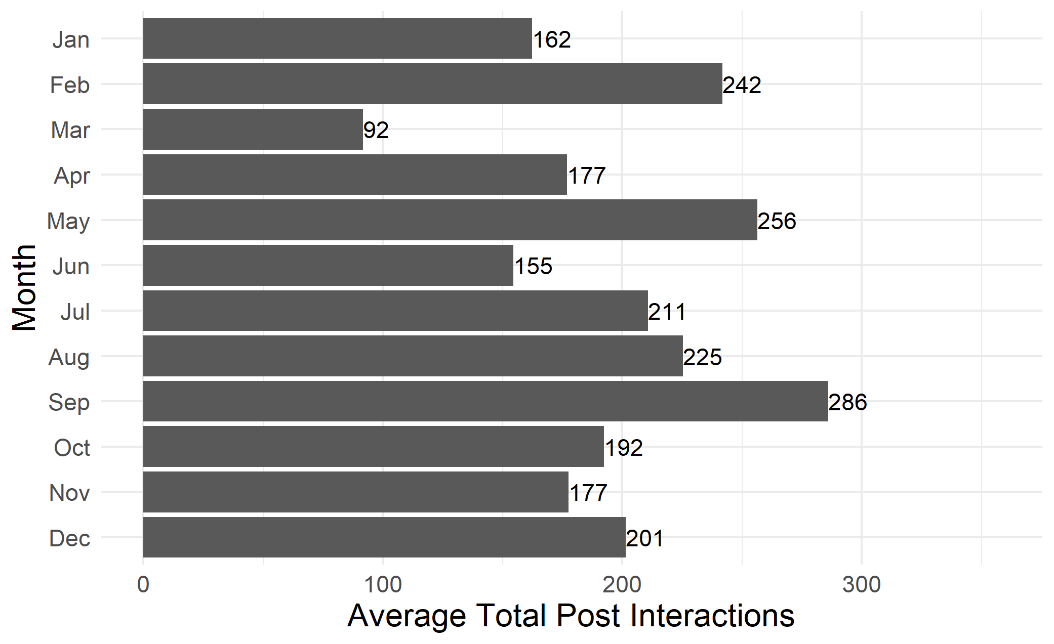
Average Total Interactions by Month

Slide 3
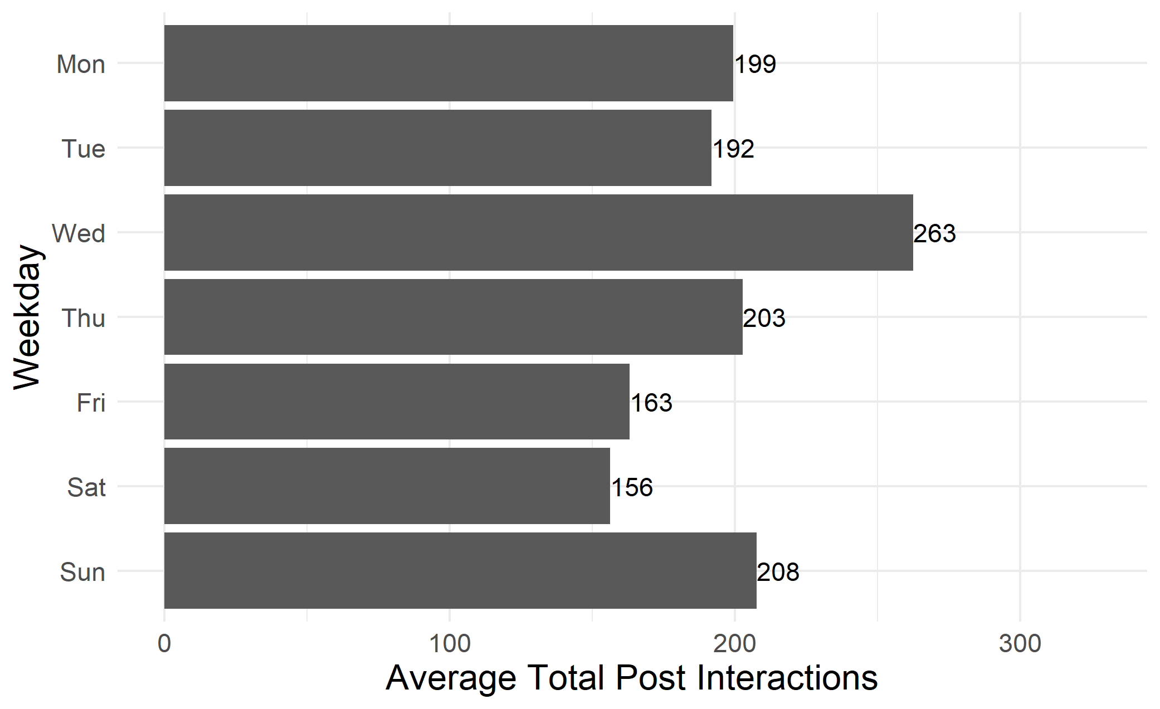
Average Total Interactions by Weekday

Slide 4
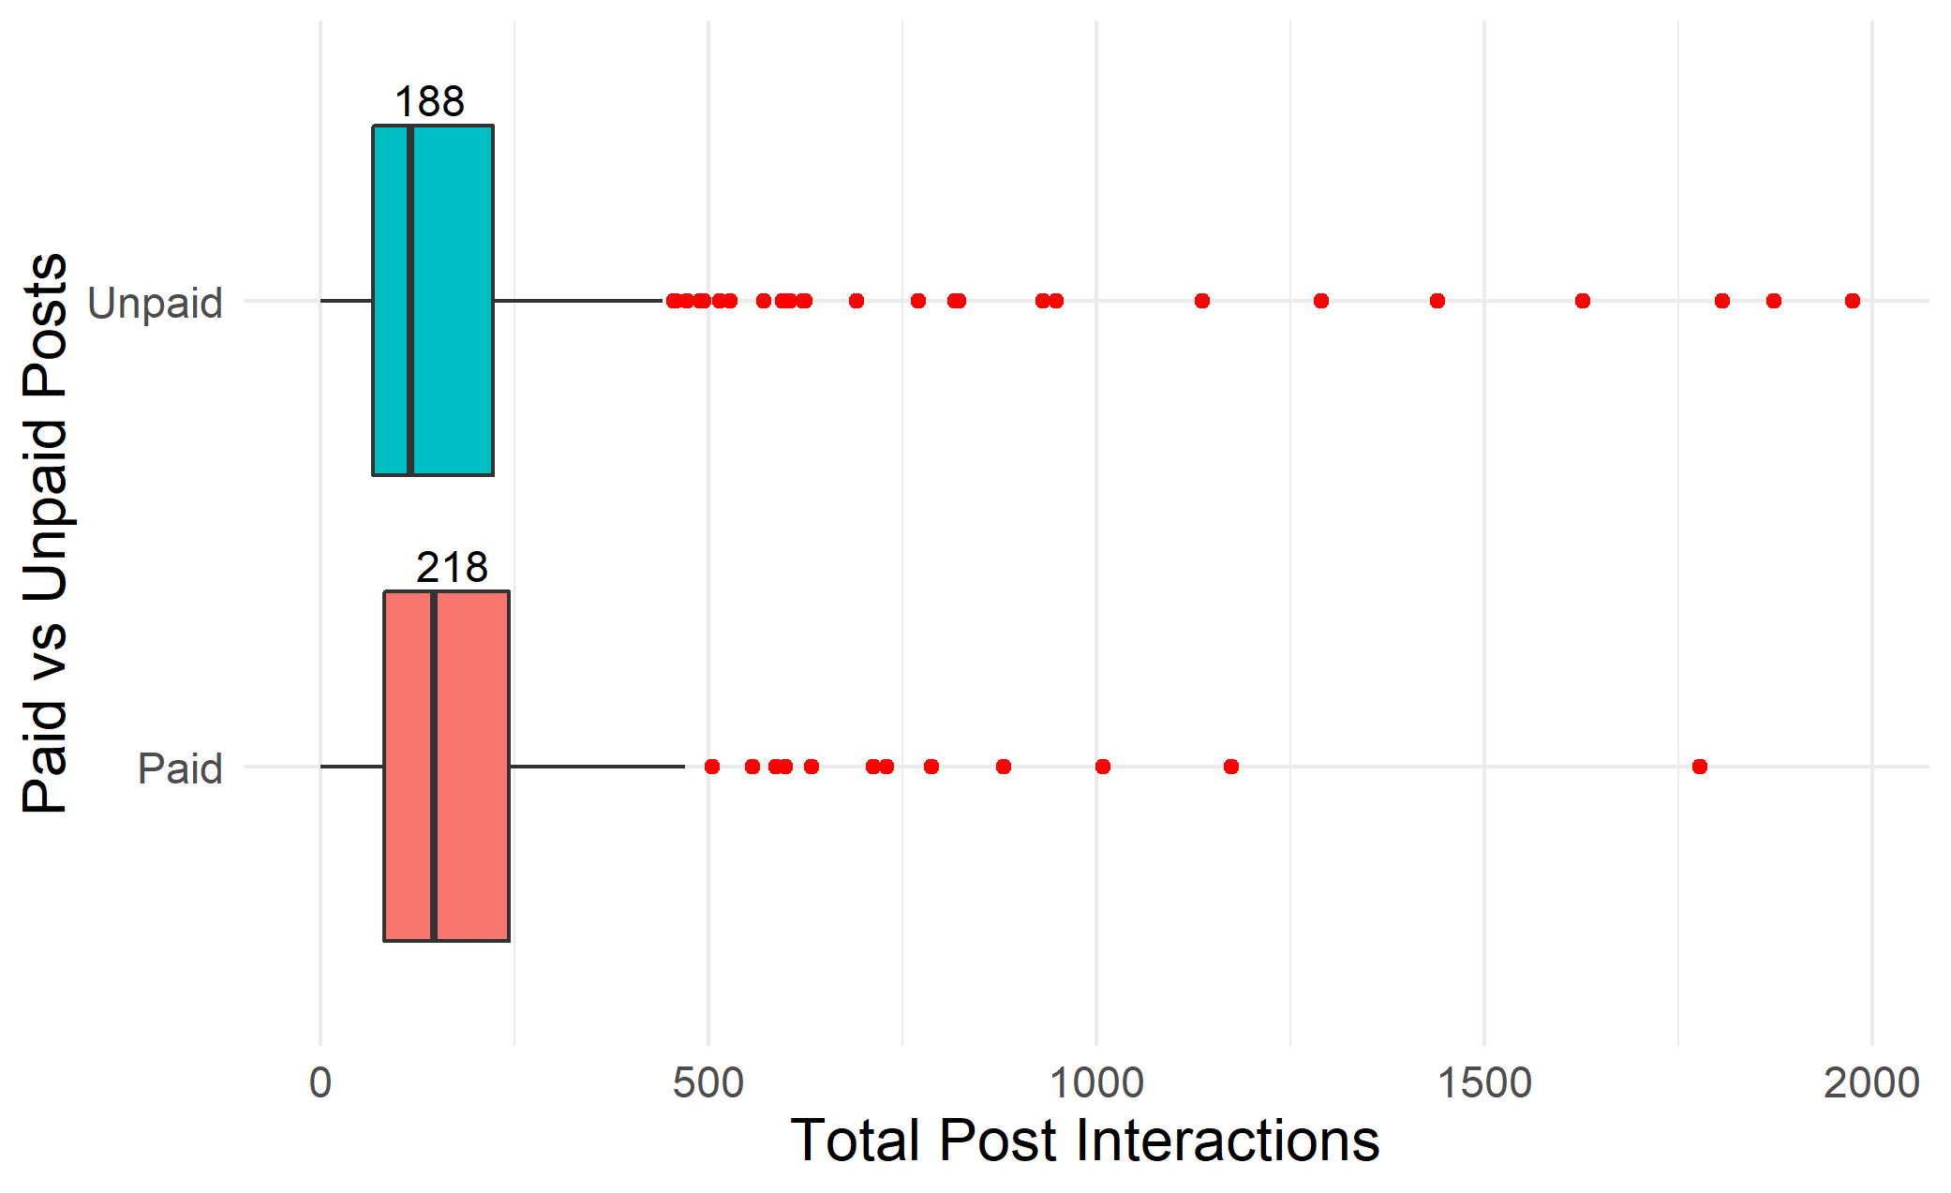
Average Total Interactions of Paid vs Unpaid Posts

