Slide 1
TAKENMIND GLOBAL DATA ANALYTICS INTERNSHIP
PROOF OF CONCEPT
Name: Dhyan Somaiya
Email Id: dhyansomaiya5@gmail.com
LinkedIn Profile: https://www.linkedin.com/in/dhyan-somaiya-000506157
PROJECT TITLE
EMPLOYEE ATTRITION CONTROL

Slide 2
PROBLEM STATEMENT
The data is for company X which is trying to control attrition. There are two sets of data: “Existing employees” and “Employees who have left”.
Following attributes are available for every employee:-
Satisfaction Level
Last evaluation
Number of projects
Average monthly hours
Time spent at the company
Whether they have had a work accident
Whether they have had a promotion in the last 5 years
Departments (column sales)
Salary
Whether the employee has left
OBJECTIVE:
Explaining what types of employees are leaving .
Determining which employees are prone to leave.
Predict the future employee who would tend to leave the company.

Slide 3
Data Analysis
Analysis
As per the data analysis, 45.01 percent of the existing employees who have their salary low while 60.82 percent of the employees who had left had their salary low, 44.88 percent of the existing employees who have their salary medium while 36.88 percent of the employees who had left had their salary medium, 10.11 percent of the existing employees who have their salary high while 2.3 percent of the employees who had left had their salary high.

Slide 4
Solution Methodology
Univariate
Analysis
Bi - variate
Analysis
Multivariate
Analysis
Univariate analysis is used to describe one attribute that varies from observation to observation in order to draw insights from the data.
Bivariate analysis is used to describe two attributes simultaneously for the purpose of determining the empirical relationship between them.
Multivariate analysis is used to observe and analyse that contain more than one variable in order to draw insights from the data.

Slide 5
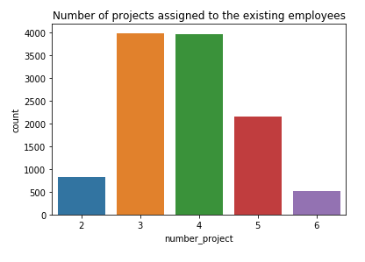
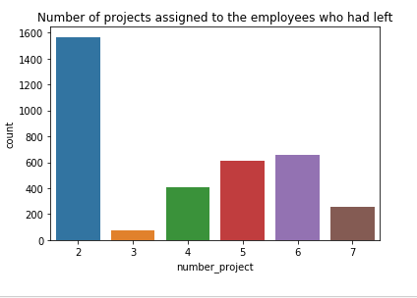
Exploratory Data Analysis
Univariant Analysis
From this count plot we notice that the most of the existing employees were assigned approximate 3 to 5 projects each.
From this count plot we notice that the employees who had left had been assigned mostly 2 projects each.

Slide 6
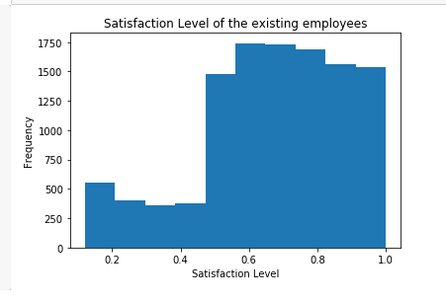
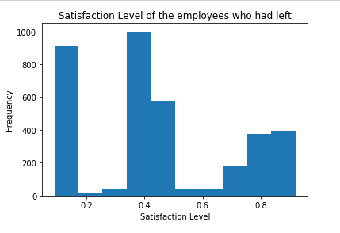
Exploratory Data Analysis
From this histogram, we notice that existing employees have their satisfaction level high.
From this histogram, we notice that most of the employees who have left have their satisfaction level low.

Slide 7
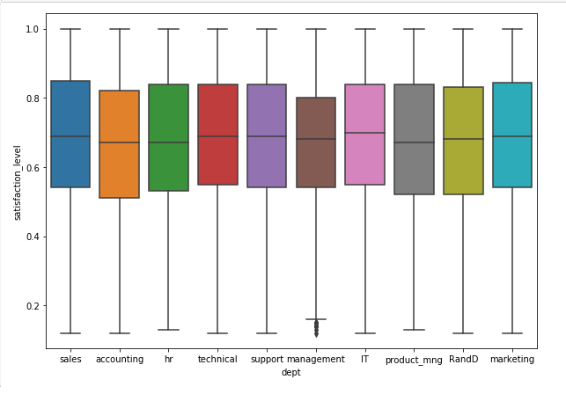
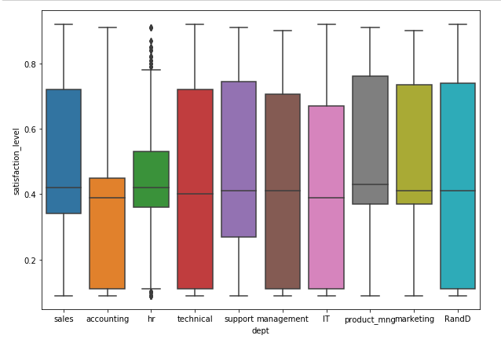
Exploratory Data Analysis
Bivariant Analysis
There were outliers present in the management department whose satisfaction level was less than 20%.
There were outliers present in the HR department whose satisfaction level was less than 20% and more than 80%.

Slide 8
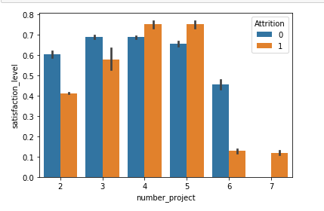
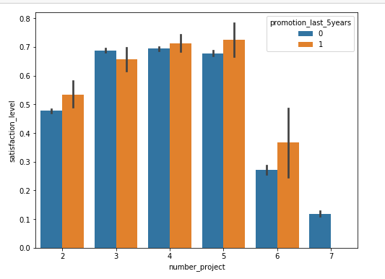
Exploratory Data Analysis
Multi-Variant Analysis
Satisfaction level of all the employees based on number of projects and their attrition
Satisfaction level of all the employees based on number of projects and promotion.
From this graphs, we can notice that the employees who left had more than 5 projects which resulted in decreasing their satisfaction level.

Slide 9
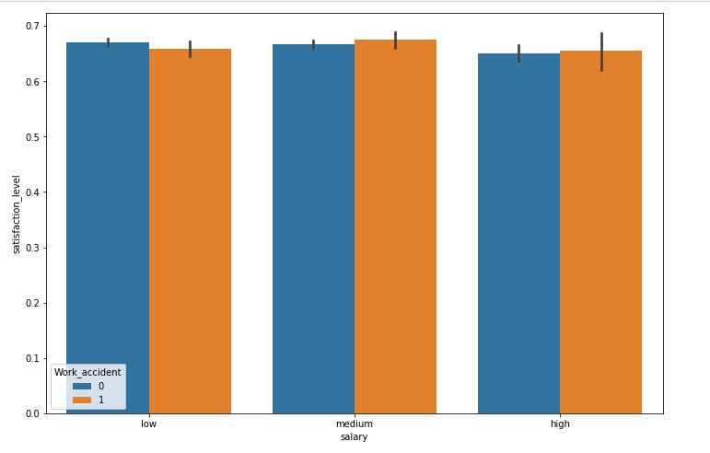
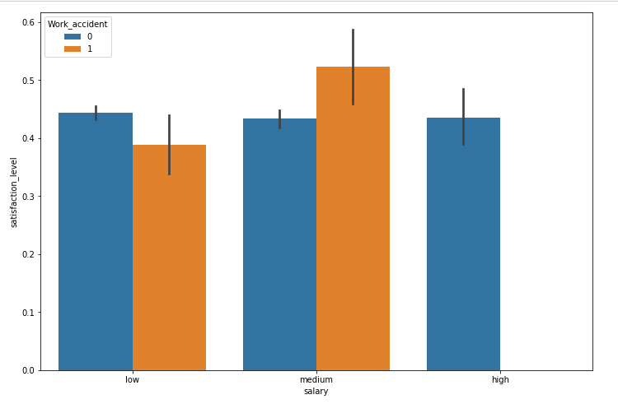
Exploratory Data Analysis
Satisfaction level of the existing employees based on their salary and work accident
Satisfaction level of the employees that left based on their salary and work accident
From this graphs, we can notice that the employees that left having their salary high had their satisfaction level low while those of the existing employees had their satisfaction level high.

Slide 10
Observations
After exploring the data, we found that the mean satisfaction level of employees that left was 44% while those existing was 67%. After further analysis, it was found that 60.29% of employees that left had less than 44% satisfaction level.
It was observed that the salary of the employees that left who had work accident was in the low and medium range while of those existing employees salary lies in low, medium and high range.
By looking at the statistics of the employees average monthly hours, we observed that the employees that left 207 hours monthly on an average while the existing employees spent 199 hours monthly..

Slide 11
Recommendations
To control the attrition of these employees, they need to be identified on which point their satisfaction level is diminishing and compensate on any way to increase their satisfaction level.
The company needs to ensure that they don’t allocate more number of projects to the employees which decreases their enthusiasm and as a result, their satisfaction level decreases.
The company need to maintain their salary structure in a good way so as to increase the satisfaction level of the employees.

