Slide 1
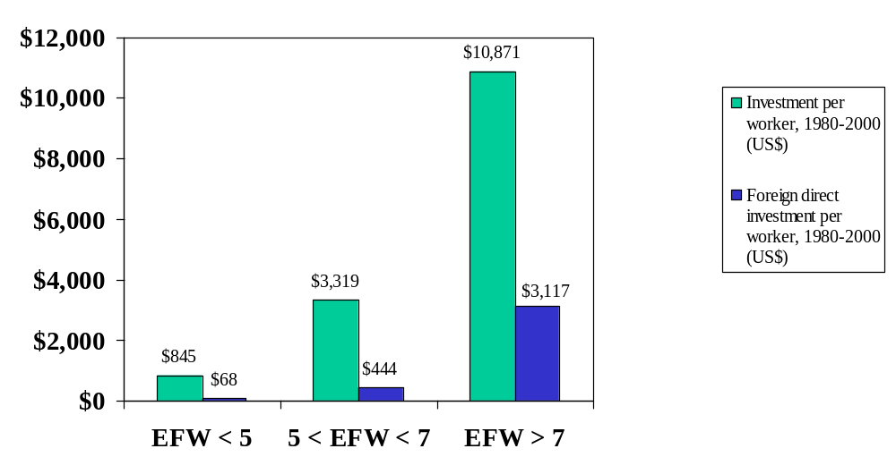
Exhibit 1: Economic Freedom and Investment Per Worker, 1980-2000

Slide 2
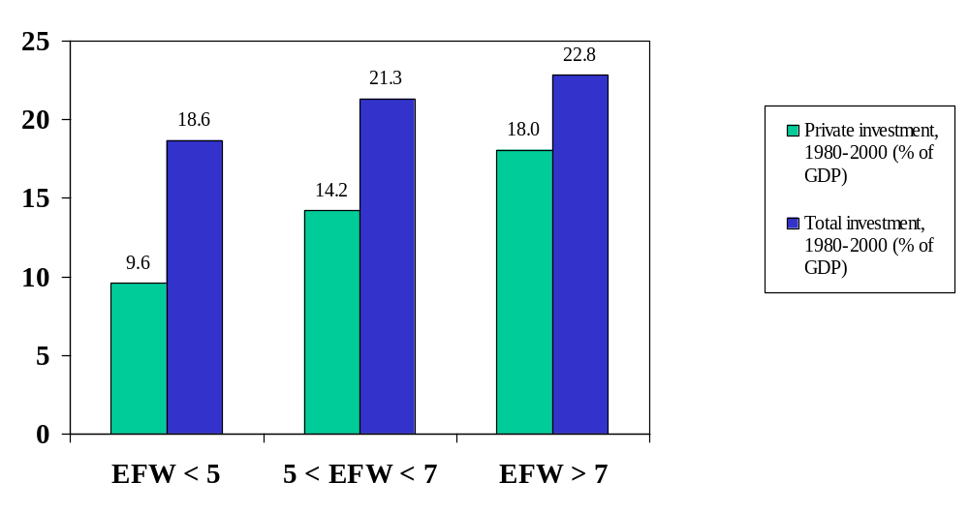
Exhibit 2: Economic Freedom and Investment as a Share of GDP, 1980-2000

Slide 3
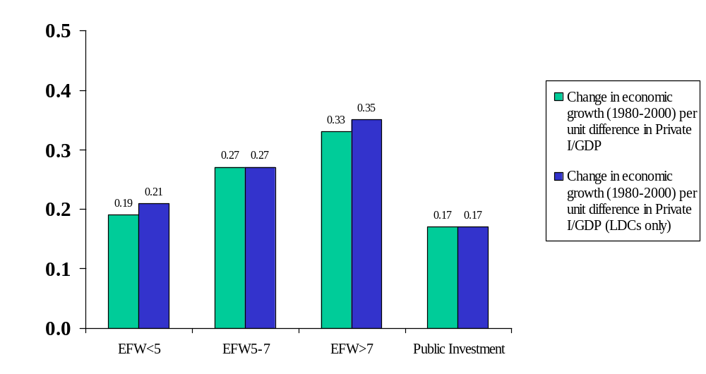
Exhibit 3: Economic Freedom and the Productivity of Investment, 1980-2000
See Appendix Table 2 for details.

Slide 4
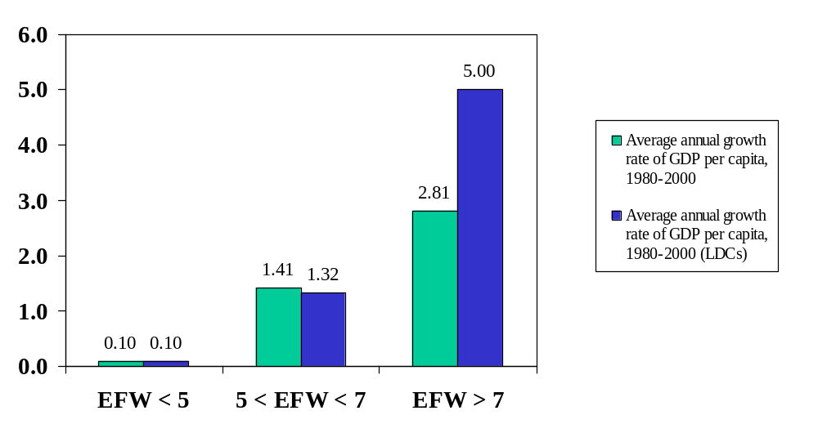
Exhibit 4: Economic Freedom and Growth of Per Capita GDP, 1980-2000

Slide 5
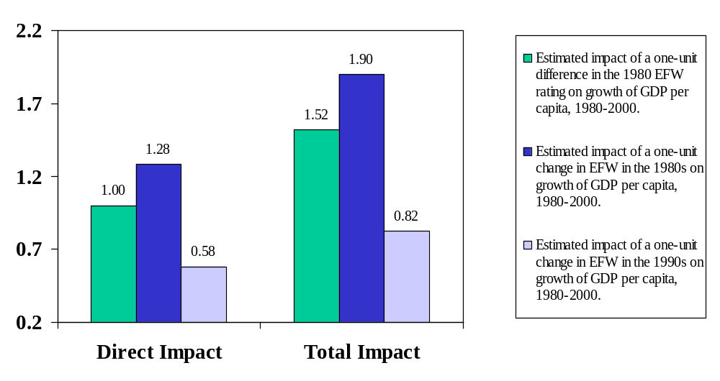
Exhibit 5: Economic Freedom and Changes in Economic Freedom and Economic Growth, 1980-2000
See Appendix Table 3 for details.

Slide 6
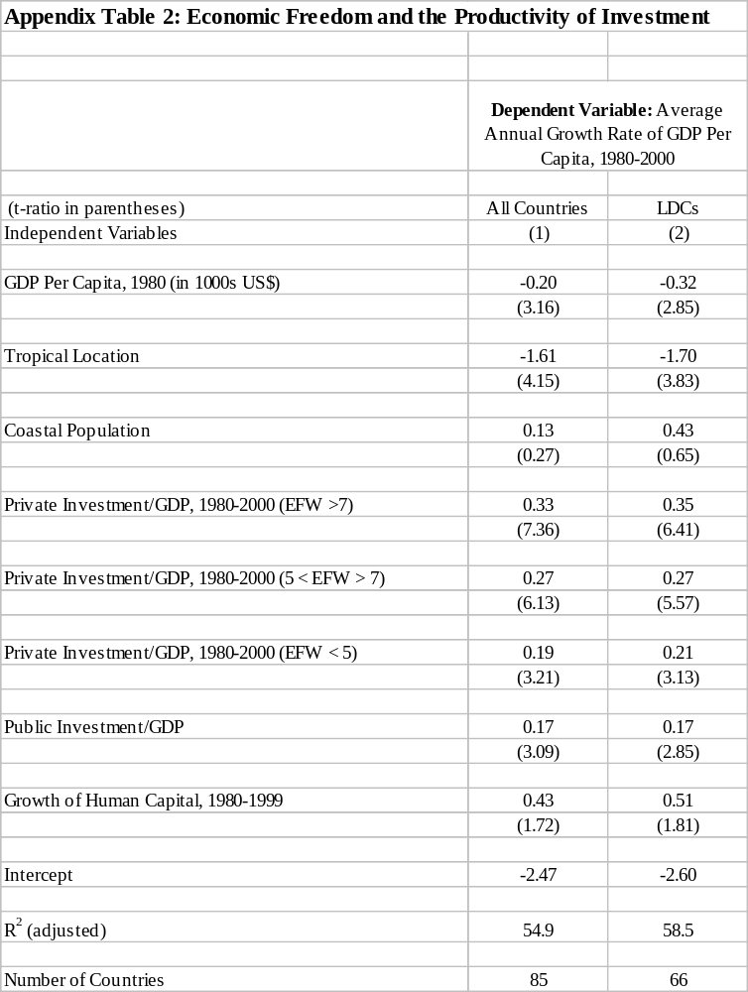

Slide 7
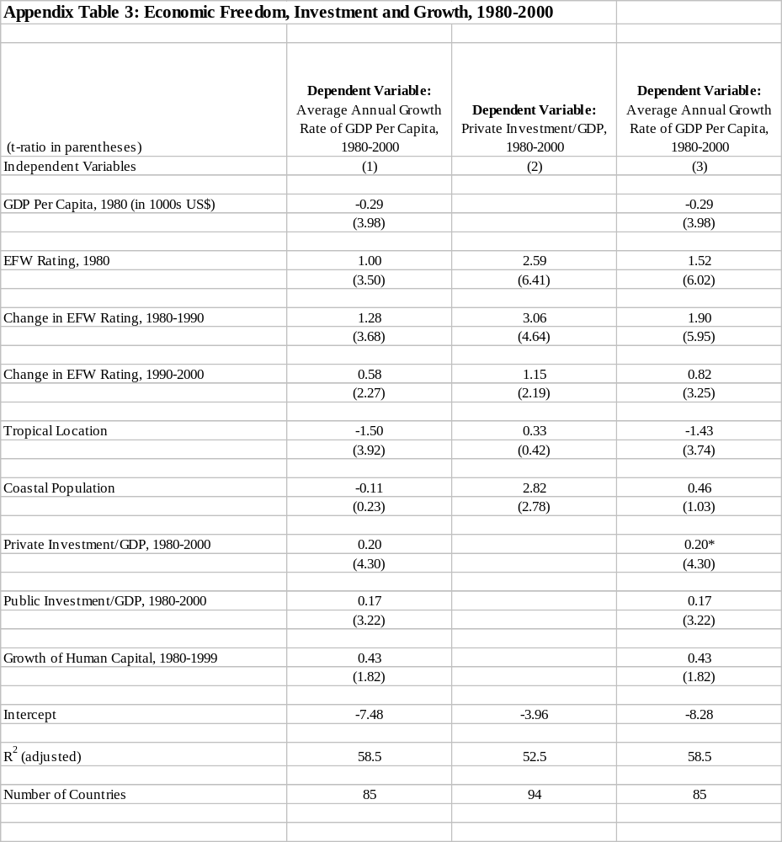

Slide 8
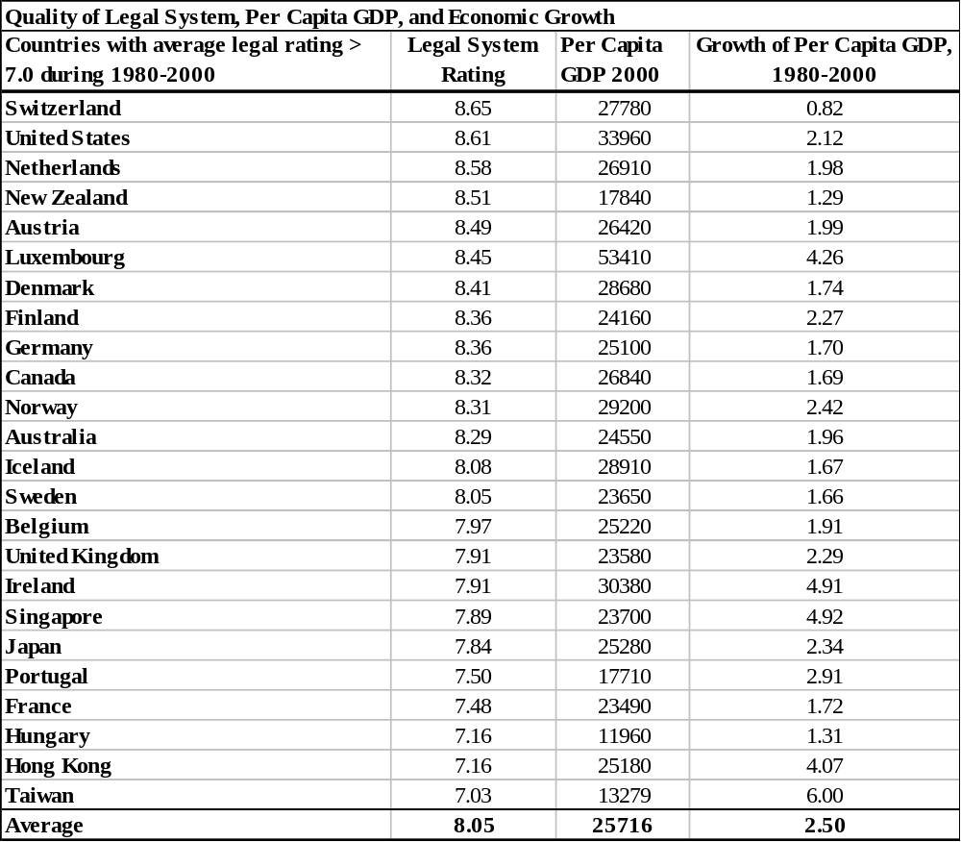
Appendix Table 4: The Legal System and Income and Growth

Slide 9
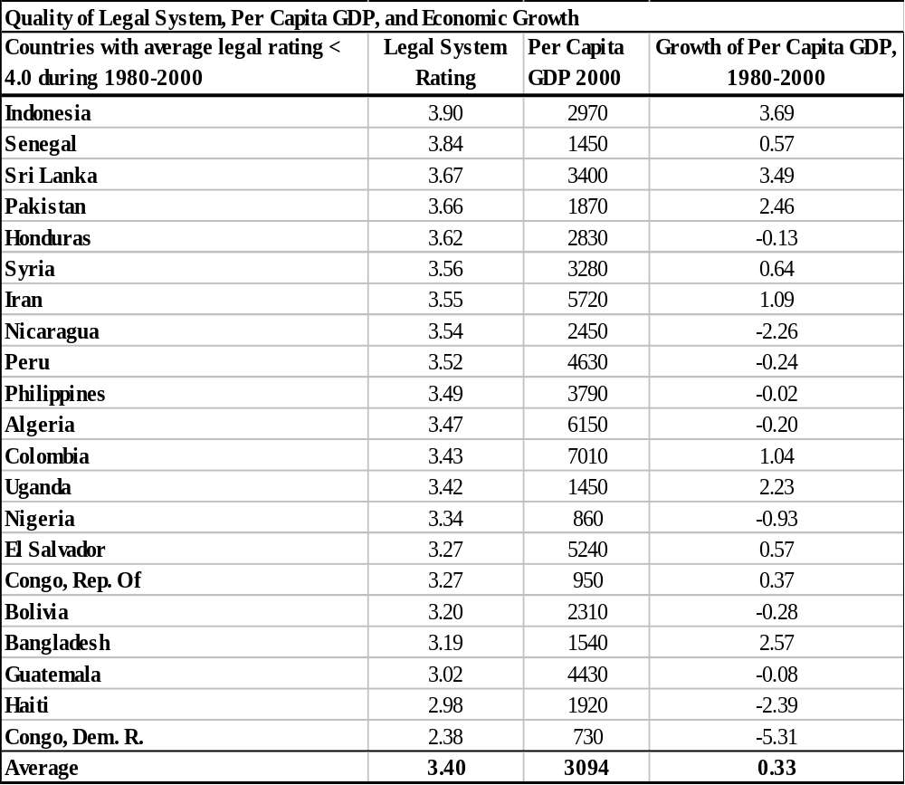
Appendix Table 5: The Legal System and Income and Growth

