Slide 1
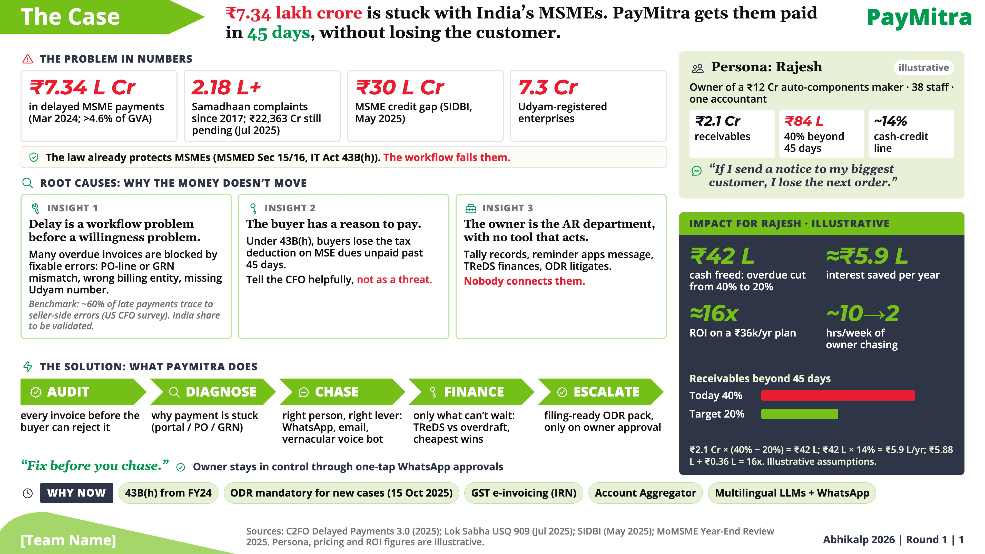
Notes:
“If I send a notice to my biggest customer, I lose the next order.” That’s Rajesh. He runs a ₹12 crore auto-components plant, and ₹84 lakh of his money is stuck beyond 45 days. He is not alone: ₹7.34 lakh crore is owed to India’s MSMEs, and after 2.18 lakh Samadhaan complaints, ₹22,363 crore is still pending. The law already protects him. The workflow fails him. Our idea in four words: fix before you chase. Many overdue invoices are blocked by fixable errors, like a PO-line or GRN mismatch, a wrong billing entity or a missing Udyam number. Under 43B(h) the buyer also has a reason to pay, if someone tells the CFO helpfully. And today the owner is the AR department, with tools that record or message but never act. PayMitra audits every invoice, diagnoses why it is stuck, chases the right person on WhatsApp, email or a vernacular voice bot, finances only what can’t wait, and escalates to ODR only when Rajesh approves. Five enablers make this possible now. For Rajesh, illustratively, that frees ₹42 lakh, saves about ₹5.9 lakh a year in interest, and returns roughly 16 times the subscription.

Slide 2
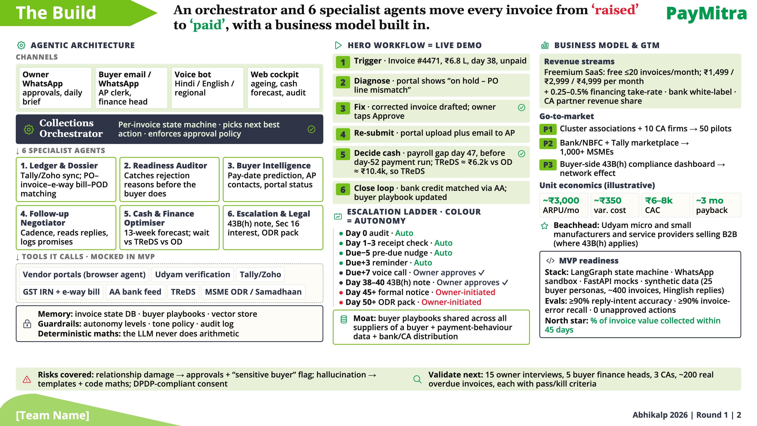
Notes:
Half the score is agentic building, so here is the machine. A Collections Orchestrator runs a state machine for every invoice, picks the next best action and enforces the approval policy. It delegates to six specialists: Ledger and Dossier, Readiness Auditor, Buyer Intelligence, Follow-up Negotiator, Cash and Finance Optimiser, and Escalation and Legal. They call real rails, Tally, GST IRN, Account Aggregator, vendor portals, TReDS and the ODR portal, mocked in the MVP behind the same interfaces. Memory and guardrails sit under every action, and the LLM never does arithmetic. Our live demo follows invoice 4471: ₹6.8 lakh, day 38, on hold for a PO-line mismatch. The agent drafts the fix, Rajesh taps Approve, it re-submits, and because payroll lands before the buyer’s payment run, it picks TReDS at about ₹6,200 over overdraft at ₹10,400. The escalation ladder runs on its own until a step a buyer could resent; those need the owner. We earn from freemium SaaS, a financing take-rate, bank white-label and CA partners, with an illustrative three-month payback, and our moat is buyer playbooks that improve with every supplier. Next we validate with 15 owners, 5 finance heads, 3 CAs and 200 real overdue invoices, each with pass or kill criteria.

