Slide 1
Formatting Etc slide
4ca1d6
001d43
cacccc
444444

Slide 2
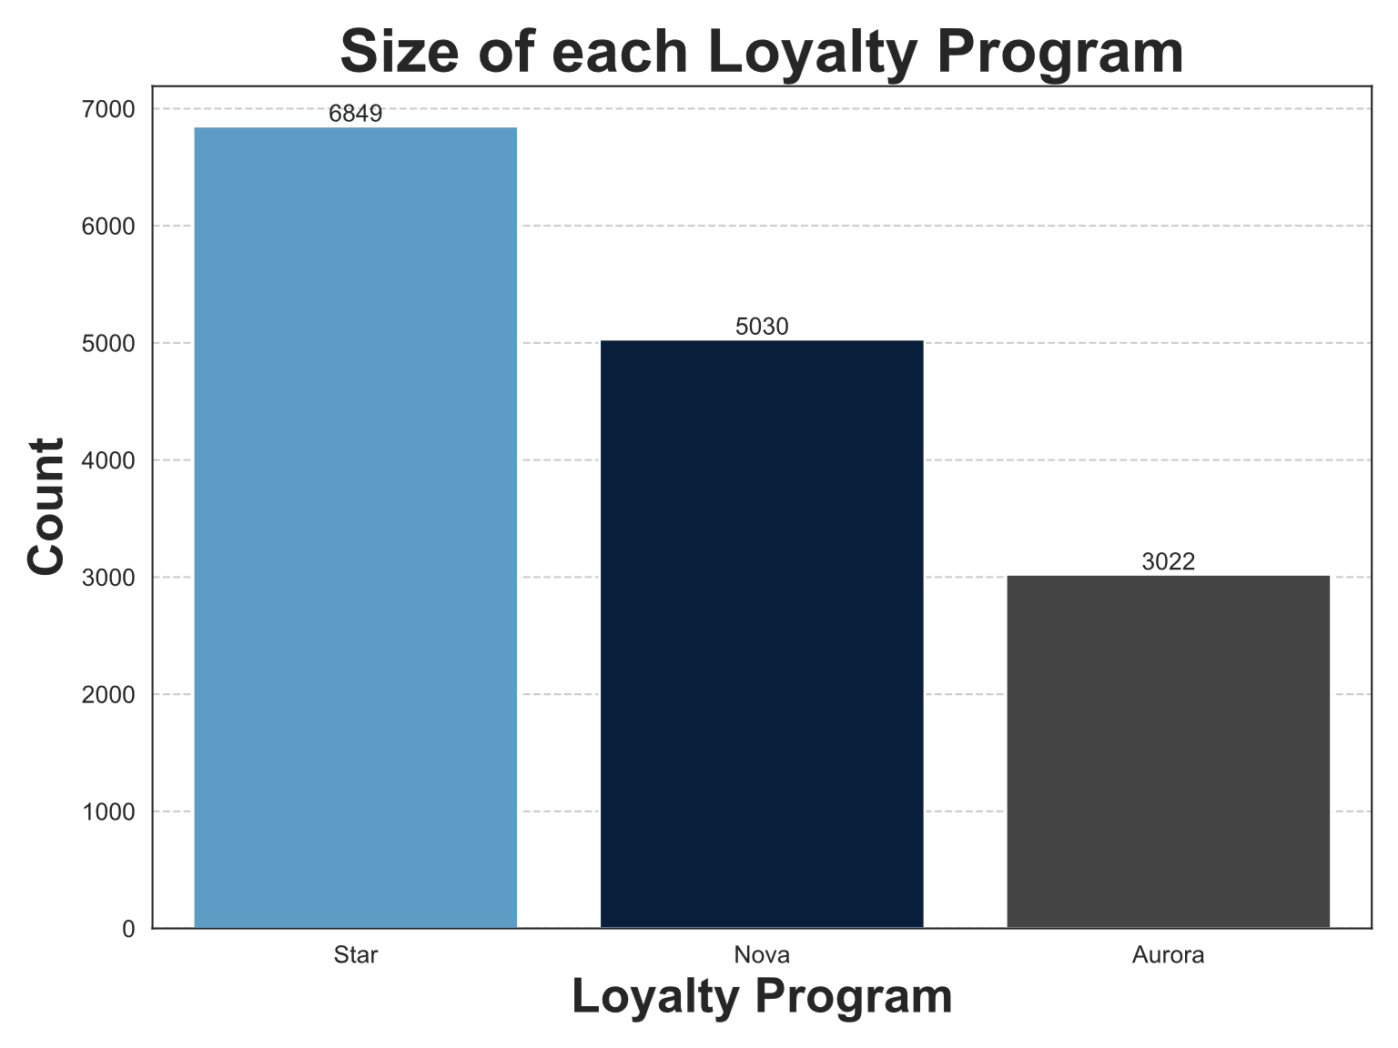
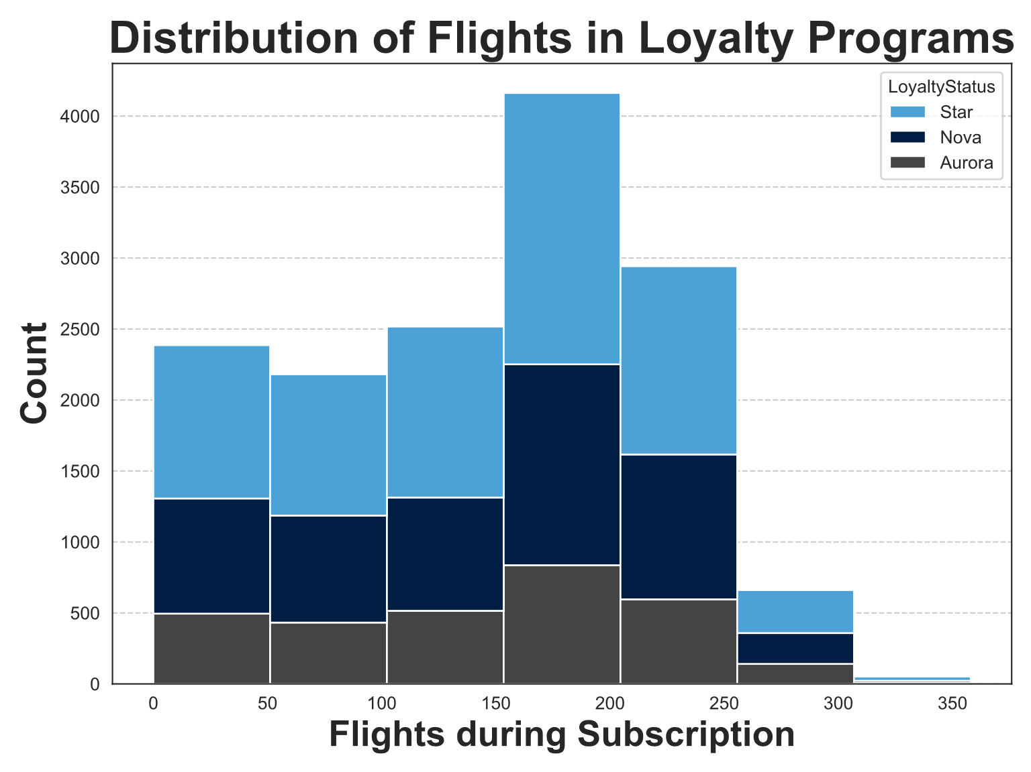
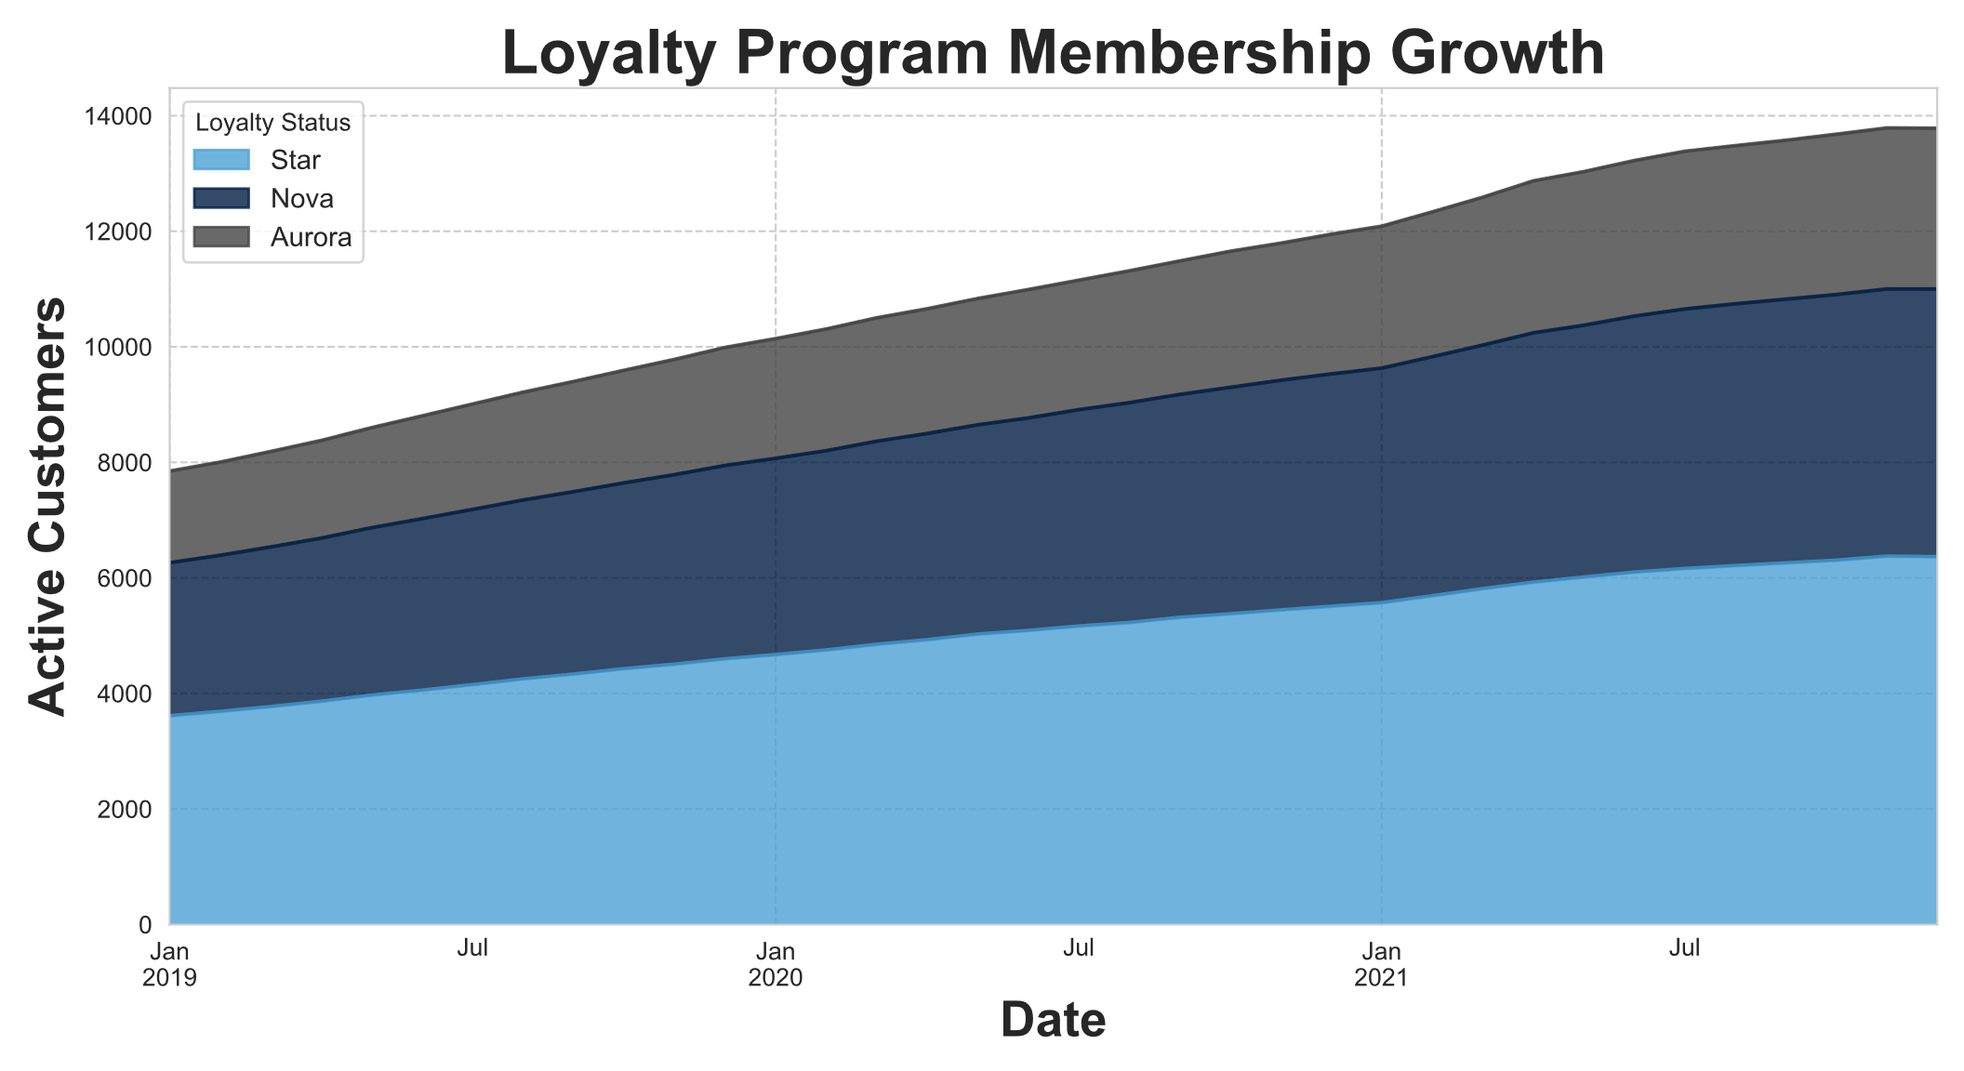
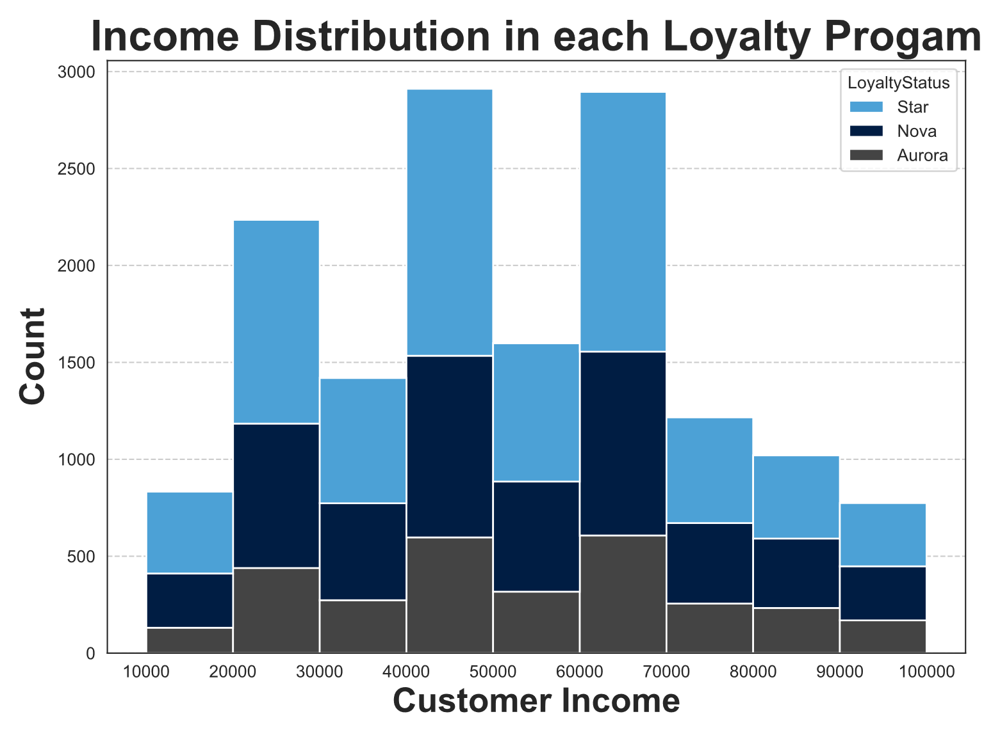
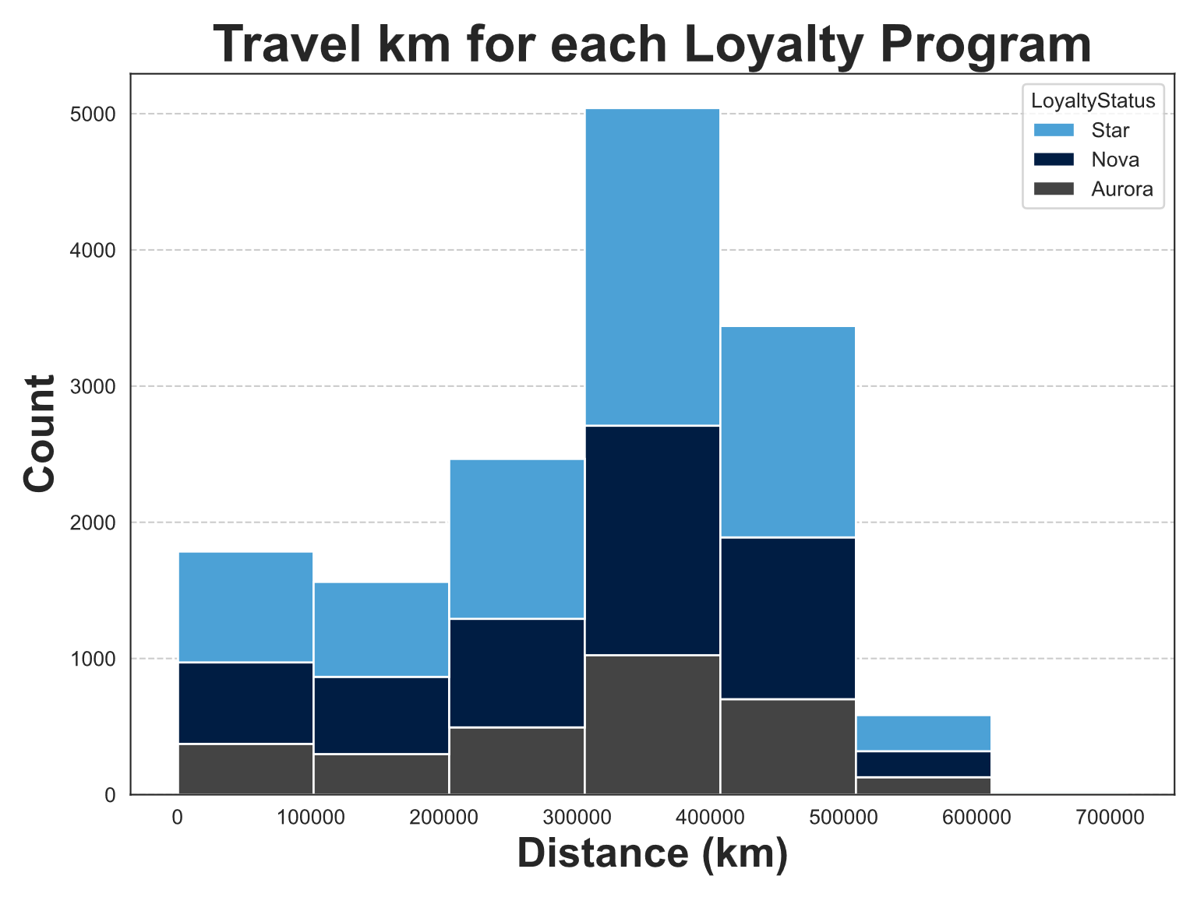
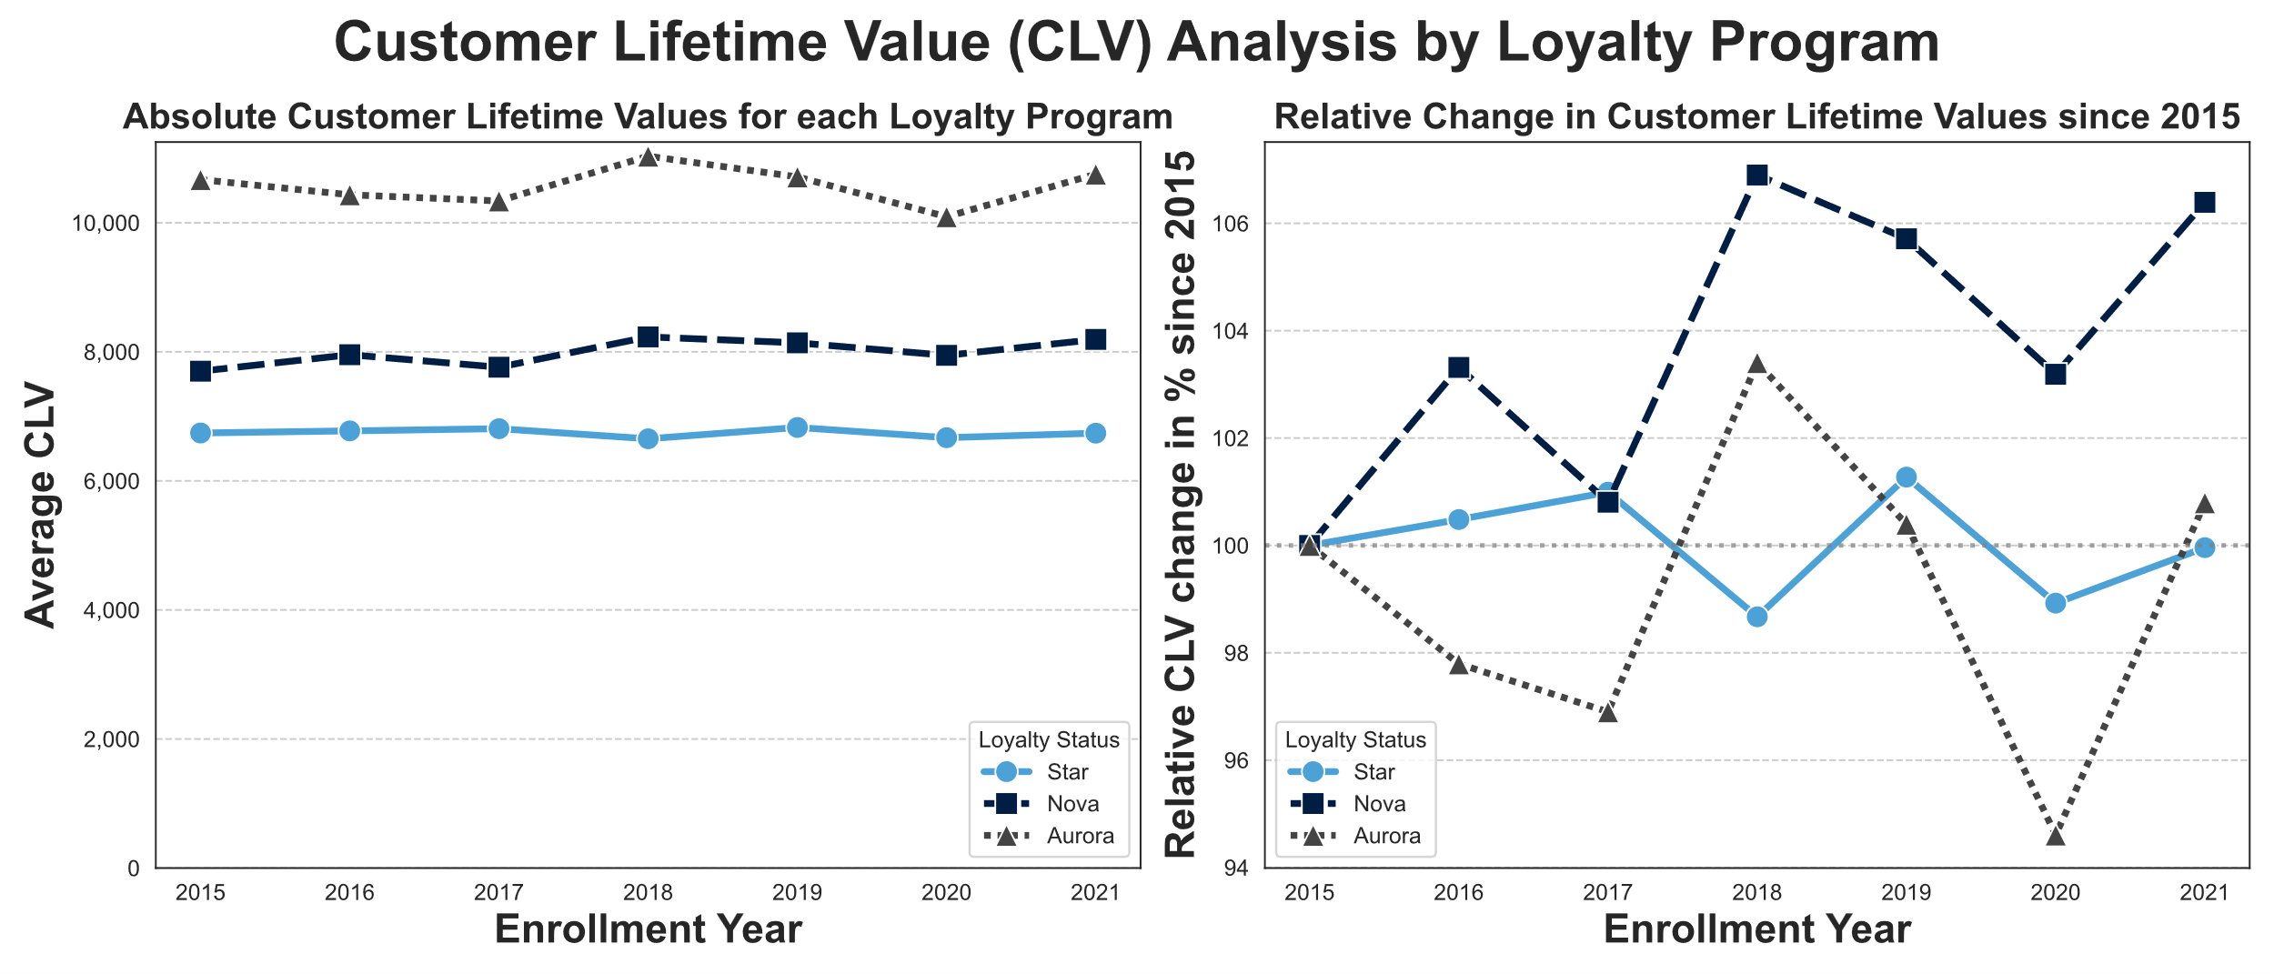
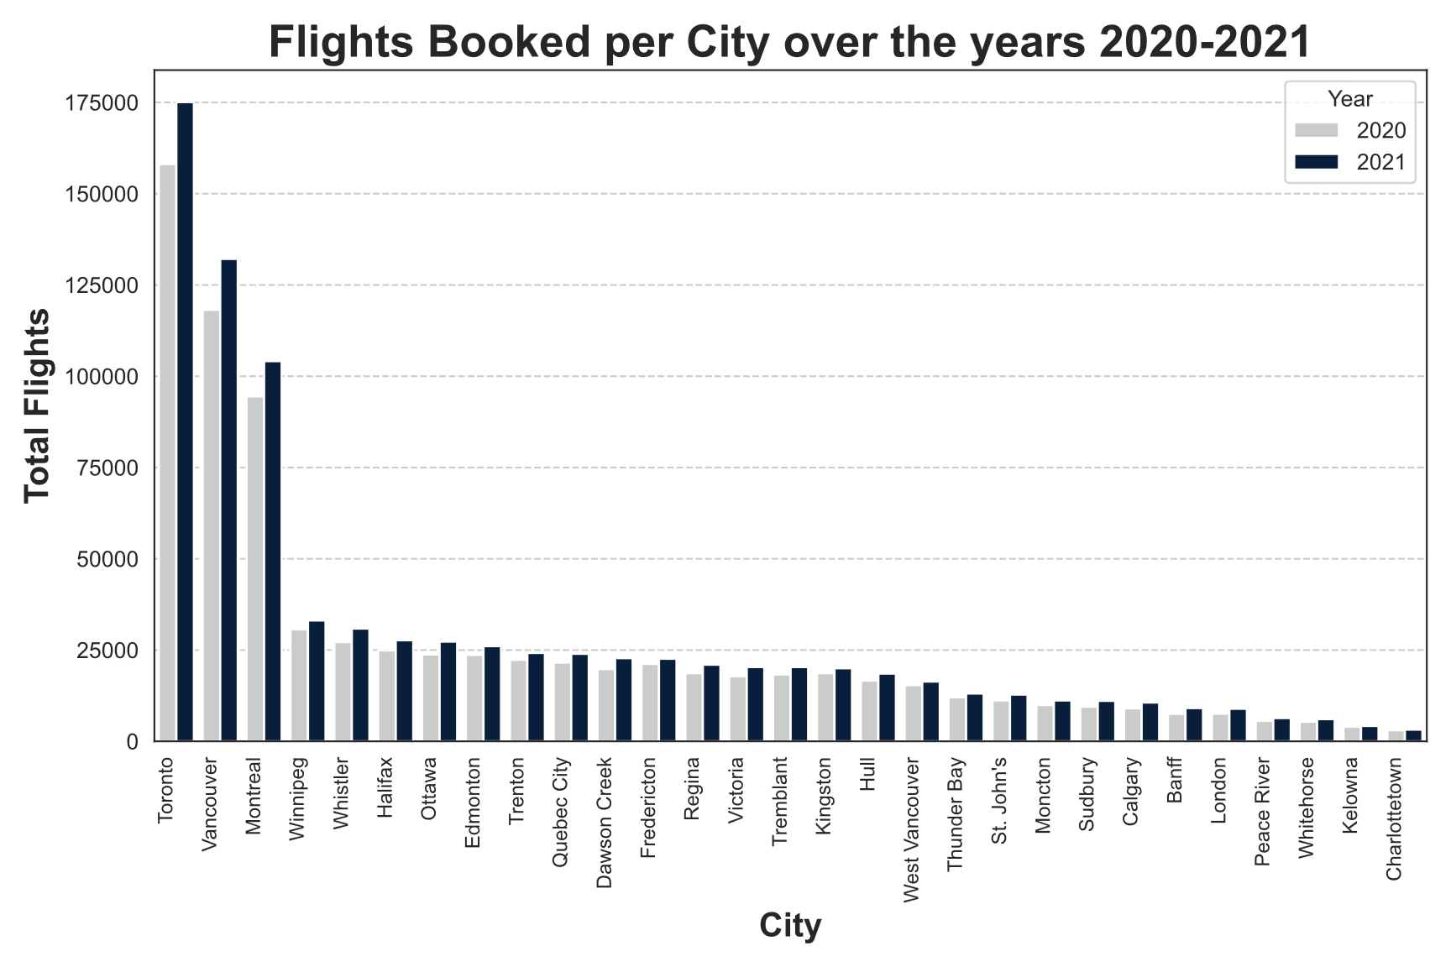


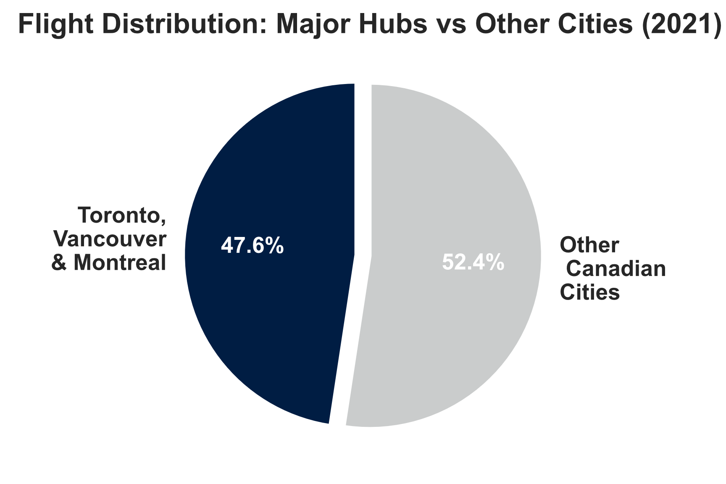

Amazing Airlines Customer Analysis
Moritz Baldauf, Libero Biagi, Jenny Cubelo, Marcell Hajdú
Current Customer Segmentation doesn’t separate for Travel or Income
Loyalty program growth is constant, but Lifetime Value growth is stagnating
Analysis
Remarks
As shown above, there is no clear behavioral distinction between customers across loyalty segments. This shows the need for a new approach to customer segmentation and a rethinking of the existing loyalty program.
Although all loyalty programs grew in the past, their customers’ lifetime values remained constant. This suggests that the customer acquisition is not targeted towards finding the most profitable clients.
Three Cities make up 47% of customers’ Travels
Further clustering approaches should be based on behavioural and profit metrices
Based on Recency, Frequency, and Monetary value
Refine segments by points redemption rates to fine-tune for the most profitable customers
Consider different geographical features, such as hub development and customer density, for marketing campaigns
Mega Hubs
Three hub airports account for nearly half of all flights and lead national growth.

Slide 3
Amazing Airlines Customer Analysis
Moritz Baldauf, Libero Biagi, Jenny Cubelo, Marcell Hajdú
Current Customer Segmentation doesn’t separate for Travel habits or Income
Loyalty program growth is constant, but Customer lifetime Value growth is stagnating
Analysis
Remarks
As shown above, there is no clear behavioral distinction between customers across loyalty segments. This shows the need for a new approach to customer segmentation and a rethinking of the existing loyalty program.
Although all loyalty programs grew in the past, their customers’ lifetime values remained constant. This suggests that the customer acquisition is not targeted towards finding the most profitable clients.
Three Cities make up 47% of customers Travels
Further clustering approaches should be based on behavioural and profit metrices
Based on Recency, Frequency, and Monetary value
Refine segments by points redemption rates to fine-tune for the most profitable customers
Consider different geographical features, such as hub development and customer density, for marketing campaigns
Mega Hubs
Three hub airports account for nearly half of all flights and lead national growth.

