Slide 1
Organoid growth charts
Normative modelling of brain-organoid cell-type composition
Pediatric growth charts let you place one child on a percentile curve. Nothing like that exists for brain organoids. We build one from public data.
Brainhack Montreal Fall 2026 | GitHub: BrainhackMTL/fall2026 issue #3 | data: 170 KB CSV, start in five minutes

Slide 2
Background: labs make thousands of organoids and cannot say which ones are normal
• A brain organoid is a 1 to 3 mm ball of human brain tissue grown from stem cells over weeks to months.
• They are used to study brain development and disease, and increasingly to test drugs.
• Known problem: organoids vary a lot between batches, lines and labs. Every lab asks "is this batch normal for its age?" and answers by eye.
• In pediatrics the same question is answered with growth charts: a reference curve with percentiles, built from a large population.
• In neuroimaging the same idea became brain charts (Bethlehem et al. 2022, Nature): normative models of brain measures over age, with a z-score for each person.
• Organoids have neither. Closest work (Faravelli et al. 2026, Nature) predicts organoid age from transcriptomes; it does not ask whether an organoid of known age is typical.
Gap: no reference curve for what a brain organoid should look like at a given day in culture

Slide 3
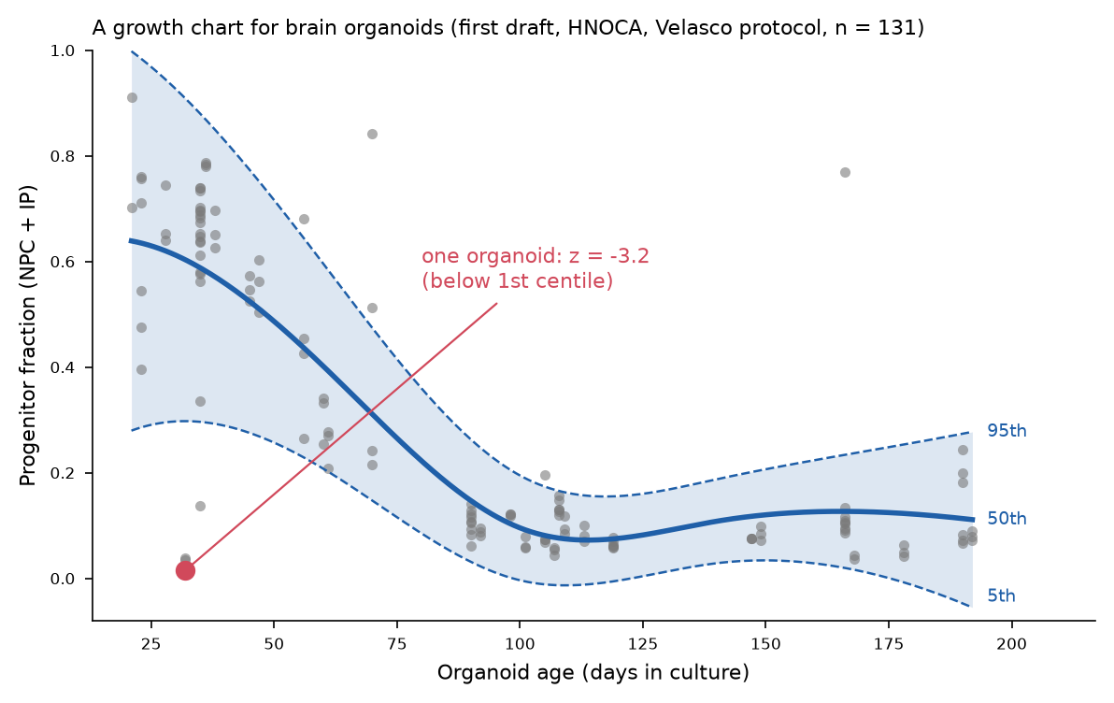
Data: HNOCA, 1.77 million cells, summarized to 322 organoid samples
• Human Neural Organoid Cell Atlas (He, Dony, Fleck et al. 2024, Nature). Public on CELLxGENE, CC BY 4.0.
• Per cell: days in culture, protocol, publication, cell line, cell-type label (17 types).
• We group cells by sample and count cell-type fractions. One row per sample: age, protocol, publication, fraction of progenitors (NPC + IP), neurons, glia.
• Script reads only metadata over HTTP, no 19 GB download, 3 minutes.
• Usable subsets: Velasco 2019 protocol, 131 samples from 4 publications, days 21 to 192. Lancaster 2014 protocol, 81 samples, days 9 to 120.
• The raw data already look like a growth chart (right).
x = days in culture (known), y = cell-type fraction. One protocol per chart, like one chart per sex in pediatrics.

Slide 4
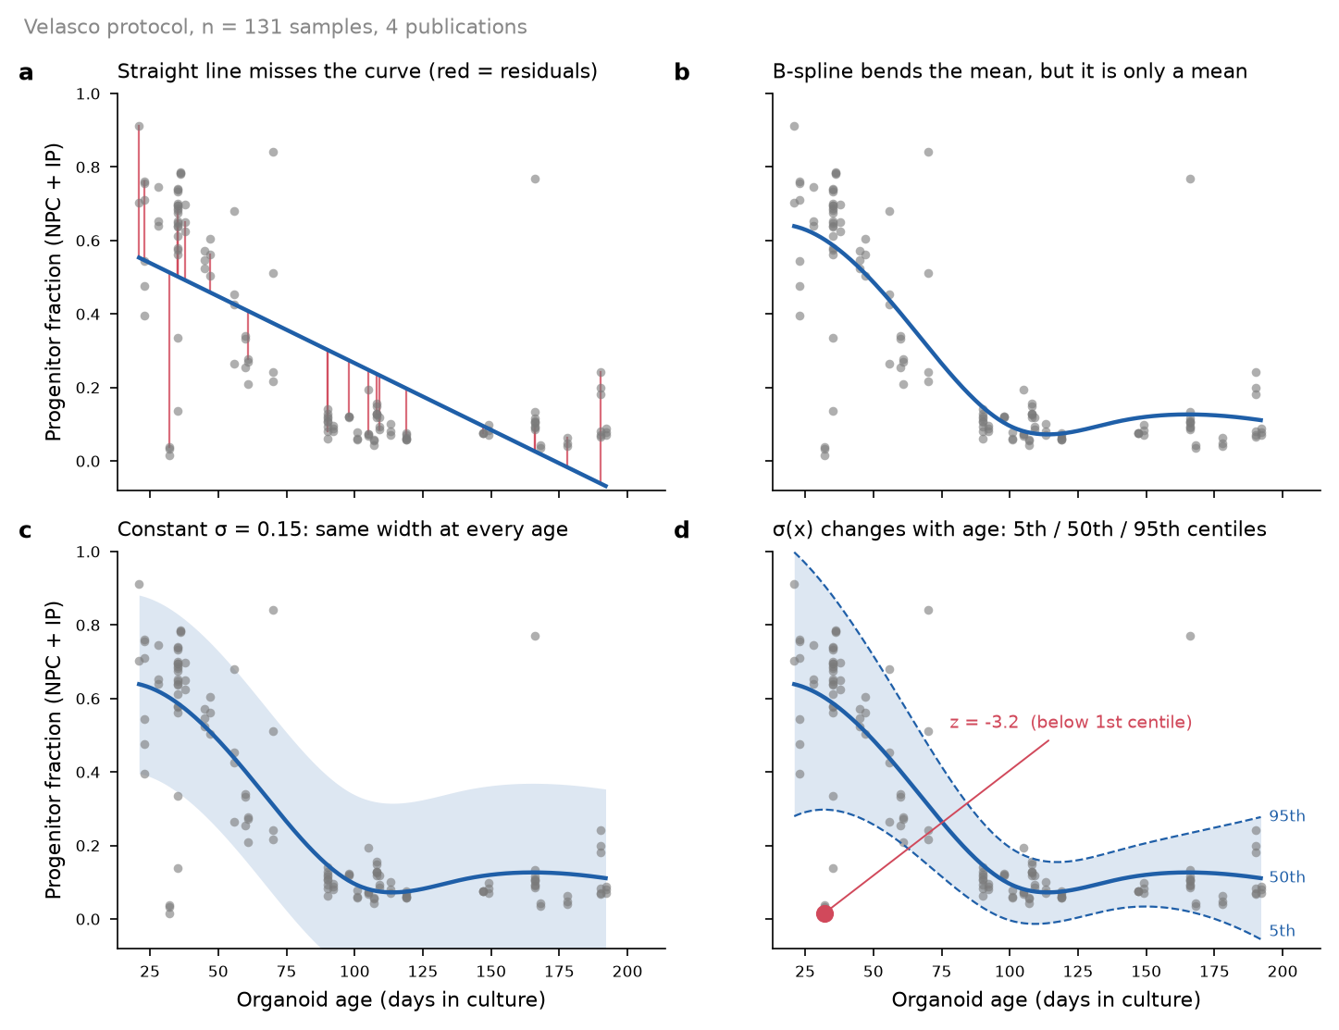
Method: normative modelling, the family of methods behind brain charts
• Fit the distribution of y at every age, not just the mean. Then every organoid gets z = (y − μ(age)) / σ(age) and a centile.
• Four things the model must capture, each one visible in our data:
  – Curvature: progenitor fraction falls from ~65% at day 20 to ~8% at day 100, then plateaus. B-spline mean.
  – Age-dependent spread: σ ≈ 0.19 at day 30, 0.06 at day 100. Heteroskedastic variance.
  – Lab offsets: 4 publications in the Velasco subset. Publication as batch effect.
  – Skew near 0: fractions are bounded. Warped BLR, or logit transform.
• Tool: PCNtoolkit, Bayesian linear regression (BLR). Bayesian so centile lines carry their own uncertainty, which matters with n = 131, not 100,000.
• Checks: z-scores on held-out samples should be ~N(0,1) in every age bin and every publication.
Left to right: a straight line fails; a spline bends the mean; constant σ is wrong; σ(age) gives the centile lines.

Slide 5
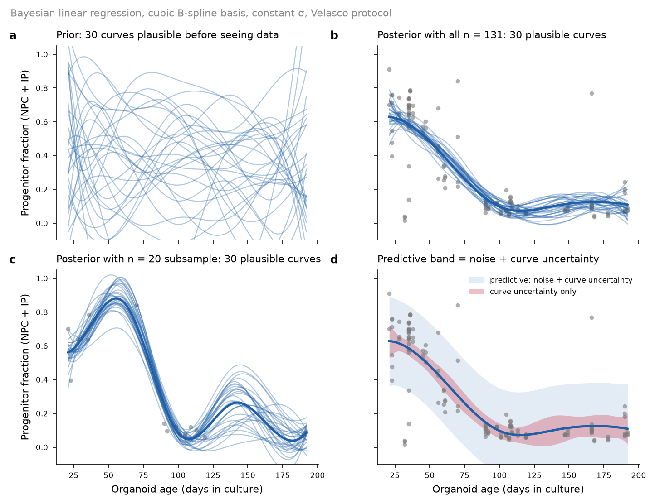
Plan for the hackathon
• Day 1 morning: load CSV, raw plots per protocol and publication, PCNtoolkit BLR running on Velasco progenitor fraction.
• Day 1 afternoon: heteroskedastic + publication batch effect, train/test split, z-score calibration by age bin.
• Day 2: warped BLR vs logit, Lancaster protocol, neuron and glia fractions, final centile figure.
• Guaranteed deliverable: a centile chart per protocol with a z-score for every organoid in HNOCA.
• Stretch: how many organoids does a lab need before the curve is stable? Refit on random subsets of 20, 50, 100 samples and watch the centiles move (right: n = 20 vs n = 131).
• Everything in one public repo: CSV, build script, notebooks, figures.
Right: Bayesian fit. With 20 samples the posterior curves wander where data are missing; that is the sample-size question made measurable.

Slide 6
Who we need and how to start
• Anyone who took Friday's normative modelling tutorial, or has used PCNtoolkit.
• Python / pandas / plotting. No organoid or biology background needed; the biology fits on one slide (this one did).
• Someone who likes the sample-size question: subsampling, bootstrap, stability of centiles.
• Someone who wants to try the alternative: GAMLSS or quantile regression as a cross-check.
• Getting started: clone the repo, open data/hnoca_sample_composition.csv (322 rows), columns age, protocol, publication, frac_NPC_IP. First plot in five minutes.
• Lead: Libo. Find me after the pitches or on Discord.
GitHub: BrainhackMTL/fall2026 issue #3 | HNOCA: He et al. 2024 Nature, CC BY 4.0

