Slide 1
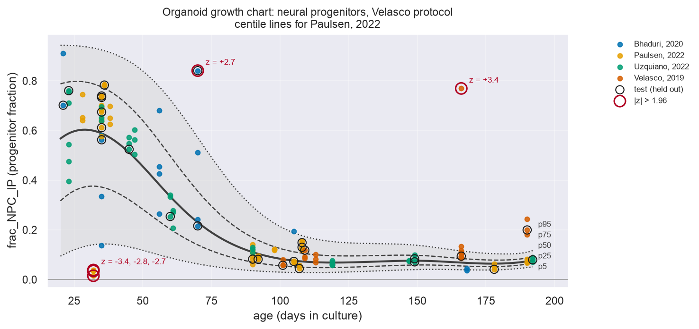
Organoid growth charts
Centile curves and z-scores for brain-organoid cell-type composition
Pediatric growth charts place one child on a percentile curve. We built the same for brain organoids from 322 public samples, and measured how many organoids a lab needs to draw one.
Brainhack Montreal, Oct 5 to 7, 2026 | Boting Li, Selene Zhang | github.com/Liberty23513/organoid-growth-charts

Slide 2
Problem: labs make thousands of brain organoids and judge "normal" by eye
• A brain organoid is a 1 to 3 mm ball of human brain tissue grown from stem cells over weeks to months.
• Batch-to-batch and lab-to-lab variability is the field's known weakness. The question every lab asks is "is this batch normal for its age?"
• Pediatrics answers that question with growth charts. Neuroimaging answered it with brain charts (Bethlehem et al. 2022): a reference distribution over age, and a z-score per person.
• Organoids had neither. Closest work, Faravelli et al. 2026, predicts an organoid's age from its transcriptome. We ask the reverse: age is known, is the composition typical?
• Deliverable we promised on Monday: a centile chart per protocol with a z-score for every organoid. Stretch: how many organoids are needed to draw one.
Normative modelling: learn the distribution of a measure as a function of covariates, then express each individual as a deviation (z) from it.

Slide 3
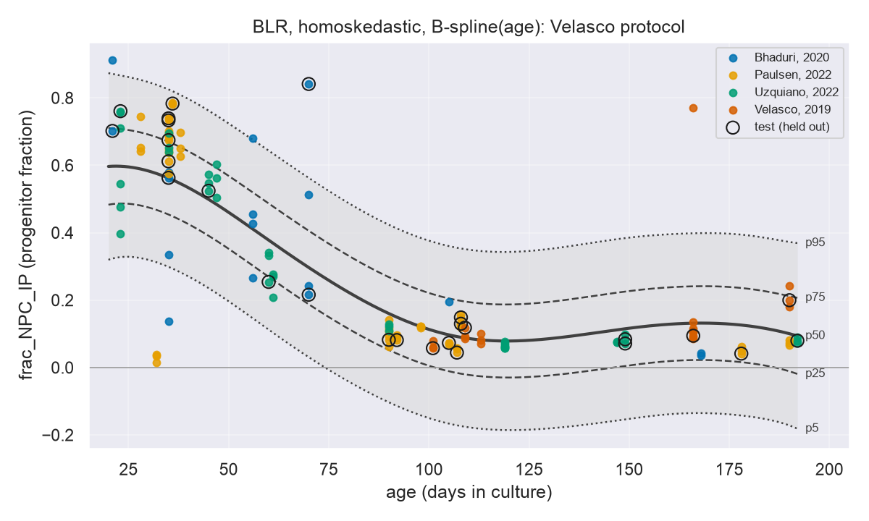
Data: HNOCA, 1.77 M cells, summarized to 322 organoid samples
• Human Neural Organoid Cell Atlas (He et al. 2024, Nature). Public on CELLxGENE, CC BY 4.0.
• Script reads only the per-cell metadata over HTTP (3 minutes, no 19 GB download), groups cells by sample, counts cell-type fractions.
• One row per sample: days in culture, protocol, publication, fraction of progenitors (NPC + IP), neurons, glia, and 17 finer types.
• Usable protocols: Velasco 2019 (131 samples, 4 publications, days 21 to 192) and Lancaster 2014 (81 samples, 3 publications, days 9 to 120). 22 of 27 protocols come from a single paper.
• One chart per protocol: different protocols follow different trajectories, like separate charts per sex.
• Fixed train/test split, stratified by age bin: 105 train, 26 test. Every number on the next slides is on the 26 held-out organoids.
Right: Velasco protocol, progenitor fraction vs age, coloured by publication. Rings = held-out test samples. Curves shown are the first (naive) model.

Slide 4
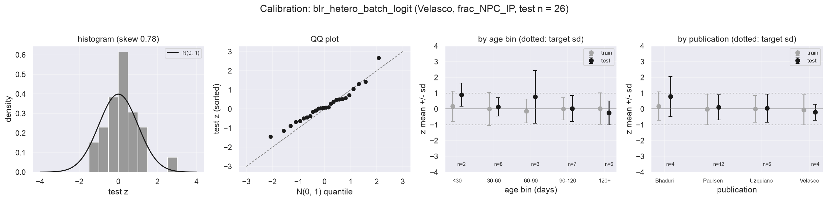
Method: six models, one test set, pick the one whose z-scores behave
• PCNtoolkit Bayesian linear regression (BLR). Mean = cubic B-spline on age (the curve bends). Centiles = mu(age) +/- k * sigma(age). z = (y - mu) / sigma.
• Added one ingredient at a time, each fixing one visible failure:
  – Heteroskedastic sigma(age): spread is 3x larger at day 30 than at day 100.
  – Publication as batch effect: lab offset in mean and in noise level.
  – Logit transform of y: fractions are bounded at 0, Gaussian centiles went negative.
• Selection rule, in order: test MSLL (scores the whole predictive distribution), z skewness near 0, per-age-bin z sd near 1, no negative 5th centile.
• Final model calibration on the 26 test organoids: z roughly N(0,1) overall, in every age bin, in every publication. Remaining skew 0.78 is driven by one test organoid at day 70 with 84% progenitors (z = +2.7).
model | MSLL | z skew | p5 < 0 (days)
rolling-window quantiles (no model) | -0.98 | 0.97 | 0
BLR, constant sigma | -0.73 | 2.01 | 118
+ sigma(age) | -0.81 | 2.02 | 119
+ publication batch effect | -1.18 | 1.88 | 20
BLR + SinArcsinh warp | -1.12 | 1.28 | 57
+ logit(y) [final] | -1.40 | 0.78 | 0
MSLL: mean standardized log loss, more negative is better. Baseline is the teammate's model-free rolling-window quantiles (+/- 15 days).

Slide 5
Result: a growth chart for Velasco-protocol organoids, 5 of 131 flagged as atypical
• Progenitors: ~60% at day 20, ~8% at day 100, flat after.
• Band is wide early (p5 to p95: 14% to 94% at day 30), narrow late (4% to 10% at day 180). A constant-sigma model cannot do this.
• 5 organoids outside |z| > 1.96 (5% expected: 6.5). Three day-32 samples from one paper with almost no progenitors; one day-70 and one day-166 sample with far too many.
• Every organoid in HNOCA now has a z-score in results/final_velasco_npc/zscores.csv.
• Curves are drawn for Paulsen 2022, the largest publication; other labs have their own offset.
Test EV 0.77, SMSE 0.27, MSLL -1.40. Rings = held-out test samples. Red rings = |z| > 1.96.

Slide 6
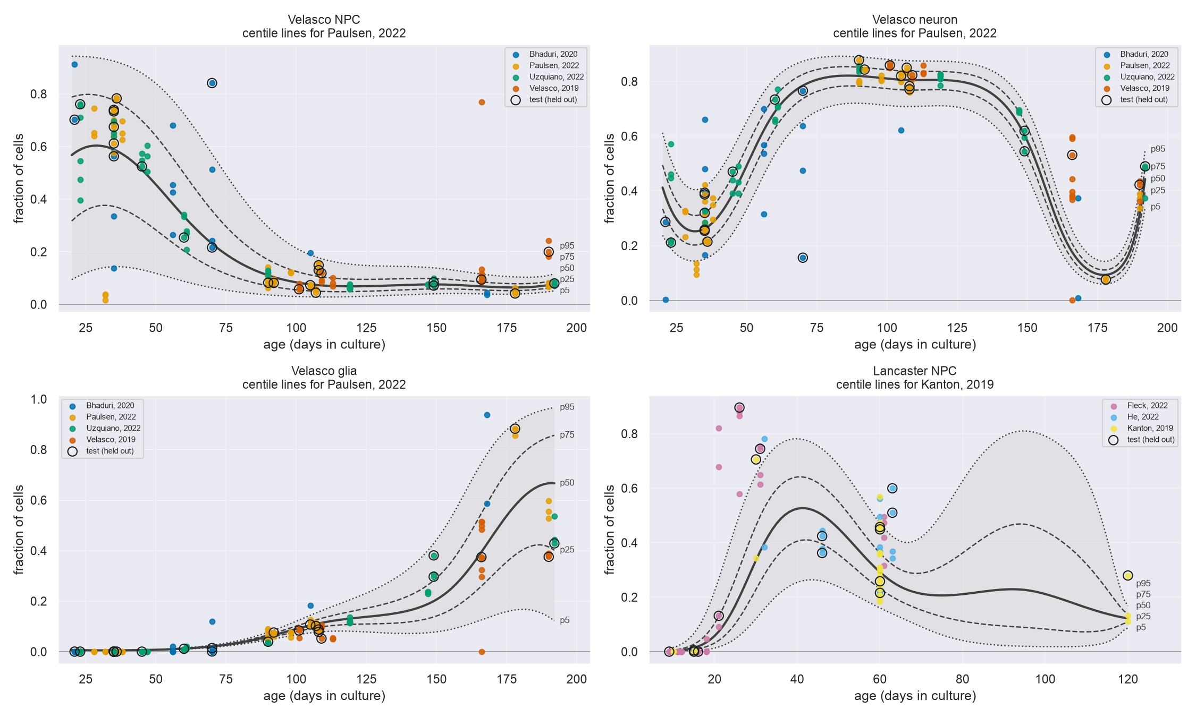
Same function, other cell types and the second protocol
src/growth_chart.py: one call per chart
• Velasco neuron: mirror image of progenitors. Test MSLL -1.15, z skew -0.47, no sample flagged.
• Velasco glia: near zero before day 90, rises after. MSLL -3.25.
• Lancaster NPC: 81 samples but no data between day 63 and 120, test z sd 1.6. The band balloons where there is nothing to fit. A demo of the method and a warning, not a result.
• Each chart: one call to fit_growth_chart(df, y_col) plus one to plot_growth_chart().
All charts drawn for the largest publication of each protocol (Paulsen 2022 for Velasco, Kanton 2019 for Lancaster).

Slide 7
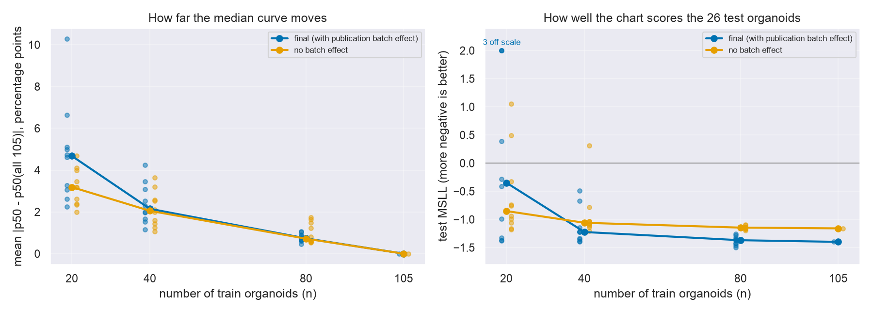
How many organoids does a lab need? About 40 to start, 80 to be stable
n train | median curve moves (pp) | test MSLL | test z sd
20 | 4.8 | 2.07 | 2.49
40 | 2.4 | -1.14 | 1.22
80 | 0.8 | -1.38 | 0.95
105 | 0.0 | -1.40 | 0.87
• Refit the final model on stratified random subsets of the 105 train organoids, 10 draws each.
• n = 20: median curve off by ~5 pp, MSLL positive (worse than guessing the mean), z sd 2.5. Unusable.
• n = 40: curve within ~2 pp, MSLL -1.1, z sd 1.2. A first chart.
• n = 80: within ~1 pp, MSLL within 0.02 of the full fit. Stable.
• Below ~10 organoids per lab the batch-effect model is worse than ignoring labs (orange beats blue at n = 20).
• Caveat: subsets are drawn from the same 105 samples, so stability at n = 80 is optimistic.
pp = percentage points of progenitor fraction, averaged over the age grid. This is the number labs currently guess.

Slide 8
What this is, what it is not, what comes next
• What we have: a working pipeline from a public atlas to a calibrated centile chart with per-organoid z-scores, in one public repo, reproducible in minutes.
• Limits:
  – 131 samples, not 100,000. Bands are honest about that: they carry the posterior uncertainty of the curve.
  – A 'sample' is one sequencing library; HNOCA does not say whether it is one organoid or a pool.
  – Publication and age are confounded (Velasco 2019 has no sample before day 101). The lab offset for that paper is partly extrapolated.
  – Composition fractions sum to 1; we model each one separately. A compositional model is the proper next step.
• Next: add new datasets as they appear (every HNOCA update is a free refit); try Dirichlet or logistic-normal likelihood; apply to a disease or drug-treated organoid set and ask which cell types leave the normal band first.
• Thanks: Johanna Bayer's normative modelling tutorial (Oct 2), the PCNtoolkit team, the HNOCA authors, Brainhack Montreal organizers.
github.com/Liberty23513/organoid-growth-charts | data: He et al. 2024 Nature (CC BY 4.0) | method: Rutherford et al. 2022 Nat Protoc, PCNtoolkit 1.3

