Slide 1
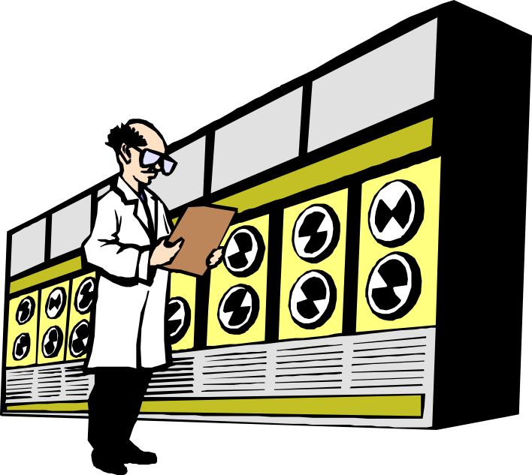
An Introduction to Data Mining
Prof. S. Sudarshan
CSE Dept, IIT Bombay
Most slides courtesy:
Prof. Sunita Sarawagi
School of IT, IIT Bombay

Slide 2
Why Data Mining
Credit ratings/targeted marketing:
  Given a database of 100,000 names, which persons are the least likely to default on their credit cards?
  Identify likely responders to sales promotions
Fraud detection
  Which types of transactions are likely to be fraudulent, given the demographics and transactional history of a particular customer?
Customer relationship management:
  Which of my customers are likely to be the most loyal, and which are most likely to leave for a competitor? :
Data Mining helps extract such information

Slide 3
Data mining
Process of semi-automatically analyzing large databases to find patterns that are:
  valid: hold on new data with some certainity
  novel: non-obvious to the system
  useful: should be possible to act on the item
  understandable: humans should be able to interpret the pattern
Also known as Knowledge Discovery in Databases (KDD)

Slide 4
Applications
Banking: loan/credit card approval
  predict good customers based on old customers
Customer relationship management:
  identify those who are likely to leave for a competitor.
Targeted marketing:
  identify likely responders to promotions
Fraud detection: telecommunications, financial transactions
  from an online stream of event identify fraudulent events
Manufacturing and production:
  automatically adjust knobs when process parameter changes
Notes:
Any area where large amounts of historic data that if understood
better can help shape future decisions.

Slide 5
Applications (continued)
Medicine: disease outcome, effectiveness of treatments
  analyze patient disease history: find relationship between diseases
Molecular/Pharmaceutical: identify new drugs
Scientific data analysis:
  identify new galaxies by searching for sub clusters
Web site/store design and promotion:
  find affinity of visitor to pages and modify layout

Slide 6
The KDD process
Problem fomulation
Data collection
  subset data: sampling might hurt if highly skewed data
  feature selection: principal component analysis, heuristic search
Pre-processing: cleaning
  name/address cleaning, different meanings (annual, yearly), duplicate removal, supplying missing values
Transformation:
  map complex objects e.g. time series data to features e.g. frequency
Choosing mining task and mining method:
Result evaluation and Visualization:
Knowledge discovery is an iterative process

Slide 7
Relationship with other fields
Overlaps with machine learning, statistics, artificial intelligence, databases, visualization but more stress on
  scalability of number of features and instances
  stress on algorithms and architectures whereas foundations of methods and formulations provided by statistics and machine learning.
  automation for handling large, heterogeneous data

Slide 8
Some basic operations
Predictive:
  Regression
  Classification
  Collaborative Filtering
Descriptive:
  Clustering / similarity matching
  Association rules and variants
  Deviation detection
Notes:
Each topic is a talk..

Slide 9
Classification (Supervised learning)

Slide 10
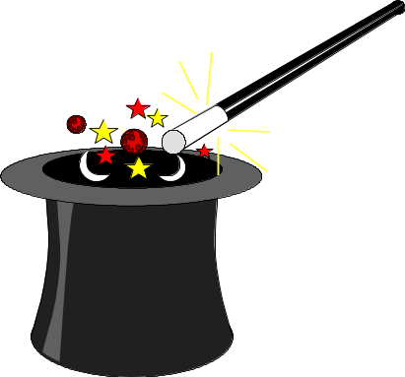
Classification
Given old data about customers and payments, predict new applicant’s loan eligibility.
Previous customers
Classifier
Decision rules
Age
Salary
Profession
Location
Customer type
Salary > 5 L
Good/
bad
Prof. = Exec
New applicant’s data

Slide 11
Classification methods
Goal: Predict class Ci = f(x1, x2, .. Xn)
Regression: (linear or any other polynomial)
  a*x1 + b*x2 + c = Ci.
Nearest neighour
Decision tree classifier: divide decision space into piecewise constant regions.
Probabilistic/generative models
Neural networks: partition by non-linear boundaries

Slide 12
Nearest neighbor
Define proximity between instances, find neighbors of new instance and assign majority class
Case based reasoning: when attributes are more complicated than real-valued.
Pros
  Fast training
Cons
  Slow during application.
  No feature selection.
  Notion of proximity vague

Slide 13
Decision trees
Tree where internal nodes are simple decision rules on one or more attributes and leaf nodes are predicted class labels.
Salary < 1 M
Prof = teacher
Age < 30
Good
Bad
Bad
Good

Slide 14
Decision tree classifiers
Widely used learning method
Easy to interpret: can be re-represented as if-then-else rules
Approximates function by piece wise constant regions
Does not require any prior knowledge of data distribution, works well on noisy data.
Has been applied to:
  classify medical patients based on the disease,
  equipment malfunction by cause,
  loan applicant by likelihood of payment.

Slide 15
Pros and Cons of decision trees
Pros
Reasonable training
time
Fast application
Easy to interpret
Easy to implement
Can handle large
number of features
Cons
Cannot handle complicated
relationship between features
simple decision boundaries
problems with lots of missing
data
More information: http://www.stat.wisc.edu/~limt/treeprogs.html

Slide 16
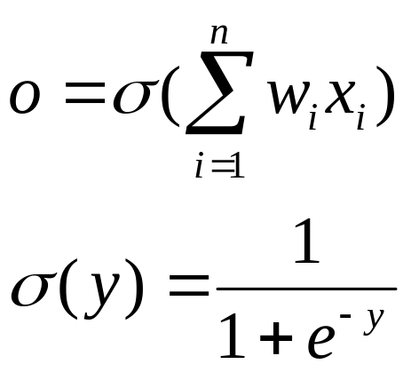
Neural network
Set of nodes connected by directed weighted edges
A more typical NN
Basic NN unit
x1
x1
w1
x2
x2
w2
x3
w3
x3
Output nodes
Hidden nodes

Slide 17
Neural networks
Useful for learning complex data like handwriting, speech and image recognition
Decision boundaries:
Linear regression
Classification tree
Neural network

Slide 18
Pros and Cons of Neural Network
Pros
Can learn more complicated
class boundaries
Fast application
Can handle large number of
features
Cons
Slow training time
Hard to interpret
Hard to implement: trial
and error for choosing
number of nodes
Conclusion: Use neural nets only if
decision-trees/NN fail.

Slide 19
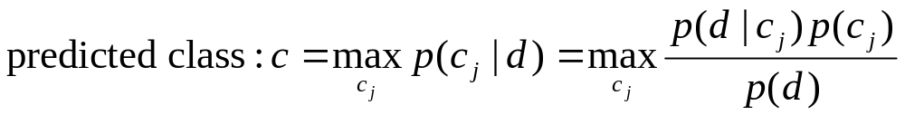
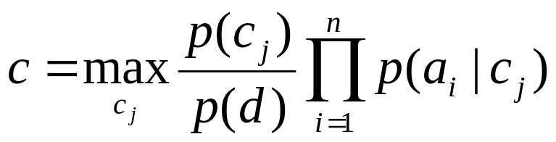
Bayesian learning
Assume a probability model on generation of data.
Apply bayes theorem to find most likely class as:
Naïve bayes: Assume attributes conditionally independent given class value
Easy to learn probabilities by counting,
Useful in some domains e.g. text

Slide 20
Clustering or Unsupervised Learning

Slide 21
Clustering
Unsupervised learning when old data with class labels not available e.g. when introducing a new product.
Group/cluster existing customers based on time series of payment history such that similar customers in same cluster.
Key requirement: Need a good measure of similarity between instances.
Identify micro-markets and develop policies for each

Slide 22
Applications
Customer segmentation e.g. for targeted marketing
  Group/cluster existing customers based on time series of payment history such that similar customers in same cluster.
  Identify micro-markets and develop policies for each
Collaborative filtering:
  group based on common items purchased
Text clustering
Compression

Slide 23
Distance functions
Numeric data: euclidean, manhattan distances
Categorical data: 0/1 to indicate presence/absence followed by
  Hamming distance (# dissimilarity)
  Jaccard coefficients: #similarity in 1s/(# of 1s)
  data dependent measures: similarity of A and B depends on co-occurance with C.
Combined numeric and categorical data:
  weighted normalized distance:

Slide 24
Clustering methods
Hierarchical clustering
  agglomerative Vs divisive
  single link Vs complete link
Partitional clustering
  distance-based: K-means
  model-based: EM
  density-based:

Slide 25
Agglomerative Hierarchical clustering
Given: matrix of similarity between every point pair
Start with each point in a separate cluster and merge clusters based on some criteria:
  Single link: merge two clusters such that the minimum distance between two points from the two different cluster is the least
  Complete link: merge two clusters such that all points in one cluster are “close” to all points in the other.

Slide 26
Partitional methods: K-means
Criteria: minimize sum of square of distance
    Between each point and centroid of the cluster.
    Between each pair of points in the cluster
Algorithm:
  Select initial partition with K clusters: random, first K, K separated points
  Repeat until stabilization:
    Assign each point to closest cluster center
    Generate new cluster centers
    Adjust clusters by merging/splitting

Slide 27
Collaborative Filtering
Given database of user preferences, predict preference of new user
Example: predict what new movies you will like based on
  your past preferences
  others with similar past preferences
  their preferences for the new movies
Example: predict what books/CDs a person may want to buy
  (and suggest it, or give discounts to tempt customer)

Slide 28
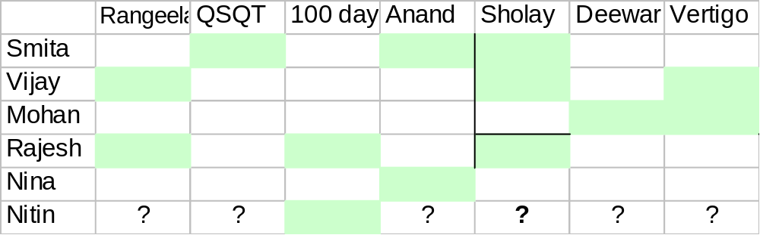
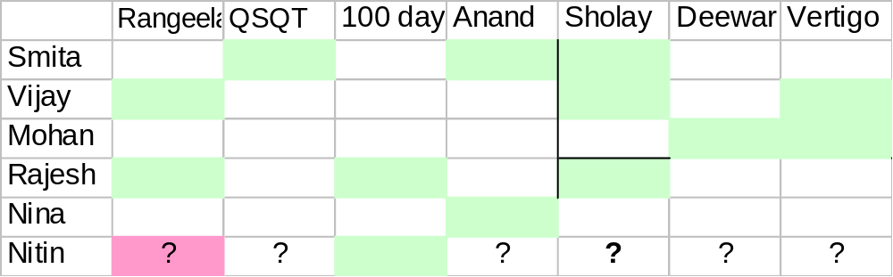
Collaborative recommendation
Possible approaches:
  Average vote along columns [Same prediction for all]
  Weight vote based on similarity of likings [GroupLens]

Slide 29
Cluster-based approaches
External attributes of people and movies to cluster
  age, gender of people
  actors and directors of movies.
  [ May not be available]
Cluster people based on movie preferences
  misses information about similarity of movies
Repeated clustering:
  cluster movies based on people, then people based on movies, and repeat
  ad hoc, might smear out groups

Slide 30
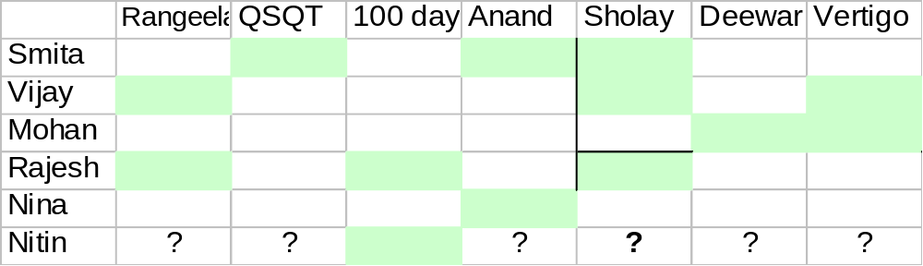
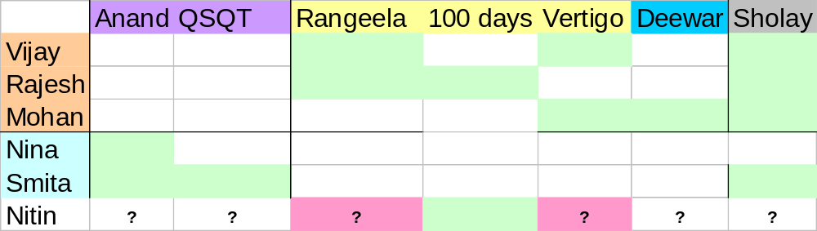
Example of clustering

Slide 31
Model-based approach
People and movies belong to unknown classes
P_{k} = probability a random person is in class k
P_{l} = probability a random movie is in class l
P_{kl} = probability of a class-k person liking a class-l movie
Gibbs sampling: iterate
  Pick a person or movie at random and assign to a class with probability proportional to P_{k} or P_{l}
  Estimate new parameters
    Need statistics background to understand details

Slide 32
Association Rules

Slide 33
Association rules
T
Milk, cereal
Given set T of groups of items
Example: set of item sets purchased
Goal: find all rules on itemsets of the form a-->b such that
  support of a and b > user threshold s
  conditional probability (confidence) of b given a > user threshold c
Example: Milk --> bread
Purchase of product A --> service B
Tea, milk
Tea, rice, bread
cereal

Slide 34
Variants
High confidence may not imply high correlation
Use correlations. Find expected support and large departures from that interesting..
  see statistical literature on contingency tables.
Still too many rules, need to prune...

Slide 35


Prevalent ≠ Interesting
1995
Milk and
cereal sell
together!
Analysts already know about prevalent rules
Interesting rules are those that deviate from prior expectation
Mining’s payoff is in finding surprising phenomena
1998
Milk and
cereal sell
together!
Zzzz...

Slide 36
What makes a rule surprising?
Does not match prior expectation
  Correlation between milk and cereal remains roughly constant over time
Cannot be trivially derived from simpler rules
  Milk 10%, cereal 10%
  Milk and cereal 10% … surprising
  Eggs 10%
  Milk, cereal and eggs 0.1% … surprising!
  Expected 1%

Slide 37
Applications of fast itemset counting
Find correlated events:
Applications in medicine: find redundant tests
Cross selling in retail, banking
Improve predictive capability of classifiers that assume attribute independence
New similarity measures of categorical attributes [Mannila et al, KDD 98]

Slide 38
Data Mining in Practice

Slide 39
Application Areas
Industry
Application
Finance
Credit Card Analysis
Insurance
Claims, Fraud Analysis
Telecommunication
Call record analysis
Transport
Logistics management
Consumer goods
promotion analysis
Data Service providers
Value added data
Utilities
Power usage analysis

Slide 40
Why Now?
Data is being produced
Data is being warehoused
The computing power is available
The computing power is affordable
The competitive pressures are strong
Commercial products are available

Slide 41

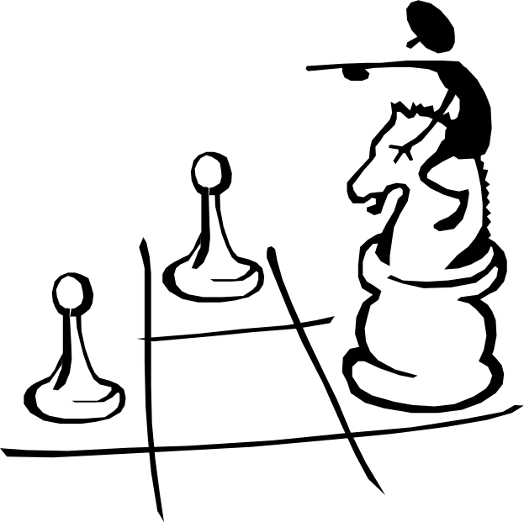
Data Mining works with Warehouse Data
Data Warehousing provides the Enterprise with a memory
Data Mining provides the Enterprise with intelligence

Slide 42
Usage scenarios
Data warehouse mining:
  assimilate data from operational sources
  mine static data
Mining log data
Continuous mining: example in process control
Stages in mining:
  data selection ➔ pre-processing: cleaning ➔ transformation ➔ mining ➔ result evaluation ➔ visualization

Slide 43
Mining market
Around 20 to 30 mining tool vendors
Major tool players:
  Clementine,
  IBM’s Intelligent Miner,
  SGI’s MineSet,
  SAS’s Enterprise Miner.
All pretty much the same set of tools
Many embedded products:
  fraud detection:
  electronic commerce applications,
  health care,
  customer relationship management: Epiphany
Notes:
Absolute: 40 M$
40M$, expected to grow 10 times by 2000 --Forrester research

Slide 44
Vertical integration:
Mining on the web
Web log analysis for site design:
  what are popular pages,
  what links are hard to find.
Electronic stores sales enhancements:
  recommendations, advertisement:
  Collaborative filtering: Net perception, Wisewire
  Inventory control: what was a shopper looking for and could not find..

Slide 45
OLAP Mining integration
OLAP (On Line Analytical Processing)
  Fast interactive exploration of multidim. aggregates.
  Heavy reliance on manual operations for analysis:
  Tedious and error-prone on large multidimensional data
Ideal platform for vertical integration of mining but needs to be interactive instead of batch.
Notes:
OLAP refers to Online Analytical Processing.
I always wondered what was the analytical part in olap products?
OLAP -- bunch of aggregates and simple group-bys on sums and average is not analysis. Interactive speed for selects/drill-downs/rollups/ no joins “analysis” manually and the products meet the “Online” part of the promise by pre-computing the aggregates.
They offer a bare-bones RISC like functionality using which
analysts do most of the work manually.
This talk is about investigating if we can do some of the analysis too?
When you have 5 dimensions, with avg. 3 levels hierarchy on each
aggregating more than a million rows, manual exploration can get
tedious.
Goal is to add more complex operations although called mining
think of them more like CISC functionalities..
Mining products provide the analysis part but they do it
batched rather than online. Greater success of OLAP means people find this form of interactive analysis quite attractive.

Slide 46
State of art in mining OLAP integration
Decision trees [Information discovery, Cognos]
  find factors influencing high profits
Clustering [Pilot software]
  segment customers to define hierarchy on that dimension
Time series analysis: [Seagate’s Holos]
  Query for various shapes along time: eg. spikes, outliers
Multi-level Associations [Han et al.]
  find association between members of dimensions
Sarawagi [VLDB2000]
Notes:
Littl e integration: here are few exceptions ---
People are starting to wake up to this possibility and here are some examples I have found by web-surfing.
. decision tree most common. Information Discovery claimed to be only serious integrator [DBMS Ap ‘98]
Clustering used by some to define new product hierarchies.
Of course, rich set of time-series functions especially for forecasting was always there
New charting software: 80/20, A-B-C analysis, quadrant plotting.
Univ. Jiawen Han.
Previous approach has been to bring in mining operations in olap. Look at mining operations and choose what fits.
My approach has been to reflect on what people do with cube metaphor
and the drill-down, roll-up, based exploration and see if there is anything there that can be automated.
Discuss my work first.

Slide 47
Data Mining in Use
The US Government uses Data Mining to track fraud
A Supermarket becomes an information broker
Basketball teams use it to track game strategy
Cross Selling
Target Marketing
Holding on to Good Customers
Weeding out Bad Customers

Slide 48
Some success stories
Network intrusion detection using a combination of sequential rule discovery and classification tree on 4 GB DARPA data
  Won over (manual) knowledge engineering approach
  http://www.cs.columbia.edu/~sal/JAM/PROJECT/ provides good detailed description of the entire process
Major US bank: customer attrition prediction
  First segment customers based on financial behavior: found 3 segments
  Build attrition models for each of the 3 segments
  40-50% of attritions were predicted == factor of 18 increase
Targeted credit marketing: major US banks
  find customer segments based on 13 months credit balances
  build another response model based on surveys
  increased response 4 times -- 2%

