Slide 1
Analysis of Gym Members Fitness and Workout Patterns.
Libin Shibhu
Data Analytics

Slide 2
Introduction
This project analyzes a dataset of 973 gym members, capturing their workout habits, physical attributes, and key fitness metrics. The data includes heart rate information, calories burned, session duration, BMI, body fat percentage, and experience levels, allowing for meaningful exploration of fitness patterns and exercise behavior.
Using Excel, this project aims to uncover meaningful patterns within the dataset, analyze relationships between physical characteristics and workout behaviors, and identify trends that support better understanding of fitness progression. Through visualizations, summary statistics, and comparative analysis, the project highlights how different variables contribute to overall workout efficiency and health indicators.

Slide 3
Objectives
To compare average calories burned across different workout types.
To analyze heart rate metrics (Resting, Avg, Max BPM) by age group and gender.
To evaluate how BMI categories relate to calories burned and session duration.
To study the relationship between experience level and workout frequency.
To compare average water intake and body fat percentage among various workout types.

Slide 4
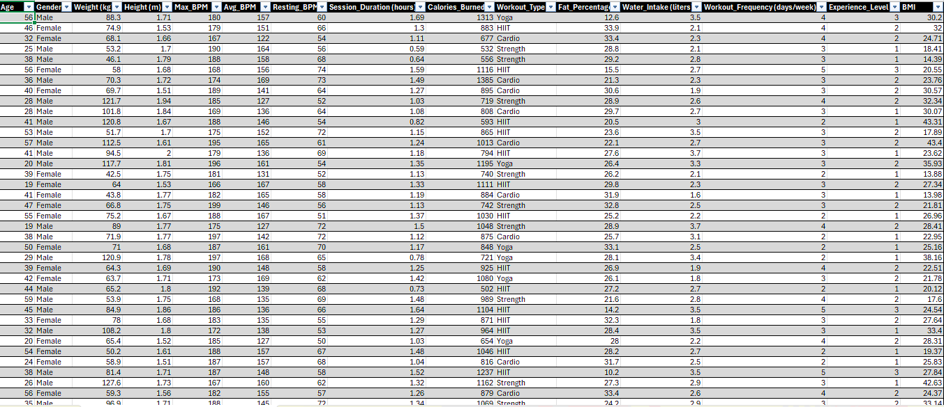
Dataset

Slide 5
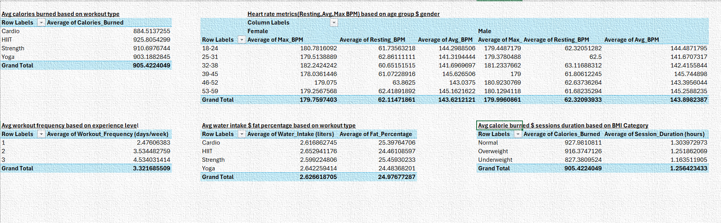
Pivot Tables

Slide 6
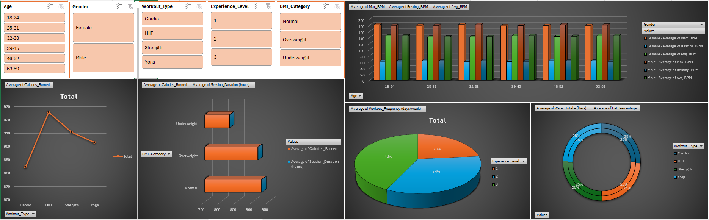
Dashboard

Slide 7
conclusion
Average Calories Burned Across Workout Types
HIIT recorded the highest average calories burned, followed by Strength and Yoga.
Cardio had the lowest calorie burn among the four types.
This suggests that high-intensity workouts are the most effective for maximizing calorie expenditure, while steady workouts like Cardio burn fewer calories on average.
Heart Rate Metrics by Age Group and Gender
Across all age groups, male and female Max_BPM , Avg_BPM , Resting_BPM values were stable across age ranges, showing minimal changes as age increased.
Overall, age does not significantly affect heart rate intensity during workouts, and both genders show similar heart rate performance across all metrics.
Calories Burned & Session Duration Across BMI Categories
Normal BMI individuals burned the highest average calories and had slightly longer workout sessions.
Overweight participants burned fewer calories than normal BMI but more than the Underweight group.
Individuals with a normal BMI appear to sustain longer and more effective workout sessions, potentially due to higher fitness levels and endurance.

Slide 8
Workout Frequency Based on Experience Level
Experts (Level 3) had the highest weekly workout frequency.
Intermediate users (Level 2) exercised moderately.
Beginners (Level 1) had the lowest frequency.
This shows a clear positive relationship between experience level and workout consistency—as individuals gain experience, their workout commitment increases.
Water Intake & Fat Percentage Across Workout Types
Average water intake was consistent across all workout types, with only slight variation.
Fat percentage also showed minimal differences between workout categories.
This indicates that hydration habits and body fat ratios are not strongly influenced by the specific type of workout, and may depend more on personal lifestyle, nutrition, or long-term training patterns.
Overall, HIIT burns the most calories, heart rate patterns remain consistent across age and gender, normal BMI individuals show better workout performance, beginners exercise less frequently, and water intake and fat percentage vary only slightly across workout types, giving a clear overview of fitness behaviors in the dataset.

Slide 9
Suggestions
Personalize Workouts for Better Calorie Burn
Since HIIT burns the most calories, users aiming for weight loss or fat reduction should include 2–3 HIIT sessions per week. For beginners, start with low-impact HIIT to avoid injury.
Improve Beginner Engagement
Beginners exercise less often, so using short 20–30-minute routines, simple challenges, and progress tracking can help them stay motivated and increase their workout frequency.
Target BMI-Specific Training Plans
Since Normal BMI participants show better performance, others may need tailored plans accordingly.
Hydration Awareness Campaign
Consume minimum 2–3 liters/day especially for HIIT/Cardio.
Balanced Weekly Workout Mix
To improve overall fitness, combine Strength + HIIT + Cardio + Flexibility (Yoga).This ensures calorie burn, endurance, muscle gain, and mobility.
Add Recovery Days for Heart Health
Recommend 1–2 rest/recovery days/week to prevent overtraining and maintain healthy BPM(Beats per minute) levels.

Slide 10
References
https://www.kaggle.com/datasets/valakhorasani/gym-members-exercise-dataset
MS EXCEL

Slide 11
Thank You

