Slide 1
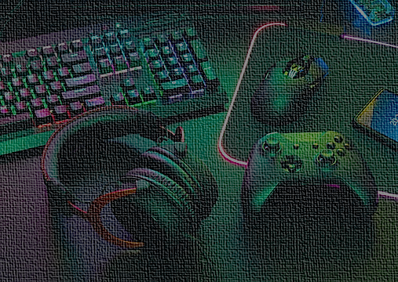
Game Time vs Productivity: Analyzing the Impact of Gaming Habits on Performance -Tableau Project
Libin Shibhu
Data Analytics

Slide 2
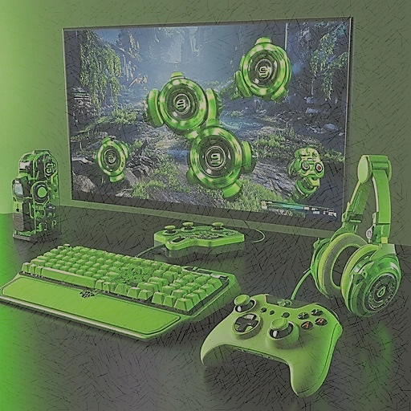
Introduction
This project analyzes the relationship between daily and weekly gaming habits and their impact on academic and workplace performance. Using behavioral data such as gaming duration, preferred gaming time, sleep hours, stress levels, focus levels, and productivity scores, the study aims to identify patterns and correlations that explain how gaming behavior affects performance outcomes.
Through interactive Tableau dashboards and visual analytics, this project provides insights into whether gaming has a positive, negative, or neutral effect on productivity. The findings can help students, professionals, and decision-makers better understand healthy gaming habits and their role in maintaining optimal performance.

Slide 3

Objectives
To analyze the relationship between gaming duration and productivity levels.
To evaluate the effect of gaming habits on sleep patterns.
To assess the impact of gaming on stress and focus levels.
To compare multiple performance indicators (productivity, focus level, and sleep duration) across different gaming patterns.
To identify optimal gaming behaviors that support healthy performance.

Slide 4

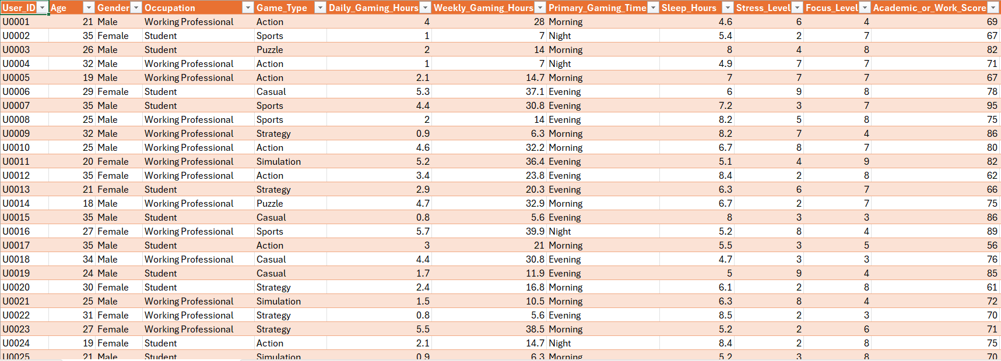
Dataset

Slide 5
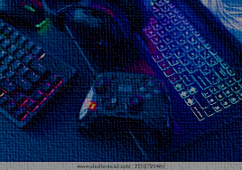
Criteria Used
Game Duration Category
Gaming Patterns
Stress Level Category
Jitter
Stress Level (Reversed Scale)
: IF ([Daily Gaming Hours])<=1 THEN "low gaming“
ELSEIF ([Daily Gaming Hours])<=3 THEN“ moderate gaming“
ELSE "high gaming“
END
: IF ([Weekly Gaming Hours])<5 THEN "casual"
ELSEIF ([Weekly Gaming Hours])<=15 THEN "moderate"
ELSE "heavy"
END
: IF ([Stress Level])<=3 THEN "low"
ELSEIF ([Stress Level])<=6 THEN "medium"
ELSE "high"
END
: (RANDOM() - 0.5) * 0.3
: -[Stress Level]

Slide 6

Dashboard Design: Objectives and Visuals Used
Objective 1: Analyze the Impact of Gaming Duration on Productivity
Purpose: Understand how low, moderate, and high gaming affect productivity.
Bar Chart is used to compare average productivity across gaming groups
Objective 2: Analyze the Effect of Gaming Habits on Sleep Patterns
Purpose: Understand how gaming affects sleep duration.
Box Plot is used to analyze sleep hours by gaming duration category
Objective 3: Examine the Relationship Between Gaming Habits, Stress, and Focus
Purpose: Identify how gaming intensity impacts mental well-being.
Scatter Plot is used to compare patterns across groups clearly.
Objective 4: Compare Overall Performance Outcomes Across Gaming Patterns
Purpose:multiple performance metrics together.
Highlight Table is used for the visual comparison of averages using size and color.
Objective 5: Identify Optimal Gaming Behaviour for Healthy Performance
Purpose: Recommend the healthiest gaming pattern
Heatmap is used and includes reversed stress scale.

Slide 7
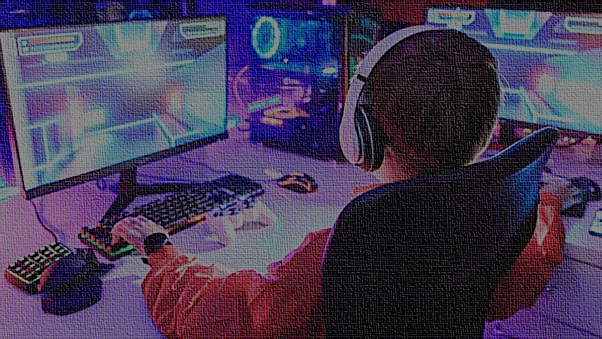
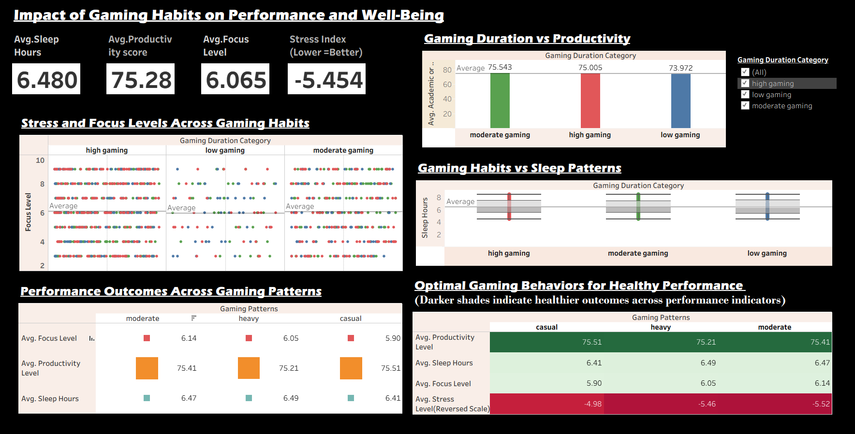
Dashboard

Slide 8
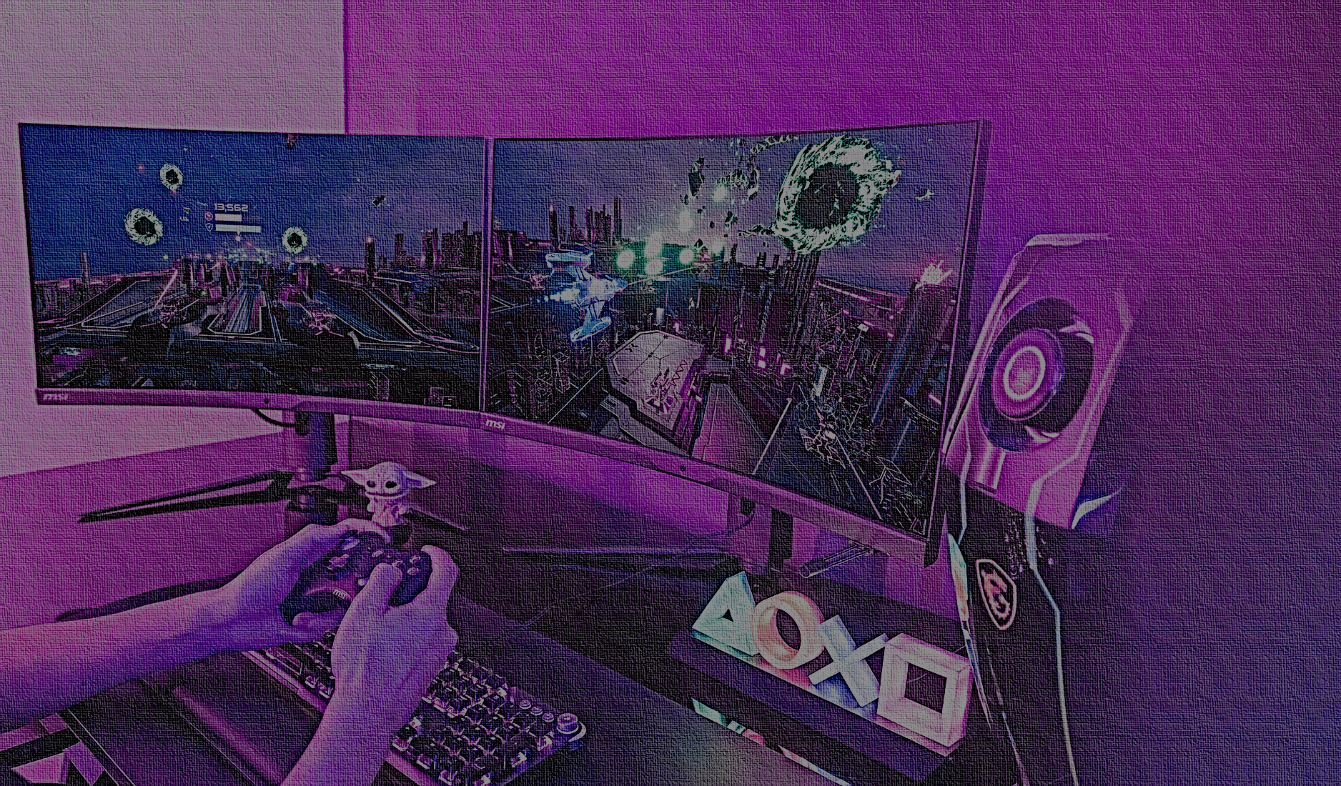
Conclusions
Gaming Duration vs Productivity
Users with moderate gaming duration show the best average productivity score compared to high and low gaming.
*Balanced gaming habits appear to support optimal productivity, while both extremes—too little or too much gaming—are associated with slightly lower performance.
Evaluate the effect of gaming habits on sleep patterns
Moderate gaming and low gaming groups show slightly higher median sleep hours compared to high gaming.
*Moderate and low gaming habits are associated with healthier and more consistent sleep patterns, while high gaming correlates with reduced and irregular sleep duration.

Slide 9
To assess the impact of gaming on stress and focus level
Moderate gaming is associated with higher and more consistent focus levels while high gaming correlates with increased stress and reduced focus consistency.
*The visualization shows that moderate gaming is associated with higher focus levels and lower stress, while excessive gaming leads to elevated stress and greater variability in focus. This suggests that balanced gaming habits support healthier cognitive performance.
Comparison of Performance Indicators Across Gaming Patterns
Moderate gaming delivers the best balance between focus, productivity, and sleep than heavy and casual gaming.
*This comparison shows that moderate gaming achieves the best balance across focus, productivity, and sleep, while heavy gaming slightly impacts focus and productivity. Casual gaming maintains productivity but shows lower focus and sleep duration.

Slide 10
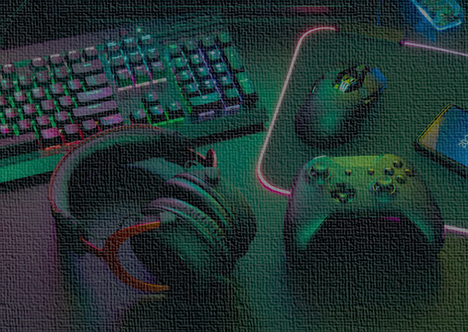
Optimal Gaming Behaviors for Healthy Performance
Balanced gaming habits support healthier performance outcomes across productivity, focus, stress, and sleep indicators.

Slide 11
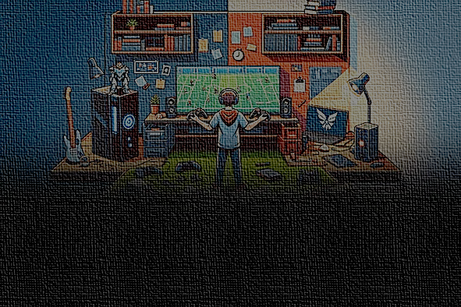
Suggestions
Promote Balanced Gaming Habits
Limit Prolonged Gaming Sessions
Prioritize Focus and Productivity Over Gaming Duration
Maintain Healthy Sleep Patterns
Use Data-Driven Insights for Personal Optimization

Slide 12

Reference
https://www.kaggle.com/datasets/prince7489/gaming-hours-vs-academic-and-work-performance
TABLEAU PUBLIC

Slide 13
Thank You

