Slide 1
Impact of lifestyle factors on sleep quality and health. -Power BI
Libin Shibhu
DA

Slide 2
Introduction
This project analyzes the relationship between sleep patterns, lifestyle habits, and key health indicators using Power BI. The dataset includes information on sleep duration, sleep quality, stress levels, physical activity, daily steps, heart rate, blood pressure, and sleep disorders across different age groups, genders, and occupations.
Using Power BI, Interactive dashboards were created to uncover trends, compare groups, and provide actionable insights that support better health and wellness decisions

Slide 3
Objectives
To analyze the relationship between physical activity level and sleep quality.
To identify how stress level impacts sleep duration and key health indicators.
To compare sleep patterns across different lifestyle categories.
To examine how daily step count influences overall sleep duration.
To analyze the overall distribution of sleep disorders among individuals.

Slide 4
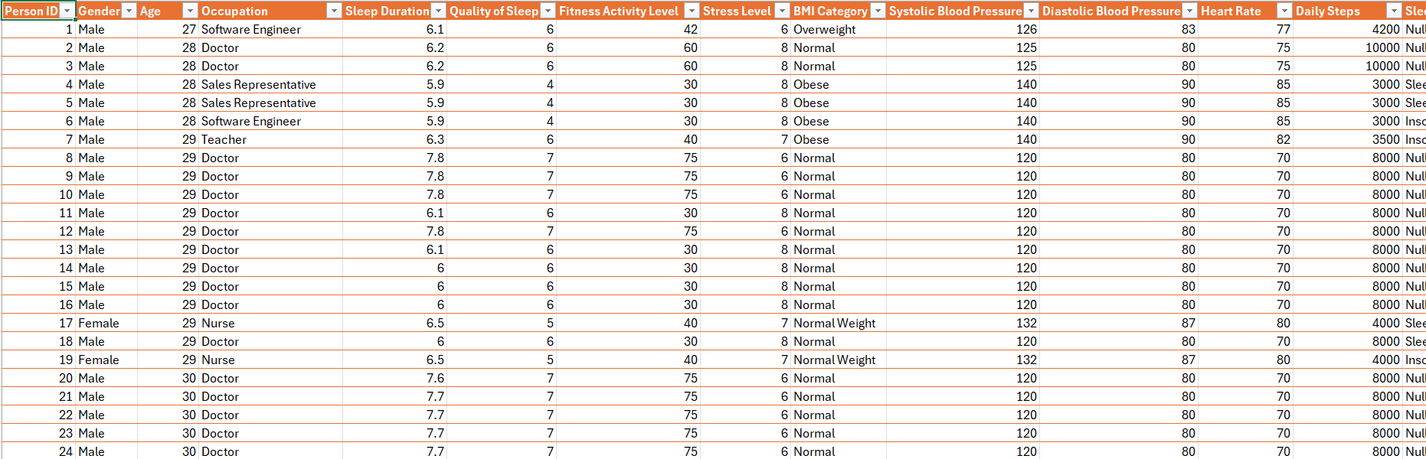
Dataset

Slide 5
Criteria Used
Avg.sleep quality = AVERAGE(Sleep_health_and_lifestyle_data[Quality of Sleep])
Avg.sleep duration=AVERAGE(Sleep_health_and_lifestyle_data[Sleep Duration])
Avg.stress level = AVERAGE(Sleep_health_and_lifestyle_data[Stress Level])
Avg.daily steps = AVERAGE(Sleep_health_and_lifestyle_data[Daily Steps])
Sleep disorder count = COUNT(Sleep_health_and_lifestyle_data[Sleep Disorder])
Physical_activity_level = IF(Sleep_health_and_lifestyle_data[Daily Steps]<5000,"low",IF(Sleep_health_and_lifestyle_data[Daily Steps]<=8000,"moderate","high"))
Stress level category = IF(Sleep_health_and_lifestyle_data[Stress Level]<4,"low stress", IF(Sleep_health_and_lifestyle_data[Stress Level]<=7,"moderate stress","high stress"))
Daily Steps Category = IF (Sleep_health_and_lifestyle_data[Daily Steps] < 5000, "< 5,000",IF (Sleep_health_and_lifestyle_data[Daily Steps] <= 8000, "5,000–8,000",IF (Sleep_health_and_lifestyle_data[Daily Steps]<= 12000, "8,000–12,000", "12,000+“)))

Slide 6
Dashboard Design:Objectives and Visuals Used
Objective 1:Analyze the relationship between physical activity level and sleep quality.
Bar Chart is used to compare Average Sleep Quality by Physical Activity Level
Objective 2:Identify how stress level impacts sleep duration and key health indicators.
Scatter Plot is used compare Stress Level vs Sleep Duration(health indicators in tooltip)
Objective 3:Compare sleep patterns across different lifestyle categories.
Matrix is used to compare Average Sleep Duration by Lifestyle Category
Objective 4:Examine how daily step count influences overall sleep duration.
Column Chart is used to compare Average Sleep Duration by Daily Step Range
Objective 5:Analyze the distribution of sleep disorders across different age groups.
Donut chart is used to compare Sleep Disorder Count by Age Group

Slide 7
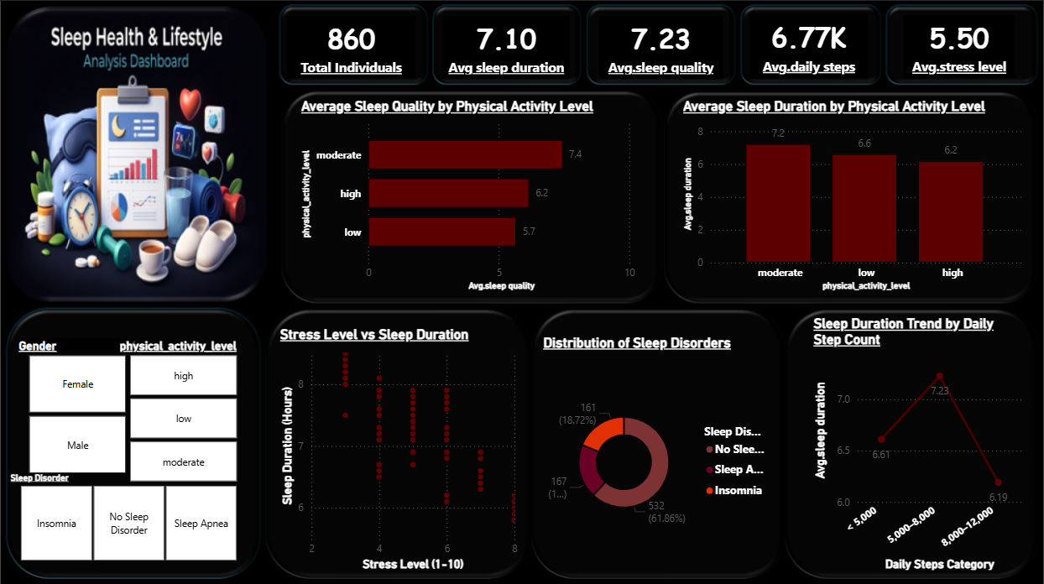
Dashboard

Slide 8
Conclusion
Physical Activity Level vs Sleep Quality
The analysis shows that moderate physical activity is associated with better sleep quality compared to both low and high activity levels.
Stress Level vs Sleep Duration
The analysis indicates a negative correlation between stress level and sleep duration, where higher stress leads to reduced sleep hours.

Slide 9
Sleep Patterns vs Lifestyle Categories
The analysis shows clear differences in sleep patterns across lifestyle categories, with moderate physical activity linked to healthier sleep behavior.
Step Count vs Sleep Duration
The analysis shows that moderate daily step counts are associated with longer sleep duration, highlighting the importance of balanced activity levels.
Distribution of Sleep Disorders Among Individuals
The analysis shows that although most individuals do not have sleep disorders, nearly two-fifths of the population is affected by insomnia or sleep apnea.

Slide 10
Suggestions
Promote Moderate Physical Activity
Implement Stress Management Strategies
Encourage Balanced Daily Movement
Monitor and Address Sleep Disorders Early
Promote Holistic Lifestyle Balance

Slide 11
Reference
https://www.kaggle.com/datasets/uom190346a/sleep-health-and-lifestyle-dataset
POWER BI

Slide 12
.THANK YOU.

