Slide 1
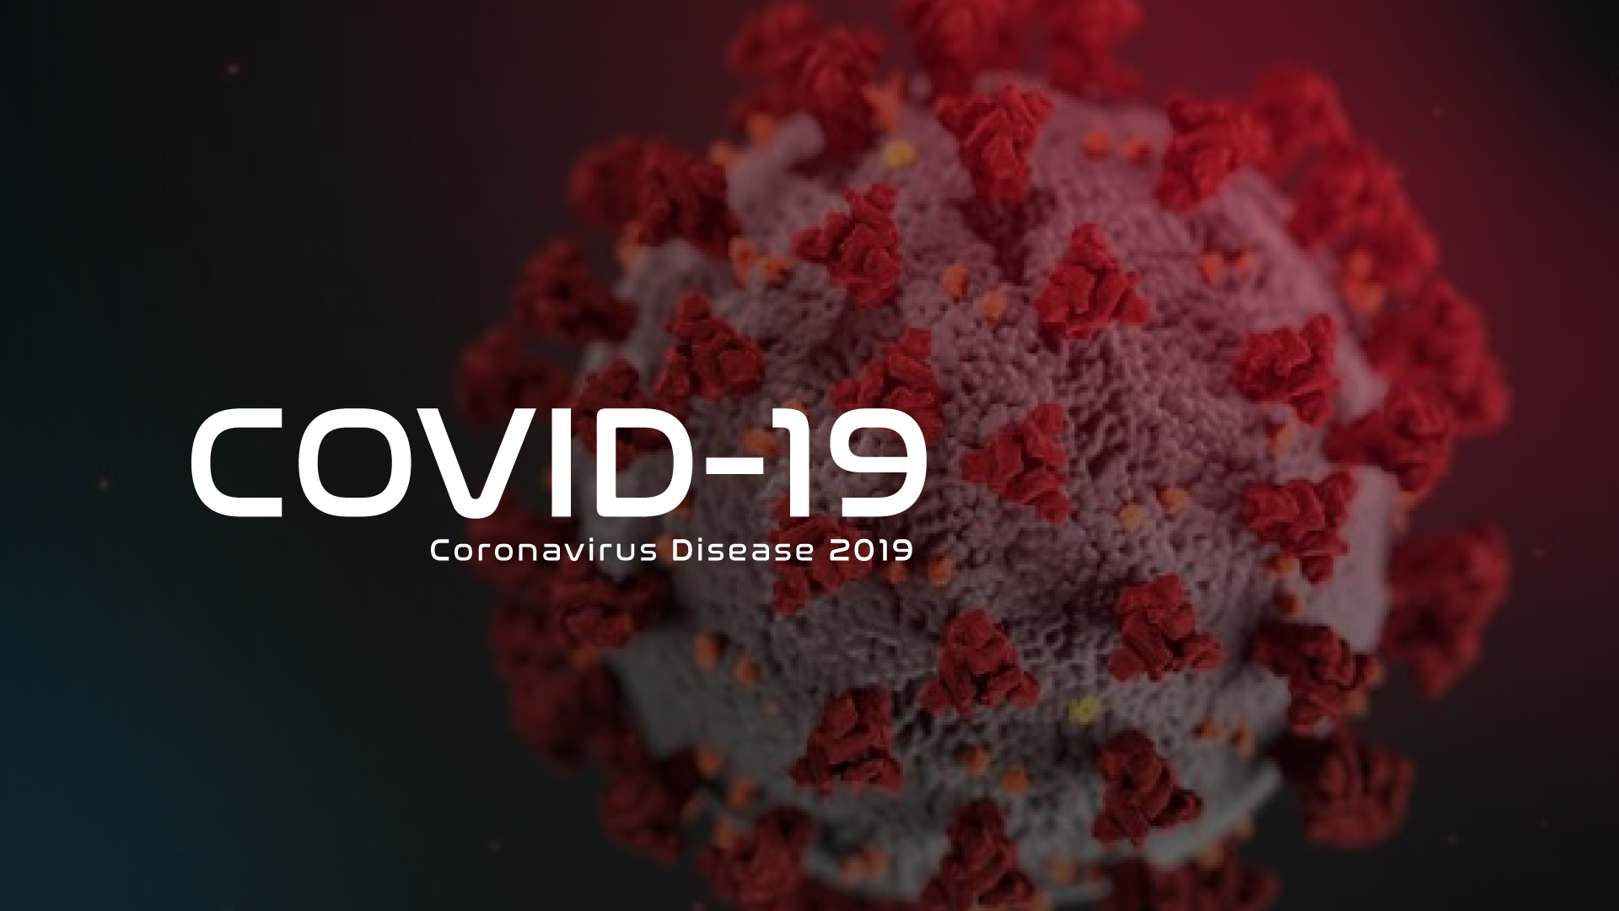
Learnable Quantization and Lesion Area Segmentation for COVID-19 Lungs’ CT Images
Hanyou Cao, Libo Zhang, Sihan lyu, Sizhe Kuang

Slide 2
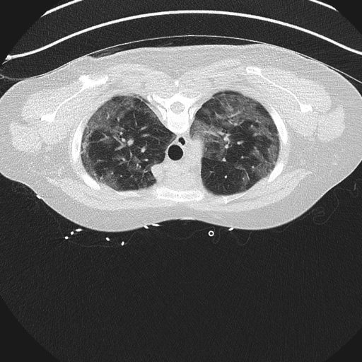
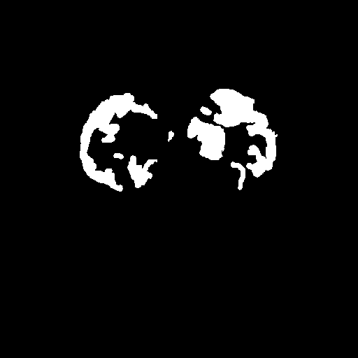
Introduction
Traditional RT-PCR is convenient, but CT image diagnosis can be faster and provide more accurate result.

Slide 3
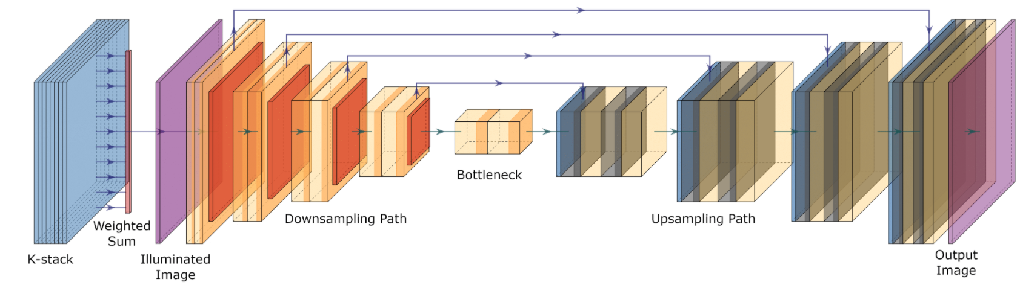
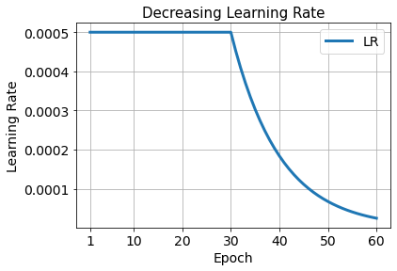
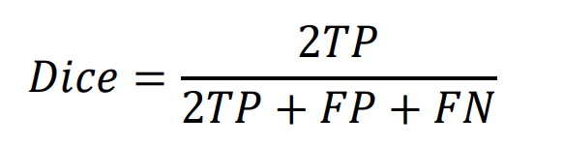
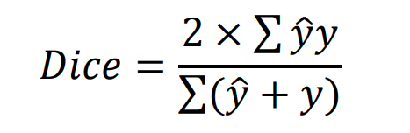
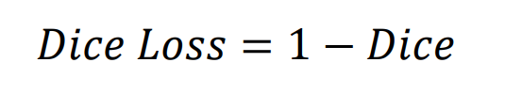
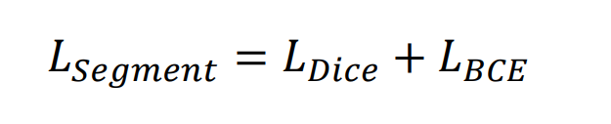
U-Net
Not illuminated images, quantized images instead
Sigmoid activation for output layer
2729 grayscale images (0-255) with size [512, 512]
80%-20% train-test split
U-Net model architecture figure referenced from Week 8 Lab Notebook

Slide 4
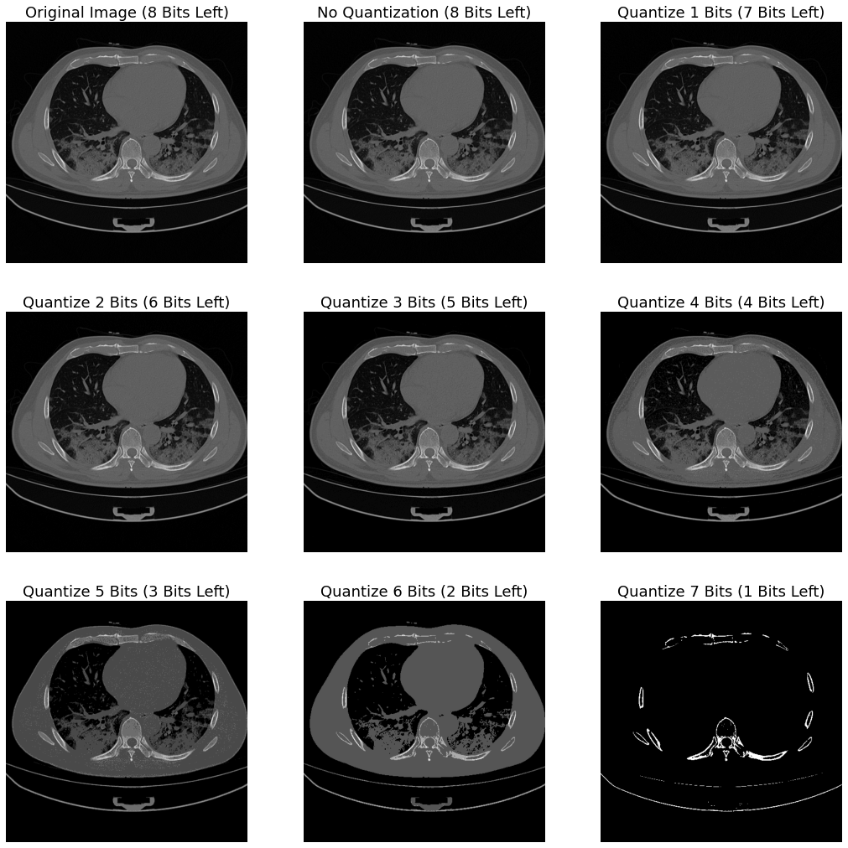
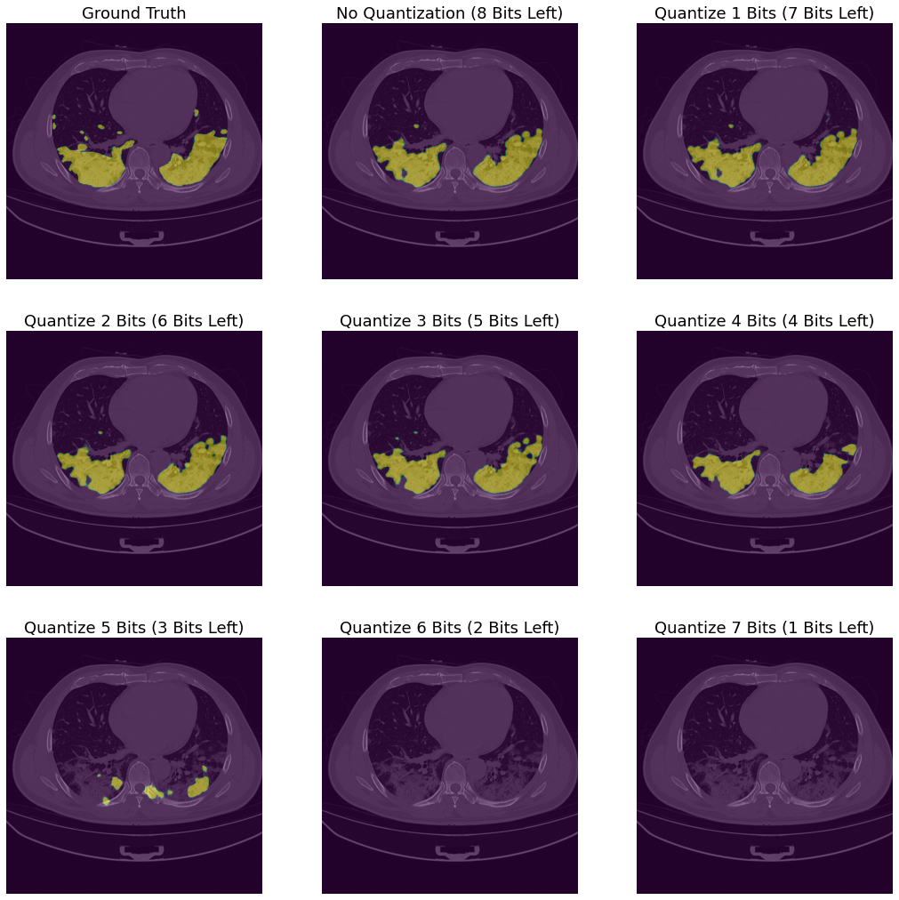
Hard-coded Quantization
Directly feed quantized images to U-Net model which was trained on non-quantized images

Slide 5
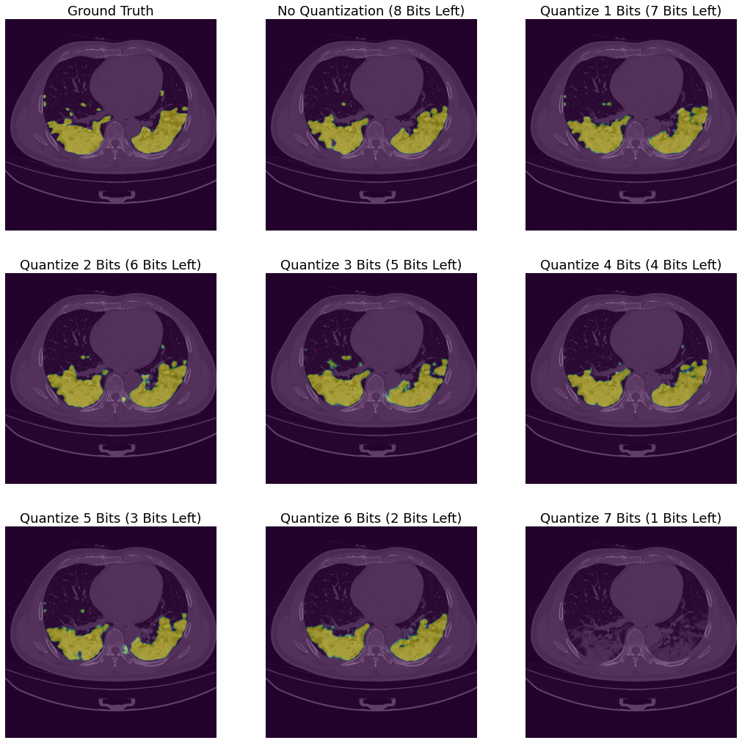
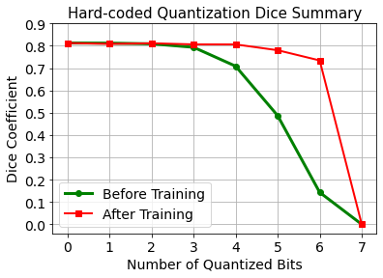
Hard-coded Quantization
Feed quantized images on U-Net models which were trained on quantized images with different bits left
After hard-coded quantization,
what about learnable quantization?

Slide 6
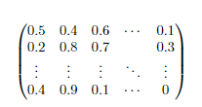
Physical Layer
Optimize the selection of pixels to quantize.
Use continuous variables to train discrete selection.
We sample the selection from a relaxed Bernoulli distribution.

Slide 7
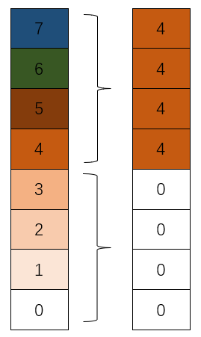
Physical Layer
Formula:
x//2^k * 2^k
In our experiment, k=7

Slide 8

Constraint
Control the number of quantized pixels
The constraint is the sum of the probabilities.
Implemented a constraint class to ensure desired number of pixels is quantized.

Slide 9
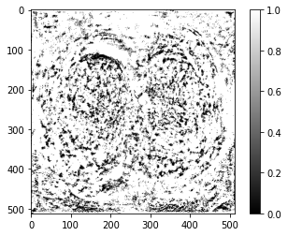
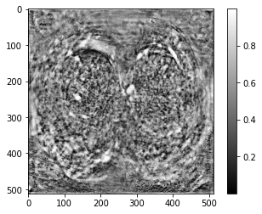
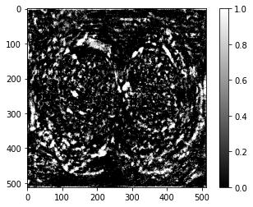
Trainable quantization weights
Where the model don’t want to quantize(black)
Where the model want to quantize(white)
Blacker: lower probs to quantize
Whiter: higher probs to quantize

Slide 10
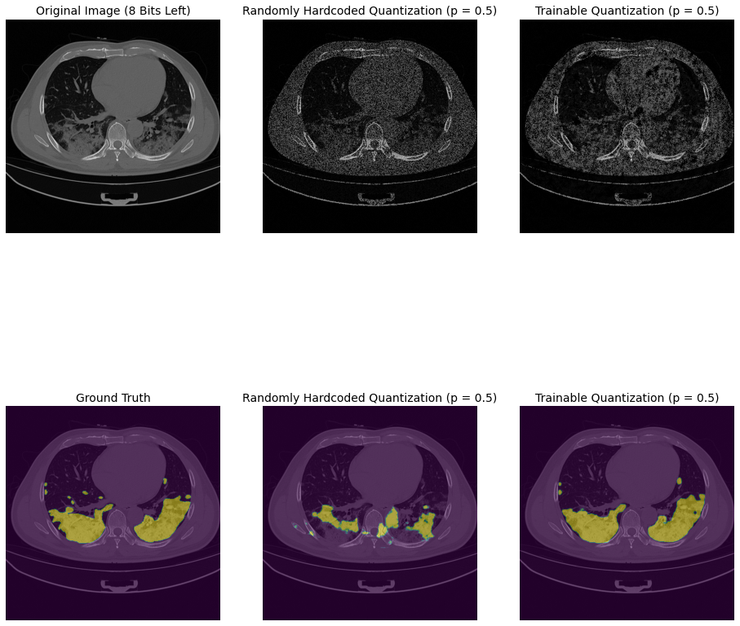
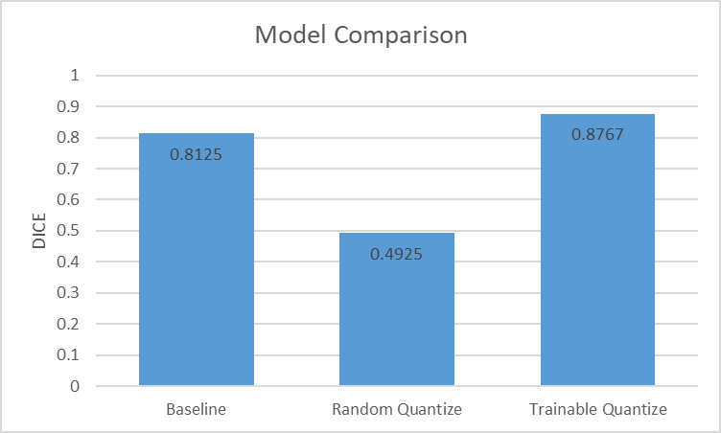
Comparsion result
DICE:0.49
DICE:0.88
Even get better performance than using data without any quantization!

Slide 11
Conclusion
Discussion
Implement U-Net to complete segementation tasks.
Train 7 more U-Net models on images with 1/2/3/4/5/6/7 hard-coded quantization bits.
Build a trainable quantization layer with constraints to improve the performance.
Improve the selection from binary choices to multiple choices
Extend the neural network to 3D images.
Examine the performance when different percentage of pixels are quantized.

Slide 12
Thank you for your listening!
Hanyou Cao
Libo Zhang Sihan lyu
Sizhe Kuang
04/27/2022

