Slide 1
AI/ML + Wireless: Signal Modulation Detection and Classification
Libo Zhang, Yujie Zhang
April 7, 2022
ECE/CompSci 590: xG Wireless and Mobile Networks

Slide 2
Presentation Outlines
Re-validation Work [1]
1. Preprocess original RadioML dataset
2. Build baseline CNN & RNN classifiers
3. Evaluate data subsampling-accuracy trade-off
4. Implement adversarial attacks (L-infinity & L-2)
5. Implement the proposed mitigation algorithm
6. Implement the proposed detection algorithm
Beyond Re-validation?
7. Visualize adversarially perturbed data
8. Implement Projected Gradient Descent attack
9. Compare whitebox attacks and blackbox attacks
10. Evaluate model compression-accuracy trade-off
11. Finetune model with high sparsity
[1] Sahay, R., Love, D. J., & Brinton, C. G. (2021, March). Robust automatic modulation classification in the presence of adversarial attacks. In 2021 55th Annual Conference on Information Sciences and Systems (CISS) (pp. 1-6). IEEE.

Slide 3
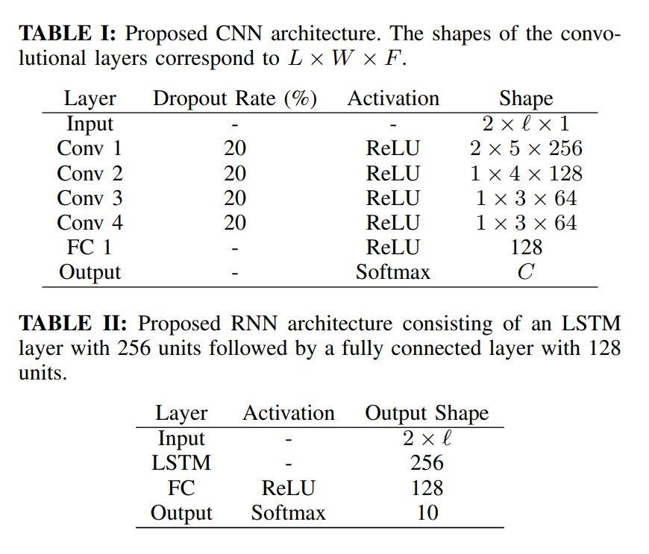
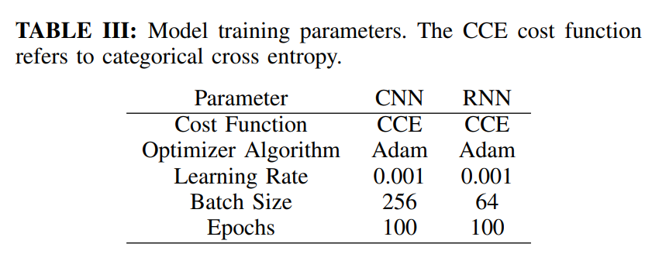
Baseline CNN & RNN
RadioML 2016.10b Dataset (1,200,000 Samples)
600,000 2×128 Wireless IQ Samples
SNRs from 0dB to 18dB
10 Modulation Schemes as True Labels
8 Digital (D) and 2 Analog (A) Constellations
BPSK (D), QPSK (D), 8PSK (D), QAM16 (D),
QAM64 (D), GFSK (D), CPFSK (D), PAM4 (D),
WB-FM (A), AM-DSB (A)
CNN Total # of Trainable Parameters = 1,130,890
RNN Total # of Trainable Parameters = 429,450

Slide 4
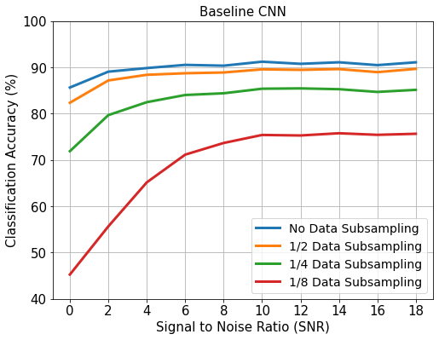
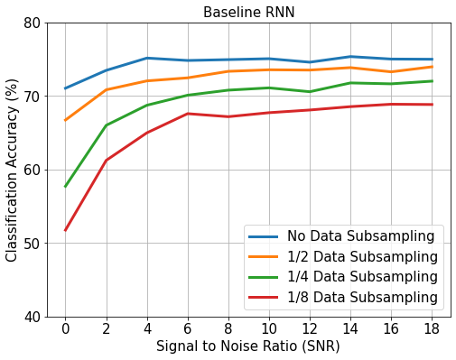
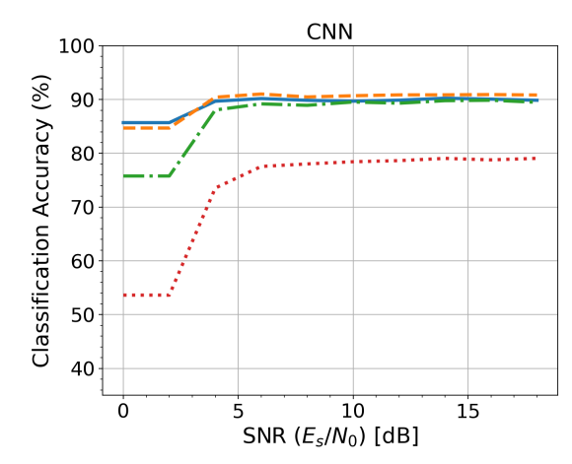
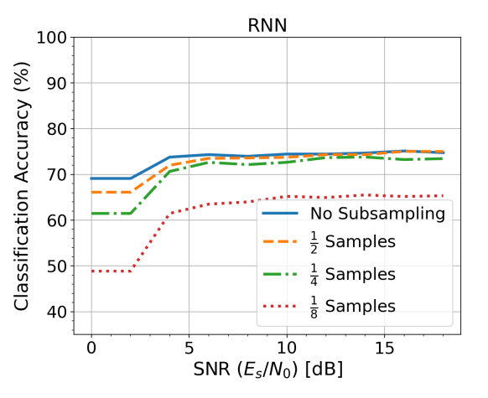
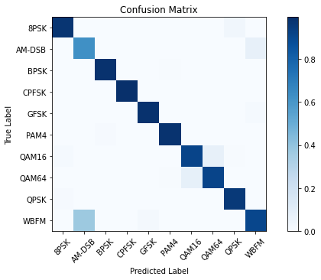
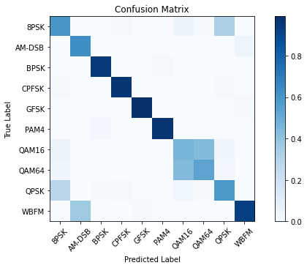
Data Subsampling
Results cited from paper [1]

Slide 5
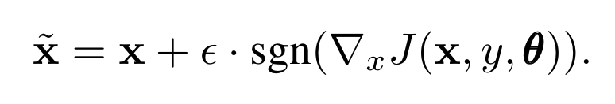

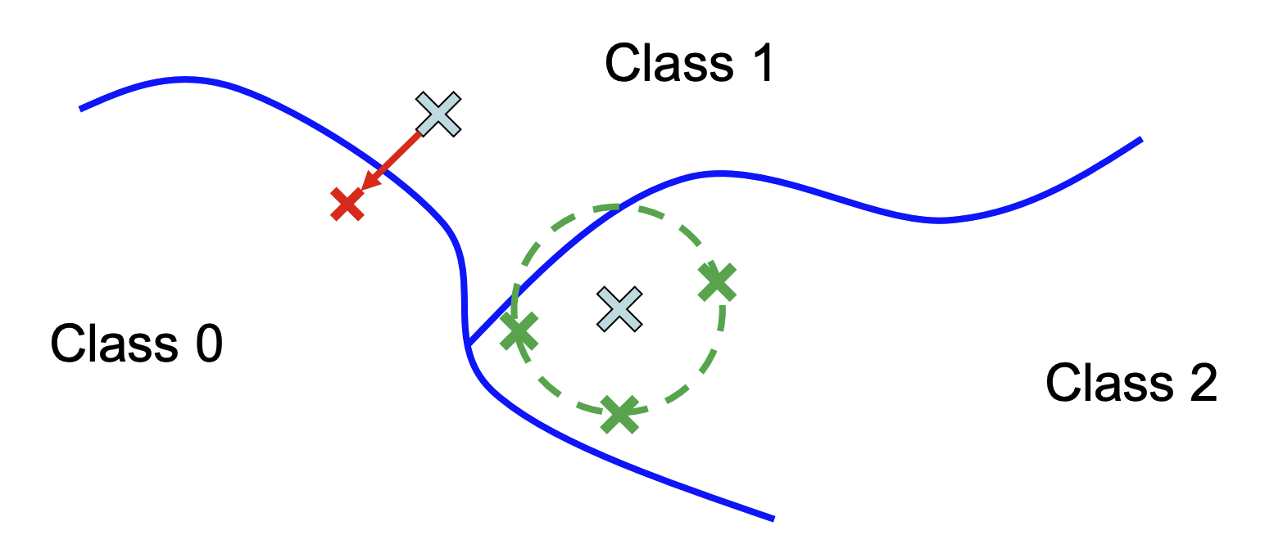
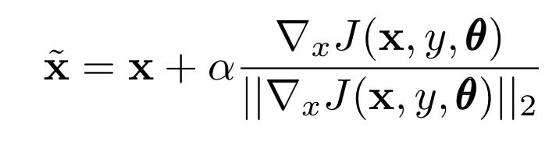

Fast Gradient Sign Method (FGSM) Attack
In training, we use gradient descent on the network’s parameters to minimize loss
In adversarial attacks, we can use gradient ascent to maximize loss
L∞-bounded attack:
input
perturbation
Here, the adversarial direction is computed as the gradient of the classification loss w.r.t. the input
L2-bounded attack:
perturbation
input
Adersarial noise
Natural noise

Slide 6
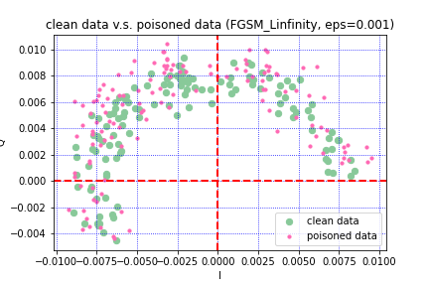
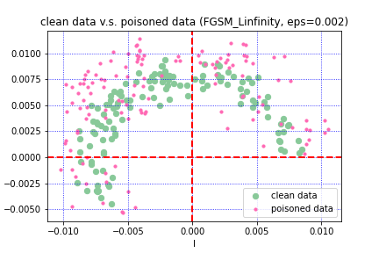
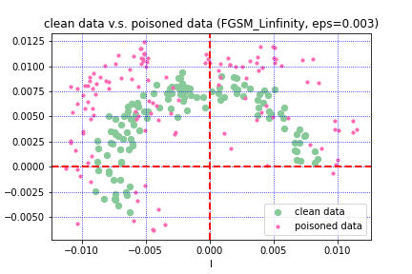
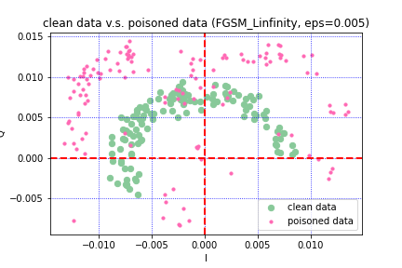
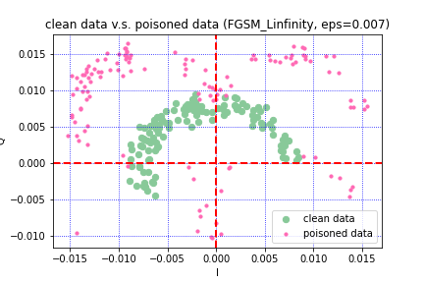
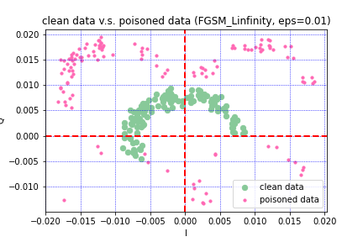
Constellation figure after FGSM Linfinity attack (GFSK)
test accuracy = 0.53
test accuracy = 0.35
test accuracy = 0.25
test accuracy = 0.15
test accuracy = 0.12
test accuracy = 0.10

Slide 7
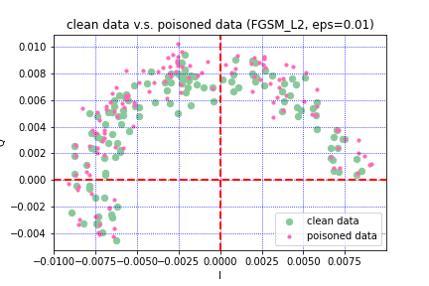
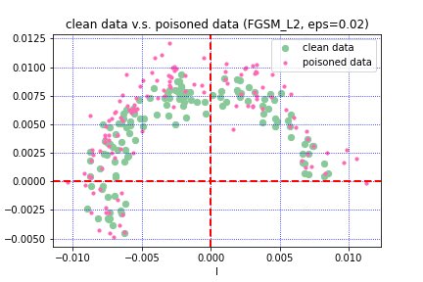
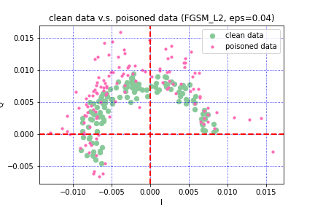
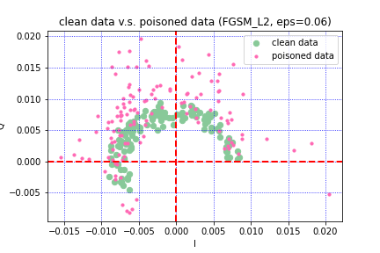
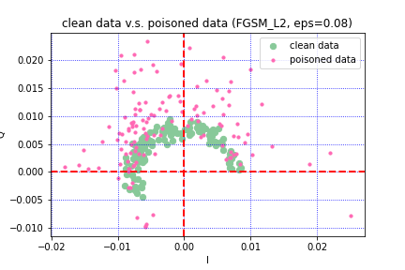
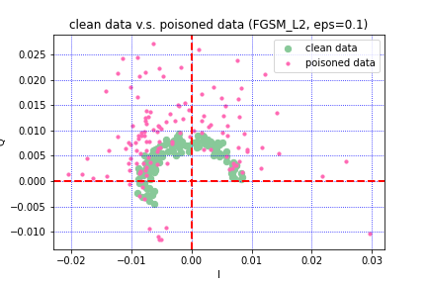
Constellation figure after FGSM L2 attack (GFSK)
test accuracy = 0.60
test accuracy = 0.50
test accuracy = 0.29
test accuracy = 0.22
test accuracy = 0.20
test accuracy = 0.19

Slide 8
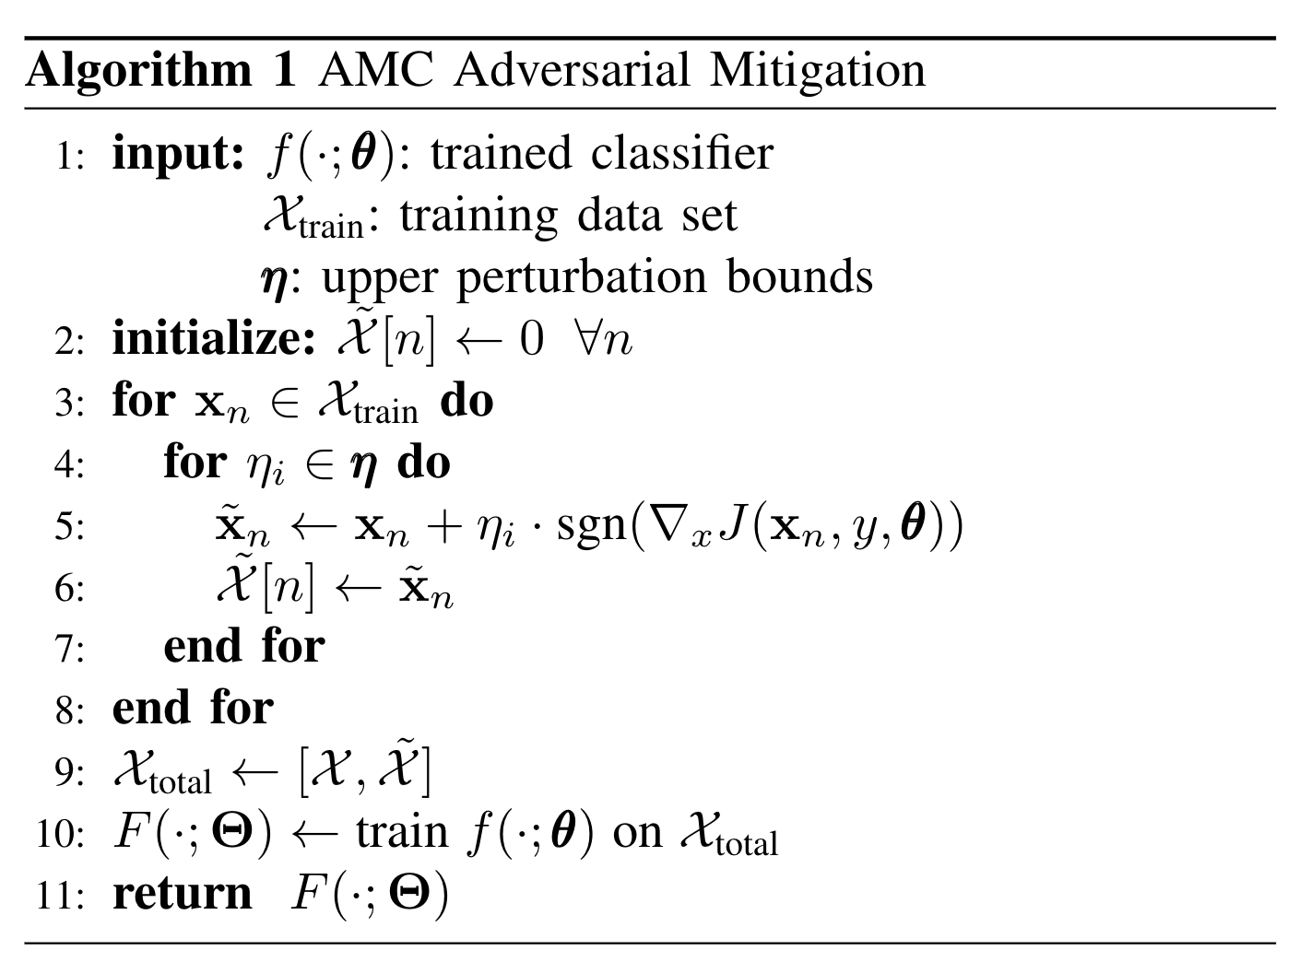
AMC Adversarial Mitigation Design

Slide 9
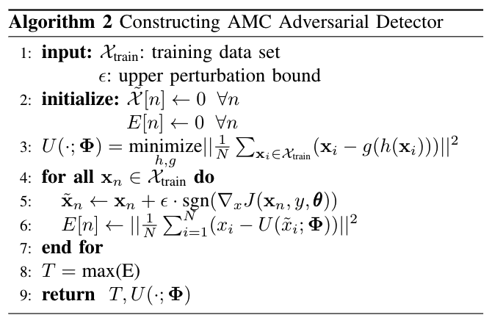
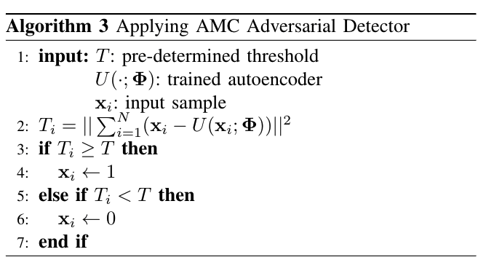
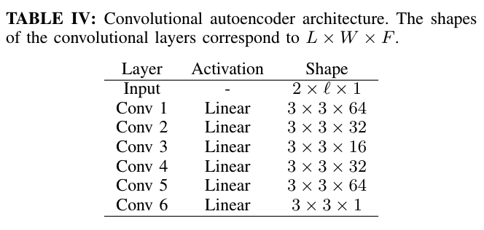
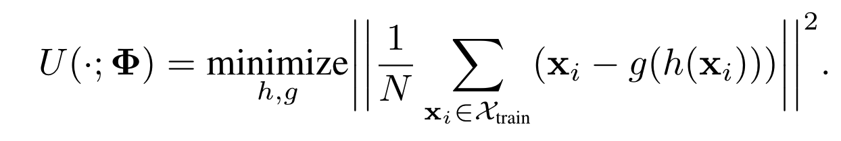
AMC Adversarial Detector Design
encoder
decoder
encoder
decoder

Slide 10
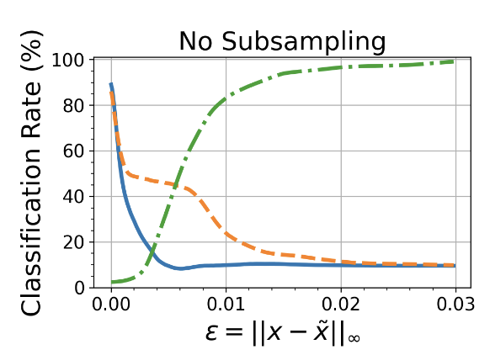
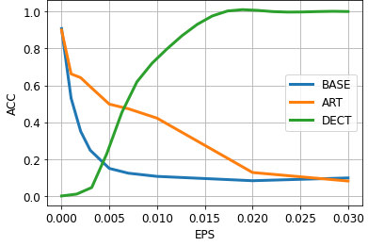
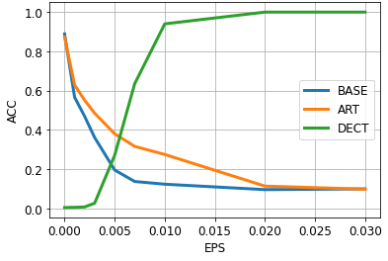
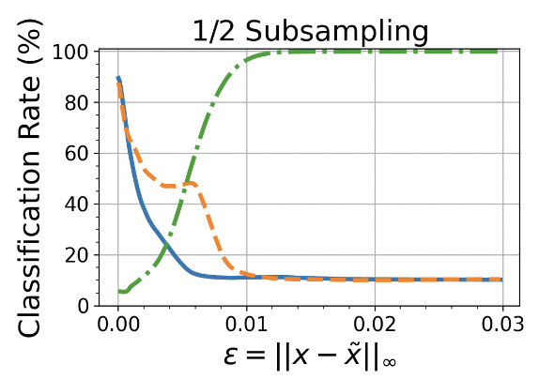
Evaluation of Defence on CNN
No Subsampling
1/2 Subsampling
our results
results
in paper
Defense effectiveness on the CNN against an L∞-bounded perturbation.

Slide 11
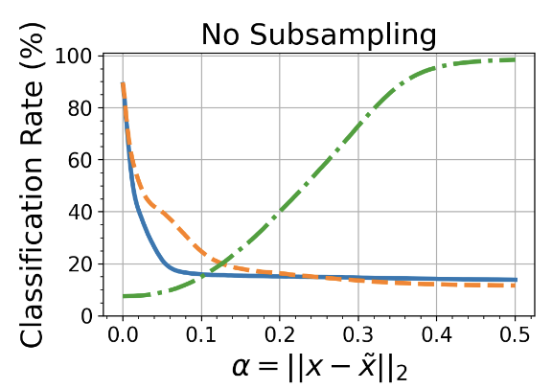
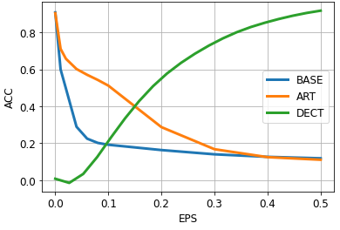
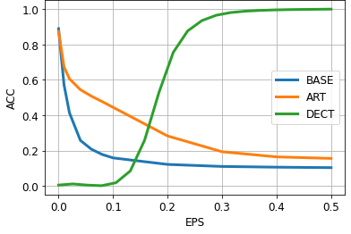
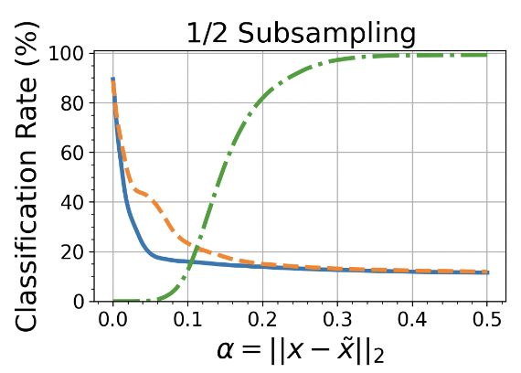
Evaluation of Defence on CNN
No Subsampling
1/2 Subsampling
our results
results
in paper
Defense effectiveness on the CNN against an L2-bounded perturbation.

Slide 12
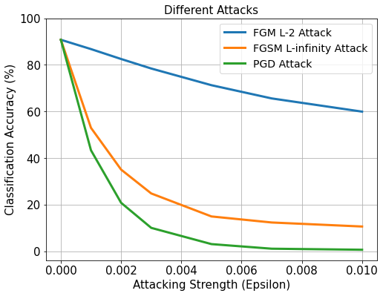
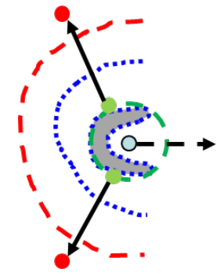
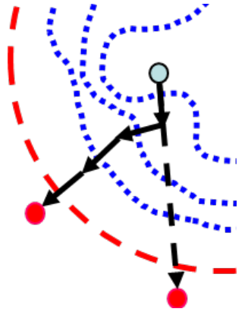
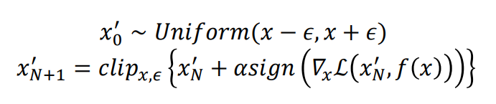
Projected Gradient Descent (PGD) Attack
FGSM attack might have gradient masking problem
Local minima of the loss function near the data point causes the FGSM direction to contradict the direction of decision boundary
PGD attack starts from a random point near the data point, and applies iterative update towards the gradient sign direction, with clipping after each iteration to enforce lower and upper perturbation bounds
FGSM is a special case of PGD attack
No random start
Only 1 iteration
ε = α

Slide 13
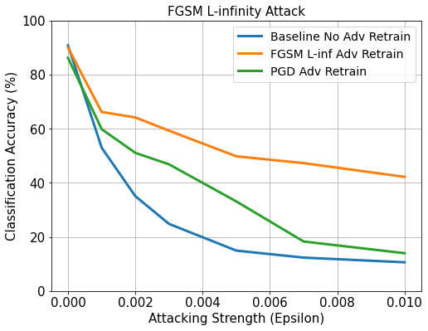
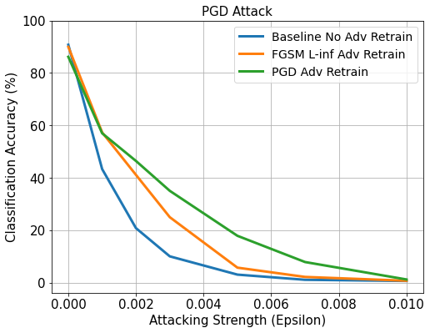
PGD-based Adversarial Retraining
PGD is a “universal” adversary among first-order (gradient based) approaches.
Theoretically, robustness to PGD allows robustness against all first-order attacks within the ε constraints
Experimentally, however…

Slide 14
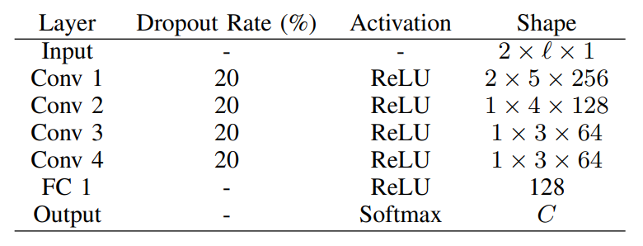
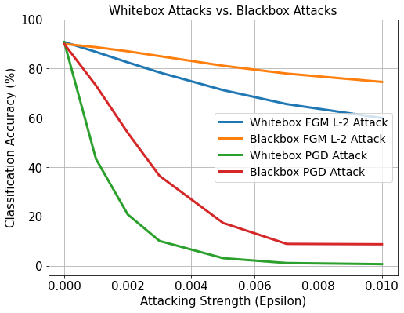
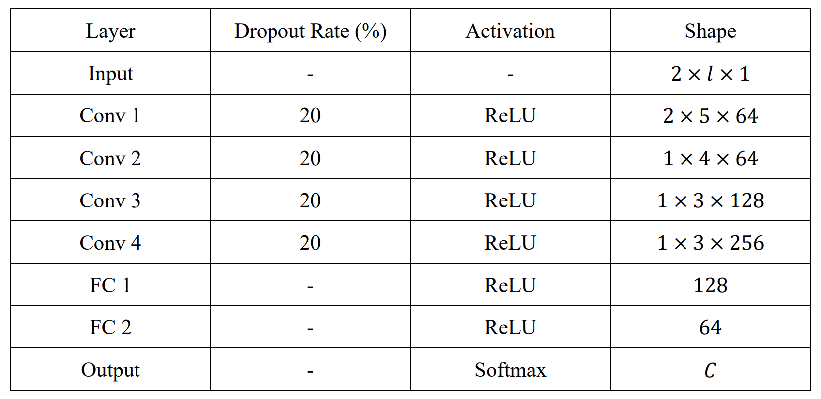
Whitebox Attacks vs. Blackbox Attacks
Old CNN, Base Acc = 90.78% (Whitebox)
Whitebox attacks assume full access to the target model including architecture and weights
Blackbox attacks assume only query access
Transfer Attacks
New CNN, Base Acc = 90.01% (Blackbox)

Slide 15
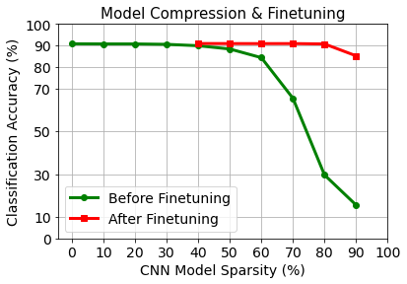
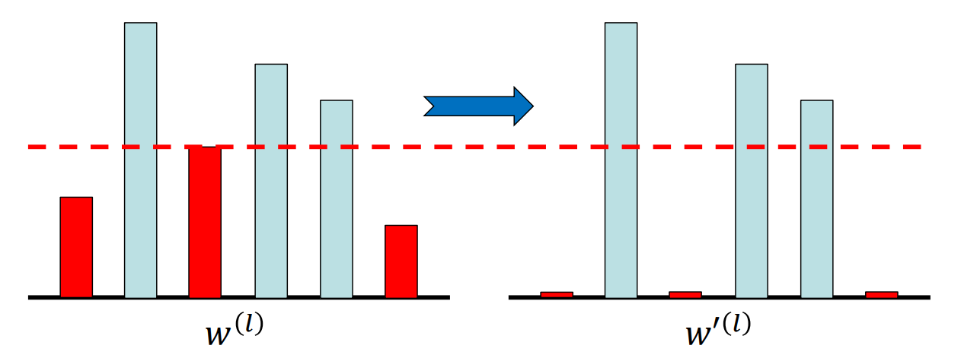
Model Compression and Finetuning
Larger weights have larger effects on the activation, and therefore more important
Prune by Percentage (Induce model sparsity)
Identify and remove “unimportant” elements
Model Finetuning (Retraining with sparse constraints)
Create a binary mask to locate large weights
High sparsity destroyed during retraining
Apply the binary mask to restore sparsity
Only finetune “important” elements
Finetune for at most 30 epochs
Significant performance improvement

Slide 16
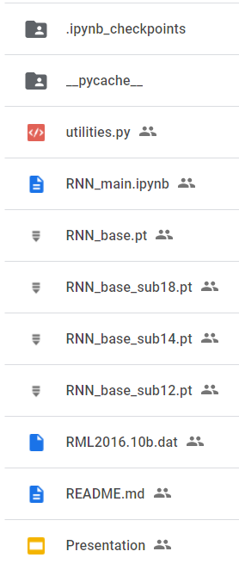
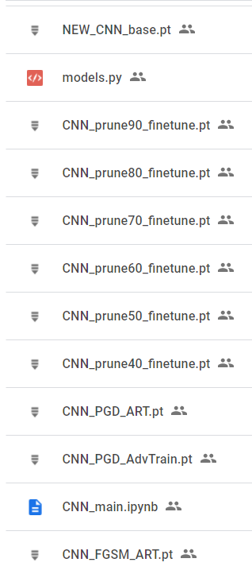
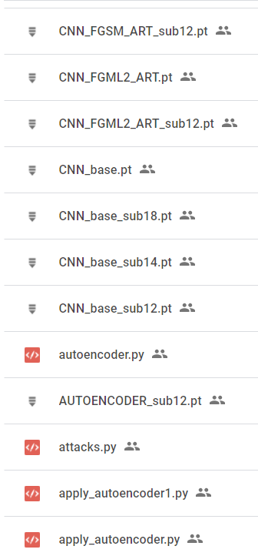
Summary
Completed re-validation work and re-produced experimental results [1]
Baseline CNN & RNN
Data Subsampling
FGSM L-infinity & FGM L-2 Attack
Mitigation & Detection Algorithms
Challenged beyond re-validation
Perturbed Data Constellation Visualization
PGD Attack & Mitigation
Whitebox vs. Blackbox Attacks
Model Compression & Finetuning
GitHub: https://github.com/baina23/Robust-AMC
Google Drive: https://drive.google.com/drive/folders/14ovsEO4oVs_uLPwlm9lHhE7jHpChzZt3?usp=sharing

Slide 17
Discussion (Q&A)
Thank You!

