Slide 1
Artwork

Slide 2

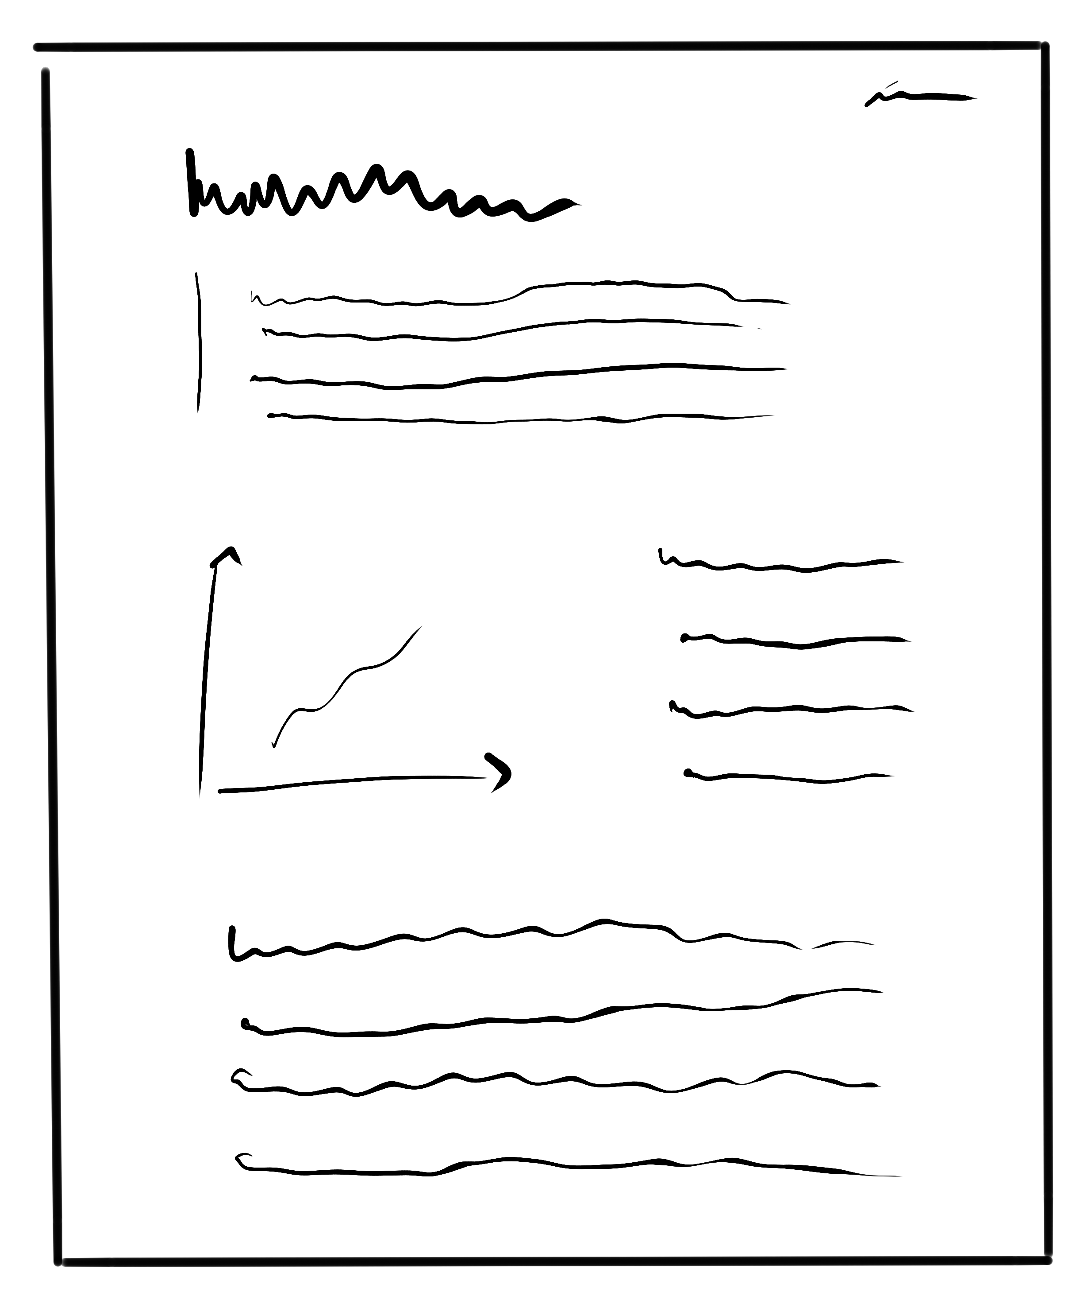

Process of transcript
Paper & Theses
Review article
Lecture
scripts
Books
One integrated net

Slide 3






Level of access
Researcher
Private
Wiki
Signature
Data

Slide 4
Level of access
Work-group
Researcher
Private
Wiki
Paper
Workgroup
Wiki
Signed from
authors
colllaborate
Data to be
published

Slide 5


Level of access
Company
Uni 2
Paper
Publishing
(on behalf of the university)
Uni 3
Peer-review
University
Work-group
Researcher
Private
Wiki
Uni-Wiki
Workgroup
Wiki

Slide 6
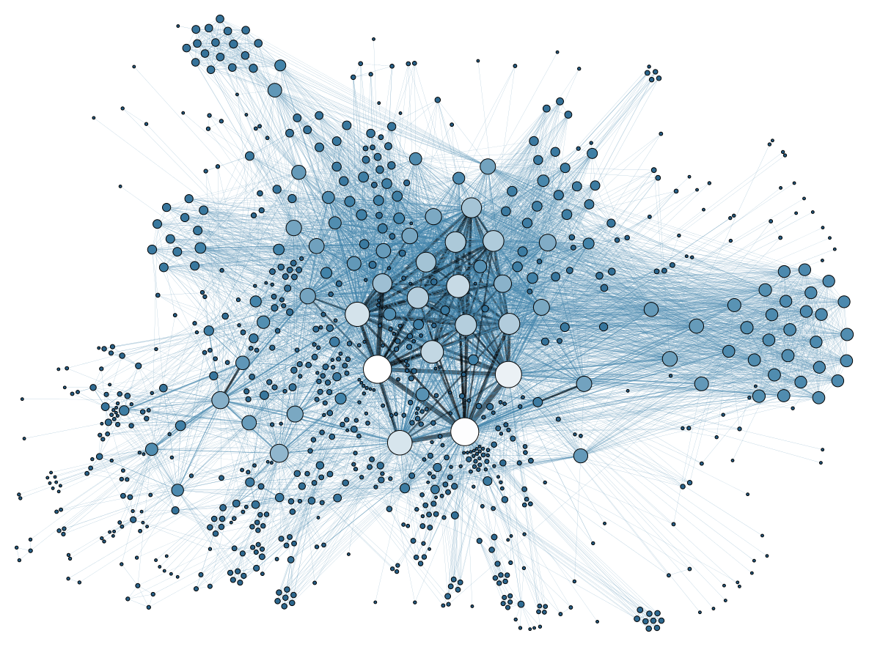
Level of access
World wide science web
Open access
Web of trust
Integrated
database

Slide 7

Why should people join?
Useful in daily life
due to Wiki, database
and easy search

Slide 8
Automatic open acces journal
Daily, weekly, monthly
& yearly
Customizable categories
Divided into research areas:
Biophysics
Astrophysics
Organic electronics
Mathematics
Citations
&
rating
...
Mixed magazines:
Physics
Health
Natural sciences

