Slide 1
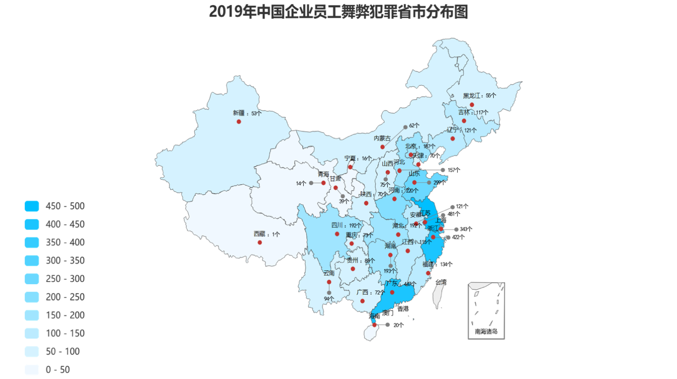
Distribution of Corruption Crimes Committed by Chinese Enterprise Employees by Provinces and Cities in 2019

Slide 2
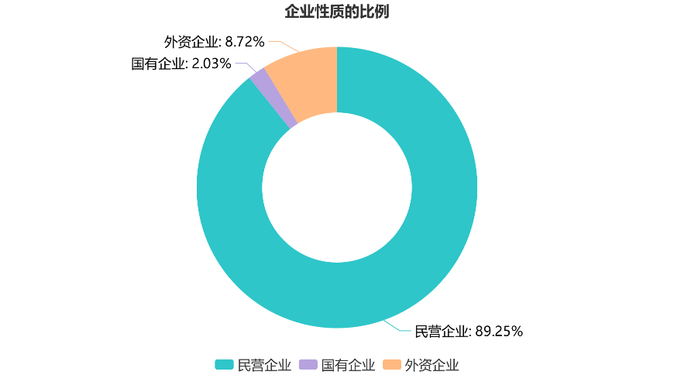
Proportions of Cases
by Nature of Enterprises
Foreign-funded enterprises: 8.72%
State-owned enterprises: 2.03%
Private enterprises: 89.25%
Private
enterprises
State-owned
enterprises
Foreign-funded
enterprises

Slide 3
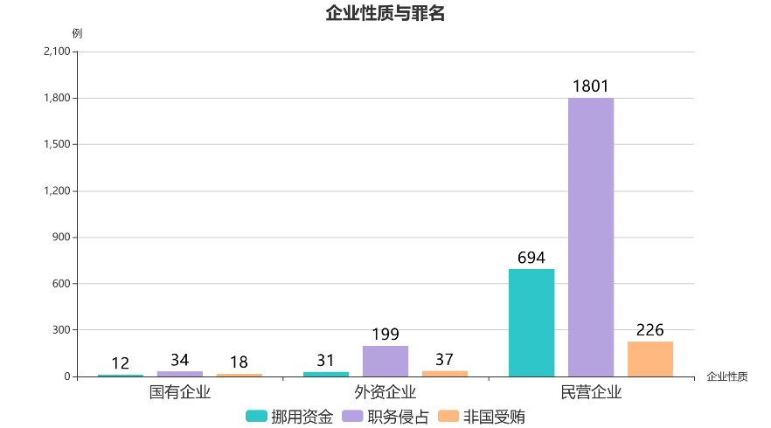
Nature of Enterprises and Crimes
Cases
Nature of enterprise
State-owned enterprises
Foreign-funded enterprises
Private enterprises
Misappropriation of funds
Occupational embezzlement
Acceptance of bribes by non-state functionaries

Slide 4
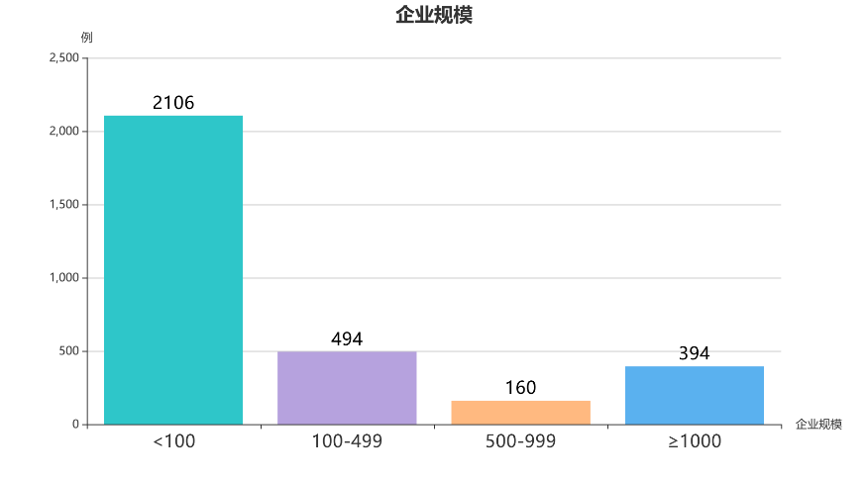
Size of Enterprises
Cases
Size of Enterprises

Slide 5
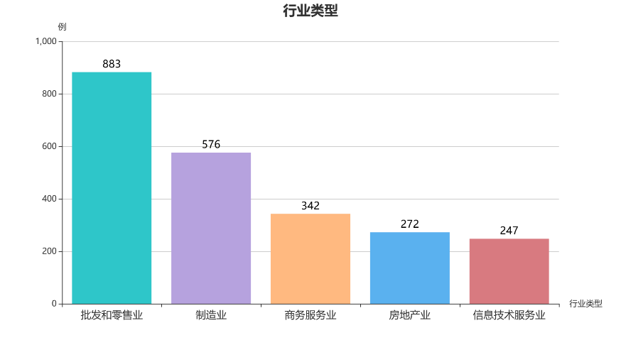
Type of Industry
Cases
Cases
Wholesale and retail
Manufacturing
Business service
Real estate
Information technology service
Type of Industry

Slide 6
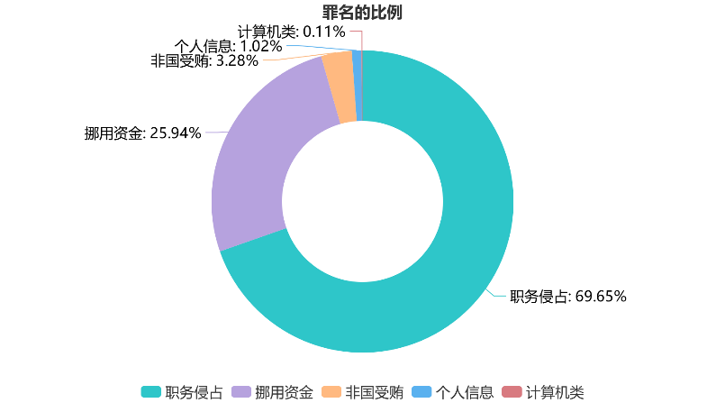
Proportions of Cases by Crimes
Computer-related corruptions: 0.11%
Infringement upon personal information: 1.02%
Acceptance of bribes by non-state functionaries: 3.28%
Misappropriation of funds: 25.94%
Occupational embezzlement: 69.65%
Occupational embezzlement
Misappropriation of funds
Acceptance of bribes by
non-state functionaries
Infringement upon personal information
Computer-related corruptions

Slide 7
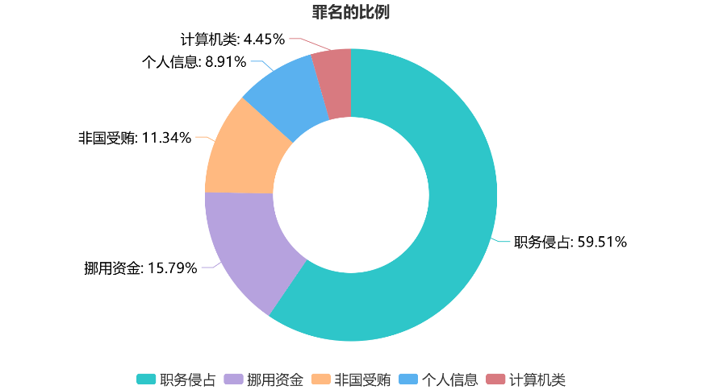
Proportions of Cases by Crimes
Computer-related corruptions: 4.45%
Infringement upon personal information: 8.91%
Acceptance of bribes by non-state functionaries: 11.34%
Occupational embezzlement: 59.51%
Misappropriation of funds: 15.79%
Occupational embezzlement
Misappropriation of funds
Acceptance of bribes by non-state functionaries
Infringement upon personal information
Computer-related corruptions

Slide 8
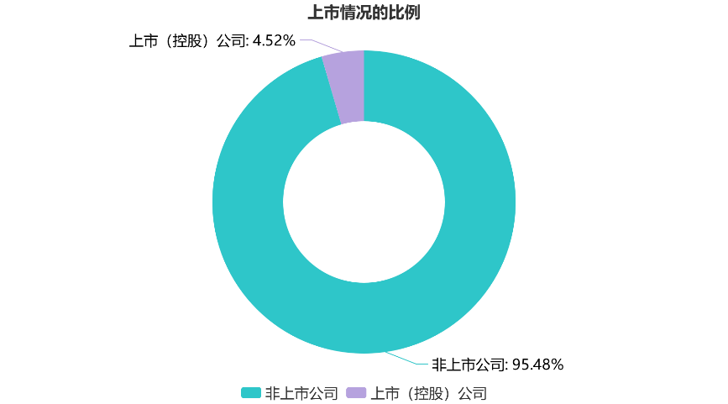
Proportions of Cases by Listing Status of Enterprises
Listed (holding) companies: 4.52%
Non-listed companies: 95.48%
Non-listed companies
Listed (holding) companies

Slide 9
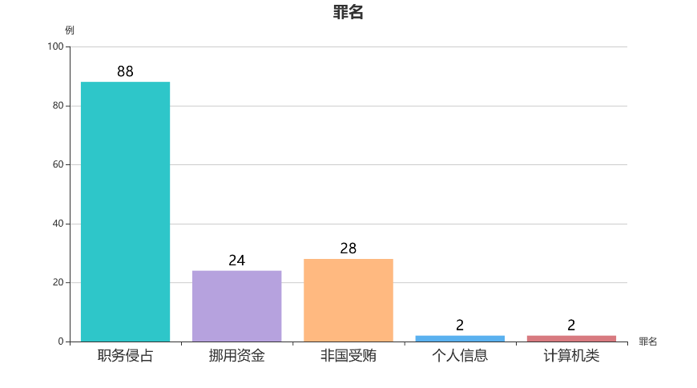
Crimes
Cases
Crimes
Occupational embezzlement
Misappropriation of funds
Acceptance of bribes by non-state functionaries
Infringement upon personal information
Computer-related corruptions

Slide 10
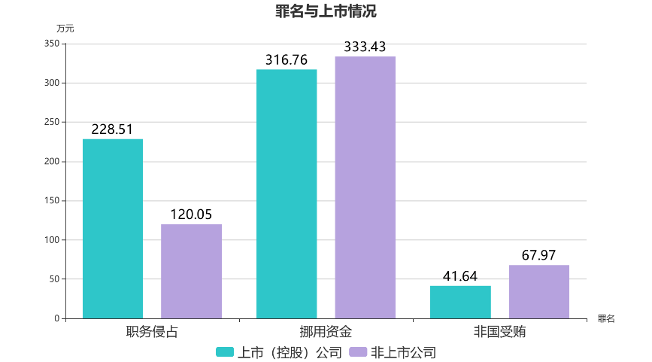
Crimes and the Listing Status of Enterprises
(RMB 10,000)
Crimes
Occupational embezzlement
Misappropriation of funds
Acceptance of bribes by non-state functionaries
Listed (holding) companies
Non-listed companies

Slide 11
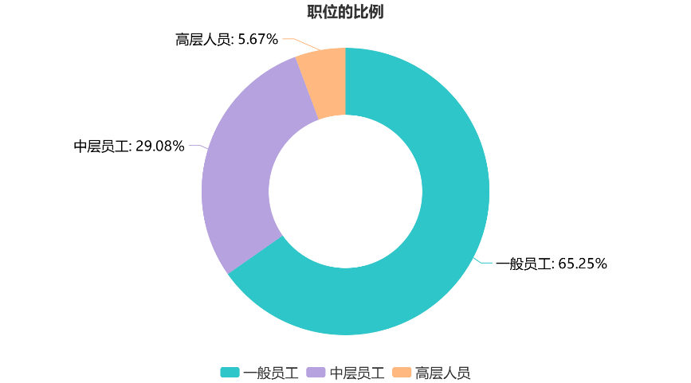
Proportions of Perpetrators by Position
Senior executives: 5.67%
Mid-level employees: 29.08%
Ordinary employees: 65.25%
Ordinary employees
Mid-level employees
Senior executives

Slide 12
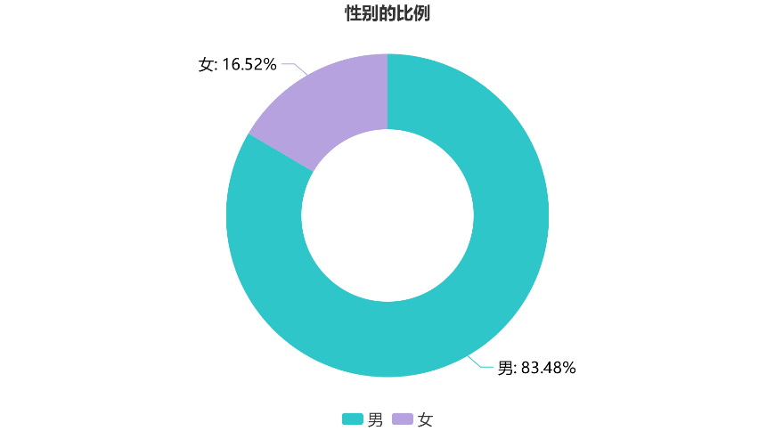
Proportions of Perpetrators by Gender
Female:16.52%
Male: 83.48%
Male
Female

Slide 13
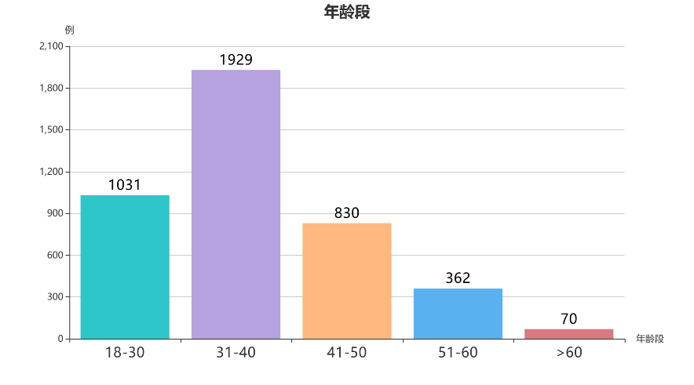
Age Group
Cases
Age Group

Slide 14
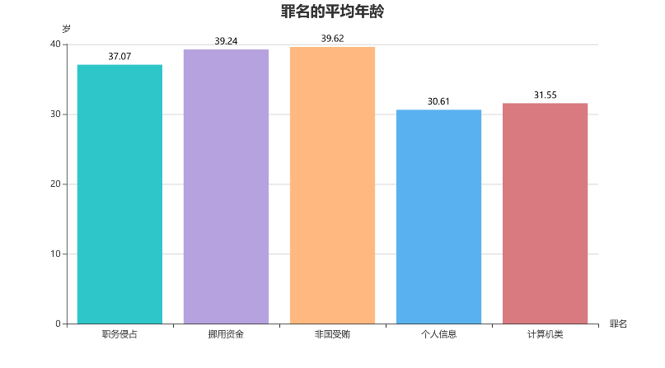
Average Age of Perpetrators by Crimes
Years
Crimes
Occupational embezzlement
Misappropriation of funds
Acceptance of bribes by non-state functionaries
Infringement upon personal information
Computer-related corruptions

Slide 15
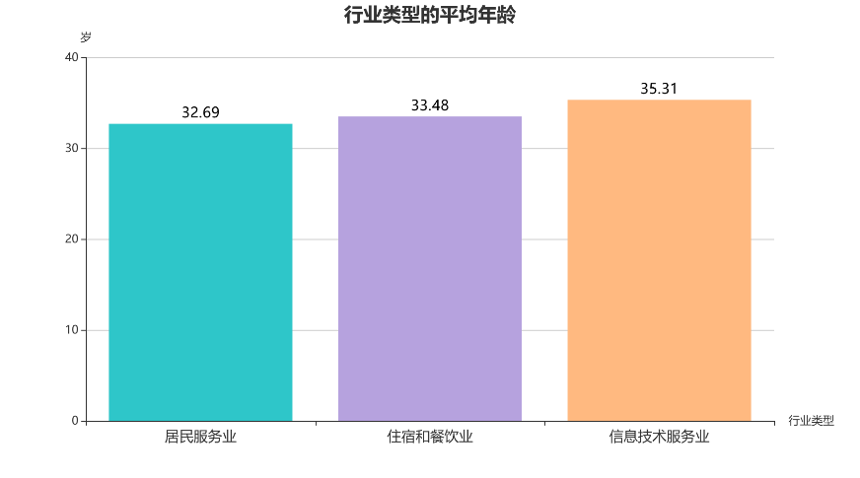
Average Age of Perpetrators by Type of Industry
Years
Type of industry
Residential service
Accommodation and catering
Information technology service

Slide 16
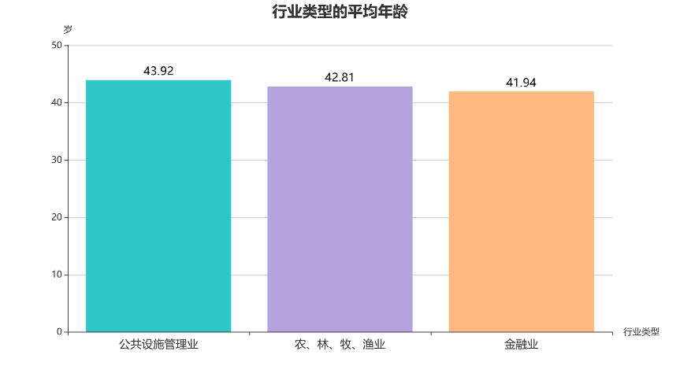
Average Age of Perpetrators by Type of Industry
Years
Type of industry
Public facilities management
Agriculture, forestry, animal husbandry, and fishery
Financial industry

Slide 17
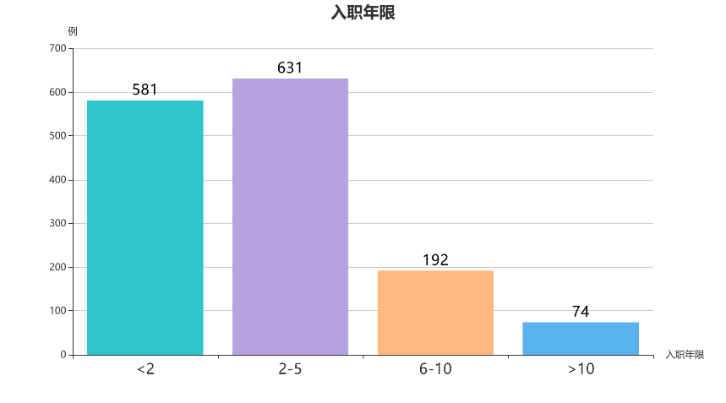
Years of Employment
Cases
Years of Employment

Slide 18
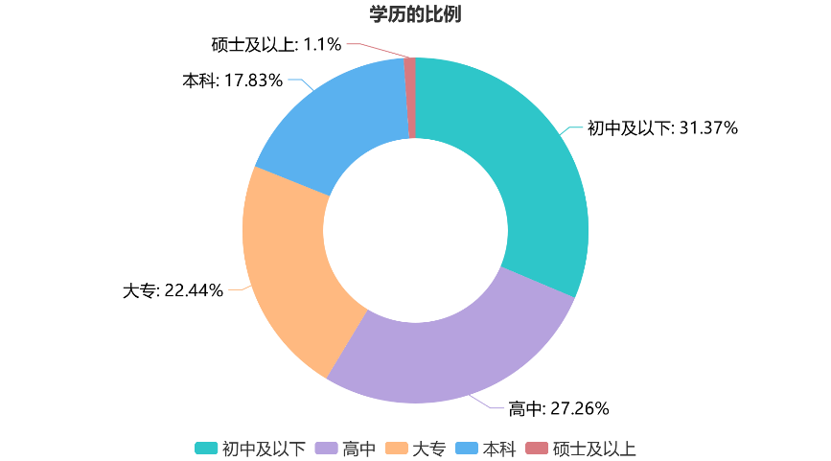
Proportions of Perpetrators by Educational Level
Master's degree or above: 1.1%
Bachelor's degree: 17.83%
Junior school degree or below: 31.37%
Junior college degree: 22.44%
High school degree: 27.26%
Junior school degree or below
High school degree
Junior college degree
Bachelor's degree
Master's degree or above

Slide 19
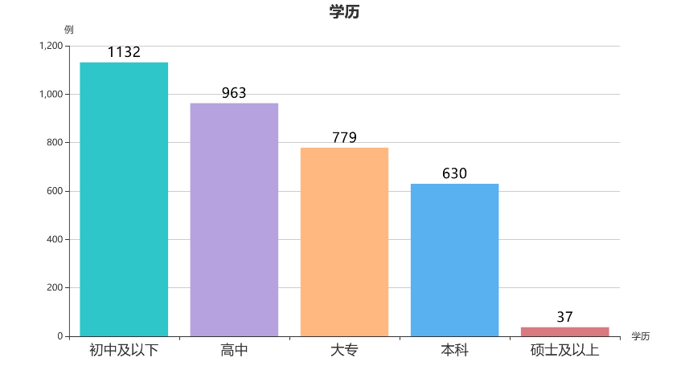
Educational Level
Cases
Educational Level
Junior school degree or below
High school degree
Junior college degree
Bachelor's degree
Master's degree or above

Slide 20
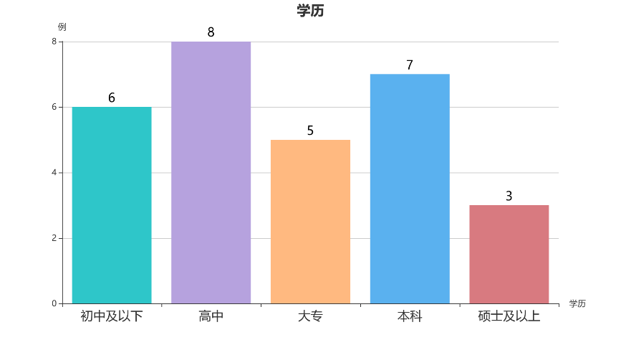
Educational Level
Cases
Educational Level
Junior school degree or below
High school degree
Junior college degree
Bachelor's degree
Master's degree or above

Slide 21
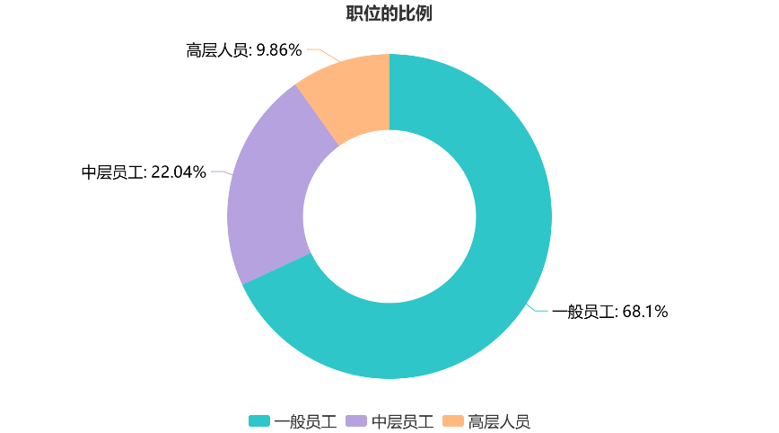
Proportions of Perpetrators by Position
Senior executives: 9.86%
Mid-level employees: 22.04%
Ordinary employees: 68.1%
Ordinary employees
Mid-level employees
Senior executives

Slide 22
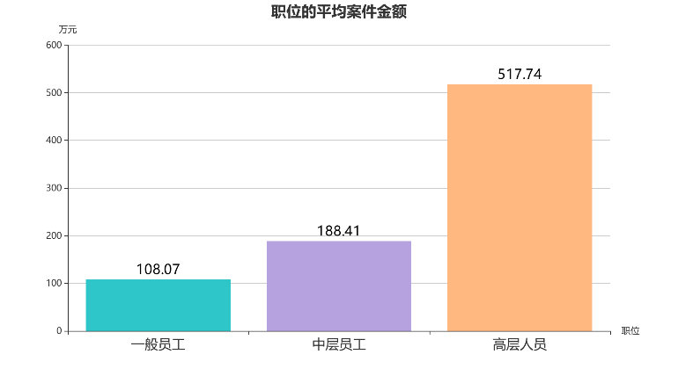
Average Case Amount by Position
(RMB 10,000)
Position
Ordinary employees
Mid-level employees
Mid-level employees

Slide 23
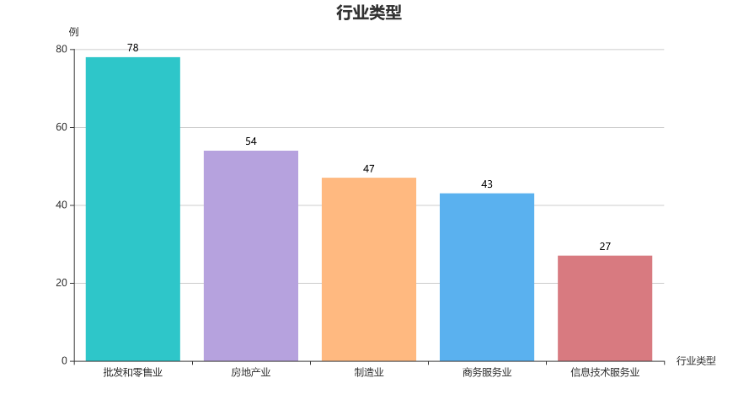
Type of Industry
Cases
Type of Industry
Wholesale and retail
Real estate
Manufacturing
Business service
Information technology service

Slide 24
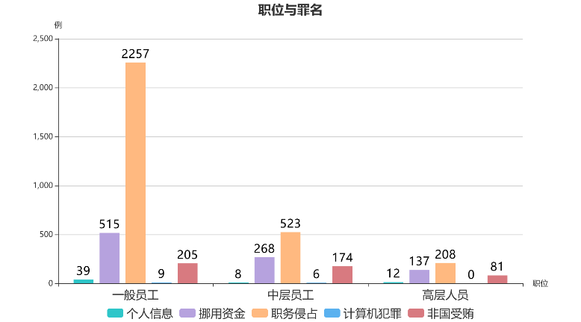
Position and crime
Cases
Positions
Ordinary employees
Mid-level employees
Senior executives
Infringement upon personal information
Misappropriation of funds
Occupational embezzlement
Computer-related corruptions
Acceptance of bribes by non-state functionaries

Slide 25
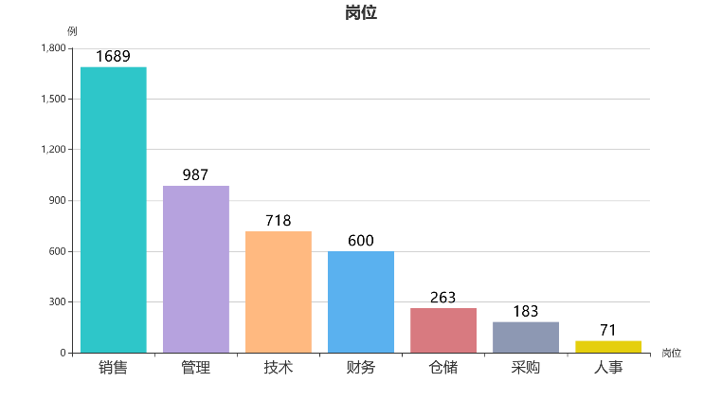
Posts
Cases
Posts
Sales
Management
Technology
Finance
Warehousing
Procurement
HR

Slide 26
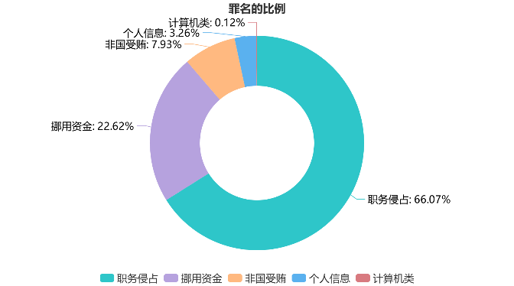
Proportions of Cases by Crimes
Computer-related corruptions: 0.12%
Infringement upon personal information: 3.26%
Acceptance of bribes by non-state functionaries: 7.93%
Misappropriation of funds: 22.62%
Occupational embezzlement: 66.07%
Occupational embezzlement
Misappropriation of funds
Acceptance of bribes by non-state functionaries
Infringement upon personal information
Computer-related corruptions

Slide 27
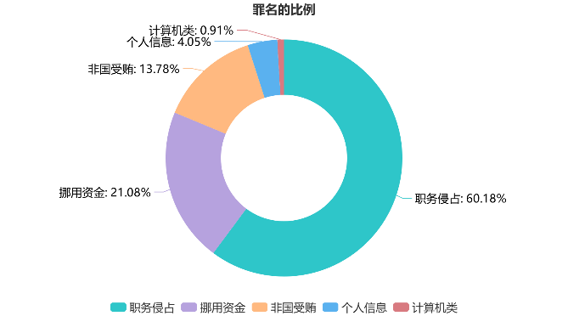
Proportions of Cases by Crimes
Computer-related corruptions: 0.91%
Infringement upon personal information:4.05%
Acceptance of bribes by non-state functionaries: 13.78%
Misappropriation of funds: 21.08%
Occupational embezzlement: 60.18%
Occupational embezzlement
Misappropriation of funds
Acceptance
of bribes by non-state functionaries
Infringement upon personal information
Computer-related corruptions

Slide 28
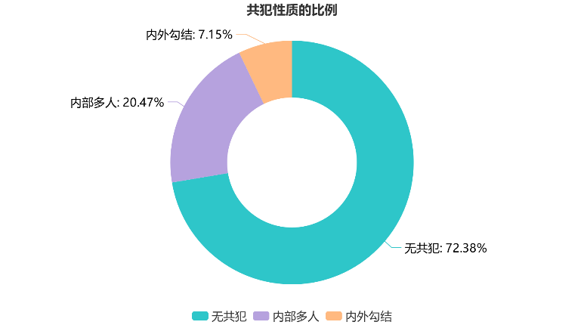
Proportions of Cases by Nature of Accomplices
Internal and external accomplices: 7.15%
Internal accomplices: 20.47%
No accomplices: 72.38%
No accomplices
Internal accomplices
Internal and external accomplices

Slide 29
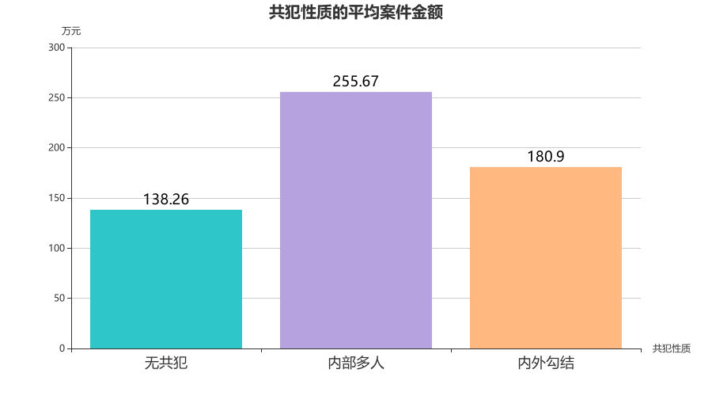
Average Amount of Cases by Nature of Accomplices
(RMB 10,000)
Nature of accomplices
No accomplices
Internal accomplices
Internal and external accomplices

Slide 30
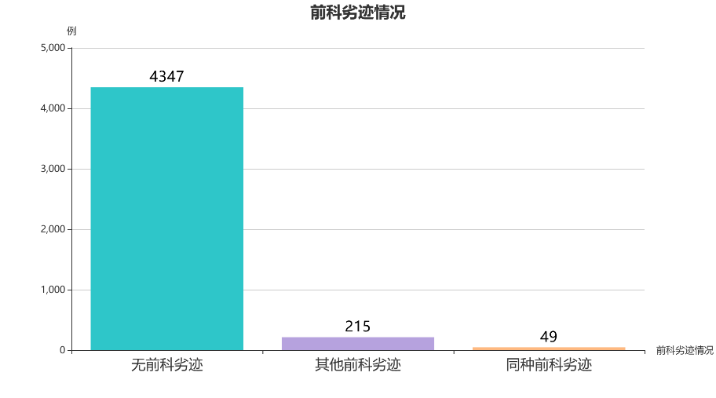
Criminal Records
Cases
Criminal records
No criminal record
Other criminal records
Same criminal records

Slide 31
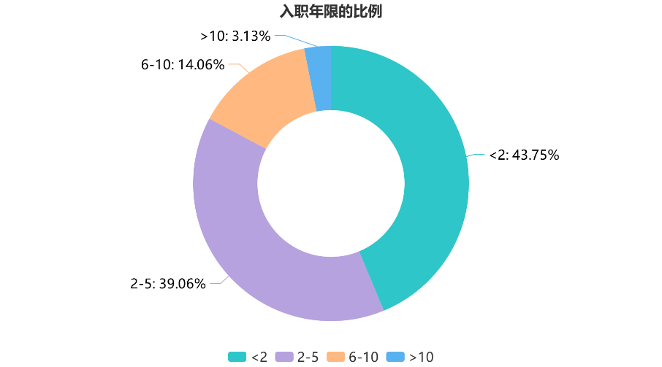
Proportions of Perpetrators by Years of Employment

Slide 32
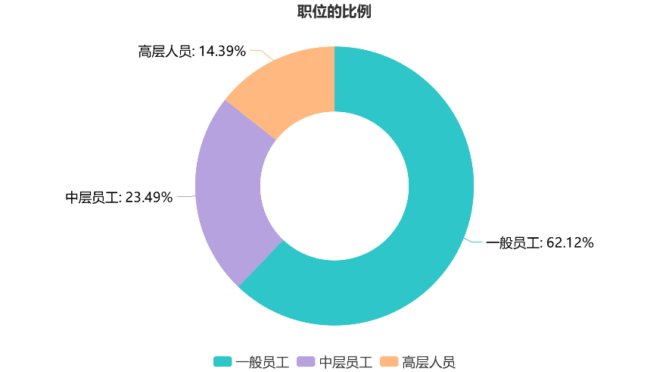
Proportions of Perpetrators by Position
Senior executives: 14.39%
Mid-level employees: 23.49%
Ordinary employees: 62.12%
Ordinary employees
Mid-level employees
Senior executives

Slide 33
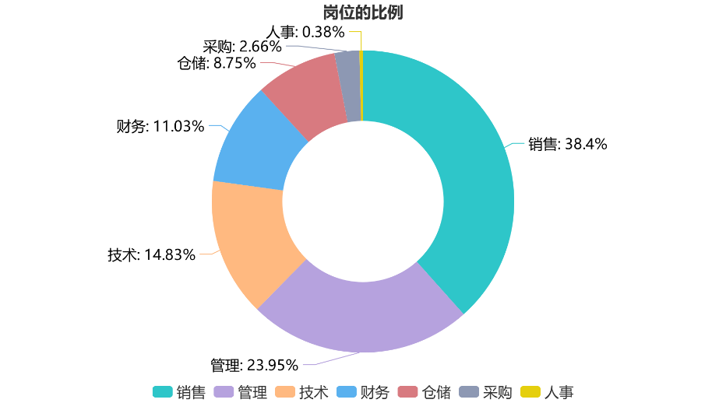
Proportions of Perpetrators by Posts
HR: 0.38%
Procurement: 2.66%
Warehousing: 8.75%
Finance: 11.03%
Sales: 38.4%
Technology: 14.83%
Management: 23.95%
Sales
Management
Technology
Finance
Warehousing
Procurement
HR

Slide 34
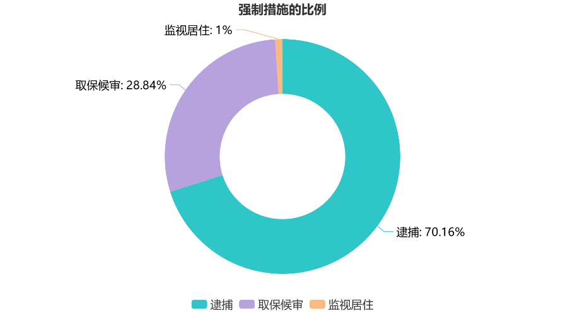
Proportions of Perpetrators by Coercive Measures
Residential surveillance: 1%
Guarantor pending trial: 28.84%
Arrest: 70.16%
Arrest
Guarantor pending trial
Residential surveillance

Slide 35
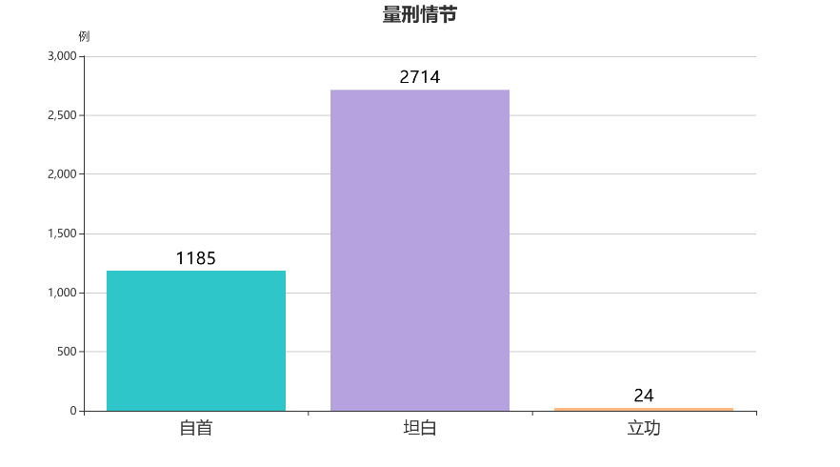
Sentencing Circumstances
Cases
Surrender
Confession
Meritorious service

Slide 36
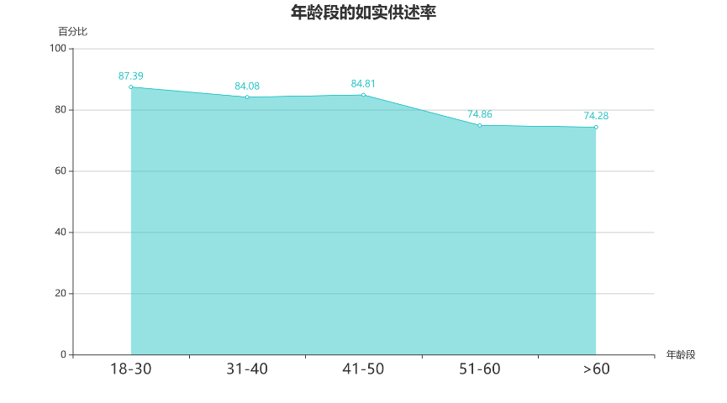
Truthful Confession Rate by Age Group
Percentage
Age Group

Slide 37
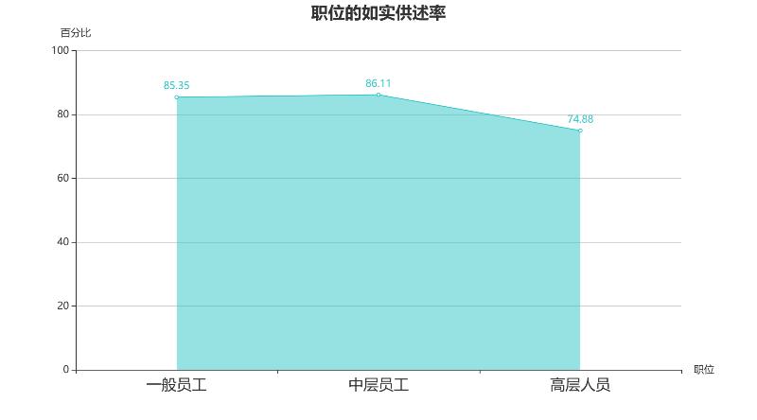
Truthful Confession Rate by Age Group
Percentage
position
Ordinary employees
Mid-level employees
Senior executives

Slide 38
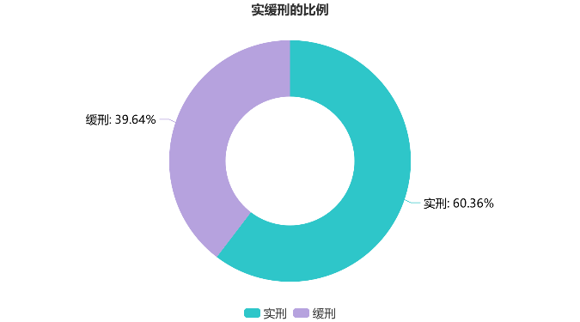
Proportions of Perpetrators by Substantial Punishment and Probation
Probation: 39.64%
Substantial punishment: 60.36%
Substantial punishment
Probation

Slide 39
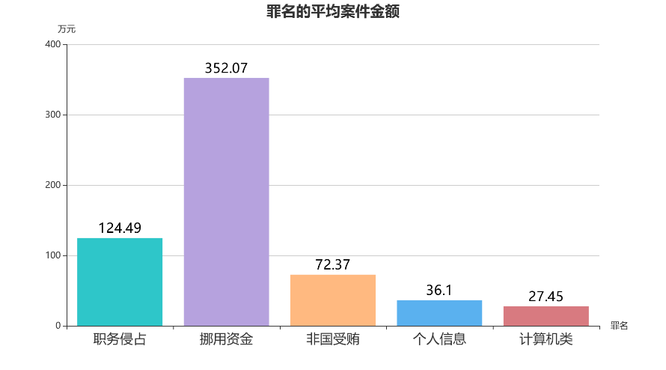
Average amount of cases by Crimes
(RMB 10,000)
Crimes
Occupational embezzlement
Misappropriation of funds
Acceptance of bribes by non-state functionaries
Infringement upon personal information
Computer-related corruptions

Slide 40
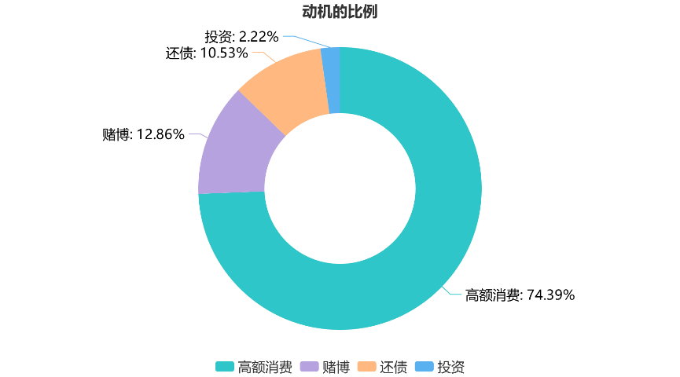
Proportions of Cases by Motives
Investment:2.22%
Debt repayment: 10.53%
Gambling: 12.86%
High consumption: 74.39%
High consumption
Gambling
Debt repayment
Investment

Slide 41
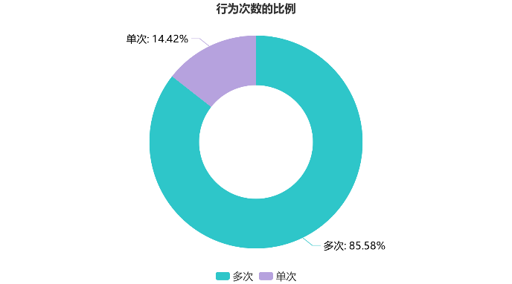
Proportions of Perpetrators by Frequency
Once: 14.42%
Multiple times: 85.58%
Multiple times
Once

Slide 42
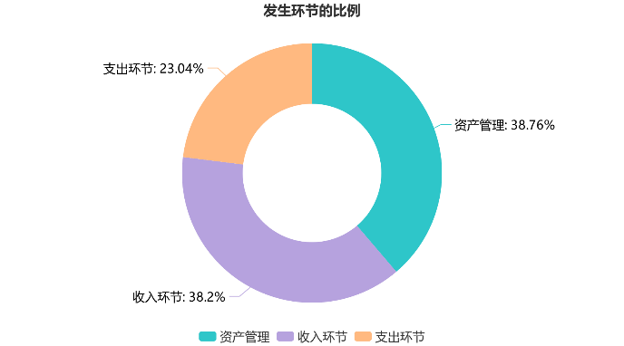
Proportions of Cases by Links of Occurrence
Expenditure: 23.04%
Asset management: 38.76%
Income: 38.2%
Asset management
Income
Expenditure

Slide 43
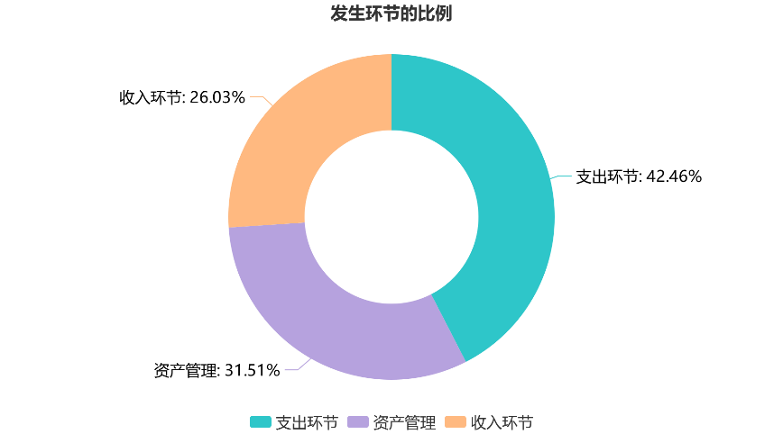
Proportions of Cases by Links of Occurrence
Income: 26.03%
Expenditure: 42.46%
Asset management: 31.51%
Income
Asset management
Expenditure

Slide 44
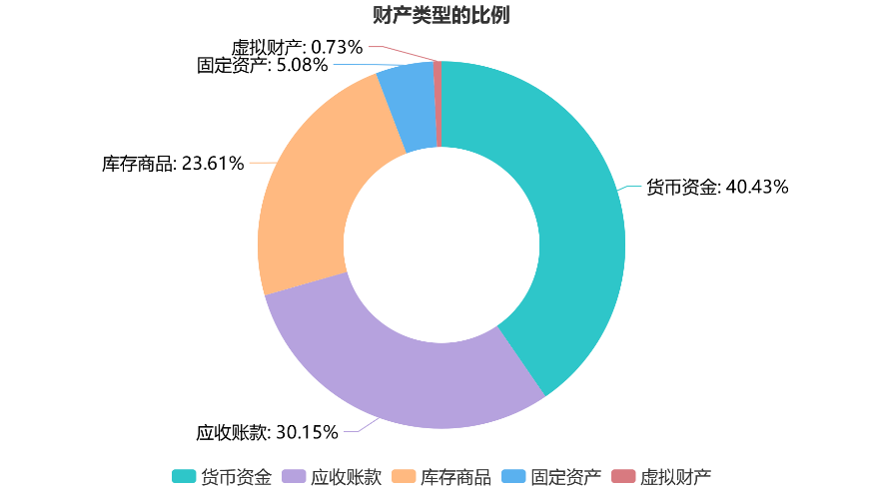
Proportions of Cases by Type of Property
Virtual property: 0.73%
Fixed property: 5.08%
Merchandise inventory: 23.61%
Monetary capital: 40.43%
Accounts receivable: 30.15%
Monetary capital
Accounts receivable
Merchandise inventory
Fixed property
Virtual property

Slide 45
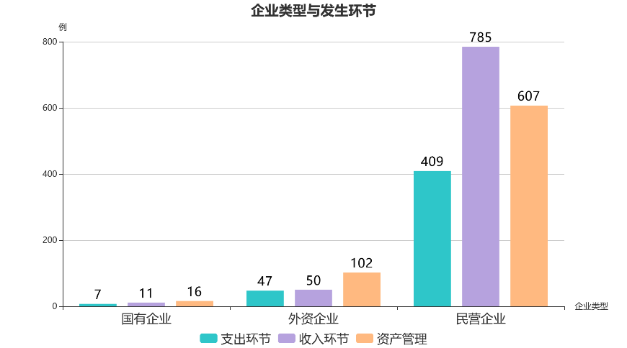
Type of Enterprises and Links of Occurrence
Cases
Type of Enterprises
state-owned enterprises
Foreign-funded enterprises
Private enterprises
Expenditure
Income
Asset management

Slide 46
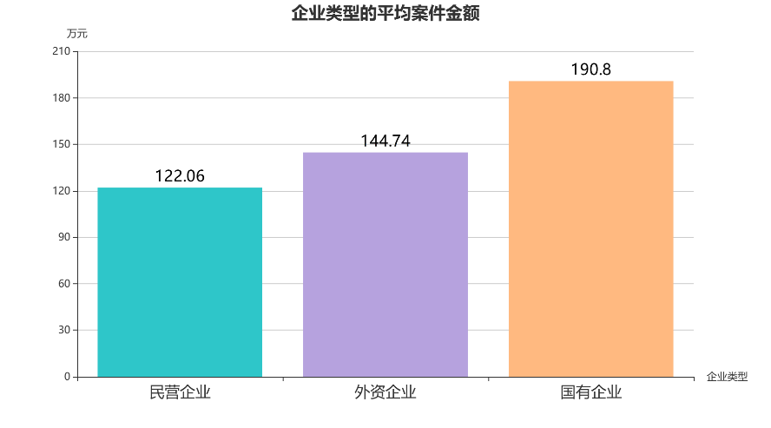
Average Case Amount by Type of Enterprises
(RMB 10,000)
Type of Enterprises
Private enterprises
Foreign-funded enterprises
state-owned enterprises

Slide 47
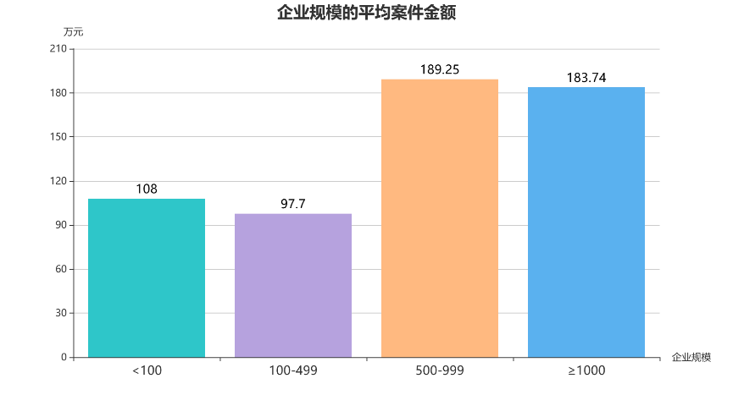
Average Case Amount by Size of Enterprises
(RMB 10,000)
Size of enterprises

Slide 48
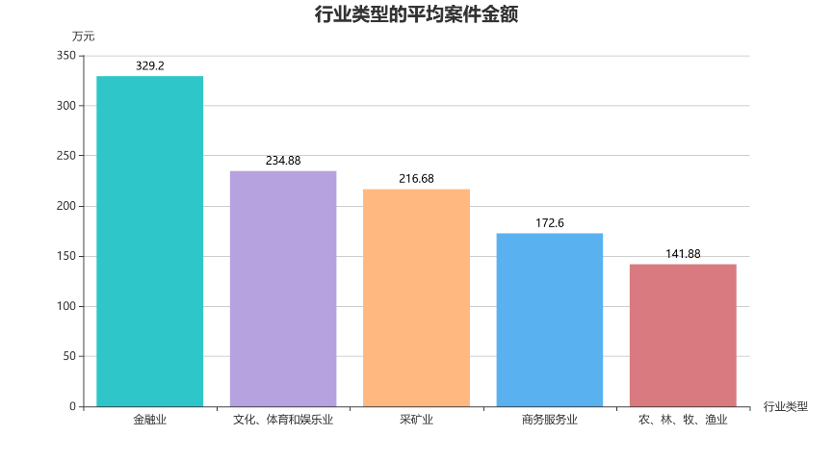
Average Case Amount by Type of Industry
(RMB 10,000)
Type of industry
Financial
Culture, sports and entertainment
Mining
Business service
Agriculture, forestry, animal husbandry, and fishery

Slide 49
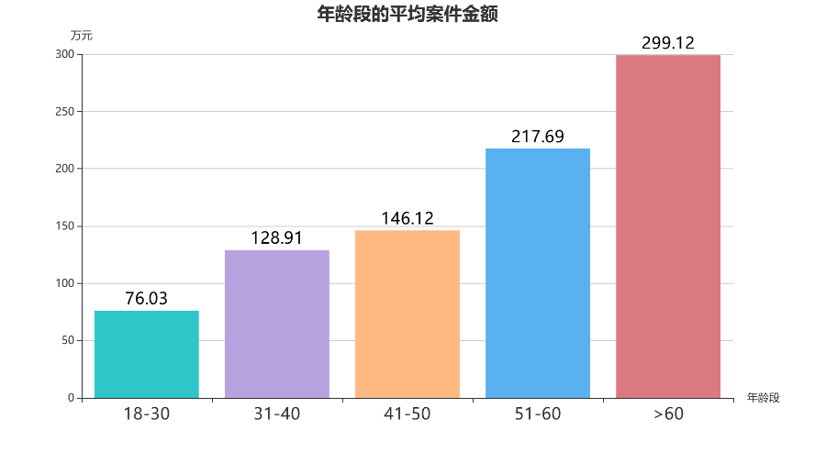
Average Case Amount by Age Group
(RMB 10,000)
Age Group

Slide 50
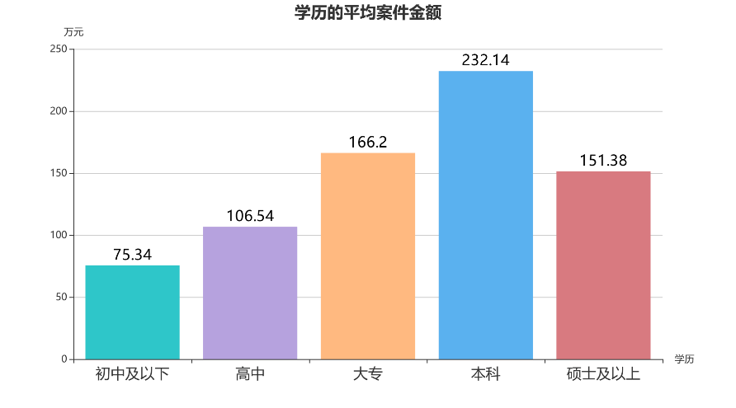
Average Case Amount by educational level
(RMB 10,000)
Educational level
Junior school degree or below
High school degree
Junior college degree
Bachelor's degree
Master's degree or above

Slide 51

Average Case Amount by Position
(RMB 10,000)
Position
Ordinary employees
Mid-level employees
Senior executives

Slide 52

Average Case Amount by the years of employment
(RMB 10,000)
Years of employment

Slide 53

Proportions of Cases by Availability of Return or Compensation
Without return or compensation: 38.02%
With return or compensation: 61.98%
With return or compensation
Without return or compensation

Slide 54

Rate of Return or Compensation by Position
percentage
Position
Ordinary employees
Mid-level employees
Senior executives

Slide 55

Principal Punishment
Cases
Principal Punishment
Exemption from punishment
Criminal detention
Less than 5 years
More than 5 years

Slide 56

Proportions of Perpetrators by Substantial Punishment and Probation
Probation: 38.12%
Substantial punishment: 61.88%
Substantial punishment
Probation

Slide 57

Percentage of Perpetrators Granted probation by Availability of Return or Compensation
Percentage
Availability of return or compensation
With return or compensation
Without return or compensation

Slide 58

Percentage of Perpetrators Granted probation by Availability of Forgiveness
Percentage
Availability of forgiveness
With forgiveness
Without forgiveness

Slide 59

Proportions of Cases by Uses of Misappropriated Funds
Loaning to others: 3.58%
Profit-making activities: 16.85%
Illegal activity: 17.72%
Personal use: 61.85%
Personal use
Illegal activity
Profit-making activities
Loaning to others

Slide 60

Uses and Age Group
Cases
Uses
Loaning to others
Personal use
Profit-making activities
Illegal activity

Slide 61

Average Case Amount by Uses
(RMB 10,000)
Uses
Illegal activity
Profit-making activities
Personal use
Loaning to others

Slide 62

Rate of Return or Compensation of Misappropriated Funds by Uses
Percentage
Uses
Personal use
Profit-making activities
Loaning to others
Illegal activity

Slide 63

Posts
Cases
Posts
Sales
Management
Finance
Technology
Procurement
Warehousing
HR

Slide 64

Proportions of Perpetrators by Frequency
Once: 11.74%
Multiple times: 88.26%
Multiple times
Once

Slide 65

Proportions of Perpetrators by Relationship of Accomplices
Relatives: 8.2%
Friends: 16.39%
Colleagues: 75.41%
Colleague
Friend
Relative

Slide 66

Average case amount by Posts
(RMB 10,000)
Posts
Sales
Procurement
Finance
Management
Technology
Warehousing
HR

Slide 67

Average Case Amount by Type of Industry
(RMB 10,000)
Culture, sports and entertainment
Real estate
Manufacturing
Construction
Financial
Type of industry

Slide 68

Average Case Amount by Type of Property
(RMB 10,000)
Type of property
Monetary capital
Accounts receivable
Merchandise inventory
Fixed assets

Slide 69

Average Case Amount by Age Group
(RMB 10,000)
Age Group

Slide 70

Average Case Amount by the years of employment
(RMB 10,000)
Years of employment

Slide 71

Average Case Amount by the Size of Enterprises
(RMB 10,000)
Size of enterprises

Slide 72

Average Case Amount by the Educational Level
(RMB 10,000)
Educational Level
Junior school degree or below
High school degree
Junior college degree
Bachelor's degree
Master's degree or above

Slide 73

Proportions of Perpetrators by Position
(RMB 10,000)
Position
Ordinary employees
Mid-level employees
Senior executives

Slide 74

Coercive Measures
Cases
Coercive Measures
Arrest
Guarantor pending trial
Residential surveillance

Slide 75

Principal Punishment
Cases
Principal Punishment
Criminal detention
Less than 3 years
3 to 10 years

Slide 76

Percentage of Perpetrators Granted probation by Availability of Forgiveness
Percentage
Availability of forgiveness
With forgiveness
Without forgiveness

Slide 77

Rate of Return or Compensation of Misappropriated Funds by Uses
Percentage
Personal use
Loaning to others
Uses
Illegal activity
Profit-making activities

Slide 78

Proportions of Perpetrators by Substantial Punishment and Probation
Probation: 48.29%
Substantial punishment: 51.71%
Substantial punishment
Probation

Slide 79

Proportions of Perpetrators by Relationship of Accomplices
Relatives: 3.35%
Friends: 6.7%
Business partners: 10.62%
Colleagues: 79.33%
Colleagues
Business partners
Friends
Relatives

Slide 80

Proportions of Perpetrators by Sources of Bribes
Colleagues: 4.14%
Distributors: 15.9%
Suppliers: 49.89%
Purchasers: 30.07%
Suppliers
Purchasers
Distributors
Colleagues

Slide 81

Proportions of Cases by Ways of Accepting Bribes
Equity: 0.43%
Physical delivery: 1.74%
Cash: 28.26%
Transfer: 69.57%
Transfer
Cash
Physical delivery
Equity

Slide 82

Type of Industry
Cases
Type of Industry
Manufacturing
Real estate
Business service
Wholesale and retail
Financial

Slide 83

Proportions of Perpetrators by Frequency
Once: 7.83%
Multiple times: 92.17%
Multiple times
Once

Slide 84

Type of Enterprises and Links of Occurrence
(RMB 10,000)
Type of Enterprises
Private enterprises
Foreign-funded enterprises
state-owned enterprises

Slide 85

Average Case Amount by Type of Industry
(RMB 10,000)
Business service
Type of industry
Information technology service
real estate
wholesale and retail
Public facilities management

Slide 86

Average Case Amount by Size of Enterprises
(RMB 10,000)
Size of enterprises

Slide 87

Average Amount of Cases by position Educational Level
(RMB 10,000)
Educational Level
Junior school degree or below
High school degree
Junior college degree
Bachelor's degree
Junior college degree

Slide 88

Average Amount of Cases by position Age Group
(RMB 10,000)
Age Group

Slide 89

Average Amount of Cases by position Years of Employment
(RMB 10,000)
Years of Employment

Slide 90

Average Amount of Cases by position
(RMB 10,000)
Position
Ordinary employees
Mid-level employees
Senior executives

Slide 91

Average case amount by Posts
(RMB 10,000)
Post
Sales
Procurement
Finance
Management
Technology
Warehousing
HR

Slide 92

Rate of Return or Compensation by Position
Percentage
Position
Ordinary employees
Mid-level employees
Senior executives

Slide 93

Principal Punishment
Cases
Criminal detention
Less than 5 years
More than 5 years
Principal Punishment

Slide 94

Proportions of Perpetrators by Substantial Punishment and Probation
Substantial punishment:49.35%
Probation:50.65%
Probation
Substantial punishment

Slide 95

Type of Industry
Cases
Type of Industry
Business service
Information technology service
Real estate
Wholesale and retail
Financial industry

Slide 96

Proportions of Cases by Type of Information
Financial customer information:12.77%
Owner's personal information:87.23%
Owner's personal information
Financial customer information

Slide 97

Type of Enterprises
Cases
Type of Enterprises
Private enterprises
Foreign-funded enterprises

Slide 98

Average terms of sentences by position
(RMB 10,000)
Position
Ordinary employees
Mid-level employees
Senior executives

Slide 99

Proportions of Cases by Uses of Information
Information exchange:5.88%
Knowledge sharing:14.12%
Sale for profit:80%
Sale for profit
Knowledge sharing
Information exchange

Slide 100

Average Case Amount by Position
(RMB 10,000)
Position
Ordinary employees
Mid-level employees
Senior executives

Slide 101

Principal Punishment
Cases
Criminal detention
Less than 3 years
3 to 7 years
Principal Punishment

Slide 102

Type of Industry
Cases
Type of Industry
Information technology service
Manufacturing
Wholesale and retail
Transportation, wholesale and postal industry

Slide 103

Proportions of Perpetrators by Educational Level
Master's degree or above: 10.34.1%
Junior school degree or below: 20.69%
Bachelor's degree: 24.14%
High school degree: 27.59%
Junior college degree: 17.24%
Junior school degree or below
High school degree
Junior college degree
Bachelor's degree
Master's degree or above

Slide 104

Crimes
Cases
Crimes
Access
Control
Damaging

Slide 105

Proportions of Perpetrators by Principal Punishment
3 to 7 years:43.75%
Less than 3 years:56.25%
Less than 3 years
3 to 7 years

Slide 106

Proportions of Cases by Availability of Return or Compensation
With compensation:43.75%
Without compensation:56.25%
With compensation
Without compensation

