Slide 1
House of Congress SPRINT 2
Daryna Aloff – Project Manager
Gaziz Mailibai – Scrum Master
Sean Campbell – Programmer 2
Jeremy Tucker – Programmer 1
Richard Jan – QA

Slide 2
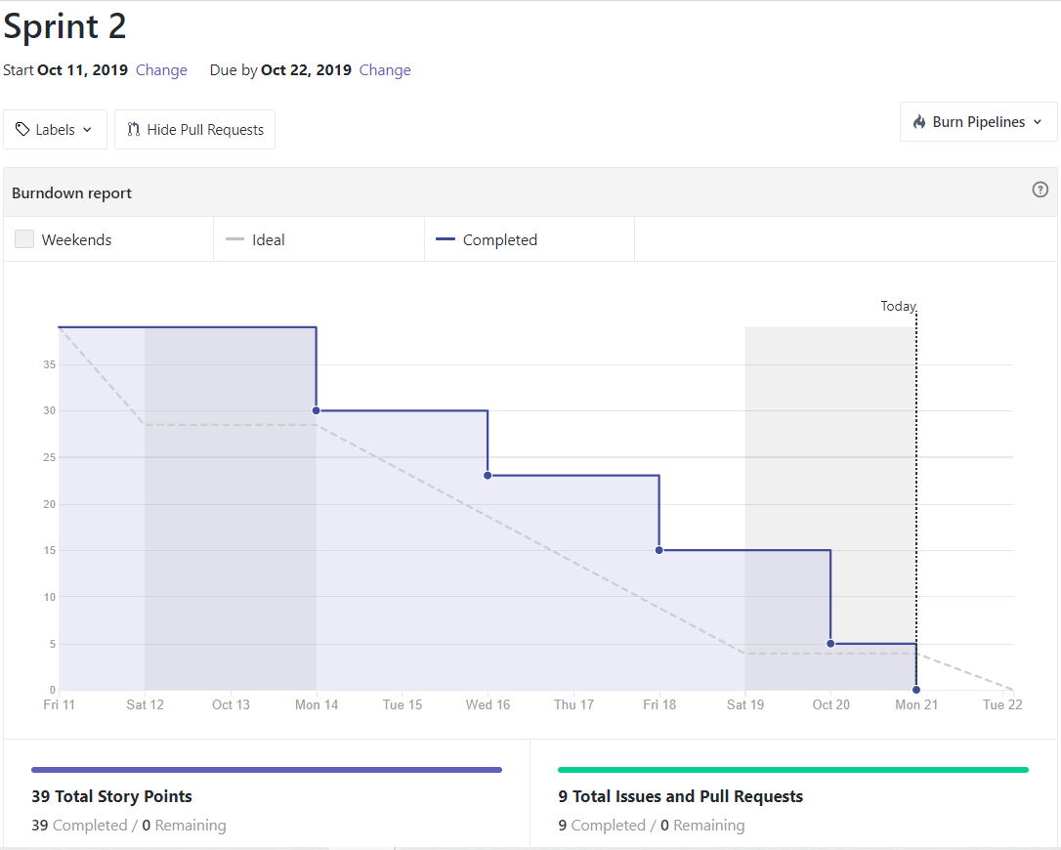
Burndown chart

Slide 3
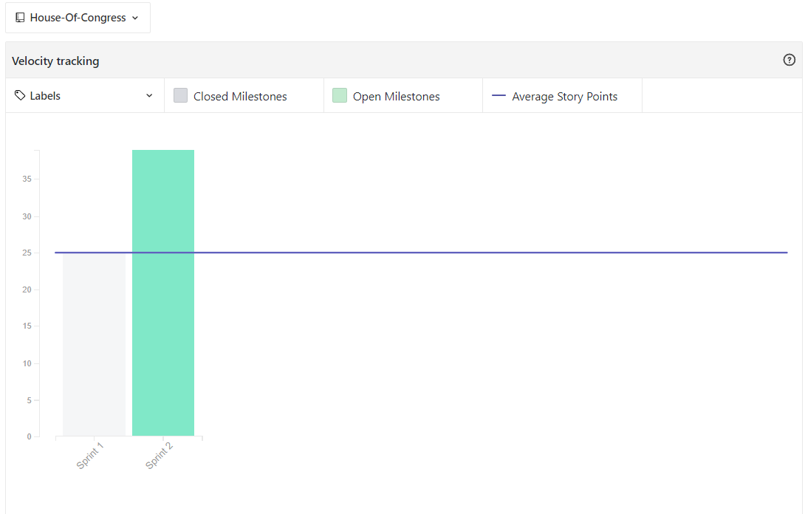
Velocity chart

Slide 4
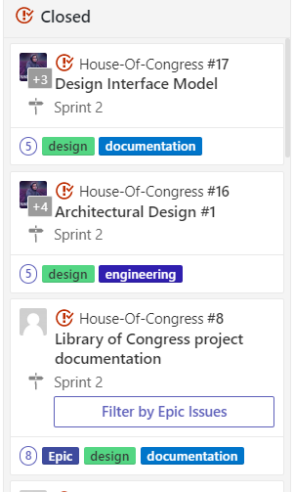
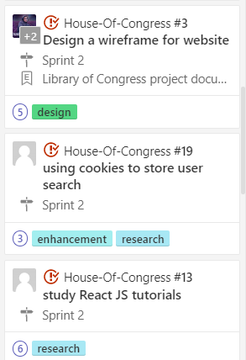
Completed stories

Slide 5
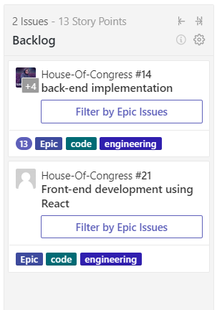
Backlog stories

Slide 6
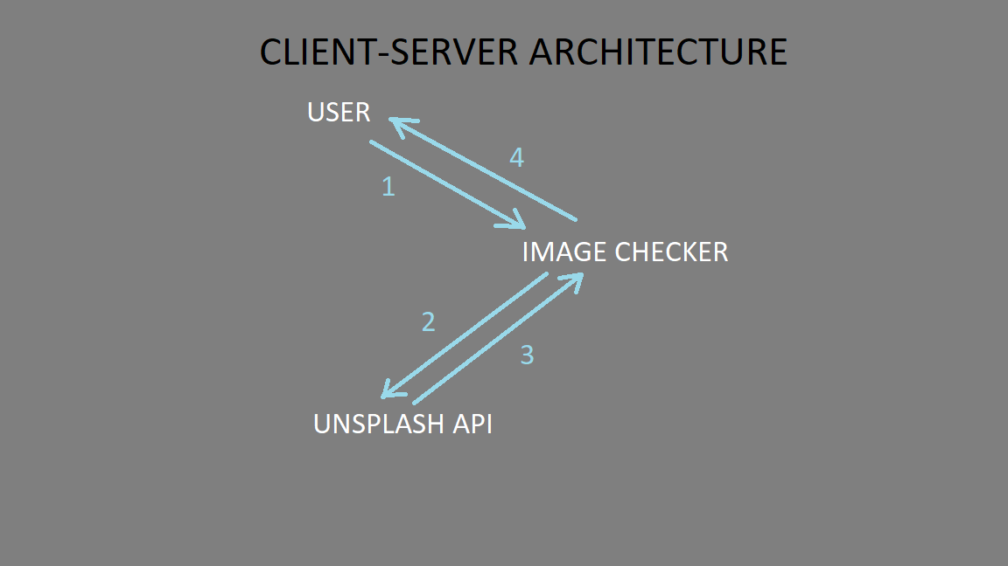
Architecture Pattern

Slide 7
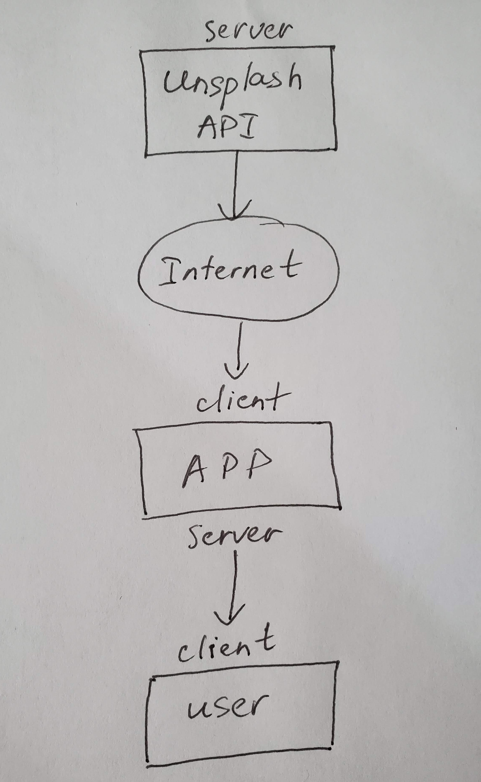
Architecture Pattern:
Client-Server architecture

Slide 8
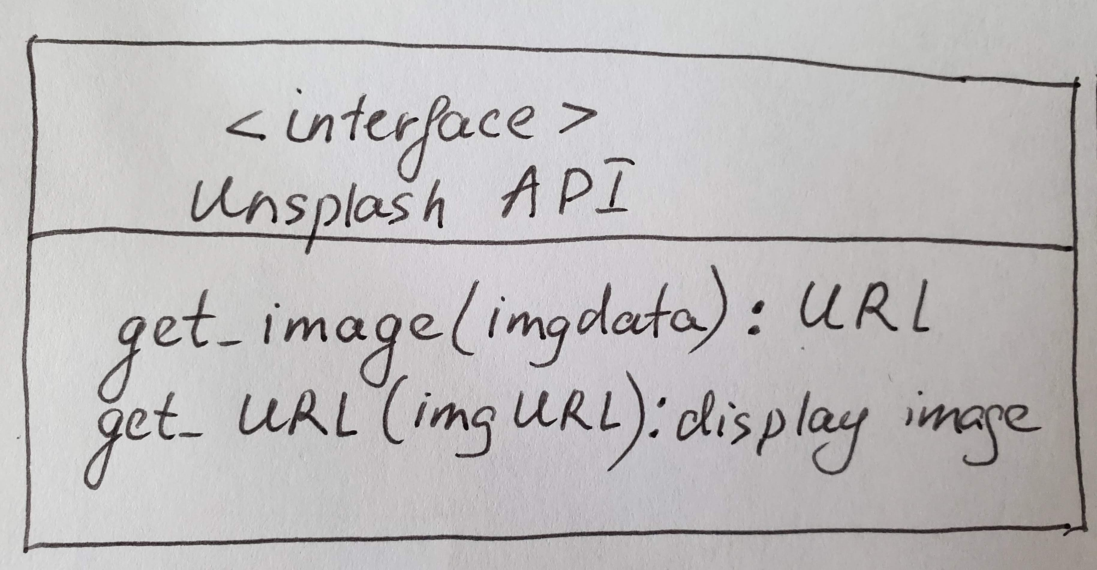
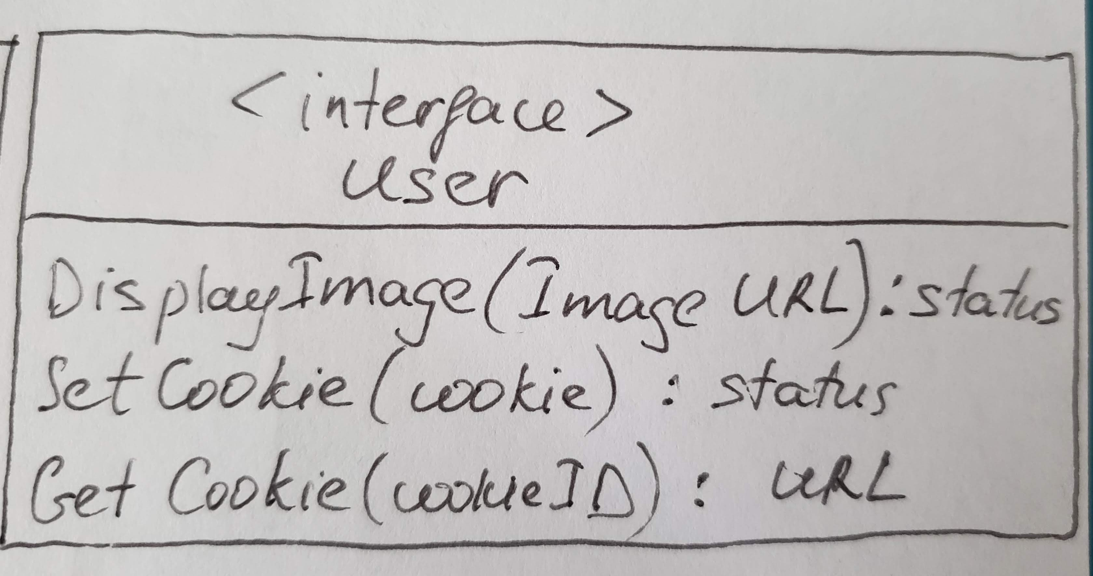
Interface Model

Slide 9
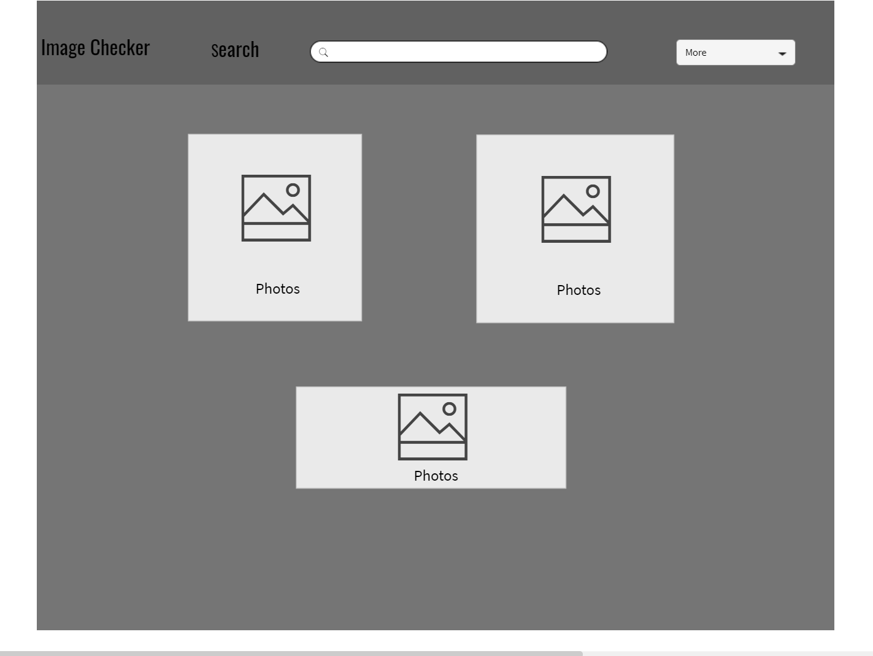
Wireframes

Slide 10
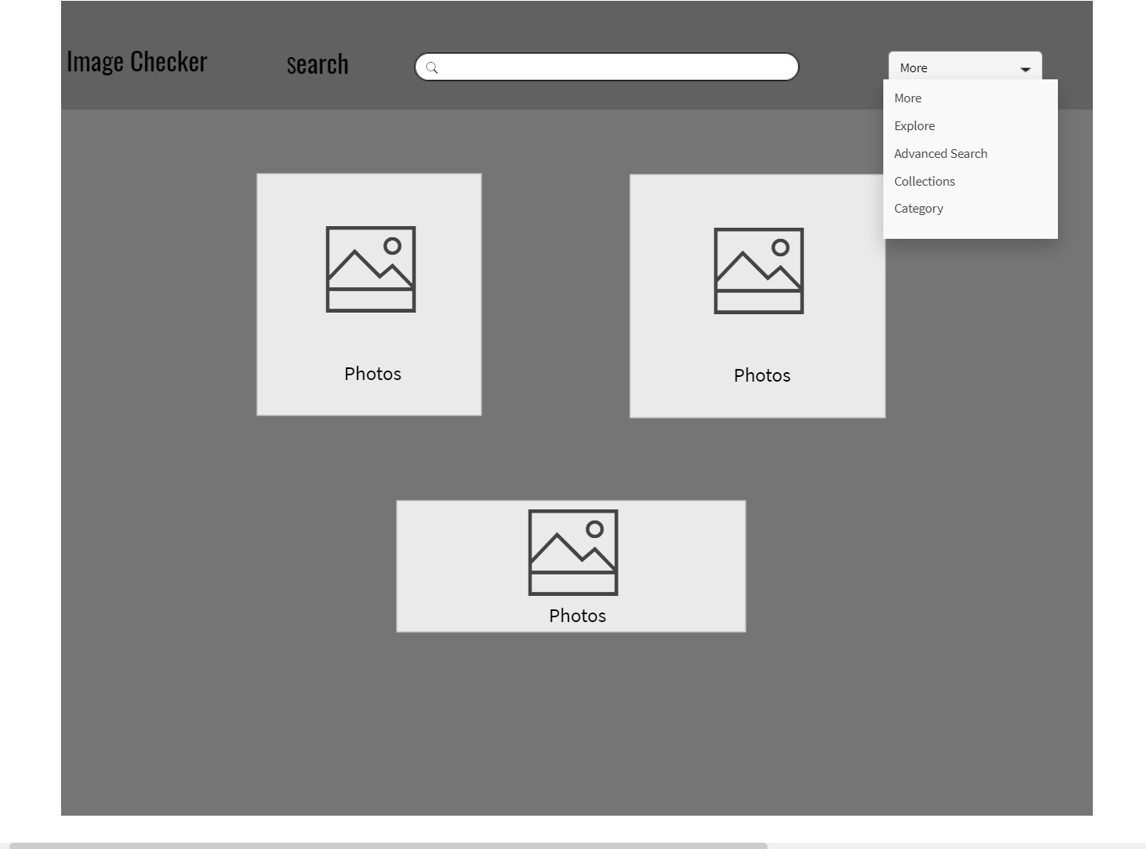
Wireframes

Slide 11
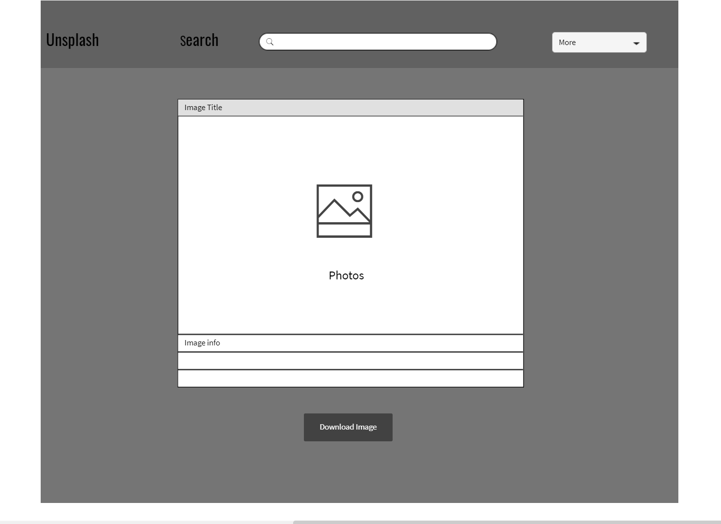
Wireframes

Slide 12
THANK YOU!

