Slide 1
How to use this deck
This is an editable slide presentation to use for outreach related to the Open Science Team Agreement
How to use:
Make a copy of the google slide presentation
Customize + adapt:
Slide 1: Add your name, contact information and branding
Slide 13: Optional exercise - choose to use, skip or delete
Slide 14: Add related library services or workshops that you would like to promote
Slides available as CC BY 4.0
Before you present, delete this slide
Estimated time: 15 minutes (without exercise); 30 minutes (with exercise)

Slide 2
Practicing Open Science with Team Agreements
Your name, role, institution
Image here
Branding/
Logo
Date HERE
Notes:
Introductions

Slide 3
Outline
Defining Open Science and related practices
Introducing the Open Science Team Agreement Template
Discussion + Activity
Notes:
Outline, edit/add as needed

Slide 4
What is open science?
Open science is the principle and practice of making research products and processes available to all, while
respecting diverse cultures,
maintaining security and privacy, and
fostering collaborations, reproducibility, and equity.
Source: NASA Transform to Open Science
Notes:
Let’s start with a definition of Open Science to get everyone on the same page.

Slide 5
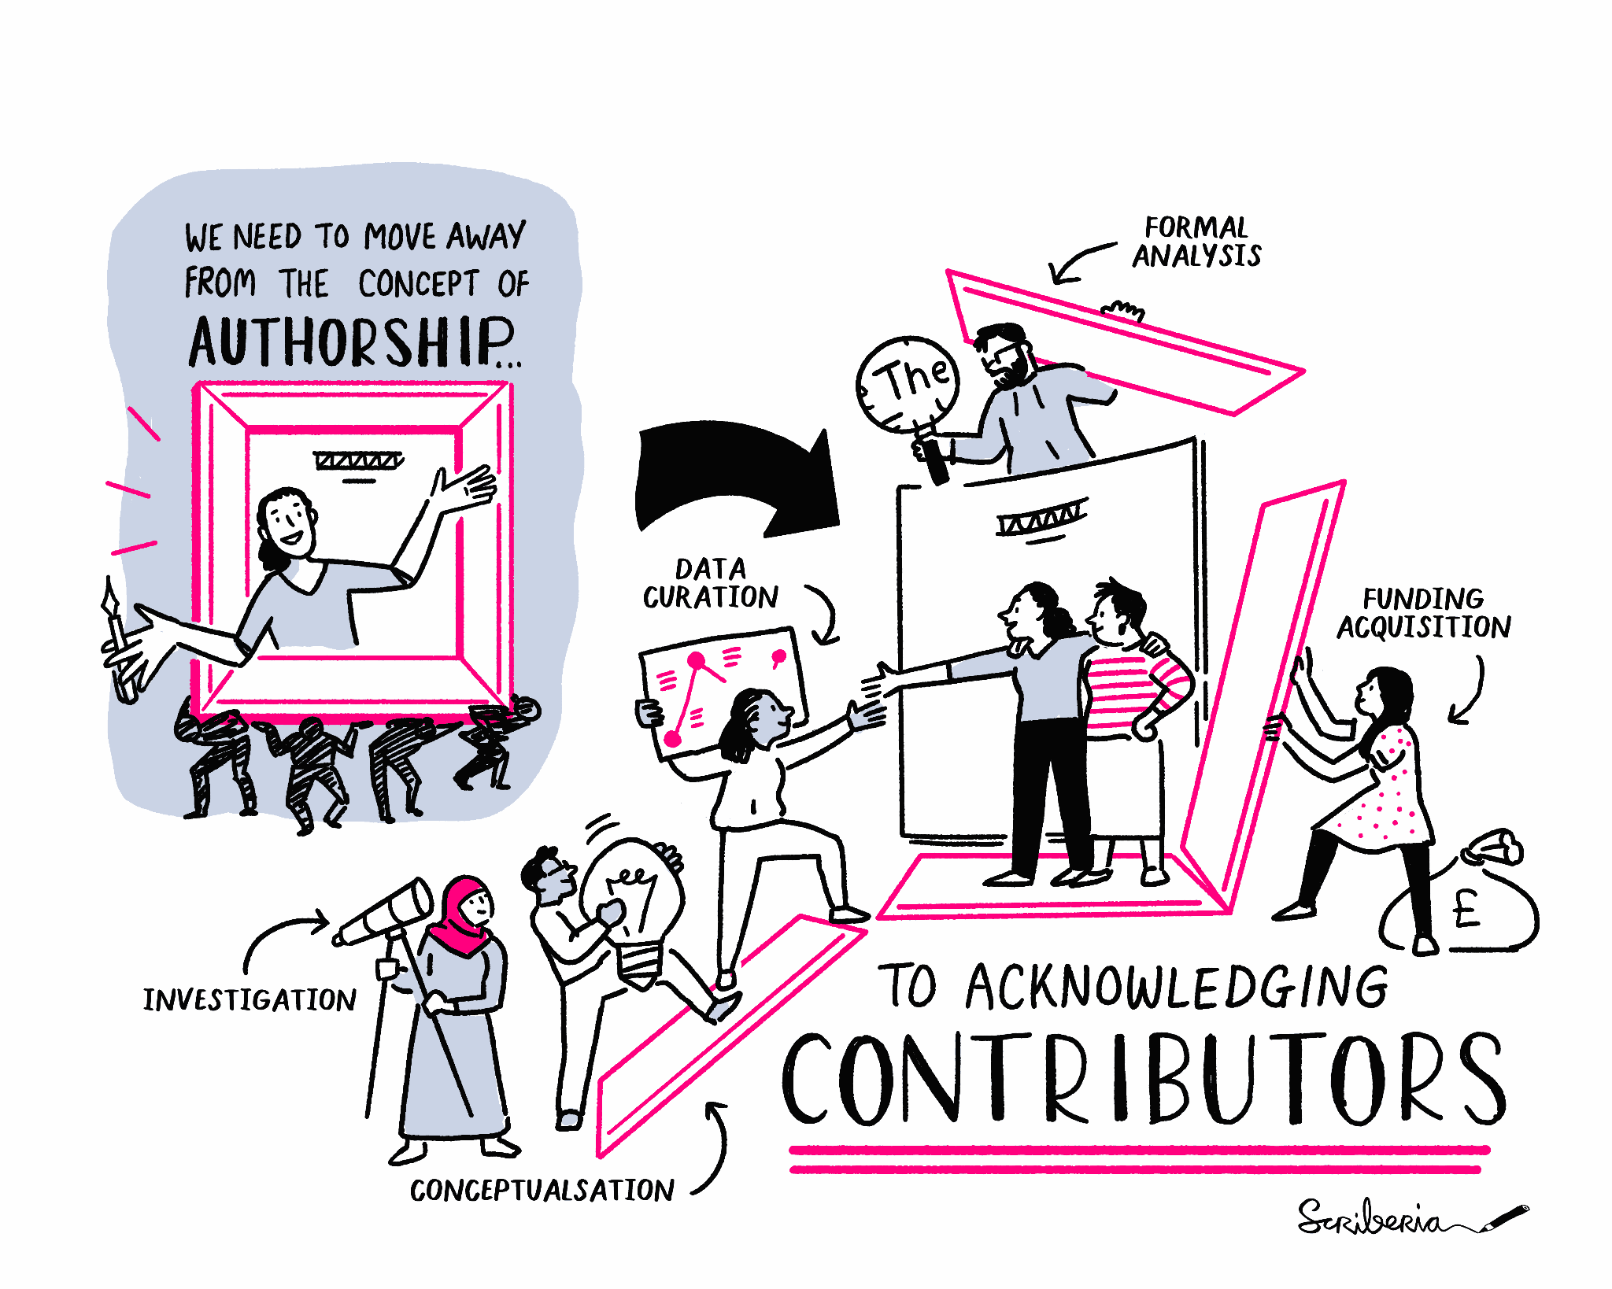
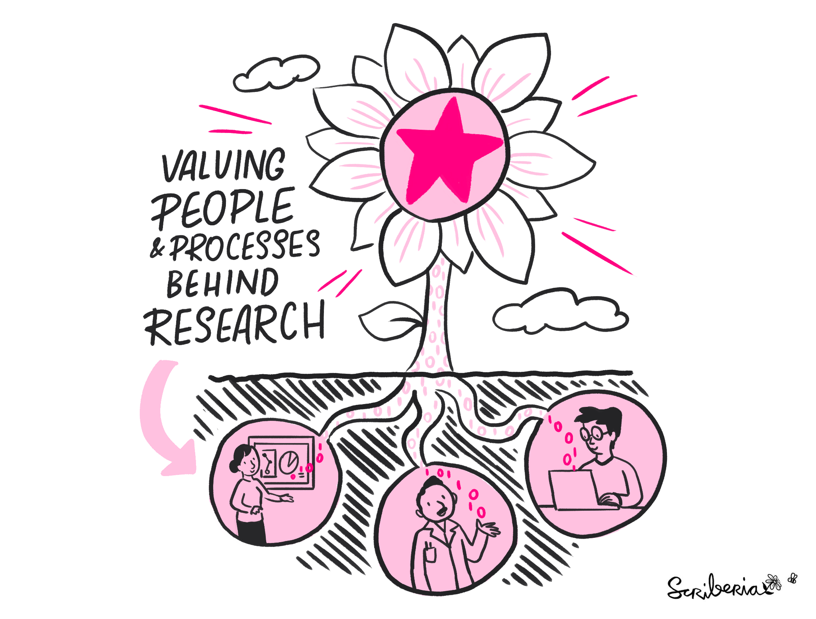
Not just focused on outputs
The Turing Way Community, & Scriberia. (2023). Illustrations from The Turing Way: Shared under CC-BY 4.0 for reuse. Zenodo. https://doi.org/10.5281/zenodo.7587336
Notes:
One of the most important aspects of open science is that it is not just focused on outputs.
Open science aims to acknowledge contributors in many roles, and values the people and processes that make research happen.

Slide 6
Open Science Practices
Open science is a buffet of practices
Open Access - accessible + readable publications with no restrictions
Open Data - research data, often raw data, shared + licensed for reuse
Open Methods + Protocols - step-by-step documents describing how research was performed
Open Code - allows for computational reproducibility
Open Source - software + source code licensed for sharing + distribution
Open Educational Resources - teaching and learning materials in the public domain
Open Pedagogy - students as co-creators
Open Authorship - transparent roles + contributions in a scientific collaboration
Notes:
There are many Open Science practices, and we won’t focus on all of them today, but this will give you a sense of the many ways your group/team could participate and open your workflows.

Slide 7
Open Science in Your Work
Discussion Topics
What does open science look like in your work?
What open science practices are you excited about?
Are these practices currently part of your work culture?
Notes:
Feel free to pick 1-2 discussion questions to hear where people are at

Slide 8
Open Science Team Agreement
Notes:
Today, I’d specifically like to introduce a tool called the Open Science Team Agreement template.

Slide 9
What is the Open Science Team Agreement?
Created by the Bay Area Open Science Group
Inspired by lab group manuals
Describes several open science practices, with a short blurb and link to learn more
Labs or teams can use it to start conversations, learn about open science, and commit to new practices
Designed to be edited and revised as practices change
Notes:
Inspired by lab manuals, the Bay Area Open Science Group created this open science team agreement to codify a commitment to certain research practices. Intended for collaborations of any size, the Open Science team agreement allows group members to start conversations, learn about open science and commit to new open practices. Groups can return to and revise the agreement at regular intervals as needed. We recommend creating the team agreement for a new project or team.
The template can be used individually as well but is most effective at the team level.

Slide 10
The Team Agreement covers
Focus on both products and process of science
1
2
3
4
Authorship and Collaboration
Articles and Research Materials
Data and Code
Communication and Impact
Notes:
The team agreement covers the following topics:
Authorship: ORCID, deciding author order
Articles and materials: open access publishing, sharing presentations, preprints
Data and Code: sharing data, publishing code and using open source tools
Communication: promoting your work, opening science beyond academia

Slide 11
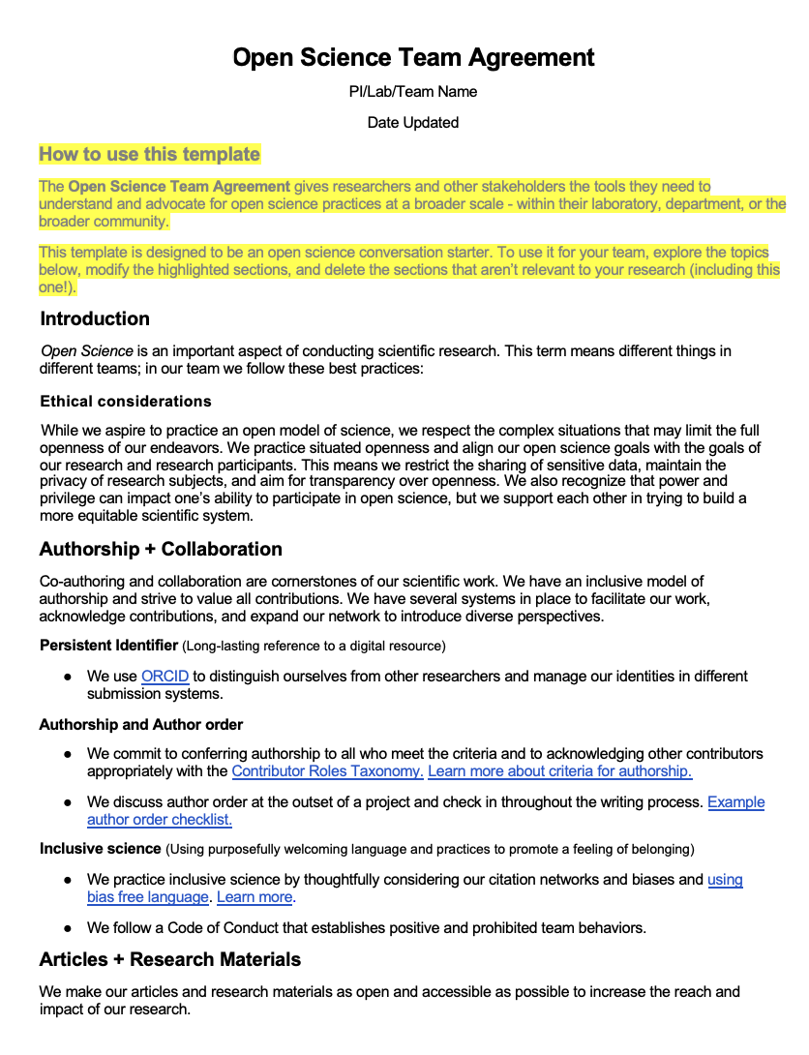
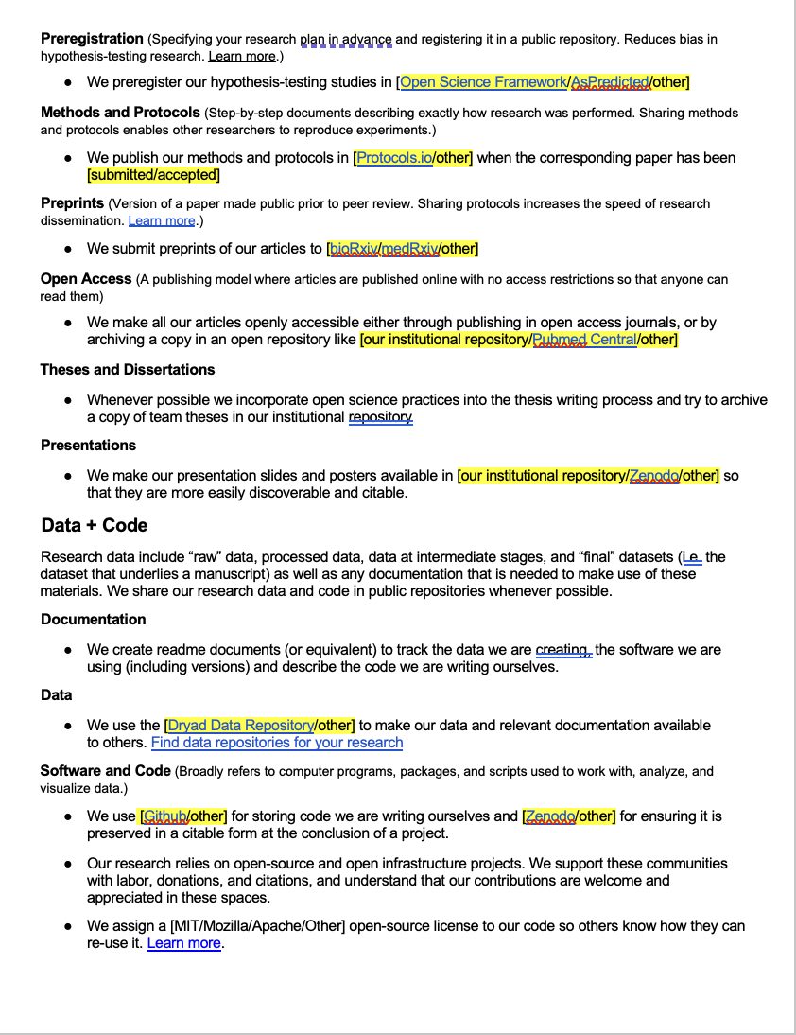
Screenshot of the Open Science Team Agreement
Notes:
Here’s a quick screenshot to demonstrate what it looks like.
Idea is that you will fill in the highlighted areas and delete other areas that don’t resonate

Slide 12
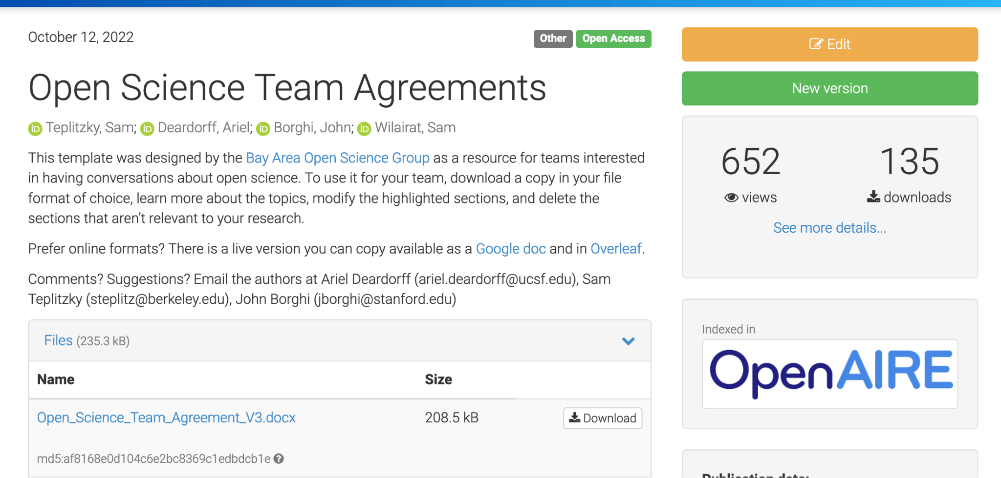
Access:
Zenodo
Overleaf
Google Docs
Notes:
You can access the team agreement in several places: Google doc, word doc and on overleaf for LaTeX users.

Slide 13
Exercise
1
2
3
Download the Open Science Team Agreement in your preferred format.
Examine the section on data.
Make one edit to add an appropriate data repository for your group’s work.
Save and upload the revised document to a shared workspace.
Plan for future revisions.
Notes:
Let’s pause for questions and then move into an exercise to try out the open science team agreement.
In this exercise, we will practice
Downloading the team agreement
Examining one section together and making one edit to add an appropriate data repository for your group’s work.
One member of the team can then save and upload the revised document to a share workspace.
Last we’ll make a plan for future, more thorough revisions.

Slide 14
Library services for open science
Add links to library services and workshops

Slide 15
References
Open Science Team Agreements Template:
Zenodo: https://doi.org/10.5281/zenodo.7154101
Overleaf: https://www.overleaf.com/latex/templates/open-science-team-agreement/cqprjnqskhwc
NASA TOPS - https://nasa.github.io/Transform-to-Open-Science/what-is-open-science/
The Turing Way Community, & Scriberia. (2023). Illustrations from The Turing Way: Shared under CC-BY 4.0 for reuse. Zenodo. https://doi.org/10.5281/zenodo.7587336
ADD ADDITIONAL REFERENCES

Slide 16
Thank you!
Learn More:
Open Science Team Agreements Template
Slides - [Insert Link]
Questions?
[Your email@institution.edu]

Slide 17
Credits
Special thanks to all the people who made and released these awesome resources for free:
Presentation template by SlidesCarnival
Photographs by Pexels

