Slide 1
Working with Data using OpenRefine
Owen Stephens
Notes:
Introduce yourself!

Slide 2
Schedule
Introduction to OpenRefine (slides)
Basic OpenRefine functions I (demonstrations and follow-along)
Basic OpenRefine functions II (demonstrations and follow-along)
Advanced OpenRefine functions (demonstrations and follow-along)

Slide 3
“a tool for working with messy data”
http://openrefine.org
Notes:
OpenRefine is described as a tool for working with ‘messy’ data - but what does this mean? It is probably easiest to describe the kinds of data OpenRefine is good at working with and the sorts of problems it can help you solve.

Slide 4
OpenRefine can help when…
you have data in a simple tabular format
there are inconsistencies in how the data is formatted
there are inconsistencies in where data appears
there are inconsistencies in terminology used in the data
Notes:
OpenRefine is most useful where you have data in a simple tabular format but with internal inconsistencies either in data formats, or where data appears, or in terminology used. It can help you:

Slide 5
OpenRefine can help you…
Get an overview of a data set
Resolve inconsistencies in a data set
Help you split data up into more granular parts
Match local data up to other data sets
Enhance a data set with data from other sources
Notes:
These are some of the things OpenRefine can help you with.
Some common scenarios might be:
1. Where you want to know how many times a particular value appears in a column in your data
2. Where you want to know how values are distributed across your whole data set

Slide 6
For example…
Data you have | Desired data
1st January 2014 | 2014-01-01
01/01/2014 | 2014-01-01
2014-01-01 | 2014-01-01
Jan 1 2014 | 2014-01-01
Notes:
Where you have a list of dates which are formatted in different ways, and want to change all the dates in the list to a single common date format:

Slide 7
For example…
Data you have | Desired data
London | London
London] | London
London,] | London
london | London
Notes:
Where you have a list of names or terms that differ from each other but refer to the same people, places or concepts:

Slide 8
For example…
Data you have | Desired data
 | Institution | Library name | Address 1 | Address 2 | Town/City | Region | Country | Postcode
University of Wales, Llyfrgell Thomas Parry Library, Llanbadarn Fawr, ABERYSTWYTH, Ceredigion, SY23 3AS, United Kingdom | University of Wales | Llyfrgell Thomas Parry Library | Llanbadarn Fawr |  | Aberystwyth | Ceredigion | United Kingdom | SY23 3AS
University of Aberdeen, Queen Mother Library, Meston Walk, ABERDEEN, AB24 3UE, United Kingdom | University of Abderdeen | Queen Mother Library | Meston Walk |  | Aberdeen |  | United Kingdom | AB24 3UE
University of Birmingham, Barnes Library, Medical School, Edgbaston, BIRMINGHAM, West Midlands, B15 2TT, United Kingdom | University of Birmingham | Barnes Library | Medical School | Edgbaston | Birmingham | West Midlands | United Kingdom | B15 2TT
University of Warwick, Library, Gibbett Hill Road, COVENTRY, CV4 7AL, United Kingdom | University of Warwick | Library | Gibbett Hill Road |  | Coventry |  | United Kingdom | CV4 7AL
Notes:
Where you have several bits of data combined together in a single column, and you want to separate them out into individual bits of data with one column for each bit of the data:

Slide 9
For example…
Data you have | Date of Birth from VIAF (Virtual International Authority File) | Date of Death from VIAF (Virtual International Authority File)
Braddon, M. E. (Mary Elizabeth) | 1835 | 1915
Rossetti, William Michael | 1829 | 1919
Prest, Thomas Peckett | 1810 | 1879
Notes:
Where you want to add to your data from an external data source - in this example starting with information about authors, and adding dates of birth/death from the Virtual International Authority File

Slide 10
Getting help
The OpenRefine Wiki https://github.com/OpenRefine/OpenRefine/wiki
The ‘Free your metadata’ site http://freeyourmetadata.org/ and book http://book.freeyourmetadata.org
The OpenRefine mailing list and forum http://groups.google.com/d/forum/openrefine

Slide 11
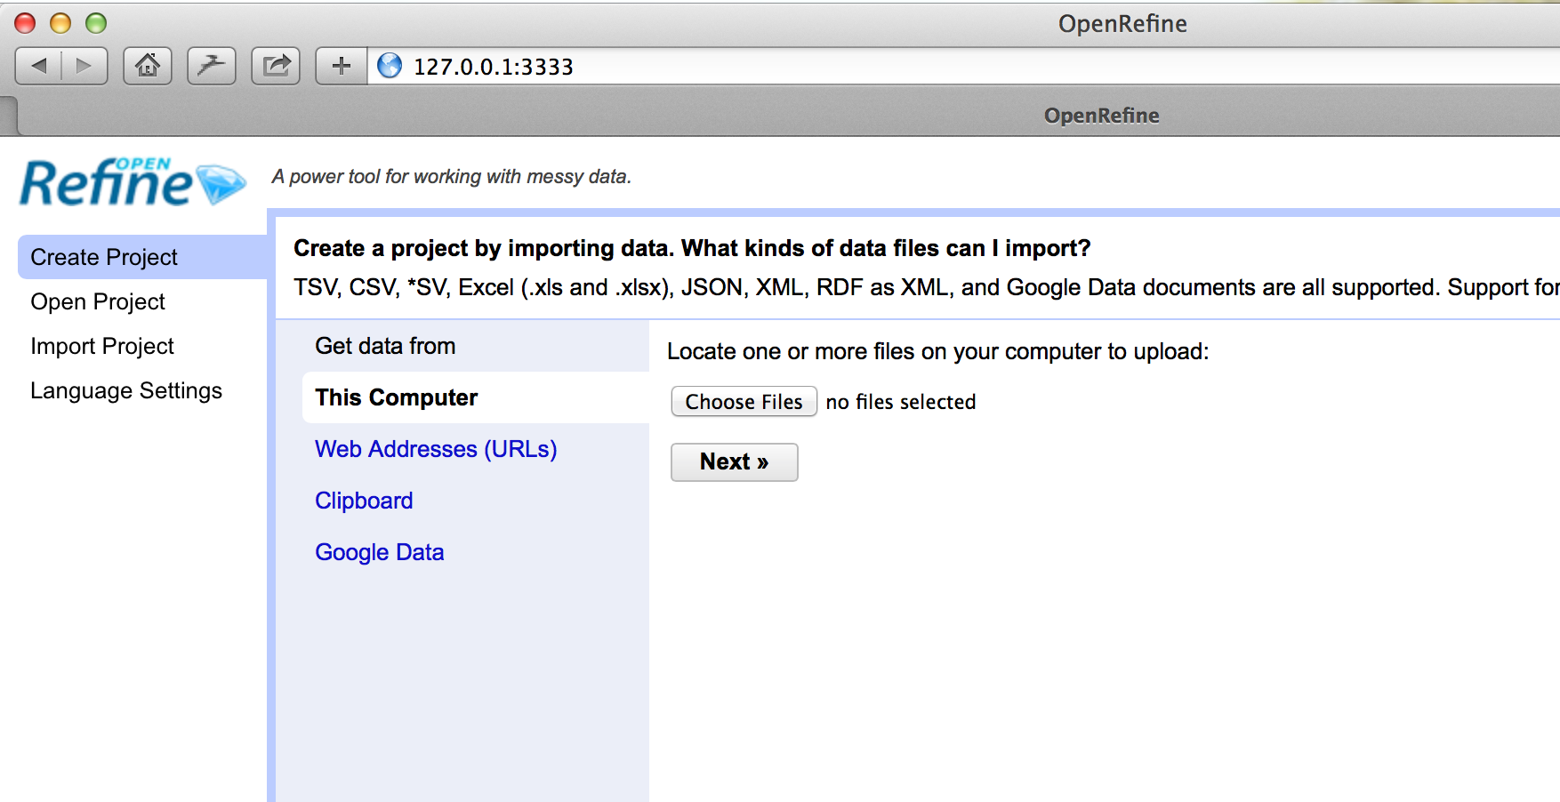
Start using OpenRefine
Notes:
OpenRefine vs Google Refine (I’ll probably just say ‘Refine’)
Start Open/Google Refine on your laptops
Refine is a web application which runs locally on your PC. You access the interface through the browser. Recommend using Chrome
[switch to notes and walk through - get them using Refine at this point]

Slide 12
http://bit.ly/lc-wk4-data

Slide 13
Demonstrations and follow-along
Download file from: http://bit.ly/lc-wk4-data
Notes:
http://bit.ly/lc-wk4-data

Slide 14
Using these slides
These slides were developed by Owen Stephens (owen@ostephens.com) on
behalf of the British Library.
Unless otherwise stated, all images, audio or video content are separate works with their own licence, and should not be assumed to be CC-BY in their own right
This work is licensed under a Creative Commons Attribution 4.0 International License http://creativecommons.org/licenses/by/4.0/. It is suggested when crediting this work, you include the phrase “Developed by Owen Stephens on behalf of the British Library”

