Slide 1






Library Carpentry
Week One: Basics
This work is licensed under a Creative Commons Attribution-ShareAlike 4.0 International License. Exceptions: logos, embeds to and from external sources and direct quotations

Slide 2
Schedule
Week 1: Some Basics
Week 2: Controlling Data (with the Shell)
Week 3: Versioning Data (with Git)
Week 4: Cleaning Data (with Open Refine)
@j_w_baker

Slide 3
Where to go for help
Stickers
Helpers
Sticky notes
github.com/LibraryCarpentry
@j_w_baker

Slide 4
Final admin
Same place, same time
Worksheets
Tea, coffee, snacks, food
Roam around
Wifi
@j_w_baker

Slide 5
Week 1: Some Basics
18:00-18:45 Jargon Busting
18:45-19:30 Foundations
19:30-20:15 Regular Expressions
@j_w_baker

Slide 6
Jargon Busting
Teams of 5 or 6
Write terms you want busting on stickies
Cluster (retaining duplicates)
Discuss and explain
Note resolved terms
Note unresolved terms
Report back
@j_w_baker

Slide 7
Foundations
The Computer is Stupid
Why automate
Keyboard shortcuts are your friend
Plain text formats are your friend
Structuring files and folders
@j_w_baker

Slide 8
Foundations
The Computer is Stupid
ERROR
@j_w_baker

Slide 9
Foundations
Why automate?
Borrow, borrow, borrow
There is no correct language
Professional development
Knowing some code ~ evaluating software
Making time to do fun stuff!
Andromeda Yelton, "Coding for Librarians: Learning by Example", Library Technology Reports 51:3 (April 2015), doi: 10.5860/ltr.51n3
@j_w_baker

Slide 10
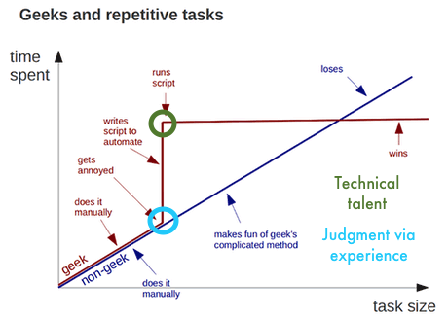
Foundations
Why automate?
Credit: Andy Kirk
@j_w_baker

Slide 11
Foundations
Keyboard shortcuts are your friend
Efficiency and control
@j_w_baker

Slide 12
Foundations
Plain text formats are your friend
Computers process them better
Platform agnostic
Display orientated files aren't your friend
Markdown
@j_w_baker

Slide 13
Foundations
Structuring files and folders
Consistent and predictable data structure
Semantic-data hybrid directory names
Your own system is fine
Links files and directories with names
You are the most likely person to forget what you once did!
@j_w_baker

Slide 14
Regular Expressions
Match on types of character
Match patterns
Capture the parts that match your pattern
@j_w_baker

Slide 15
Regular Expressions
organi[sz]e
organise
organize
reorganise
reorganize
@j_w_baker

Slide 16
Regular Expressions
[ABC] matches A or B or C.
[A-Z] matches any upper case letter.
[A-Za-z0-9] matches any upper or lower case letter or any digit.
@j_w_baker

Slide 17
Regular Expressions
. matches any character at all.
\d matches any single digit.
\w matches any part of word character.
\s matches any space, tab, or newline.
^ defines the start of the string.
$ defines the end of the string.
@j_w_baker

Slide 18
Regular Expressions
^[Oo]rgani.e$
@j_w_baker

Slide 19
Regular Expressions
* matches proceeding character any number of times including zero.
+ matches proceeding character any number of times excluding zero.
? matches the proceeding character one or zero times.
{VALUE,VALUE} matches proceeding character a defined number of times.
| simply means or.
@j_w_baker

Slide 20
Regular Expressions
^[Oo]rgani.e\w*$
@j_w_baker

Slide 21
Regular Expressions
^[Oo]rgani.e\w+$
@j_w_baker

Slide 22
Regular Expressions
^[Oo]rgani.e\w?$
@j_w_baker

Slide 23
Regular Expressions
^[Oo]rgani.e\w{2}$
@j_w_baker

Slide 24
Regular Expressions
^[Oo]rgani.e$|^[Oo]rgani.e\w{2}$
@j_w_baker

Slide 25
Regular Expressions
Exercise
Teams of 5 or 6
Work through handout
Split into two teams and write:
- strings that need regex
- regex that need outputs
Test each other!
@j_w_baker

Slide 26
Next Week
Week 2: Controlling Data (with the Shell)
You will need a computer
Set-up instructions on Github
Log an issue if you have trouble
See you next week!
@j_w_baker

Slide 27
Library Carpentry
Week One: Basics
------------------------------------------------------------------------------------------------------------------------------------------------------------
This work is licensed under a Creative Commons Attribution-ShareAlike 4.0 International License. Exceptions: logos, embeds to and from external sources and direct quotations

