Slide 1
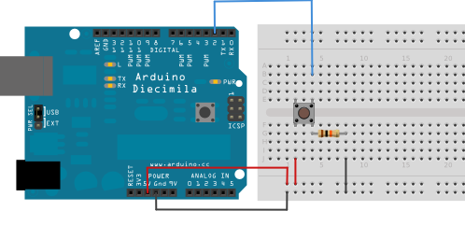
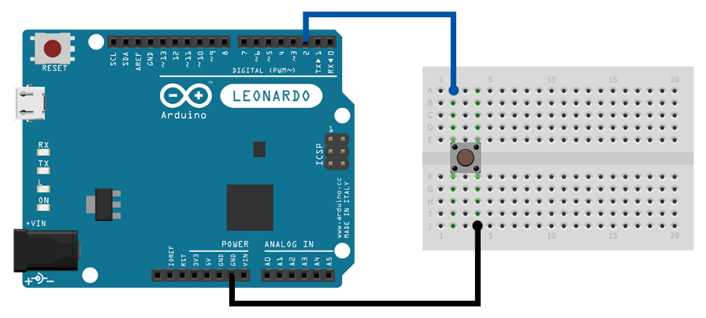
Arduino button press circuits……Amazing!
Signal Wire
Build this circuit
We are going to build Arduino button circuits. Button circuits allow us to gather user input for devices we might like to build. We will build two types button circuit, one that uses the Arduino on-board “pull-up resistor” and one that we add a pull-down resistor ourselves.
Pull-up resistor circuit
Power 5 volts
Signal Wire
Ground
Pull-down resistor
No resistor
Pull-down resistor circuit
Why two different Circuits? Well, just because we can. Many microcontrollers don’t have and on-board pull-up but the Arduino does so we will use it.
This circuit will need to use the on-board pull-up resistor
No power wire
Ground

Slide 2
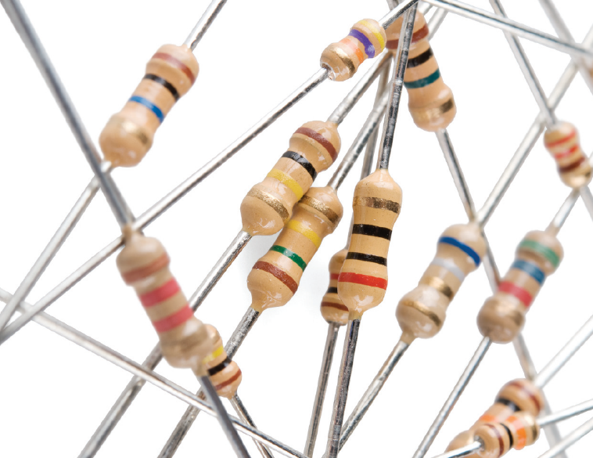
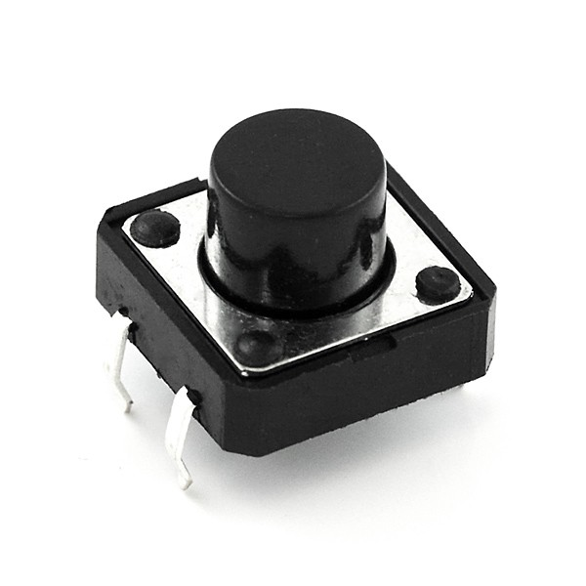
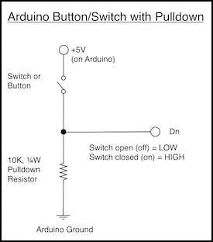
First up what does a resistor do and why do we need them in our circuit?
Resistors limit the amount of current that can flow through a circuit like using different size straws to drink water from a cup. They are very useful.
Assorted resistors
A push button switch is simple yet a little inaccurate. They tend to “float” somewhere between ground and the voltage you supply (5 volts from the Arduino). A resistor can be used to force our buttons to be either 0 volts (pull-down) or 5 volts (pull-up).
This is how a resistor looks in
A circuit diagram.

Slide 3
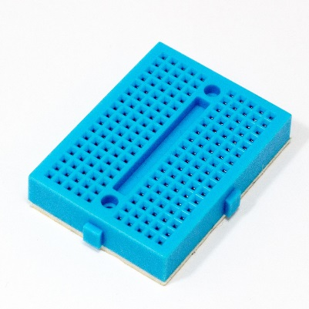
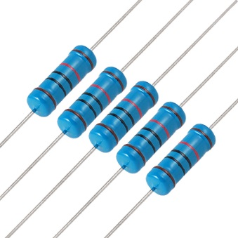
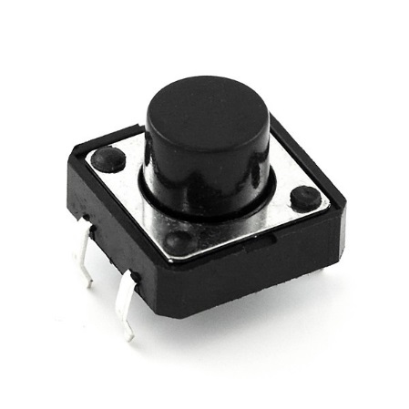
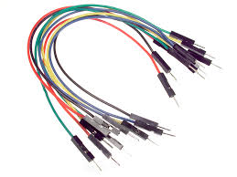
We will start with a button circuit that uses a pull-down resistor
Grab the parts from the parts list and copy the circuit below. If you need to know how a breadboard works watch Jeremy’s video (on the next page. He explains it well.
You will need these things:
Breadboard
1X 10k resistor
A bunch of jumper wires
A button
An Arduino.
Signal Wire
Build this circuit
Power 5 volts
Ground

Slide 4
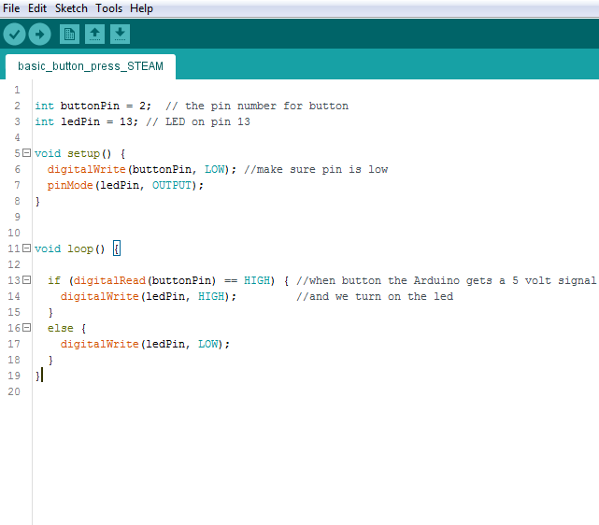

When you have a circuit ready you’ll probably want to test it
For that we’ll need some code!
(read next page also for an explanation of the code)
Jeremy Blum has a great tutorial on Arduino button circuits
https://www.youtube.com/watch?v=_LCCGFSMOr4 (you can stop watching around 8min in).
Underscore here like: “_”
Jeremy
This is some simple code. All it does is to set pin 2 as our button and 13 as our LED.
Then in setup it sets the button low (i.e. off). And the LED as an OUTPUT.
Then in the loop it reads the button and IF it is pressed (i.e. HIGH) turns on the LED. Otherwise the LED is set to off (LOW)

Slide 5
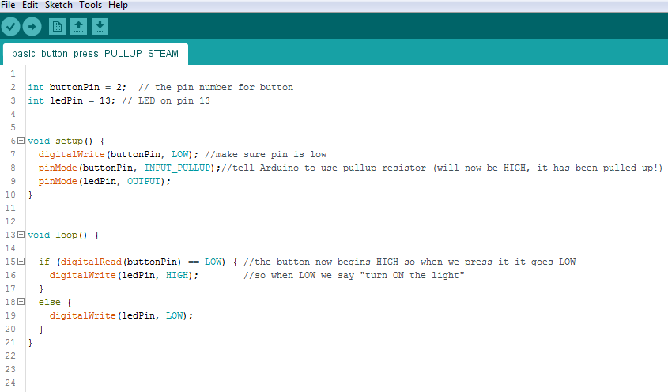
Some of the Arduino code explained (see next page also)
(We will explain more as we go along in other tutorials)
At the top is where we need to assign a name for pins.
These are called VARIABLES and they must have a type such as a number or a word (string). There are other types which we will see as we do more projects.
buttonPin is an integer (a number) so “int” comes before the name buttonPin and the “=“ sign makes it equal to the number 2 (which is pin 2).
Comments, ignored by the Arduino but helpful for us
Every Arduino programme must have a setup function and a loop function.
Setup runs just once when you power on the Arduino. This is where you set pins as inputs or outputs and any code that just needs to run once.
Loops run as long as the Arduino has power. This is where all the “action” code goes. This is where you make things happen like take user input or send information to other programmes or controllers.
Every line like this one must end with a semicolon. Look and see where semicolons are used.
Curly braces { } “wrap” code inside functions like the setup() and loop(). The also wrap code inside other stuff like IF and else statements. Think of them like hands holding the code inside them.

Slide 6
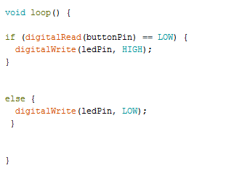
Loop function and if-else statements explained
These 2 curly braces { } wrap this block of code.
Everything inside them is part of the loop() function
It is the same for setup().
A loop() function begins at the “{“ (open curly brace) then reads and executes all the code inside and then goes back to the top and starts again. This continues forever while the power is on.
If statements are a question. They ask the question that you give them to ask. In this case we say “read the buttonPin and IF (and only if) it is being pressed (this is code from the pull-up project so pressed = LOW) do something i.e. turn on the led. The answer to the IF question will be either TRUE or FALSE. If TRUE the code inside will run otherwise the program moves on.
Notice the curly braces wrapping this ELSE statement. See also curly braces on the IF statement.
An ELSE statement can only be used after an IF statement. Here we can say what to do if the answer to the IF question is FALSE. In this case if it is FALSE we keep the light off.

Slide 7
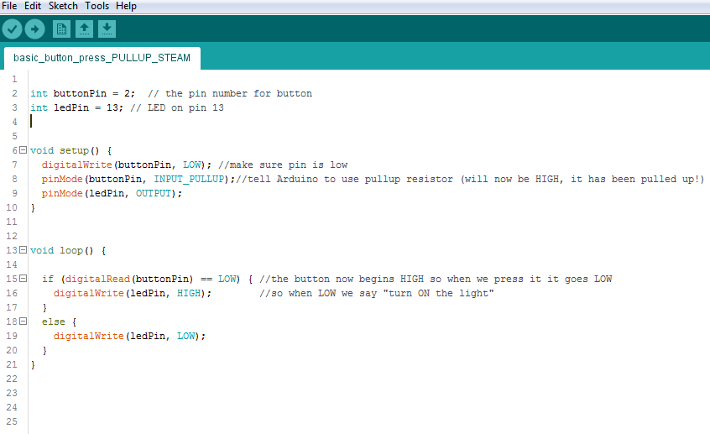
Wasn’t that the most fun thing!
Okay, so now we do the same thing but using the on-board resistor. Make a circuit that looks like this one
Different board but ignore that, okay
So, the difference? Well when we use the on board pull-up we set the button pin to HIGH i.e. “pull it up” to 5 volts. So when we press the button it will go LOW. That’s no problem though. We can just say: “IF button is LOW, turn led on by setting it to HIGH.

