Slide 1
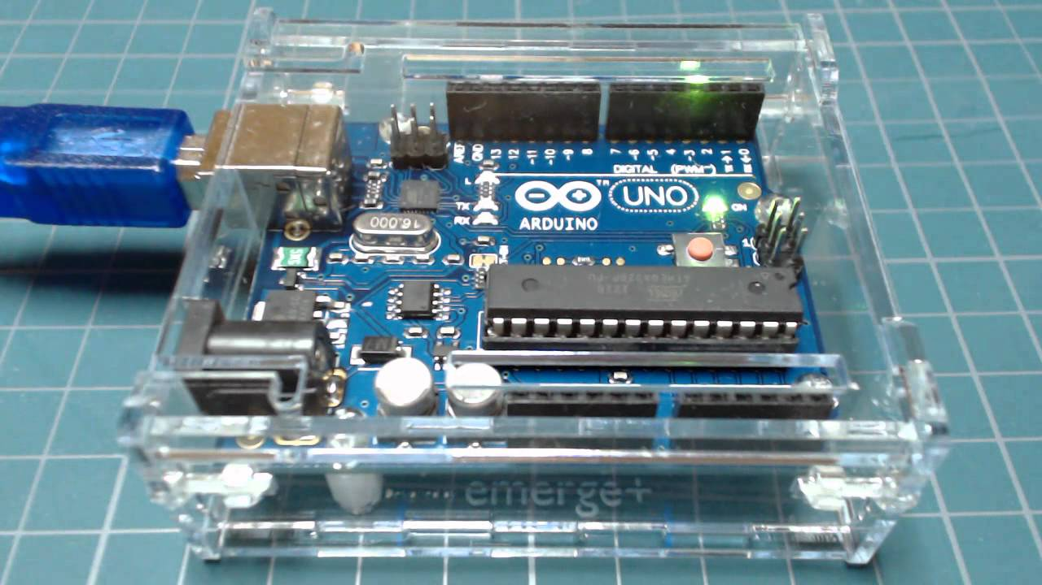
Your mission (with permission from a parent or guardian):
To download and install the Arduino IDE (Windows, Mac or Linux only), write your first Arduino program (to blink and LED) and upload that programme to the microcontroller.
Jeremy Blum gives a great YouTube tutorial.
(https://www.youtube.com/watch?v=fCxzA9_kg6s)
His tutorial will walk you through the process so follow along. Only, ignore his installation instructions. His Arduino IDE is older and therefore different. My instructions are on the next page, follow those.
The following pages contain the code and some helpful hints. Good luck! This is step one toward your world domination. ☺

Slide 2
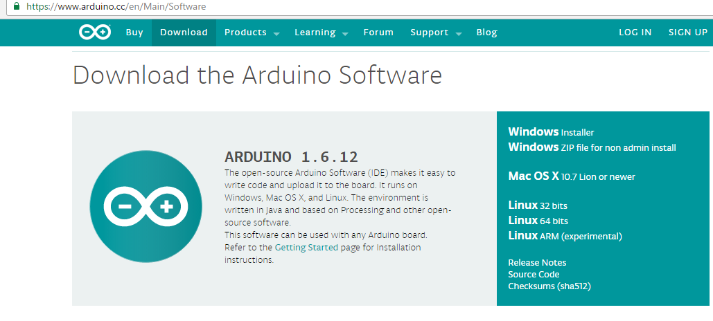

Google Arduino and navigate to this page.
You will most likely need one of the
versions with red arrows. If you are
on Linux then select the one you need.
When you click on the download link you will be greeted by this page. Select ‘just download’, this will begin the download.
It will take about 25 minutes. When finished
double click the file to begin installation (click through using default settings). When that is done you can begin the Youtube tutorial with Jeremy.

Slide 3
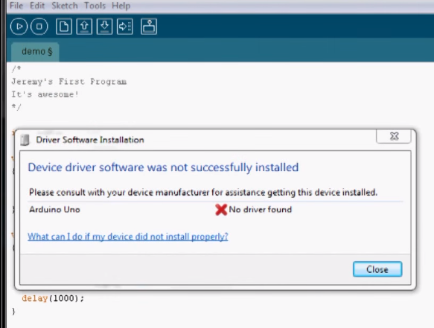
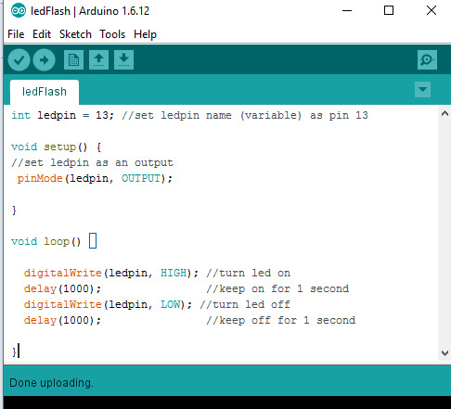
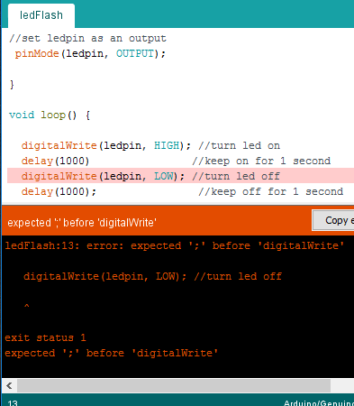
Jeremy’s version of the Arduino IDE is older and so looks a little different. Don’t worry about it. He also runs into a problem that will not happen to you (red arrow). Ignore that part.
This is the code.
So, you've written your program but you now get rude messages like this one. This is the IDE trying to help. It is saying you've missed something. In this case a semicolon is missing. If this happens check all your code for mistakes and try to upload again.
Semicolon missing from here

Slide 4
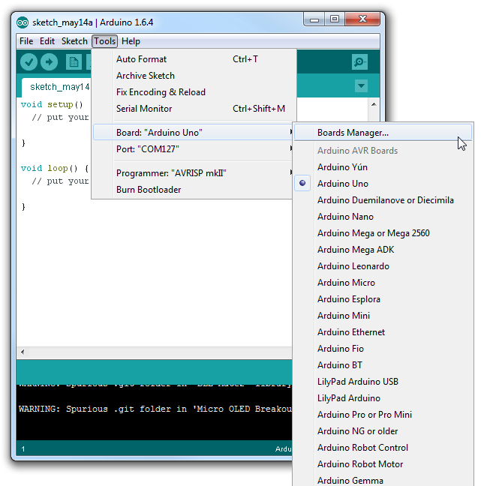
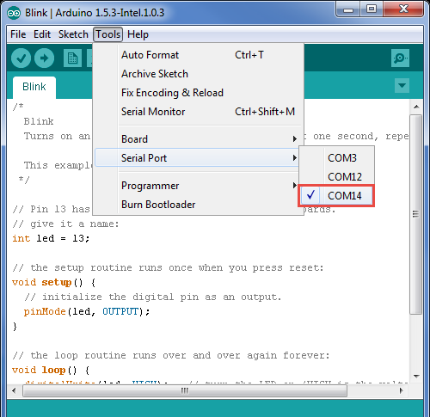
You may also get an error saying that there was a problem uploading to the board. If this happens there are two things to check:
Try changing the COM port in this list.
These change depending on what USB
port you plugged the board into.
Make sure you have “Arduino Uno” or “Arduino/Genuino Uno”
selected in this list.
This exercise teaches you way more than you realise!
If you struggle that’s a good thing, you learn loads more that way.
If you get really very stuck email: steve.nickalls@ncc.govt.nz

