Slide 1
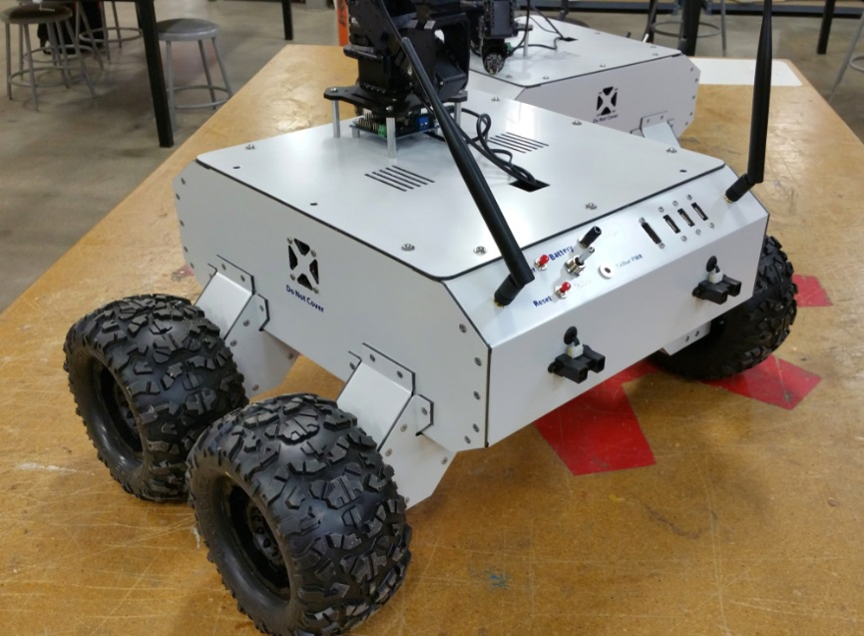
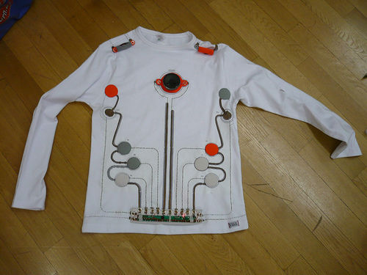
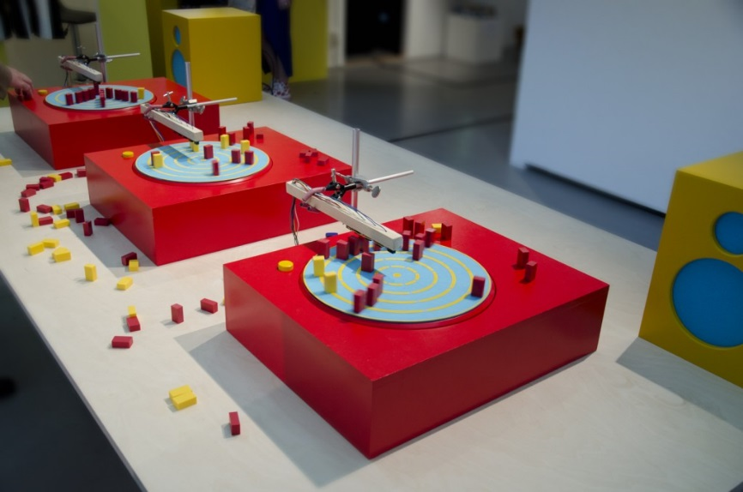
S.T.E.A.M
Science, Technology, Engineering, Art and Mathematics

Slide 2
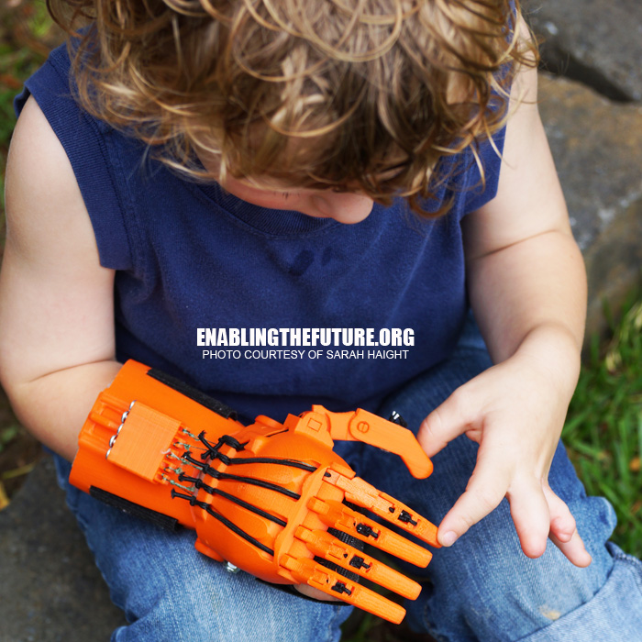
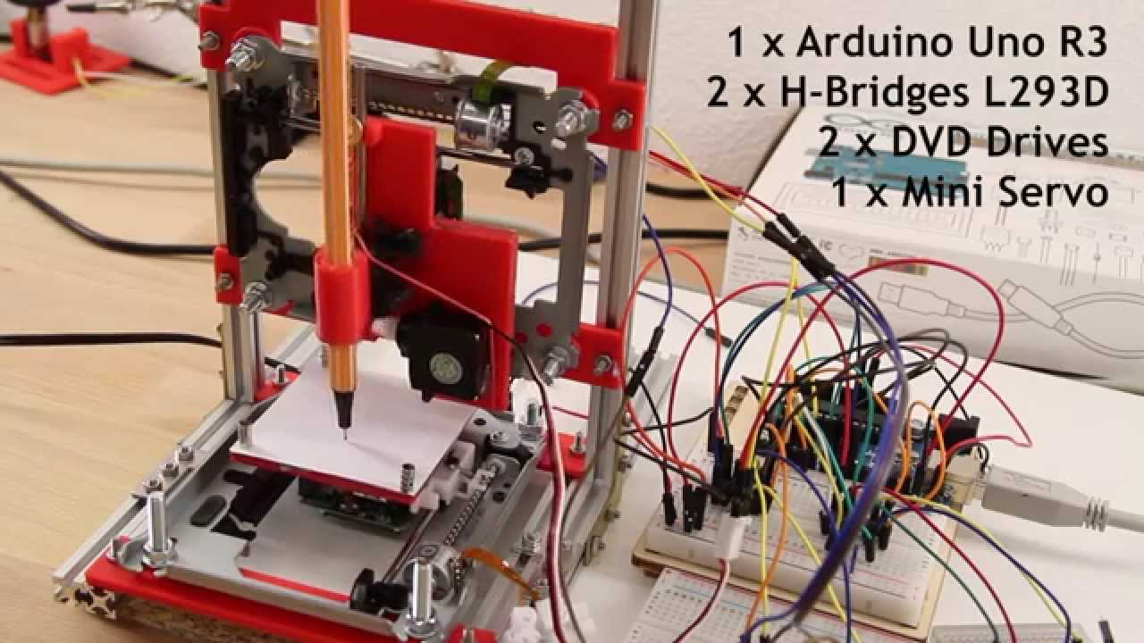
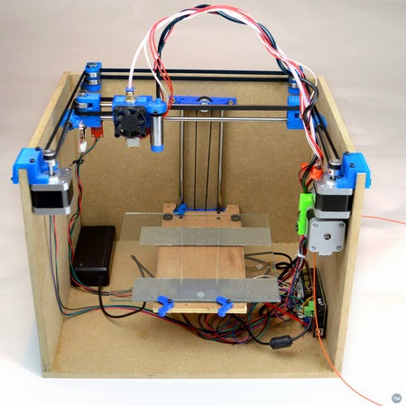
STEAM club is all about having ideas.
Its about using the resources around us in creative ways
Build a 3D printer
3D printed prosthetic hand

Slide 3
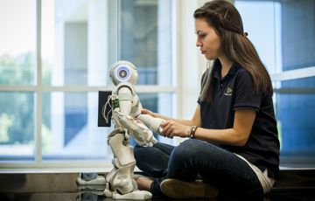
So what can we do in STEAM club?
Well, anything really. There are no rules. If you have an idea, any idea, STEAM club is the place to work on it. But to get things going here are some examples:
Browser controlled robot (9mins in):
https://www.youtube.com/watch?v=Tlz4tUEBftQ
3D printed prosthetic hands etc:
http://enablingthefuture.org/
EyeWriter
http://www.instructables.com/id/The-EyeWriter/
Skittles sorter:
https://www.youtube.com/watch?v=g3i51hdfLaw
BattleBots:
https://www.youtube.com/watch?v=aL2kkyj8bTY

Slide 4
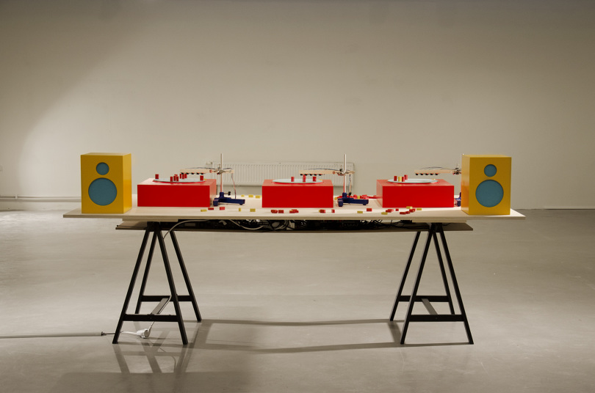
Great! But where do we start?
Beat-blox
http://thekidshouldseethis.com/post/beat-blox-wooden-blocks-on-arduino-programmed-turn-tables
Beat Blox is a great place to start. To complete this project you will need to programme a microcontroller (Arduino) to start and stop a motor and to read when a block passes the sensor. You will also need to write a Processing app to “listen” to the microcontroller and play the notes when instructed.
Don’t worry we’ll show you how!

