Slide 1
PC
Module
LibreDaq
Base
μController
LibreDaq
Mini

Slide 2
LDS Interface
Analog & Digital I/Os
USB
(480 Mbps)
…
…
(4 Slots)
USB
(480 Mbps)
Analog & Digital I/Os

Slide 3
RS/EIA-485 BUS
LDS Interface
Analog & Digital I/Os
USB
(480 Mbps)
…
…
LDS Interface
Analog & Digital I/Os
…
…
Analog & Digital I/Os

Slide 6
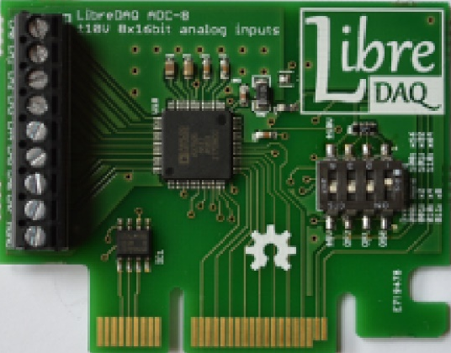
P1
LDS

Slide 7
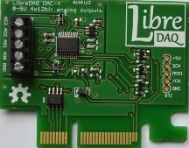
P1
P2
LDS

Slide 8
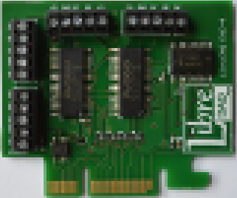
P3
P4
P2
P1
LDS

Slide 9
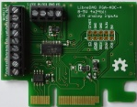
P2
P1
P3
LDS

Slide 10
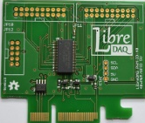
P2
P3
P1
P4
LDS

Slide 11
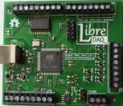
P2
P1
P3
USB
P6
P4
P5

Slide 12
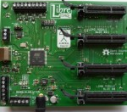
P1
SLOT3
P2
SLOT2
USB
SLOT1
P3
SLOT0
P4
P5

