Slide 1

QSE and IRUP Introduction asffdsa
April 2005
QSE = “Quality Through Software Engineering”

Slide 2

Agenda
Importance of Improving Software Quality
Introduction of QSE
Call for action

Slide 3
Objective of QSE
Meeting Purpose = Why are You / We Here?
Problems →→ Business Crisis
  Customer view and Internal IBM view
QSE Providing the Means to Address
  Overview = vision, objectives, priorities
  QSE Operations = staff roles, committees, workgroups

Slide 4
IBM Revenues UP, Yet Profits Down
Expenses Grew with Inflation – Stock at New Low
hfnncncccx rjvooi wooi yuqyg iubioi
viwuvi uhi thouw irjvooi wooi yuqyg
iubioi viwuvi uhi thouw irjvooi
thouw irjvooi wooi yuqyg iubioi dkm
iubioi viwuvi uhi thouw irjvooi wooi
yuqyg iubioi viwuvi uhi thouw irjvooi
thouw irjvooi wooi yuqyg iubioi dkm
viwuvi uhi thouw irjvooi wooi yuqyg
Iubioi viwuvi uhi thouw irjvooi wooi
Customers Give Up On Hard To Use SW
Not Fully Reliable Nor Consumable
Customers Declare MS & Oracle Easier to Integrate than IBM
thouw irjvooi wooi yuqyg iubioi dkm
viwuvi uhi thouw irjvooi wooi yuqyg
Iubioi viwuvi uhi thouw irjvooi wooi
thouw irjvooi wooi yuqyg iubioi dkm
iubioi viwuvi uhi thouw irjvooi wooi
yuqyg iubioi viwuvi uhi thouw irjvooi
hfnncncccx rjvooi wooi yuqyg iubioi
viwuvi uhi thouw irjvooi wooi yuqyg
iubioi viwuvi uhi thouw irjvooi
thouw irjvooi wooi yuqyg iubioi dkm
viwuvi uhi thouw irjvooi wooi yuqyg
Iubioi viwuvi uhi thouw irjvooi wooi
thouw irjvooi wooi yuqyg iubioi dkm
iubioi viwuvi uhi thouw irjvooi wooi
yuqyg iubioi viwuvi uhi thouw irjvooi
hfnncncccx rjvooi wooi yuqyg iubioi
viwuvi uhi thouw irjvooi wooi yuqyg
iubioi viwuvi uhi thouw irjvooi
Each of these caused by Ineffective Software
The headlines are made up; The situations will be real – unless…
Unless Major Process Improvements Are Made !!

Slide 5
What are Our Clients Saying about Quality ?
4 Feb 2005
Quotes from Corp WW MI Report
on Software Measure Attribute
“Quality of products has, by far, the
greatest influence on Overall Sat…”
“Majority of IBM Software customers
who are NOT completely satisfied
recommend Improvements related
to product – 34% cite quality.”
“Quality of products is
key competitive strength…”
69% of those not satisfied with
quality cited integration,
compatibility and usability
“Ease of use and ease of integration
are competitive weaknesses… efforts
to improve would be beneficial.”
“Across all divisions, usability of s/w
products is the top area for
Improvement related to quality.”
Per May IDC: For SMBs, product reliability & high quality are the TOP 2
factors in making I/T purchase decisions for technology and provider.
S/W Product QUALITY is the Greatest Satisfier & the Greatest Dis-satisfier

Slide 6
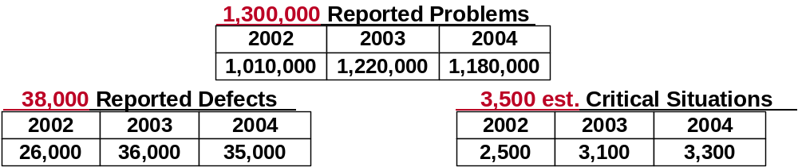
Results of Today’s Dev & Test Processes
Customers’ View of Our Software: #s wise
Note: ‘red’ #s = 2005 plans
40 to 80% customer defects analyzed by
ODC = escapes from function test or prior
30 to 70% of integration test found
problems = prior phases' escapes
System test and function test each
fighting escapes from prior phases
Lack of coherent, adaptive, disciplined
application of sw eng processes / tools
from IBM 2003 Academy Study
IBM S/W is at risk of losing our “Quality Value Add” & our position is eroding
Time to value continues to elongate due to quality issues / concerns

Slide 7
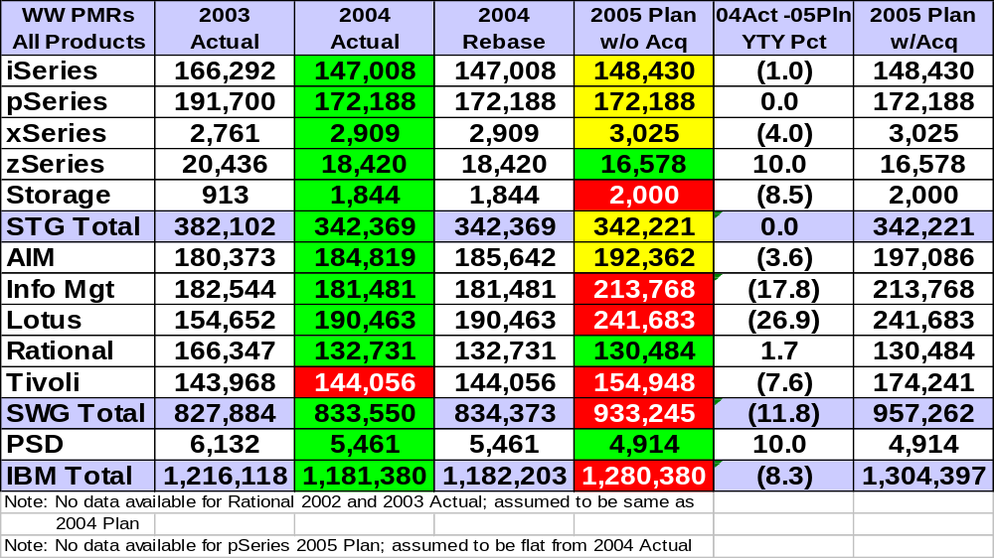
2005 PMRs = all products
4 Feb 2005
Serious growth in Emerging & Growth Products causing 8% growth YTY
Needs a lot more work and holistic quality focus to drive down…
US Only
US Only
US Only
2005 Plan vs. 2004 Actual | >= 1% Better | 5% Worse to 1% Better | >5% Worse

Slide 8
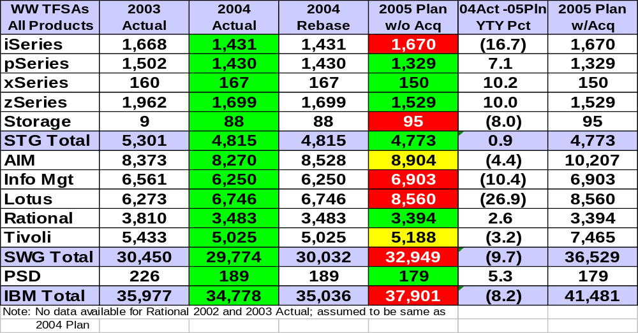
2005 TFSAs (total field submitted APAR) = all products
4 Feb 2005
Serious growth in Emerging & Growth Products causing 8% growth YTY
Needs a lot more work and quality focus to drive down…
2005 Plan vs. 2004 Actual | >= 1% Better | 5% worse to 1% Better | >5% Worse

Slide 9
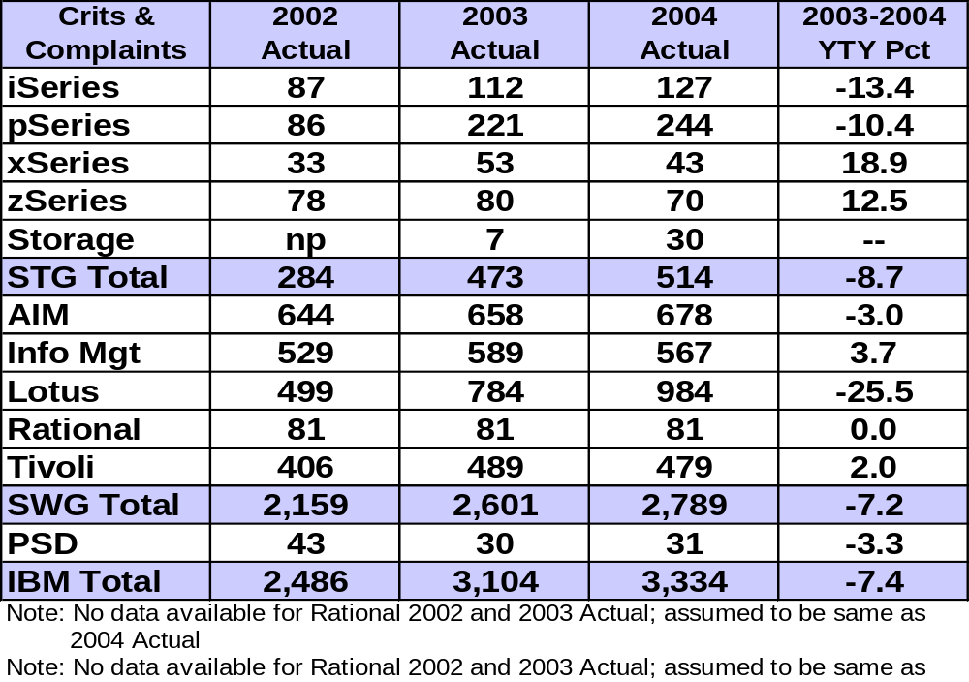
S/W Crit Sits & Complaints
4 Feb 2005
2003 to 2004 YTY grew 7.4%; but 4 brands down

Slide 10
Warranty Costs →→ Total Support Costs
4 Feb 2005
SUMMARY: New Total Support Cost Picture
 | 2003 | 2004 Plan | 2004 | 2005 Plan
Warranty Costs | $606 M | $652 M | $568 M | $598 M
Warranty E/R % | 3.8 | 4.0 | 3.6 | 3.6
Maintenance Agreement Costs | $346 M | $405 M | $388 M | $420 M
Total Support Costs (WC+MA) | $952 M | $1,057 M | $946 M | $1,018 M
Total Support E/R % | 5.9 | 6.3 | 5.8 | 6.0
Total YTY actuals turned corner = down and E/R down
2005 plan following growth of TFSAs & PMRs for all products
Note: The plan under-run appears to correlate to the major
turnaround and reduction in 2004 TFSAs & PMRs.

Slide 11


S/W Quality Process Situation = 3 points
Intense Market Pressures Forcing Development to ‘Walk a Fine Line’
Competition (New & Growing) | IBM Software
Cuts many process corners | Quality matters (IBM value add)
Targets few platforms | Targets 20 - 30 platforms
Targets limited markets (niche) | Targets multiple markets
No concern: scalability, availability | Our customers do care…
ALL units are SPENDING $$$Ms on Support & Verification at
a growing rate, instead of investing in new development
Economic Situation → Resulting Expense Crunch
→→ need more effective & efficient operations
Observation: many Dev execs & middle managers are still:
  Not looking to Quality S/W Engineering processes to help them
  and their teams achieve their business goals
The business need and opportunity is large and real…

Slide 12
Process Problems / Challenges
Since 1998, related complexities are really increasing:
  Intense Market Pressures Forcing Development & Test
  to ‘Walk a Fine Line’ (between quality process & being competitive)
  Warranty & maintenance costs
  Economic need for more effective & efficient operations
  Quality expectations of customers in the industry for solutions
  to be reliable, integratible, usable, ‘consumable’
  Complexity of technologies and combinations in solutions
  New initiatives in OnDemand and Autonomic Computing
  Development and Test process pressures from all the above
Need and Opportunity for Quality Software Engineering
Improvements in ALL Units →→ Company Wide QSE Focus

Slide 13
S/W Engineering Impacts Your Business
Better Practices
More Discipline
More Rigor
Lower
Expense
Higher
Revenue
Organizational
Effectiveness
Software
Engineering
Customer
Satisfaction
Higher
Expense
Lower
Revenue
Poorer Practices
Less Discipline
Less Rigor

Slide 14
S/W Engineering Impacts Your Business
Better Practices
More Discipline
More Rigor
Lower
Expense
Higher
Revenue
Organizational
Effectiveness
Software
Engineering
Customer
Satisfaction
Higher
Expense
Lower
Revenue
Poorer Practices
Less Discipline
Less Rigor

Slide 15
S/W Engineering Impacts Your Business
Better Practices
More Discipline
More Rigor
Lower
Expense
Higher
Revenue
Organizational
Effectiveness
Software
Engineering
Customer
Satisfaction
Higher
Expense
Lower
Revenue
Poorer Practices
Less Discipline
Less Rigor

Slide 16


Quality thru Software Engineering
Unifying into One Cohesive S/W Community Operation
+
+
S/W Q
Technical
Champions

Slide 17

Quality thru Software Engineering (QSE)
Unifying into One Cohesive S/W Community Operation
+
+
S/W Q
Technical
Champions
➔ ➔
QSE Community Vision
  All Units are Achieving their Business Goals
  by Applying Quality Software Engineering !
  (customer sat, speed to market, time to value, profit contribution, etc.)
QSE Community Mission
  Teaming to Improve Units’ Software Operations
  and our Clients’ Satisfaction !

Slide 18
IBM’s unified QSE Community
QSE Community Vision (one liner and expanded version)
  All Units are Achieving their Business Goals
  by Applying Quality Software Engineering !
  (customer sat, speed to market, time to value, profit contribution, etc.)
  All Units believe they can increase their ability to Achieve their
  Business Goals by effectively applying IRUP with associated
  Quality S/W Engineering Processes and Practices…
  And are doing so!
  Customer Satisfaction with IBM software holistic quality
  improving, while non-productive Costs to IBM
  (warranty/maintenance) going down → BOTH SIGNIFICANTLY
  Software units increasing in proven effectiveness each
  year via IRUP yielding improved quality of IBM software
  deliverables and improved customer time to value…

Slide 19
IBM’s unified QSE Community
QSE Community Objectives
  People = Skilled, knowledgeable, motivated & effective;
  Each discipline a recognized competency
  Processes = Optimally applied with discipline & balance
  of agility and rigor; over time via IRUP
  Practices/Tools = Implementing best practices and tools
  to increase effectiveness
  Community = Dynamic, well-connected team of software
  engineers across all disciplines
  All Units = Improving operational effectiveness significantly
  and measurably each year

Slide 20
IBM’s unified QSE Community
QSE 2005 Priorities
To drive and ensure real unit progress this year, we will have a prioritized focus on driving all units to:
  Build a unified community from the strengths of many.
  Start exploiting IRUP beginning with ‘use cases’ across
  all Software Engineering disciplines.
  Improve UT & FVT significantly by meeting the standard
  for each – reducing escapes to later phases.
  Deploy common quality measurements and tools –
  focusing and driving unit improvements.
  Key foundation = need for expanded education.
  Key emphasis = ensure we maintain the relevance of all that we do
  for the individual software engineer.

Slide 21
Our Vehicle for Re-Engineering →→ IRUP
Identified Process Problems
Lots of opportunities & needs
Must be improved significantly
______Conclusion______
Time to Restructure Our
Software Development
Process
Acquisition of Rational
E2E development / test tools
Switching IBM product dev
& test to Rational tools+proc
IBM Creates Lots of Code
Software
Delivered to Customers
Testware
Used to Verify Software
IRUP
IBM (using) Rational Unified Process
Use best practices from
RUP, QSE & IBM SMEs
Led by QSE
Sponsored by Group VPs
Integrated S/W+T/W Development Process
Rqmts | Architect | Design | Code/UT | Verificat’n Phases
 | Software + Testware

Slide 22
QSE’s IRUP Management System
QSE IRUP Stakeholders Board
  Led by IBM QSE Director with IBM group level stakeholders
  Set strategy & direction based on stakeholders’ bus. needs
QSE IRUP Product Development Team
  Led by QSE Chief Architect & IRUP Project Manager
  Develop and Deliver the IRUP product based on content
  from SMEs across the company (RUP, QSE, etc.)
QSE IRUP Exploitation Team
  Led by QSE Lead Consultant; Focus = IRUP +++
  Determine how to optimize, facilitate & enable
SWG
Exploitation
Team
STG
Exploitation
Team
Other Unit
Expoitation
Teams
Exploitation consultancy provided by groups /units;
QSE Consultants facilitating / enabling.

Slide 23
Understanding the ‘Whole’ Plan
Focus = How / where are we investing our money ?
= Where are we finding the defects ?
Determining Where Opportunities are to be BOTH:
  MORE EFFECTIVE and MORE EFFICIENT
Software Quality Models - Baseline
Baseline | Req | Desgn | Code | UT | FVT | SVT | Field | Total
Duration (12 Mons) | 1 | 2 | 3 | 1 | 2 | 3 | 36 | --
Dev Resource (12) | 2 | 16 | 36 | 10 | 24 | 36 |  | 124
Test Resource (8) |  |  |  |  | 16 | 28 |  | 44
Service (4) |  |  |  |  |  |  | 144 | 144
Defects Found | 50 | 100 | 400 | 400 | 1,700 | 2,200 | 150 | 5,000
Requirements
  Standard doc
  Standard reviews
Design & Code
  Standard reviews
Unit Test
  Limited
FVT & SVT
  Comprehensive

Slide 24
QSE Action Sessions: 12-14 April 2005
Focus + Purpose + Approach:
  Focus = Our four 2005 Priorities
  Purpose = allow each unit to determine its own action
  plan to help lead / drive improvement in
  each priority area, while interactively sharing
  ideas with each other
  Approach = To allow units to work together & to nurture
  cross-unit cooperation, each session will be
  composed of 2-3 revenue-producing units;
  non-revenue units (like Grp: xx, OD Srvr,
  Research or Autonomic Computing) will
  "Pick Your Own“ session group to attend –
  spread out….

Slide 25
ACTIONS
1 of 3
“START… ACT” = Team Up Within Unit
  Sense of Urgency & Vision / Strategy
  Guiding Coalition and IRUP Exploitation
    Website: qse.ibm.com
  IRUP ‘Use Cases’ = Best Practice for Requirements
  Unit Test and FVT
    Reduce defects found in later stages
  QSE Self Assessment – coming next month
    So get ready for it! It is YOUR VEHICLE to get:
    → comprehensive understanding of where your units stands
    → the focused improvements making the most sense

Slide 26
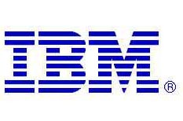
Services Oriented Architecture
and integration deeper dive
Marc Fiammante
Distinguished Engineer
marc.fiammante@fr.ibm.com

Slide 27
Agenda
What is SOA?
Business value, Business Component Modelling, Architecture
Evolution of integration to SOA. Integration architecture in the context of SOA.
Where and how do you start in an integration world?

Slide 28
Industry Definition of Service-Oriented Architecture
A service is a function that is well-defined, self-contained, and does not depend on the context or state of other services.
A service-oriented architecture is a collection of services. These services communicate with each other, e.g., simple data passing or two or more services coordinating an activity.
SOA characteristics and principles:
  Loose Coupling
  Location Transparency
  Protocol Independence
Source: Web Services and Services Oriented Architectures, by Douglas K. Barry, 2003

Slide 29
Observations about Service-Oriented Architectures
Flexibility is the primary goal
  There are many benefits in development and maintenance costs, but flexibility is the primary goal in service-oriented architecture.
Reuse of services must be achieved
Integration via interfaces
  Service-oriented architecture moves up from OO programming via interfaces to integration via interfaces to realize the same benefits at the enterprise level. But with stateless interfaces.
Service-oriented architecture align with business processes:
  There is a strong synergy between SOA and consistency of business processes across the enterprise. Full scale implementation will involve business process improvement.
Service-oriented architecture can be delivered with existing technology:
  Most of today’s production service-oriented architectures do not yet use Web Services – they use existing mature technologies, such as XML and asynchronous messaging.
Web services offer the benefits of standards and the promise of interoperability

Slide 30
Agenda
What is SOA?
Business value, Business Component Modelling, Architecture
Evolution of integration to SOA. Integration architecture in the context of SOA.
Where and how do you start in an integration world?

Slide 31
Greater Flexibility Required From Business Models And The Supporting IT Architecture
Flexible Business
Transformation
Business Process Outsourcing
Mergers, Acquisitions & Divestitures
Composable
Processes
(CBM)
Component
Business Modeling
Requires
Aligned with
Flexible IT
Cost Containment
Greater ROI for IT dollars
Better Use if IT Assets
Improved Quality of Deployed Systems
SOMA
On Demand Operating Environment
Composable
Services
(SOA)
Service Oriented Architecture (SOA)
Development
Infrastructure
Management
Software Development
Integration
Infrastructure
Management

Slide 32

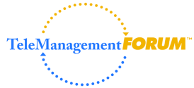







Getting the value from creating a progressive“Lego®” model
Towards flexibility to address more frequent evolutions, Faster implementation, Cost efficiency by:
  An increased use of business and IT standards
  A componentized approach of the business
  Business process driven approach
Price
AWB
Services
Customer
Cargo Reservation Cycle
Processes
IATA

Slide 33
Services Oriented Architecture steps
Step 1: Break down your business into components
Decide what is strategically important, and what is just operations in the value chain domains
Analyze the different KPIs attached to these components
Prioritize and scope your transformation projects
CBM
Strategy
Step 2: Define a Service Model
Identify your business services based on your business components
Identify your business processes
Specify the services, processes and components accordingly
Make SOA realization decisions based on architectural
decisions
SOMA
Modeling
Step 3: Implement a Service Model
Develop a service-oriented architecture to support the
Componentized Business
Implement service based scoping policy for projects
Implement appropriate governance mechanism
SOA
Realization
Business-Aligned IT Architecture

Slide 34

Modeling Components requires Business and Information
Artifacts
Business
System
Implementation
Architecture
Behavior
Business
Process
Abstract Process
(BPEL)
Concrete Process
(BPEL)
Service
Components
Techn. Neutral Contract (WSDL)
Techn. Specific Contract (WSDL)
Information
Business
Entity
Information
Model (XSD)
Data
Model (XSD)
Identify Need
Model Solution
Validate Model
IATA
Based on Standards
Viewpoint – focus on particular concerns within a system (IEEE Std 1471-2000)

Slide 35
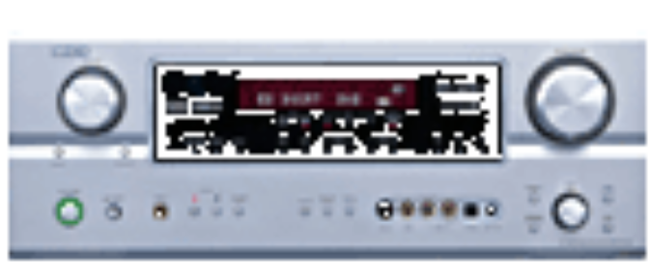
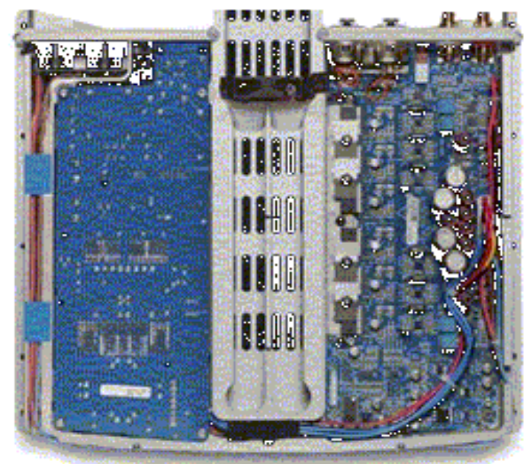
SOA limits the modeling effort by focussing on
facades
Reusable
Business Process
Visible to SOA
Business Service
Business Entity
Adaptation to standards
Granularity
Composition
Private
Invisible to SOA
Business Process
Business Service
Business Entity
SOA Modeling focusses on the visible part that all domains can see
Then what should I make visible ?
Business Domain

Slide 36
Define a collection of business components, networked together.
Component view
Ground Handling
BLU
Manifest
Booking
Pricing
AWB
Pricing
“Business components” have the potential to operate autonomously, as a separate company, for example
Improvements efforts are focused at the level of the component—the strategic capabilities that enable them and the relationships between them, rather than the detailed activities inside—in fact, each component is essentially a “black box”

Slide 37
Potential Components for Cargo
Booking
Ground Handling
Customer Profile
A/C Planning
AWB Handling
Freight Forwarding
Pricing
Billing
Customs
Manifests
Payments
Shipping
Others
Others
Others
Others

Slide 38
The business process development cycle
Services development
Process Requirements
Existing Components
Process Modeling
Services
Web & Portal Clients
Business
analyst
Integration development
Interaction
Glue
Participate
Process Execution/Choreography
Optimize
Manage Execution
Business process execution
Monitor
Analysis
Process monitoring
Notes:
Imagine that you could
Describe a process, then
model the process - graphically
simulate the operations for a month
make changes
Pull the services needed from a palette into the process map
drag and drop relationships between data, people, systems and services
identify and mark measurement points
Customize the solution with deployment options
Test your process and make sure that it runs
Collect, analyze and compare operational performance against the simulation

Slide 39
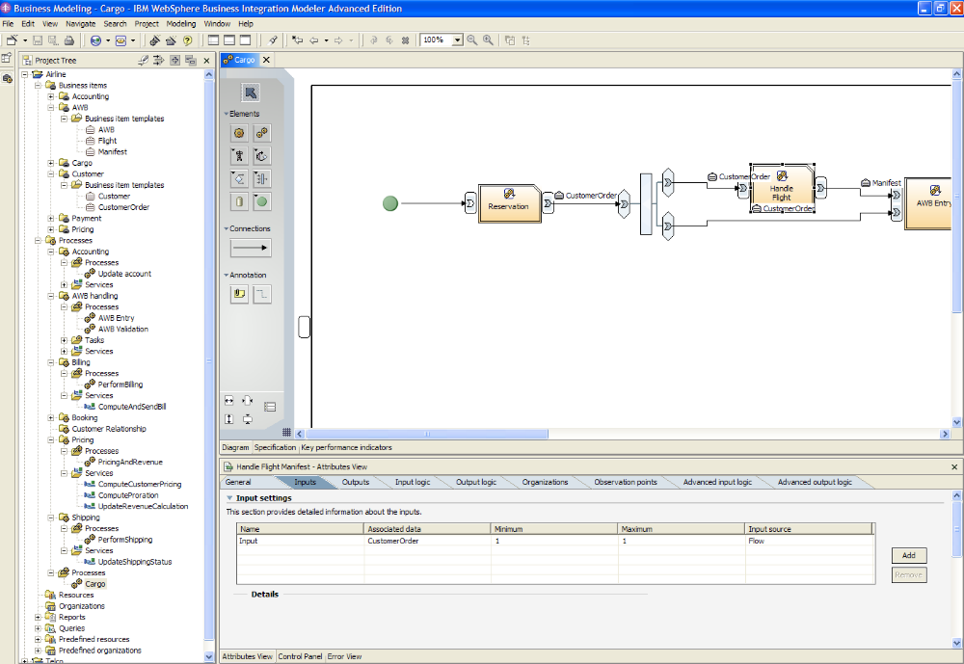
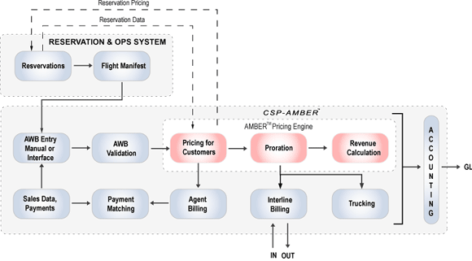
Tooling helps find and model business processes and services
Business Process flow
Information
Business Components
Services
Services

Slide 40
Agenda
What is SOA?
Business value, Business Component Modelling, Architecture
Evolution of integration to SOA. Integration architecture in the context of SOA.
Where and how do you start in an integration world?
Building an SOA programme
Case study and scenario

Slide 41


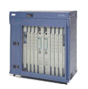





Integration in the OSI Model
←Human Workflow→
Process Integration
←Process Automation→
Application Layer
(business logic)
Bus. Int.
adaptation
Process
broker
Bus. Int.
adaptation
Application Layer
(business logic)
Presentation Layer
(data formats)
Application Connectivity
←Technical Integration→
Technical adaptation
Msg brokers
EAI, SOAP
Technical
Adaptation
Presentation Layer
(data formats)
Session Layer
API/Bridges/
Connectors
JMS, MQSeries,
IIOP. HTTP
API/Bridges/
Connectors
Session Layer
Transport Layer
TCP
Gateway
SNA
Transport Layer
Network Layer
IP
Router
IP
Network Layer
Data Link Layer
Bridge/Hub
Data Link Layer
Physical
Balun
Physical

Slide 42
SOA separates provider and consumer stack
Service Facades
can be in
Either places
Process
broker
Decomposition
Flow
Application Layer
(business logic)
Service definition
Bus. Int.
adaptation
Msg brokers
EAI, SOAP
Presentation Layer
(data formats)
Enterprise
Services Bus
Technical
Adaptation
Service binding(s)
JMS, MQSeries,
IIOP. HTTP
API/Bridges/
Connectors
Session Layer
Gateway
SNA
Transport Layer
Router
IP
Network Layer
Bridge/Hub
Data Link Layer
Balun
Physical
Standards enable more loose coupling

Slide 43
Processes, services, components and integration
Business Value from “Things”
1..n
Process
1
1
<<choreographs>>
<<is a>>
n
1
Service
1
What “Things” do
<<is a>>
n
<<implements>>
<<groups>>
1
1
What “Things” are
Component
Integration
1
1..n
1
1
1
<<represents>>
1..n
How are “Things” Constructed
Software Artifact
Web Services
Other
<<deploys>>
Where “Things” are executed
Platform
J2EE
TPF

Slide 44
When Integation technology is still required
To expose the appropriate Service Interface and granularity
  Composition and decomposition
  Atomicity of the service interfaces
  Information and format adaptation
To implement the protocol independence
  using appropriate adaptation techniques
To implement the location independence
  Dynamic routing of the services requests
  Scalability and workload management
SOA= EAI+components+loose coupling+protocol indepence+location independence

Slide 45
Agenda
What is SOA?
Business value, Business Component Modelling, Architecture
Evolution of integration to SOA. Integration architecture in the context of SOA.
Where and how do you start in an integration world?

Slide 46
Work on architecture and technology aspects alignement
Define the target reference SOA architecture
  Separation of concerns
  Domains, Layers, Standards
Define the technology elements
  Enterprise Service Bus (ESB), messaging, events
  Choreography
  Adapters
  Composition/decomposition
  Application Servers
Can reuse existing integration technology for ESB, messaging, (de)domposition

Slide 47




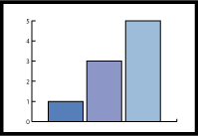
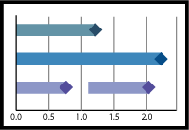


Use a Service Integration Reference Architecture
Comprehensive Services
Model
Development Platform
Design
Implement
Test
Process Monitoring
Business Performance Management Services
IT Monitoring
Interaction Services
Process Services
Information Services
Delivery
Experience
Resource
Choreography
Transactions
Staff
Federation
Replication
Transformation
Event
Enterprise Service Bus
Mediation
Transport
Business App Services
Application and Data Access Services
Partner Services
Event Detect
On-Ramp
Community
Document
Protocol
Component
Interface
Core
Business Application and Data Services
Enterprise Applications and Data
Infrastructure Services

Slide 48
Business Process Modelling, Simulation and Monitoring
Business Process Definition
Long running Workflow
Automated Process Control
Web Services
Process Integration
Business Transactions and Collaborations
Web Services
Web Services
Enterprise
Services
Bus
Bus Mediation/Brokering
Protocol Mediation
Protocol mediation
Routing and Transformation
Publish & Subscribe
Web Services
Distributed
Routing
Monitoring
Pub/Sub
Transformation
Bus Basic Connectivity/ Transport
Transport
Synchronous/Asynchronous
Connectivity
Adapters & Connectors
Adapter
JCA Connect.
Web Services
COTS 1
TX 2
Application 3
Device 4
Notes:
Animation step 1:
In a more layered view in an enterprise we find first application (south) and business processes (north). The processes may be implicitly or explicitly defined, but are the enterprise know how. The integration from application to processes can take various forms that may or may not use adapters, message broker flows, process integration services. The applications can interact directly with the message brokers or EAI using messaging APIs. All of those layer may interact together and the combination choice is the result of a solution outline process for a particular envirnment.
Monitoring also is an important aspect. Monitoring should be the business view of the process statuses. It does not have to be the technical and detailed view of how the individual tasks or operations are technically operated. Technical approach to workflow may deliver a working solution, but if no organization owns the overall workflow it may never be successful in production. Workflows are tightly linked to business views. It is often more efficient to implement the business view of the workflow, the workflow engine working in passive mode just to capture events from lower layers and enable the business monitoring of the processes.
Animation step 2:
Between all of those layers services can be defined and used, enabling more flexibility and reuse. On the west web services also can be defined to enable access to each of those layer.
Transition to next slide: Now how does one select which integration layer is the best fit for specific requirements (click)

Slide 49
days
People & application
Staff management
BPEL (WfMC) standard support
hours
Long running Workflow
1 sec
Process Integration
Business transactions
Automatic compensation
Cross reference
Request/reply
Web Services Business processes BPEL (OASIS W3C)
Bus Mediation/Brokering
Bus Basic Connectivity/ Transport
1/10 sec
Atomic transactions
XA standard. two phase commit
Stateless, fire and forget
Direct database & message access
msecs
Notes:
On the right the time scale is just indicative, but give an idea of the use cases that can match those layers. The message brokering or EAI layers are the location for atomic transactions (2 phase commit or XA standard support). It is a fast, high performance processing of messages that takes an input message, parses it in a logical memory representation, does a few manipulations and passes the information to the output destinations.
The process integration layer is the one where business transaction belong. This layer understands the semantics of the business events (create a customer in CRM, update an order in the ERP). Since it integrates applications that do not allow other applications to take control of their resources and lock until work is committed, the way to undo the work in case of error is compensation. Compensation does the opposite action to a previous action on that application. He opposite action may be complex, as an example some application do not support delete of an element after its creation and the opposite action for the creation of a customer might then be “set the customer to inactive”.
This layer is were the BPEL standard is executed. This standard that defines process integration for Web Services based activities and is a standard originated by UBM, Microsoft and BEA originated and which now is handled by OASIS.
On the upper layer we have the long running workflows that involve people and applications. A workflow activity may require the best skilled person for that particular action. The engines in this layer enable this type of flows and are most likely based on the WfMC workflow coalition standards (from 1995).

Slide 50
Enterprise Service Bus for SOA Realization
Service Implementation
SOAP / HTTP
Service Requester
.NET
Policy
Service Requester
Behaviour
Find
Interface
Discover
Bind
Service Registry
reality
Service Registry
Link
Mediation
Patterns
Domain Models
Service Provider
Discover
Service Provider
Interface
Publish
Behaviour
TPF / SOAP
IMS / MQ
Policy
Existing Applications TPF, IMS etc

Slide 51







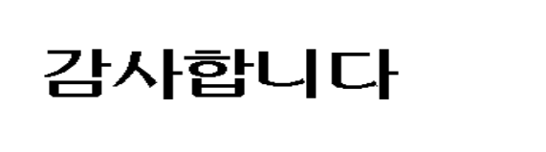

Hindi
Thai
Traditional Chinese
Gracias
Russian
Thank You
Spanish
English
Obrigado
Arabic
Brazilian Portuguese
Danke
Grazie
German
Simplified Chinese
Merci
Italian
French
Tamil
Japanese
Korean

