Slide 1
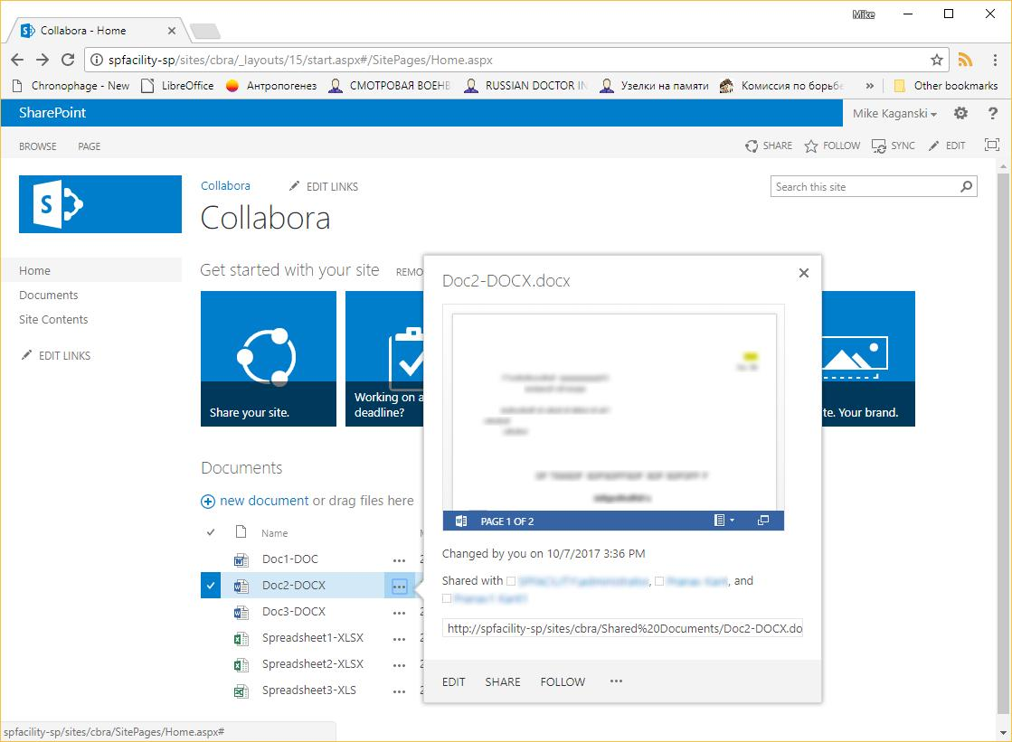
Notes:
Comments

