Slide 1
Description of the problem:
The height of the text node is set to fixed value 60 on “Diagram60” and value 20 on “Diagram20”. Thus the rectangles are 60mm tall and 20mm tall, respectively.
The height is correct, but the position of those text nodes, that have second level text, is wrong.
Tested with 17487 included, 2026-10-30

Slide 2
One
Two
Three
Level 2 first
Level 2 second

Slide 3
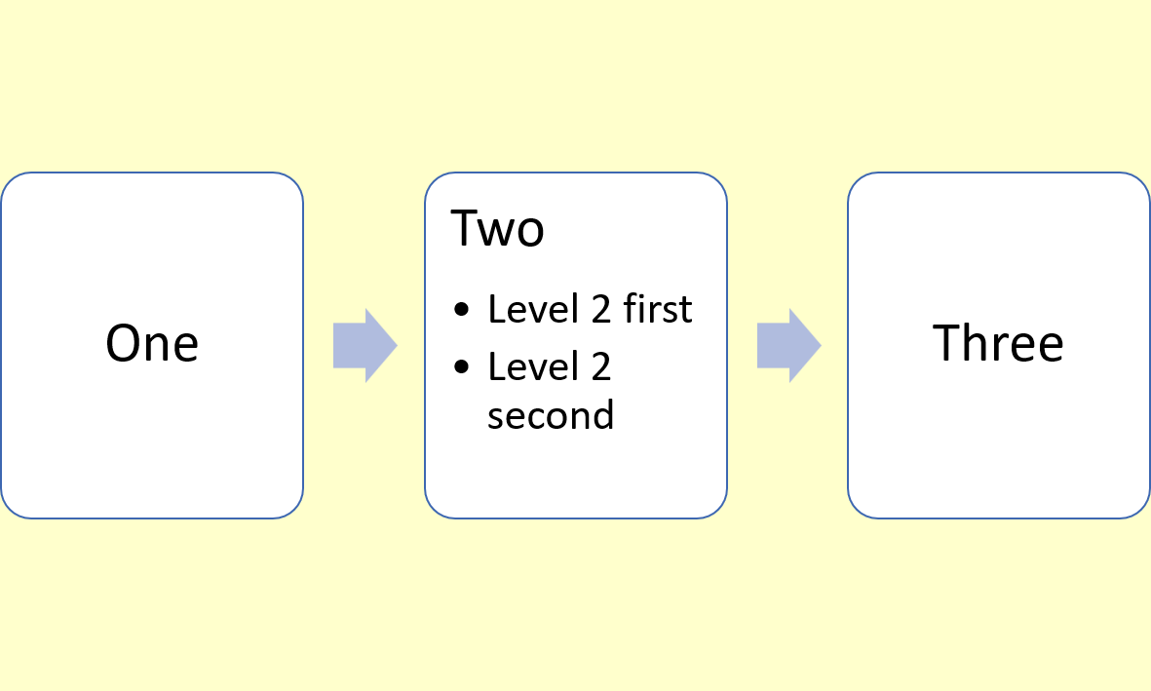

Slide 4
Four
Five
Six
Level 2 first
Level 2 second
Level 2 third

Slide 5


