Slide 1
One
Eleven
Twelve
Two
Twenty-one
Twenty-two
Three
Four
Forty-one
Thirteen
Forty-two

Slide 2
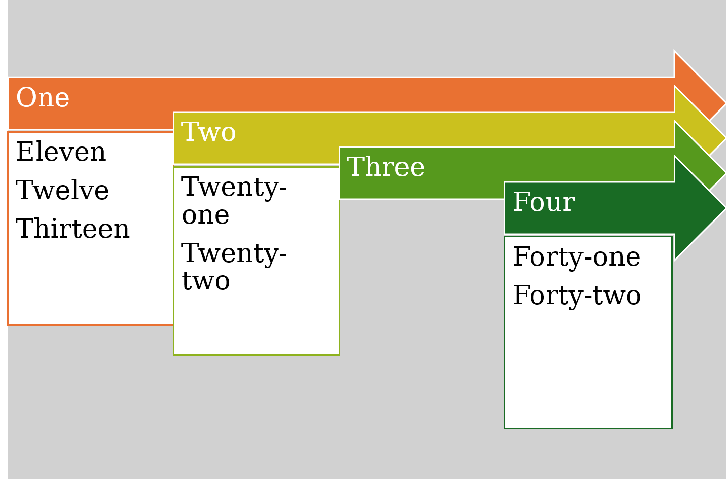
Screenshot

