Slide 1

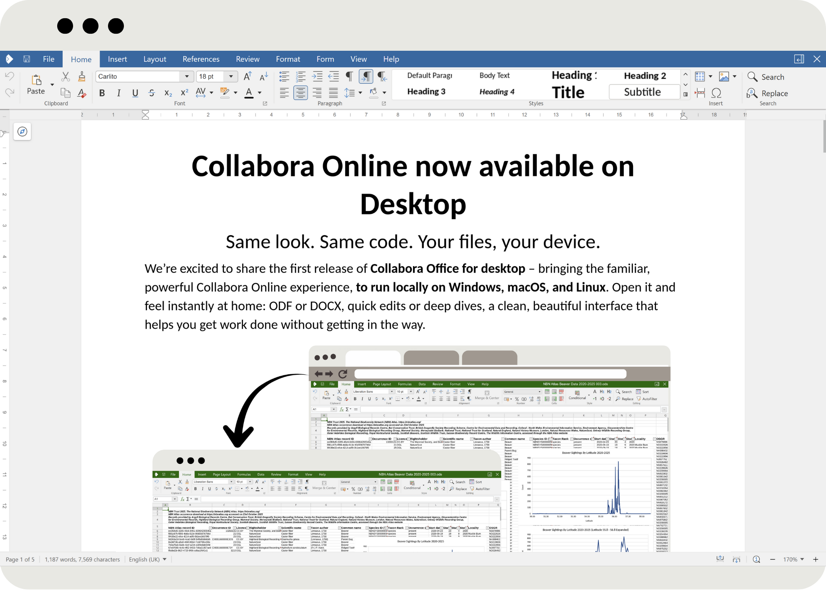
_All New Collabora Office
_Same look, same code
_Your files, your device
www.collaboraonline.com
_Find out more!

Slide 2
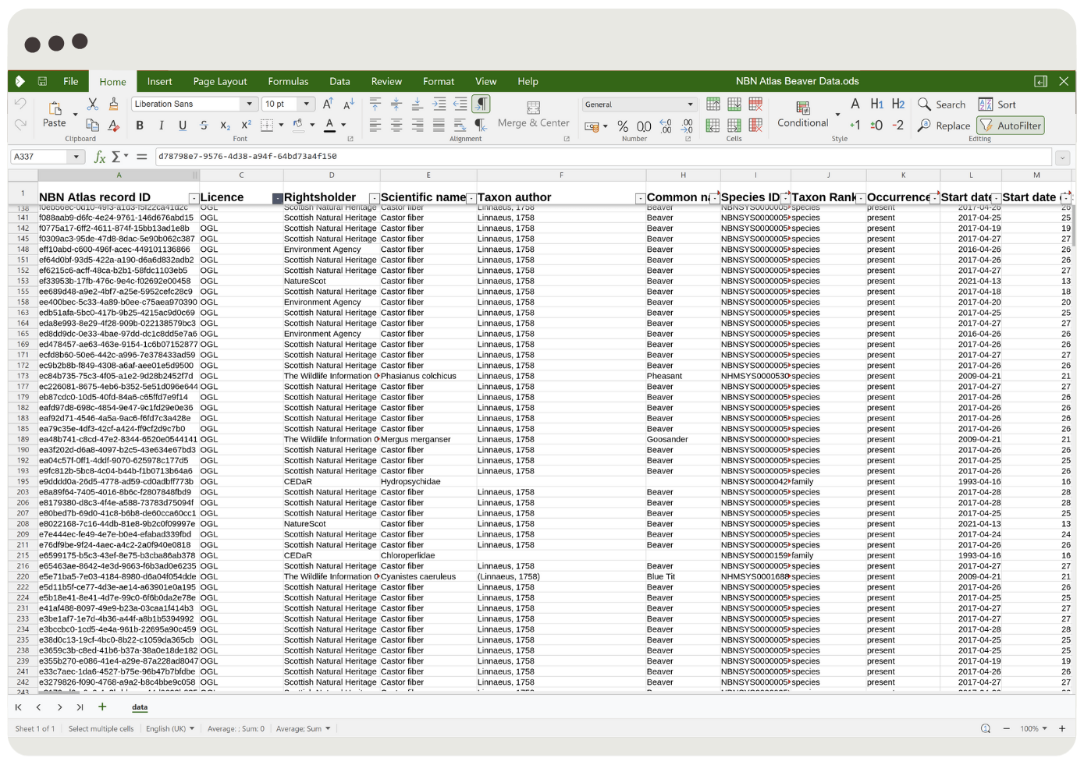
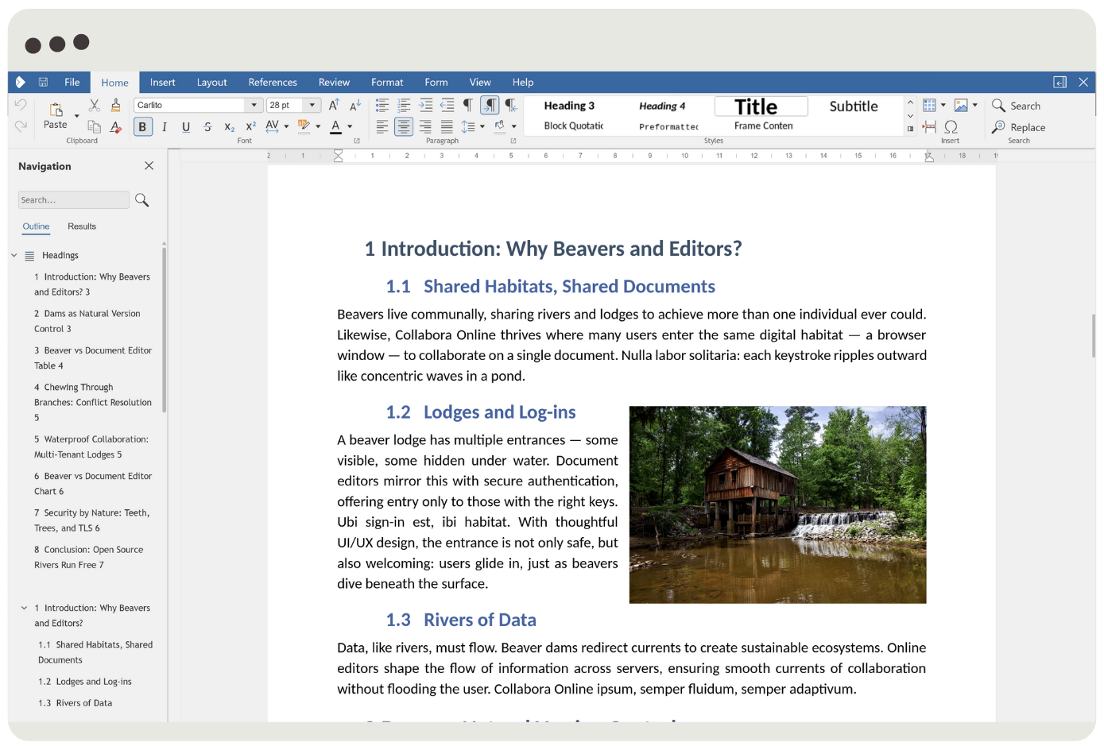
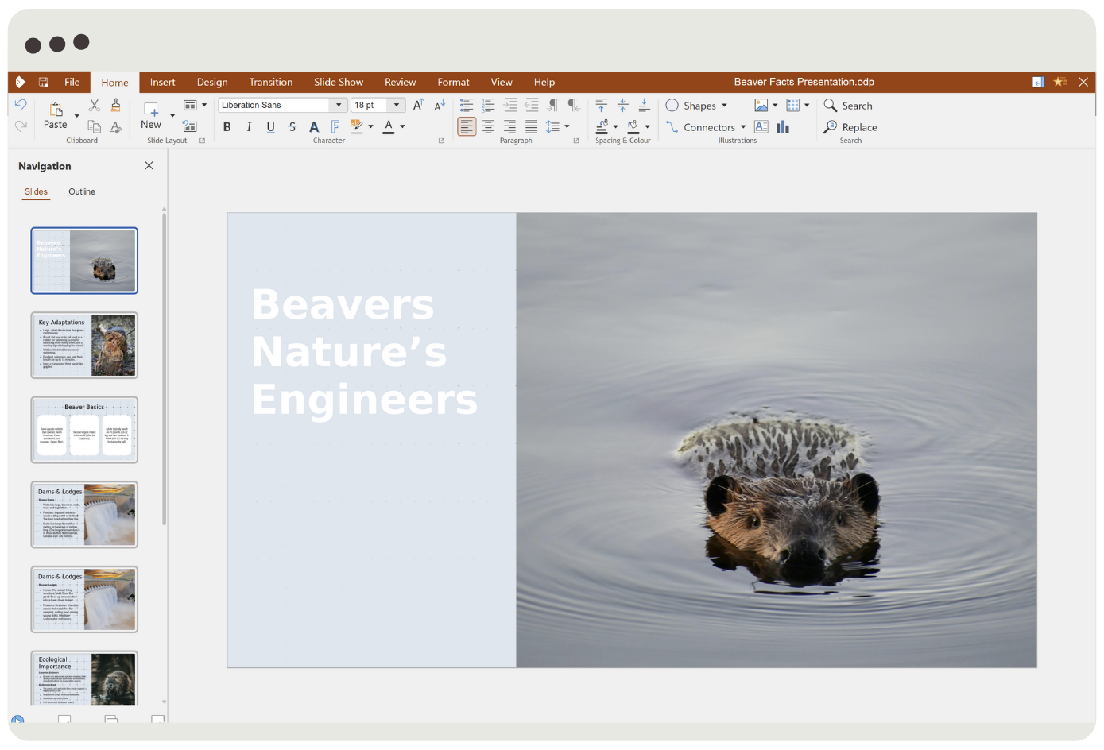
Collabora Office
_Open it and feel instantly at home:
_ODF or DOCX
_Quick edits or deep dives
_A clean, beautiful interface
www.collaboraonline.com
_Next

Slide 3
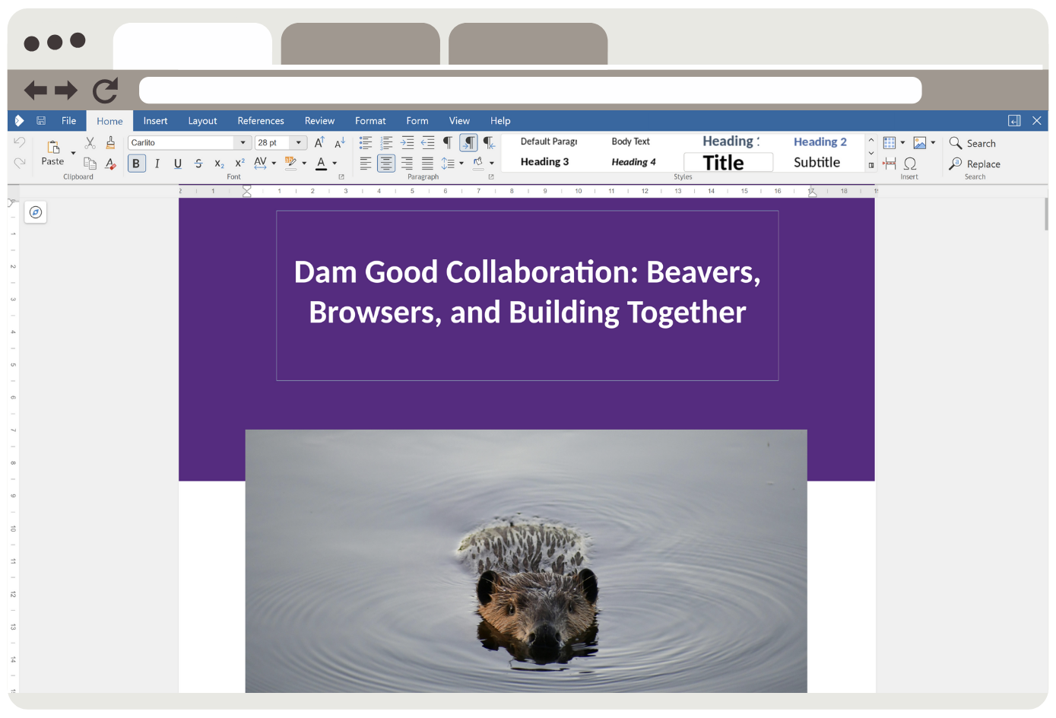


Collabora Office
_The familiar, powerful Collabora Online experience
_Now locally on Windows, macOS, and Linux
www.collaboraonline.com
_Next

Slide 4
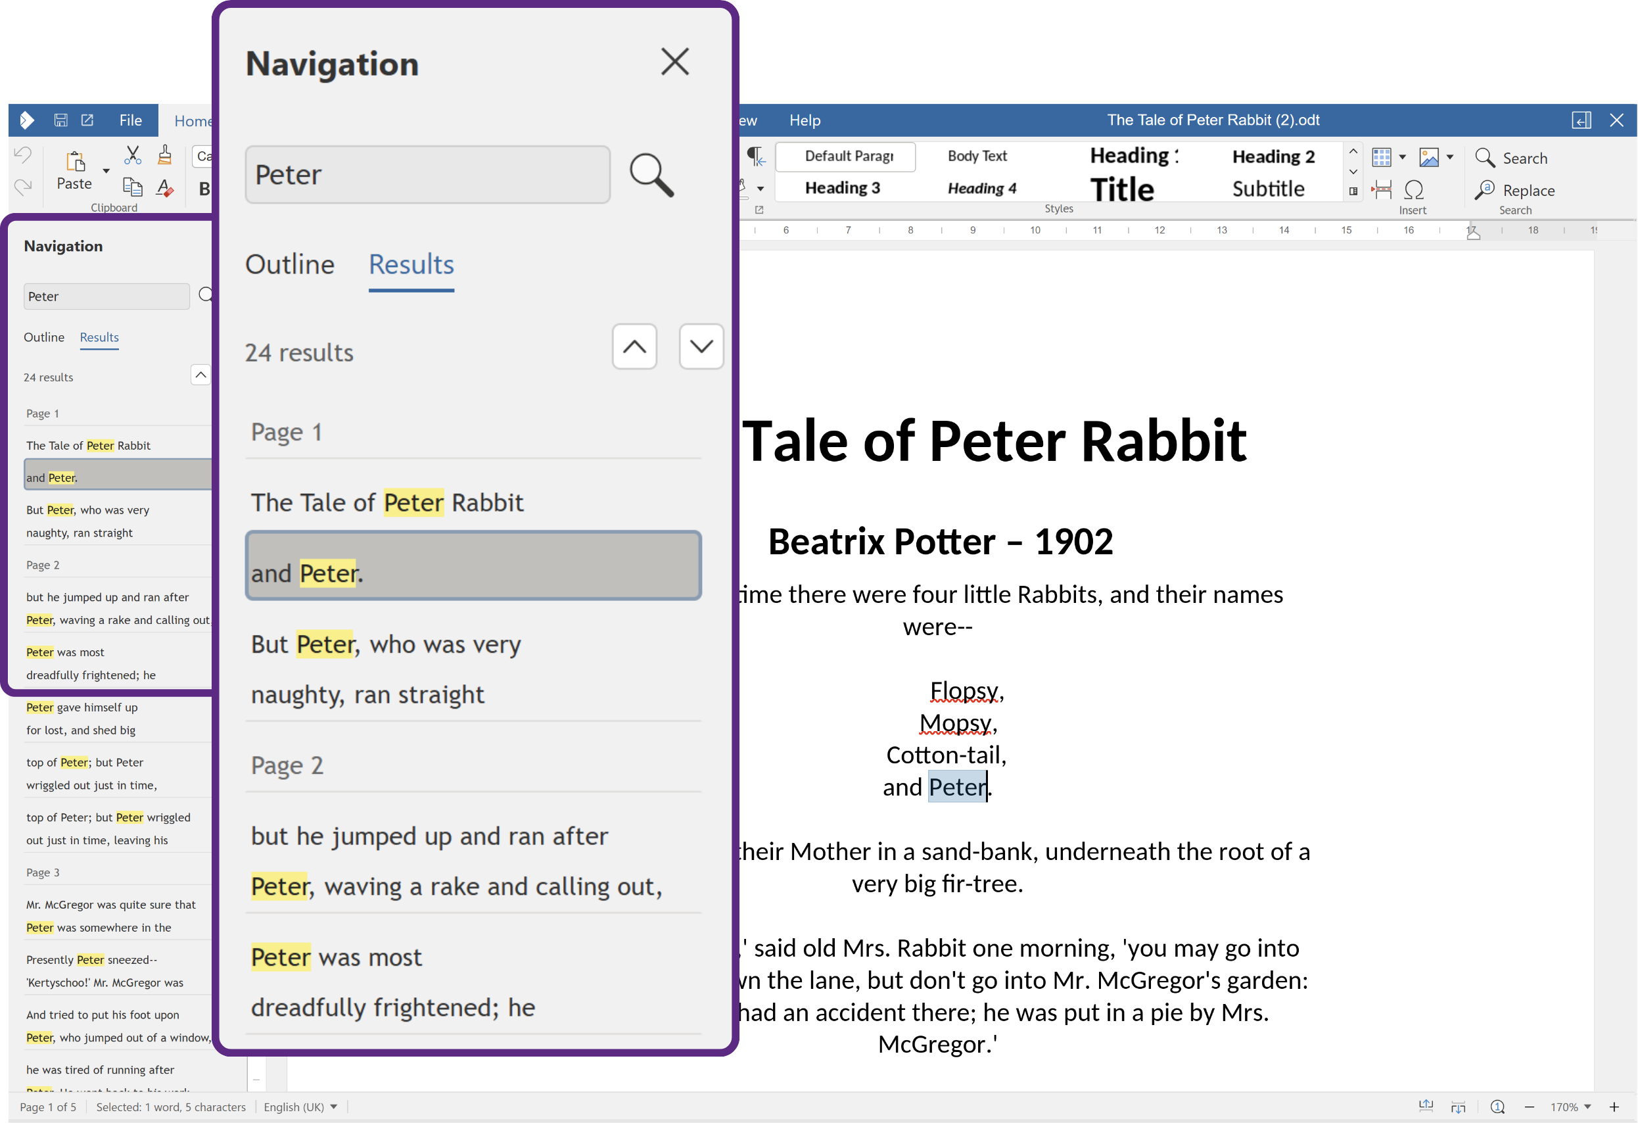
Collabora Office
_Enjoy editing your documents locally with an intuitive, intelligent interface
www.collaboraonline.com
_Navigator bar with document search
_Next

Slide 5
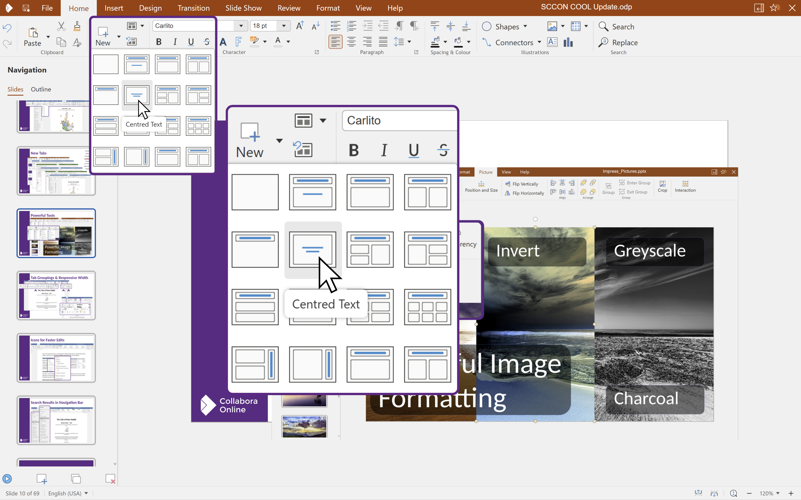
Collabora Office
_Enjoy editing your documents locally with an intuitive, intelligent interface
www.collaboraonline.com
_Helpful quick access examples
_Next

Slide 6
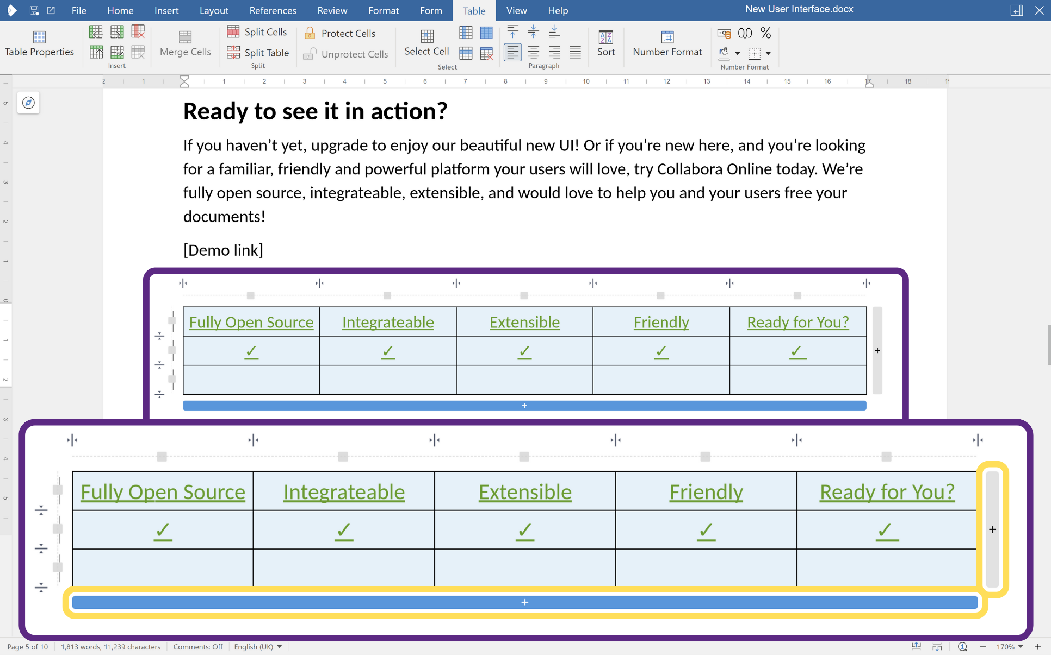
Collabora Office
_Enjoy editing your documents locally with an intuitive, intelligent interface
www.collaboraonline.com
_Create and edit tables within documents
_Next

Slide 7
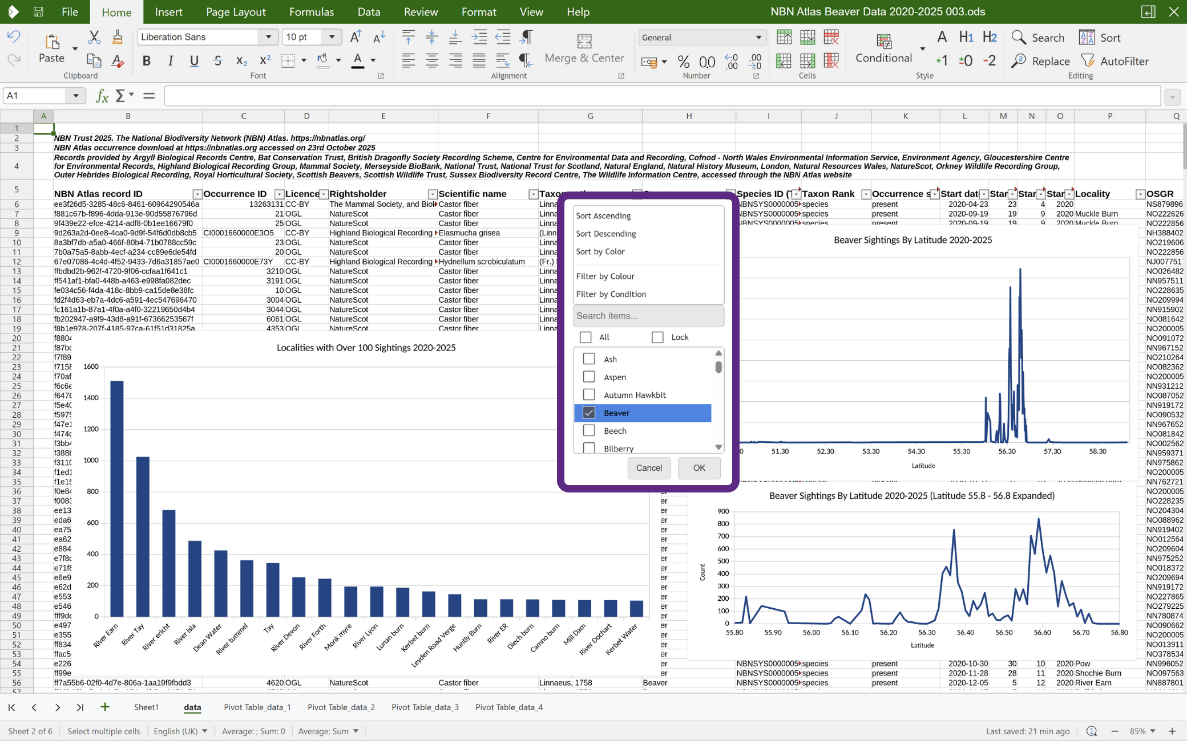
Collabora Office
_Enjoy editing your documents locally with an intuitive, intelligent interface
www.collaboraonline.com
_Powerful data and charting tools
_Next

Slide 8
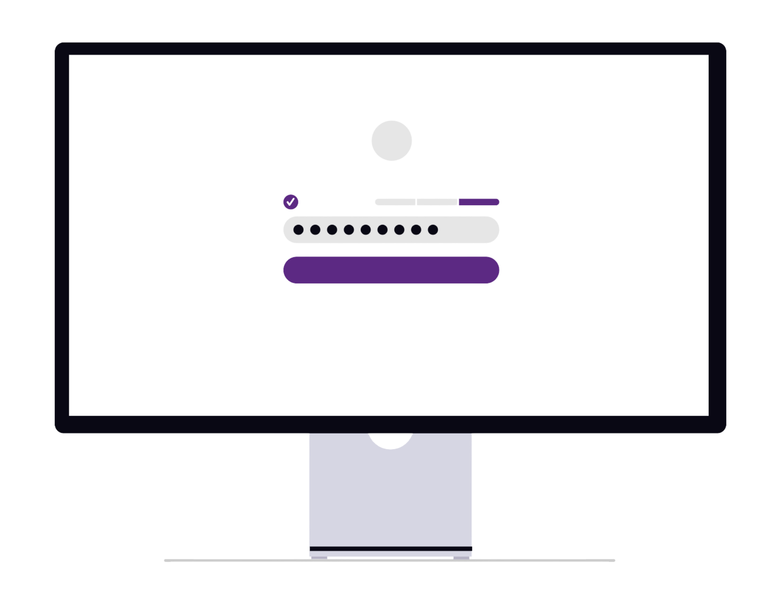
Collabora Office
_Privacy by design
_Fully open source – no hidden executables, no spyware
_Documents never leave your device – unless you say so
www.collaboraonline.com
_Next

Slide 9

Collabora Office
_We’re excited to share this release with the community
_Try it out. Break things. Let us know what works and what doesn’t.
_Together, we're building a privacy-respecting, open, and elegant office suite for everyone.
www.collaboraonline.com
_Take back control

