Slide 1

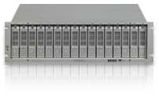
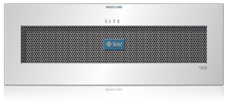
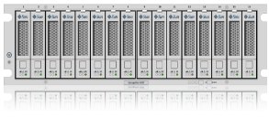
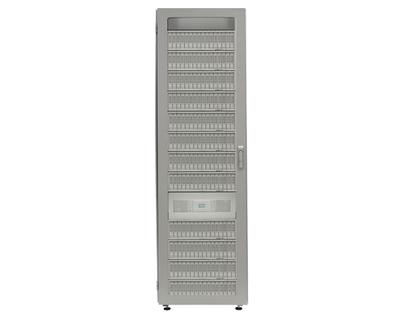
Sun Storage 6000 array family
Product Overview
S6180
ENTRY FLEXIBLE & AFFORDABLE
4GB, 4 or 8 Host Ports
Up to 112 disks, 224TB
NEBS-Level 3 Certified
S6580
MID-LEVEL SCALABLE
Up to 32GB cache, 8 Host Ports
Up to 256 drives, 512TB
Supports up to 20 x 73GB SSD
S6780
FLAGSHIP PERFORMANCE DRIVEN
2-4x Performance over 6500 Class
Up to 64GB cache, 8 or 16 host ports
Up to 448 disk, 896TB raw capacity
Mix Host Interface Cards
Supports up to 20 x 73GB SSD
STANDARD FEATURES (ALL MODELS)
8Gbps Fibre Channel Host Ports
Sun Storage Common Array Manager
Cache De-Stage to Flash Drives
Tiered storage with HDDs intermix in the same tray
Data-In-Tray Migration from 6180 to 6780
OPTIONAL STORAGE DATA SERVICES (ALL MODELS)
Sun Storage Domain Software
Sun Storage Local Copy Software (Volume Copy & Snapshot)
Sun Storage Data Replicator Software
Data Encryption Services Software

