Slide 1
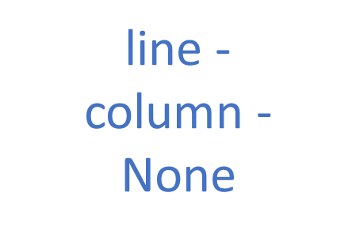
line -
column -
None

Slide 2
line 0 column 2 Arch Down
line 0 column 2 Arch Down
line 0 column 2 Arch
line 0 column 2 Arch
line 0 column 4 Button
line 0 column 4 Button
line 0 column 4 Button
line 0 column 3 Circle
line 0 column 3 Circle

Slide 3
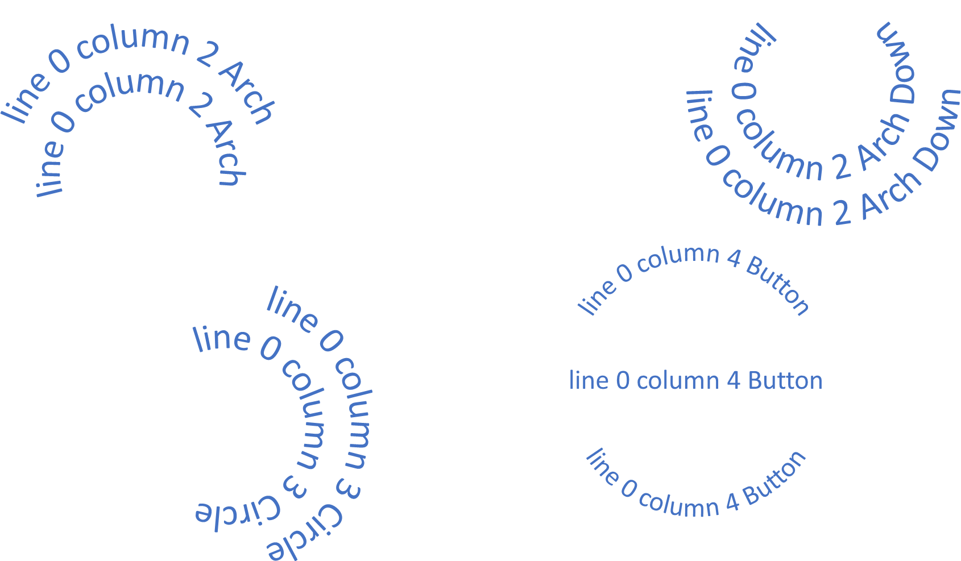

Slide 4
line 1
column 1
Square
line 1
column 2
Stop
line 1
column 4
Triangle Down
line 1
column 3
Triangle Up

Slide 5
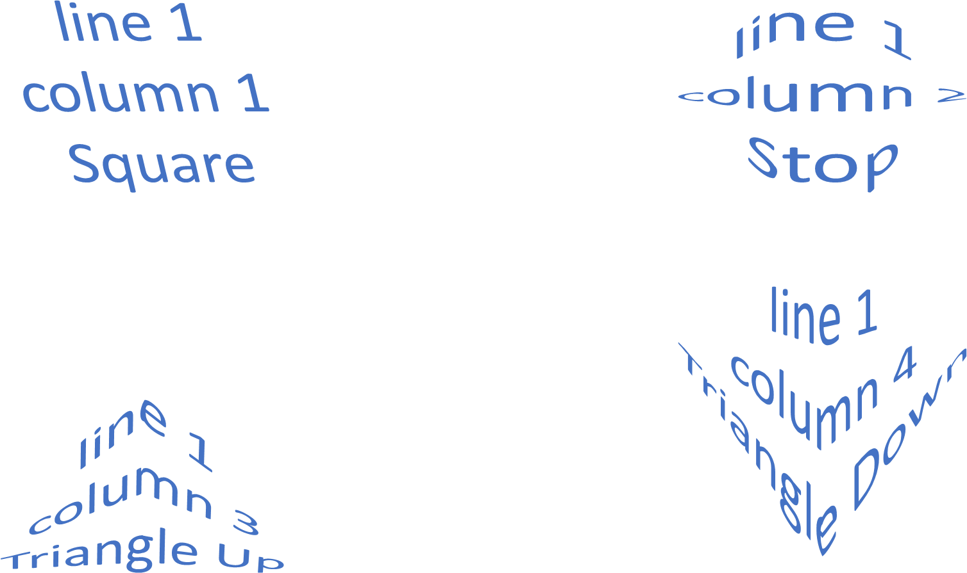

Slide 6
line 2
column 1
Chevron Up
line 2
column 2
Chevron Down
line 2
column 3
Ring Inside
line 2
column 4
Ring Outside

Slide 7
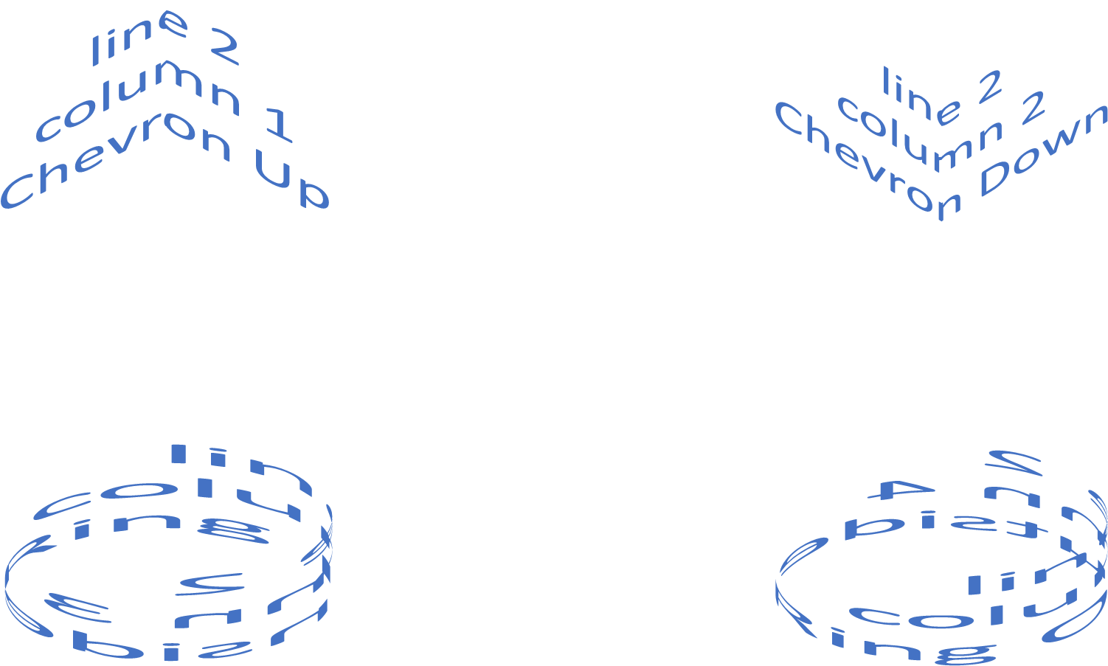

Slide 8
line 3
column 1
Arch Warped
line 3
column 2
Arch Warped Down
line 3
column 3
Warped Circle
line 3
column 4
Warped Button

Slide 9
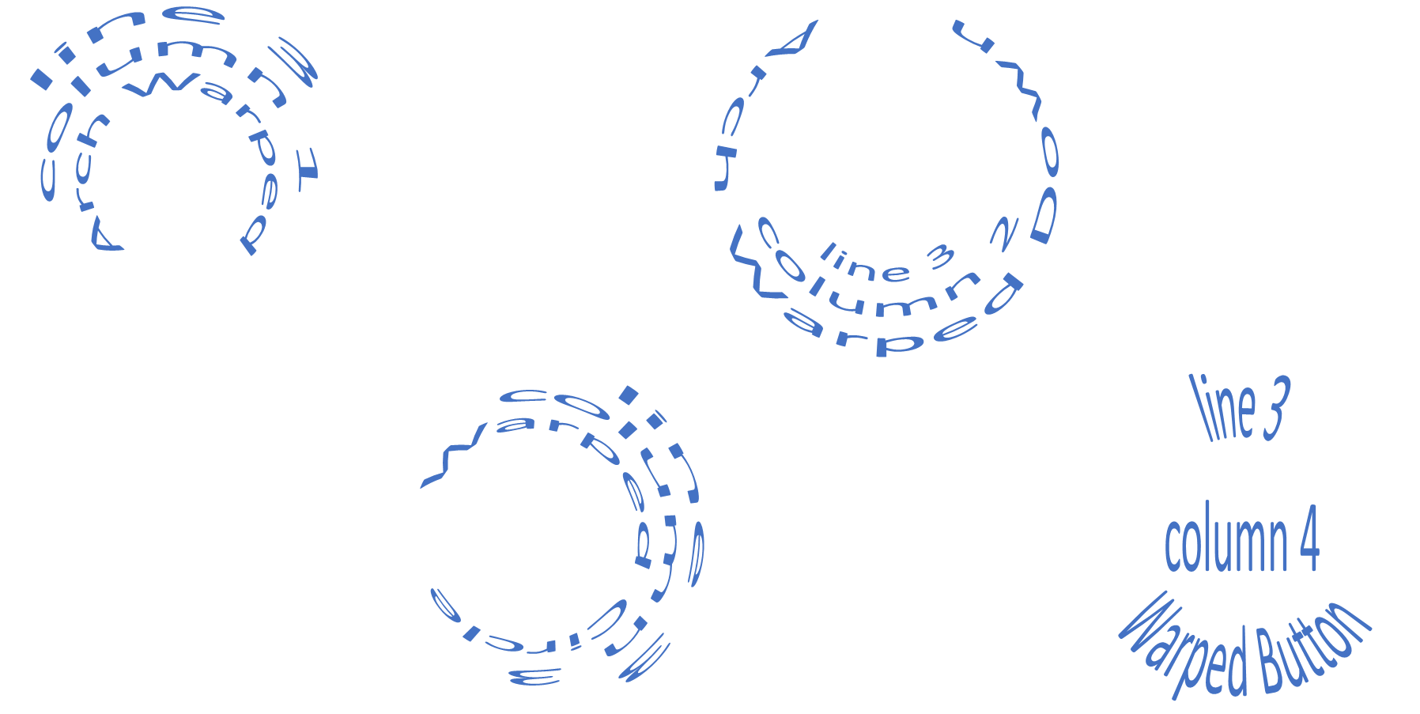

Slide 10
line 4
column 1
Curve Up
line 4
column 2
Curve Down
line 4
column 3
Warp Up
line 4
column 4
Warp Down

Slide 11
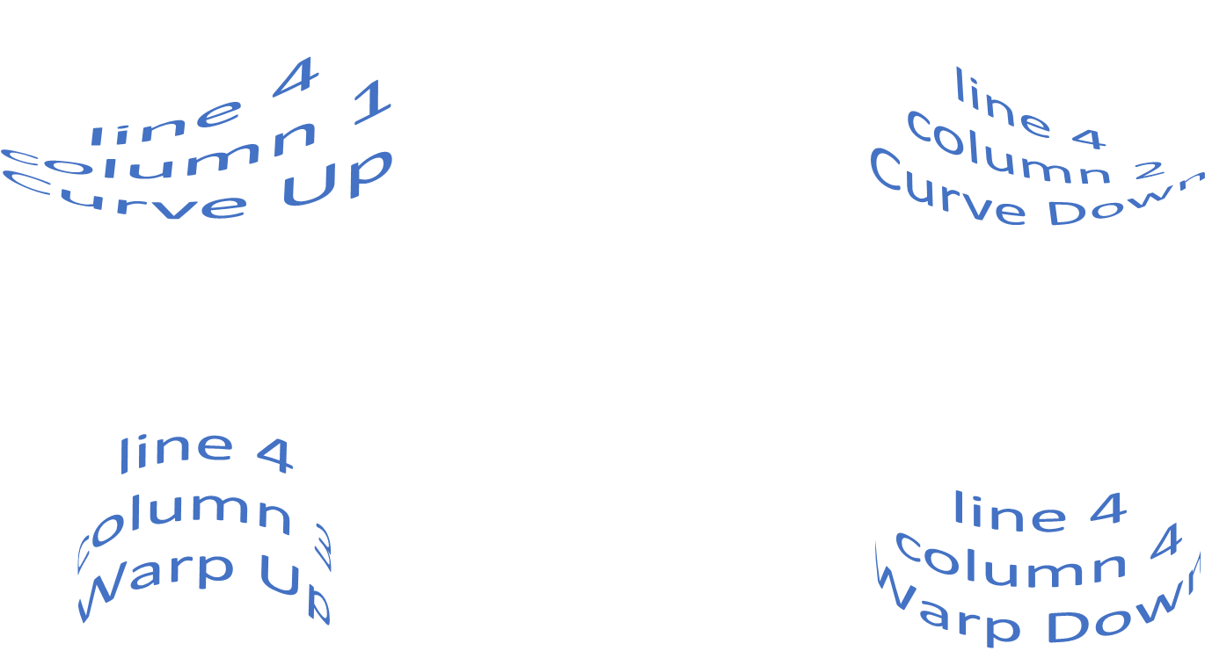

Slide 12
line 5
column 1
Wave Down
line 5
column 2
Wave Up
line 5
column 3
Double Wave Down-Up
line 5
column 4
Double Wave Up-Down

Slide 13
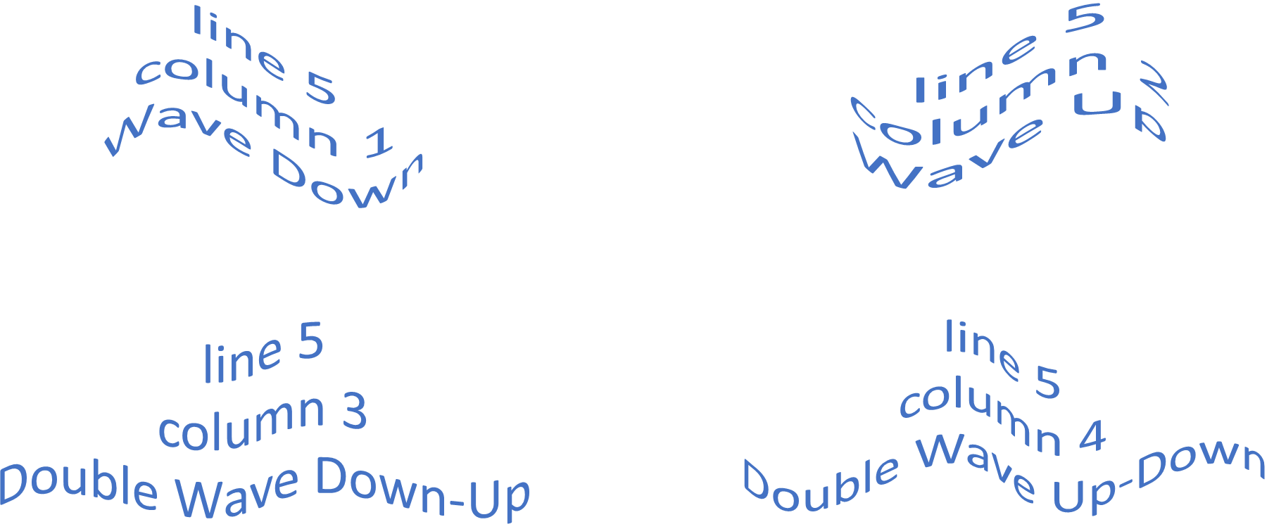

Slide 14
line 6
column 1
Inflate
line 6
column 2
Deflate
line 6
column 3
Inflate Bottom
line 6
column 4
Deflate Bottom

Slide 15
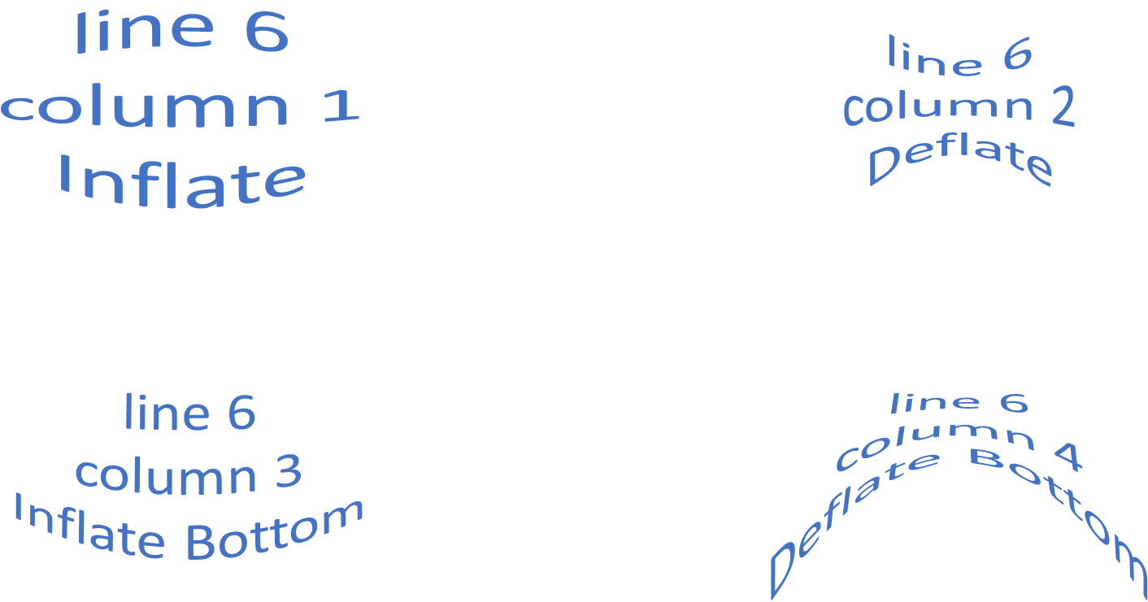

Slide 16
line 7
column 1
Inflate Top
line 7
column 2
Deflate Top
line 7
column 3
Deflate Top Inflate Bottom
line 7
column 4
Inflate Middle Deflate Top and Bottom

Slide 17
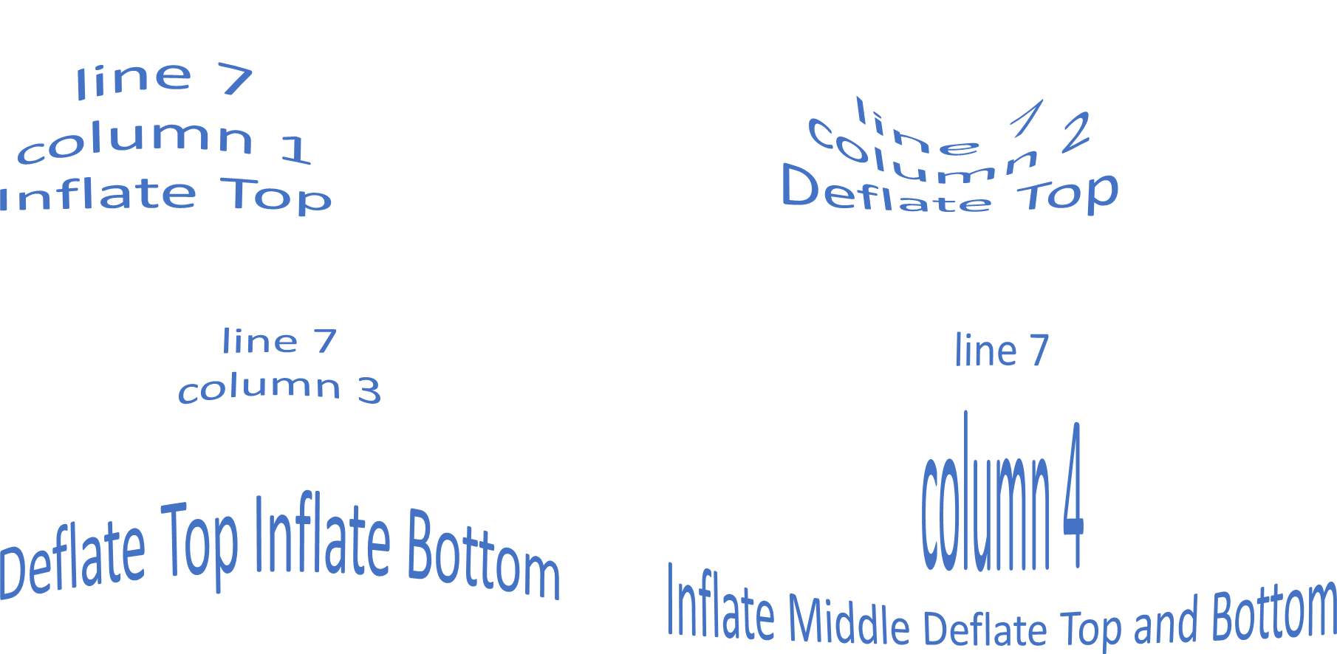

Slide 18
line 8
column 1
Fade Right
line 8
column 2
Fade Left
line 8
column 3
Fade Up
line 8
column 4
Fade Down

Slide 19
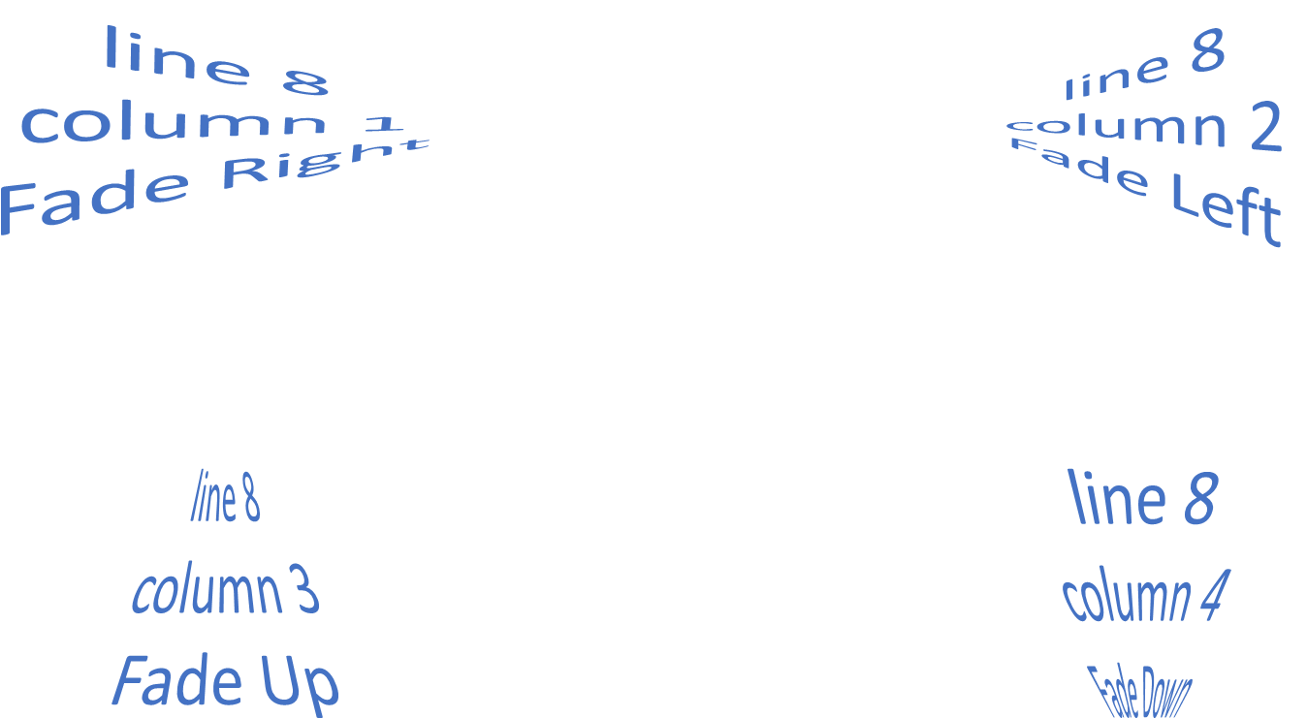

Slide 20
line 9
column 1
Slant Up
line 9
column 2
Slant Down
line 9
column 3
Cascade Up
line 9
column 4
Cascade Down

Slide 21
