Slide 1
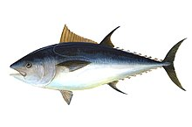
Atlantic bluefin tuna
Notes:
This is the atlantic bluefin tuna.
It lives in a can.

Slide 2
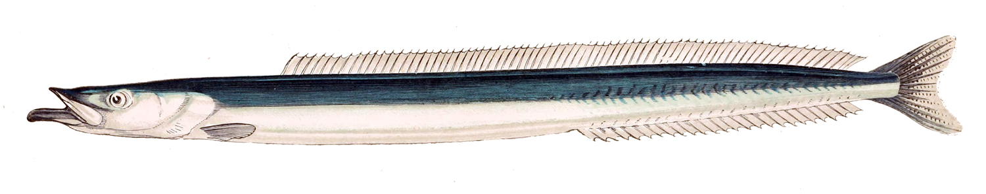
Great sand eel
Notes:
Smoke it.

Slide 3
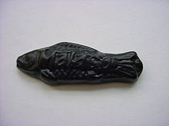
Swedish Fish

Slide 4
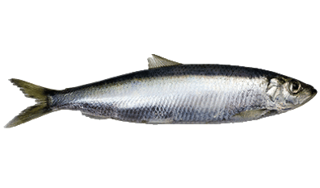
Baltic herring

Slide 5

Northern pike

