Slide 1


SearXNG
Information in the presentation is sourced from SearXNG documentation. No license is indicated for the documentation, however the project itself is licensed under the AGPLv3+ license.
https://docs.searxng.org
By Mike
@QuantumCheap
And now...
@quantumcheap@infosec.exchange

Slide 2
TABLE OF CONTENTS
01
03
02
04
What is SearXNG?
Public vs. Private Instances
Why use it?
Balance

Slide 3
What is SearXNG?
01

Slide 4
Metasearch engine
A search engine that aggregates search results from other search engines.
Examples
  Skyscanner
  Kayak.com
  Dogpile
  Metacrawler
  SearX

Slide 5
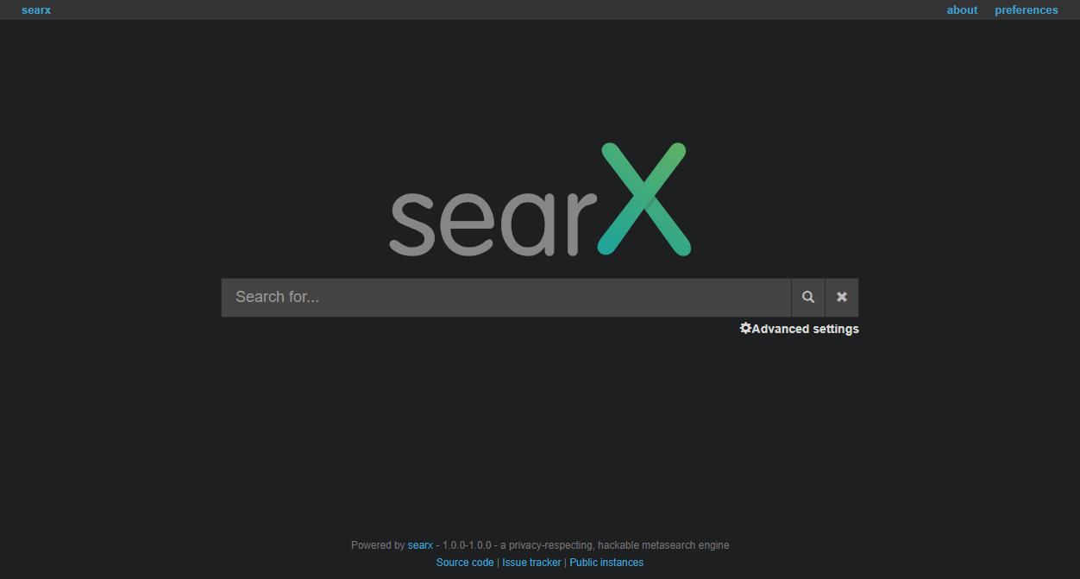
What is SearX?
SearX (pronunced sɜːks) is a free internet metasearch engine which aggregates results from more than 70 search services. Users are neither tracked nor profiled. Additionally, SearXNG can be used over Tor for online anonymity.

Slide 6
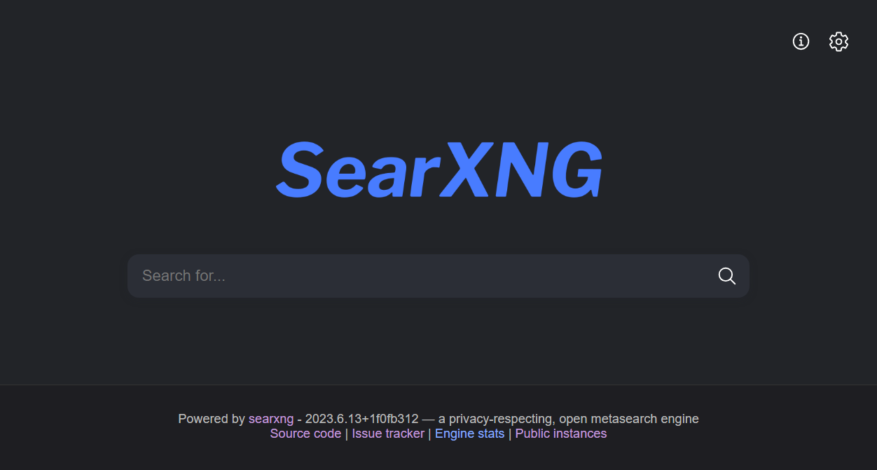
What is SearXNG?
SearXNG also is a free internet metasearch engine which aggregates results from more than 70 search services. Users are neither tracked nor profiled. Additionally, SearXNG can be used over Tor for online anonymity.

Slide 7
What’s the difference?
TL;DR: SearXNG is for users that want more features and bugs getting fixed quicker. If you prefer a minimalist software and stable experience, use searx.
SearxNG is a fork of searx, created by a former maintainer of searx.
SearxNG has rolling releases, dependencies updated more frequently, and engines are fixed faster.

Slide 8
02
Why use it?

Slide 9
Why use Searx
SearXNG may not offer you as personalized results as Google, but it doesn’t generate a profile about you.
SearXNG doesn’t care about what you search for, never shares anything with a third-party, and it can’t be used to compromise you.
SearXNG is free software, the code is 100% open, and everyone is welcome to make it better.

Slide 10
How does SearXNG protect privacy?
SearXNG protects the privacy of its users in multiple ways regardless of the type of the instance (private, public). Removal of private data from search requests comes in three forms:
removal of private data from requests going to search services (generating a random browser profile for every request)
not forwarding anything from a third party services through search services (e.g. advertisement)
removal of private data from requests going to the result pages

Slide 11
Demo
2b

Slide 12
Public vs. Private Instances
03

Slide 13
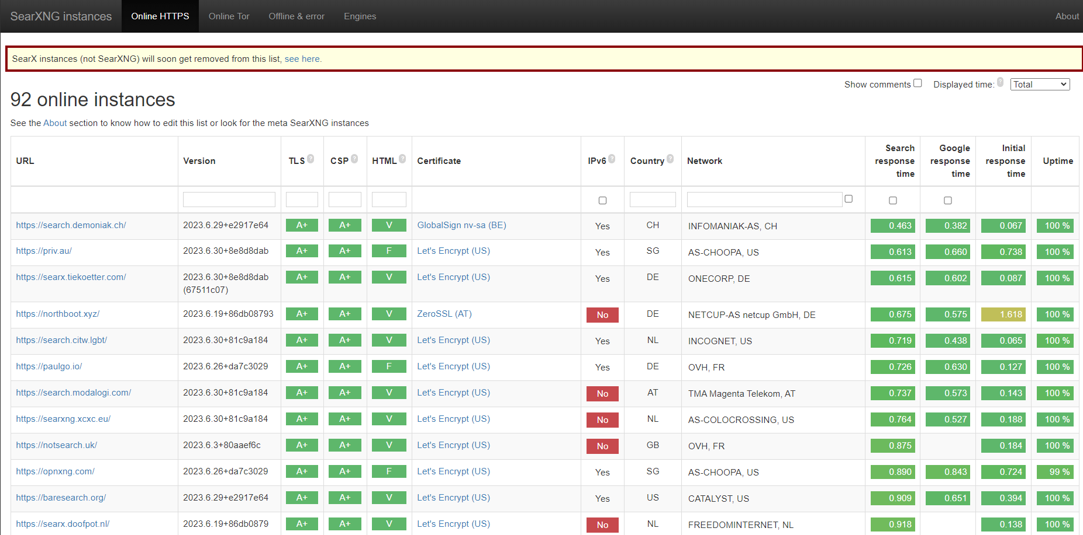
https://searx.space

Slide 14
Considerations of using a public instance
If someone uses a public instance, they have to trust the administrator of that instance. This means that the user of the public instance does not know whether their requests are logged, aggregated and sent or sold to a third party.
Also, public instances without proper protection are more vulnerable to abusing the search service, In this case the external service in exchange returns CAPTCHAs or bans the IP of the instance. Thus, search requests return less results.

Slide 15
What about private instances?
If you run your own instance, everything is in your control: the source code, logging settings and private data. You don’t have to trust an an unknown administrator.
Furthermore, there is no need to use cookies to tailor SearXNG to your needs since the default settings of your instance are editable. So your preferences will not be reset when clearing browser cookies. And since settings are stored on your computer, it will not be accessible to others as long as your computer is not compromised.
However, search engines will still know that a search originated from you IP.

Slide 16
Balance
04

Slide 17
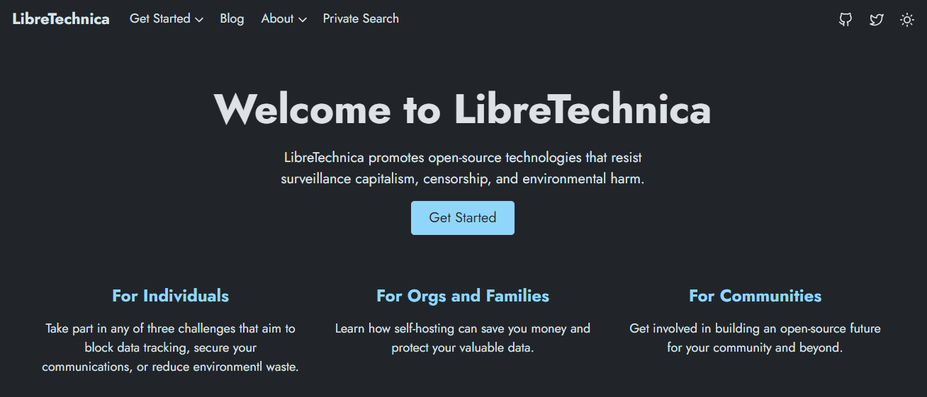
Try SearXNG at LibreTechnica
Go to https://www.libretechnica.org > Click on “Private Search”

Slide 18
Conditions
Feel free to try it out and see if you want to run your own instance. In doing that, I sternly request the following:
No hacking the server
No searching for stuff that will get you sent to prison.
Do not post the site on https://searx.space or any other list. That could traffic to the point of throttling/blocking by the primary search engines.

Slide 19
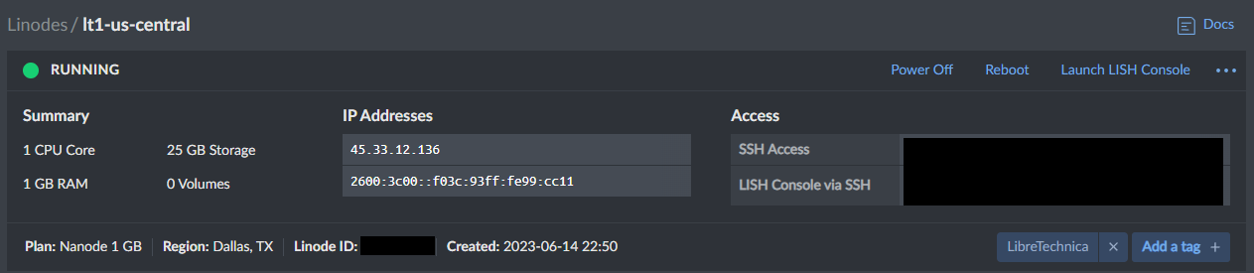
Trust issues?
Instance Details:
TLS certificate through Let’s Encrypt
You have just met the administrator.
Your searches will be mixed with others’ searches. This will hinder profiling based on query history.
It’s hosted on LibreTechnica’s domain, so I’m staking it’s reputation on it being private.

Slide 20
THANKS!
Do you have any questions?
@QuantumCheap @quantumcheap@infosec.exchange
Please keep this slide for attribution

