Slide 1
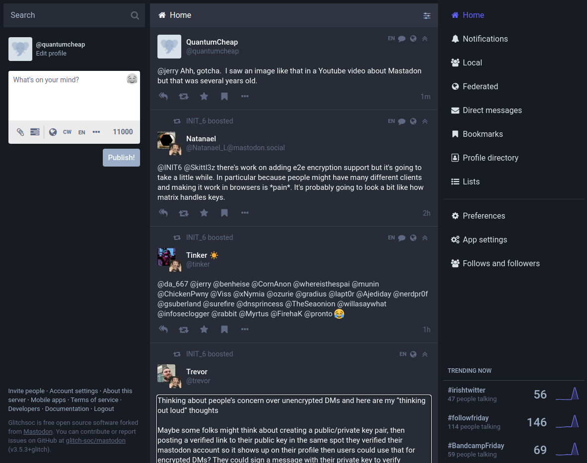





Introduction to
&
By Mike
@QuantumCheap
And now... @quantumcheap@infosec.exchange

Slide 2
Twitter vs. Mastodon
𝕏
micro-blogging platform | micro-blogging platform
is a company | is a free and open-source project
powered by advertisements | has no advertising
is beholden to shareholders (mainly Elon Musk) | is beholden to nobody
users “tweet” | users “toot”
every users is connected to every user | users are either conntected to other on one instance or to other instances as well
moderated globally | moderation varies on a per-instance basis
users are locked in, cannot export data | users are free to export their data and move to another instance completely

Slide 3
Reddit vs. Lemmy
link aggregator | link aggregator
is a company | is a free and open-source project
powered by advertisements | has no advertising
is beholden to shareholders (venture capital) | is beholden to nobody
forums are called “subreddits” | forums are called “communities”
every users is connected to every user | users are either conntected to other on one instance or to other instances as well
moderated globally | moderation varies on a per-instance basis
users are locked in, cannot export data | users are free to export their data and move to another instance completely

Slide 4
How does this “federation” thing work?
Facebook users cannot communicate directly with MySpace users. They’re closed systems. Imagine if upgrayedd@aol.com could not email presidentcamacho@compuserve.com.
The fediverse works like actual email, though. Users of different services like outlook.com or gmail.com can all email each other through common standards and protocols. Likewise, users of a particular Mastodon instance can reach out (and follow, boost, etc.) to users of another instance.
For example, I (quantumcheap@infosec.exchange) can DM or re-toot someone at Fosstodon (libretechnica@fosstodon.org). This is enabled by a standard protocol called ActivityPub.

Slide 5
Ramifications
You are not served advertisements
Nobody is profiting from your interactions, user data, or clicks.
Your feed algorithm doesn’t feed you rage-bait
Profit-driven social media encourages uses to engage in controversial topics. The long you’re on the platform, the longer they can serve you ads.
Smaller, more insular communities
You’re less likely to encounter those with extremely opposing views. This can foster a sense of community like in LGBTQ+ instances, but it can also promote radicalization within fringe insular communities like Truth Social.
You’re closer to the administrators
Each instance has it’s own code of conduct and moderation team and could take abuse more seriously.

Slide 6
Let’s hop on a Mastodon!
A fantastic guide is found here: https://axbom.com/mastodon-guide/
1. Find a server
https://joinmastodon.org/servers or https://instances.social/
My presences are at
https://infosec.exchange/
https://counter.social/
And LibreTechnica is at
https://fosstodon.org/
2. Sign up, verify email, and setup your profile
3. Start following
You can follow those in other instances as well. For example, I (quantupcheap@infosec.exchange) am following libretechnica@fosstodon.org

Slide 7
Let’s hop on Lemmy!
A Getting Started guide is at the LibreTechnica Blog https://www.libretechnica.org/blog/join-our-lemmy-instance/
1. Find a server
https://github.com/maltfield/awesome-lemmy-instances
https://the-federation.info/platform/73
My presences are at:
https://lemmy.world/
https://libretechni.ca/
2. Sign up, verify email, and setup your profile
3. Start following
You can subscribe to communities on other instances as well. For example, my account (QuantupCheap@libretechni.ca) follows following !selfhosted@lemmy.world.

Slide 8
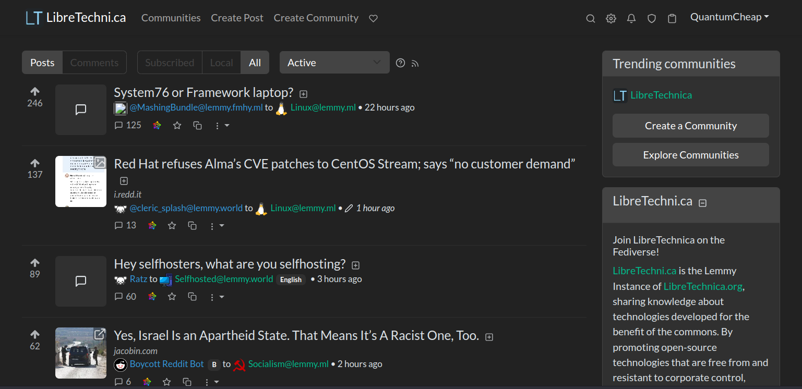
Join us at https://libretechni.ca
Registration is free and open.

Slide 9
Let’s get noticed!
To be included in the list of Lemmy instances on join-lemmy.org you must meet the following requirements:
Federate with at least one instance from the list
Have a site description and icon
Don't have closed sign-ups
Have at least 5 users who posted or commented at least once in the past month
Be on the latest major version of Lemmy

Slide 10
Thank you!
Follow DHA on Mastodon
@dallas_hackers@infosec.exchange
C’mon, all the cool kids are doin’ it.
Do you have any questions?
@QuantumCheap @quantumcheap@infosec.exchange

