Slide 1
Google Street View –
To blur or not to blur...
Question proposed by @LibreTechnica
Presented by @quantumcheap

Slide 2
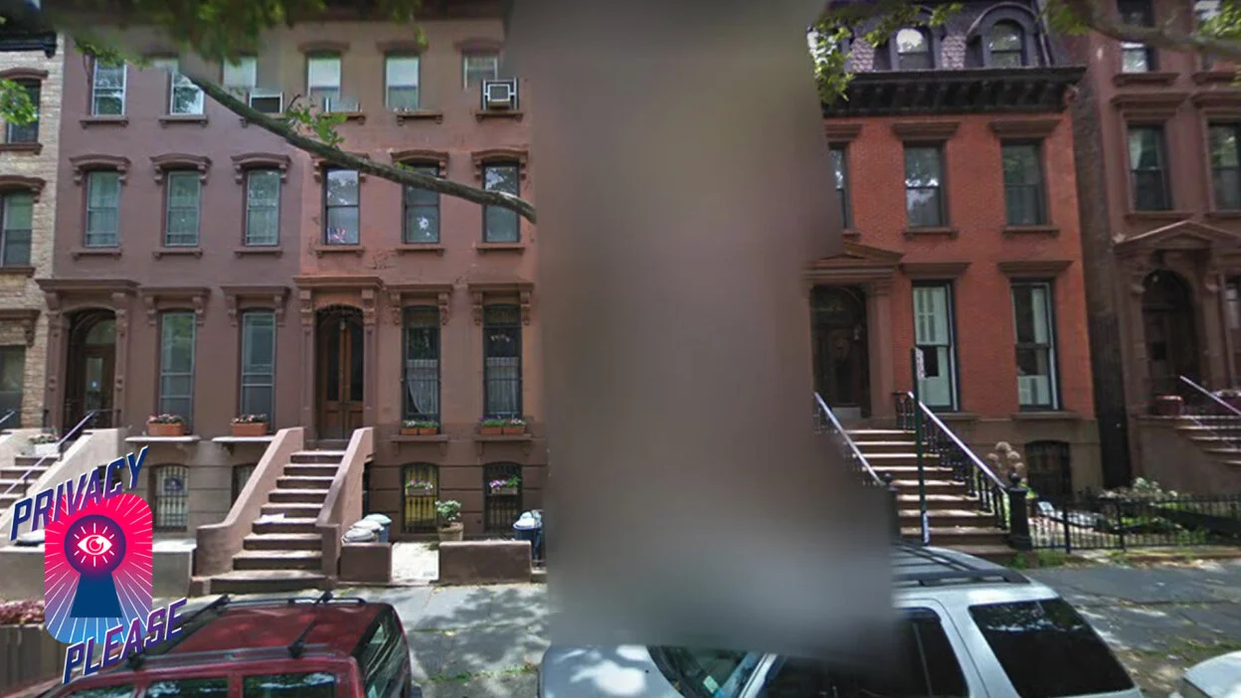
To blur...

Slide 3
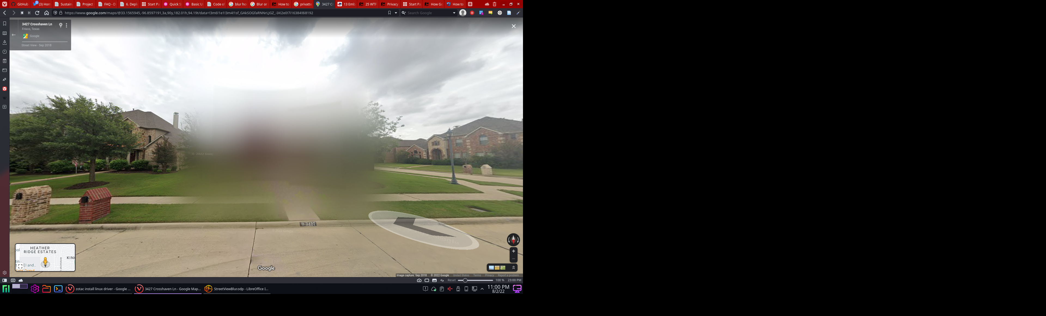
To blur...

Slide 4
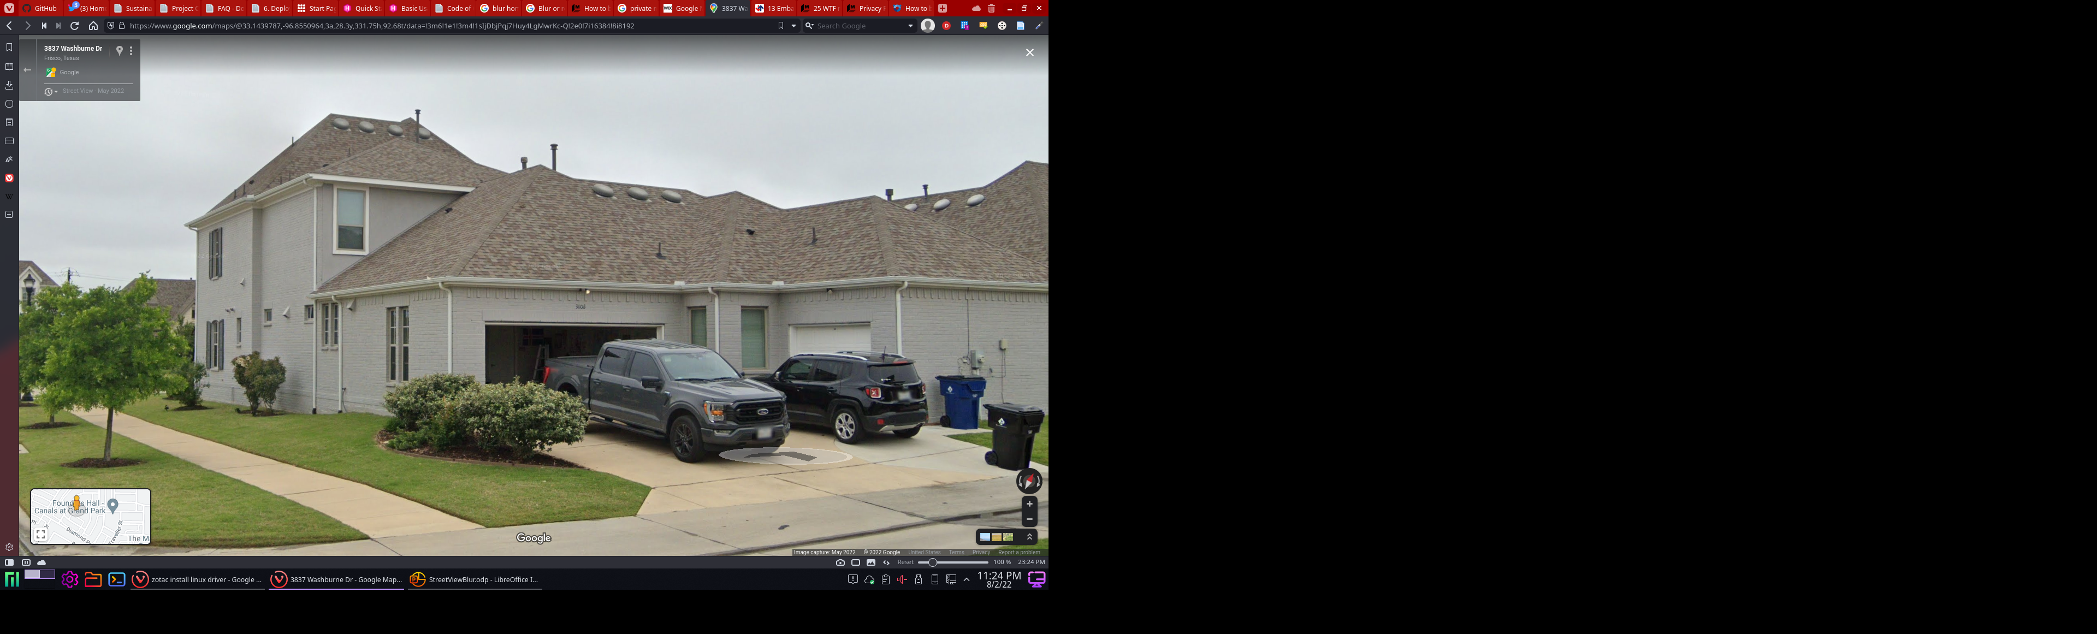
..or not to blur.

Slide 5
..or not to blur.
Risks
  Casing the house for robbery
  Get information for stalking/harassment
  Can obtain other information to identify and track you like your car type/color
  Source: https://www.pandasecurity.com/en/mediacenter/security/blur-your-house/

Slide 6
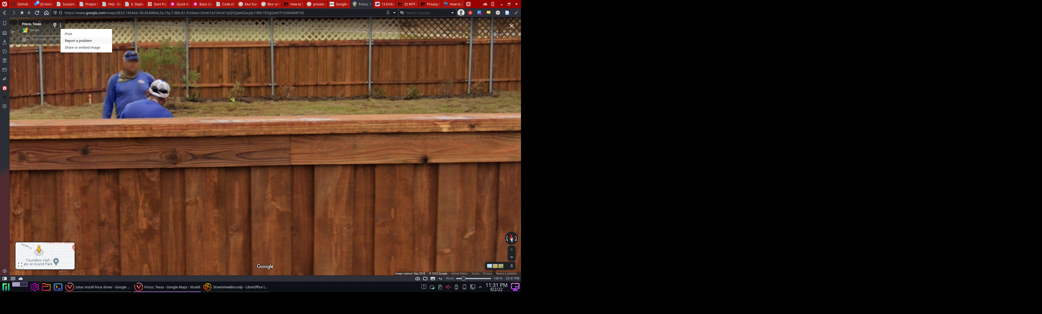
How to blur your face or your place
Anyone can type an address on Google Maps, click on the three dots, and then hit report a problem to blur a house.
Once prompted, homeowners can focus the view on their property and adjust the image view of their home. Then they can request blurring of the house by providing an email.
After completing the captcha validation, Google takes care of your request. Once a blur is requested, it stays there forever.
  Source: https://www.pandasecurity.com/en/mediacenter/security/blur-your-house/

Slide 7
What do you think?
To blur or not to blur?
Discuss.

