Slide 1


By Mike
@QuantumCheap

Slide 2
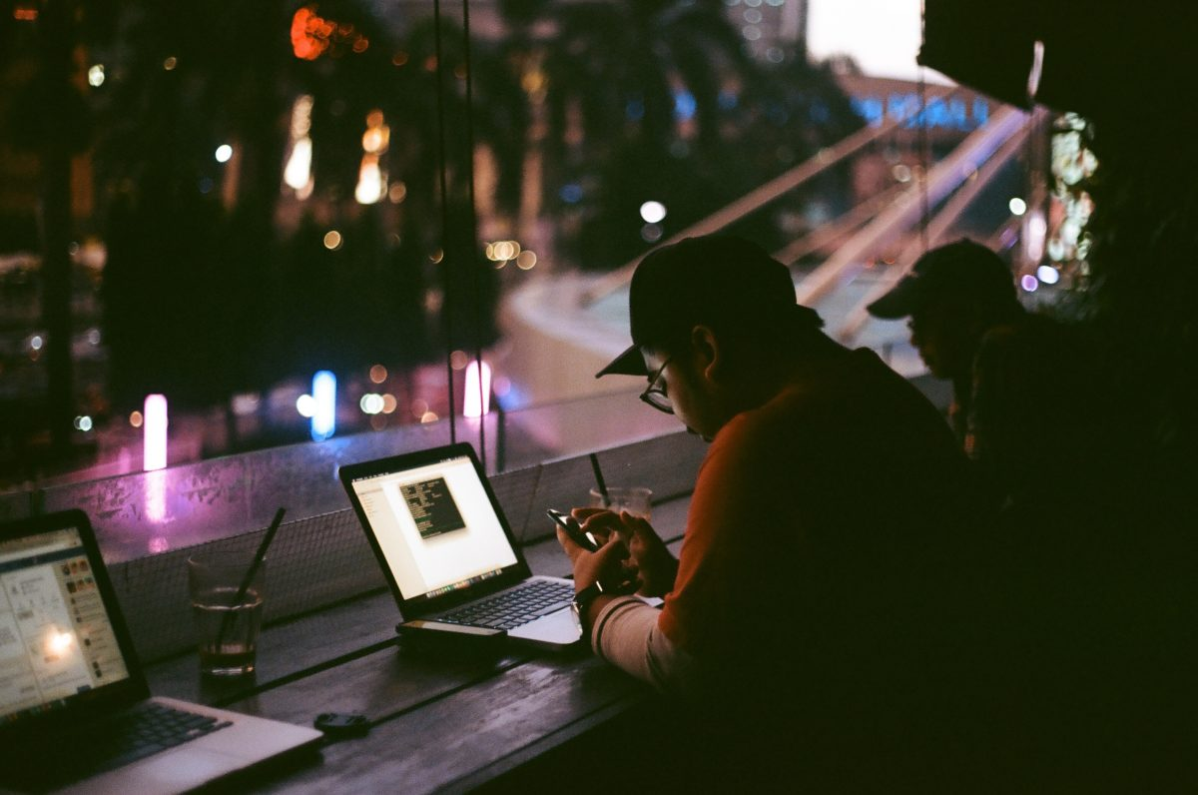
What are the threats to digital freedom?
Commercial
Governmental
Political
Social
Environmental

Slide 3

Commercial
If the service is free, you are the product
You are targeted for ads 6k-10k times per day
Monopolies and duopolies dominate tech
1st Amendment does not apply to being deplatformed
Companies have more control over the things you buy

Slide 4
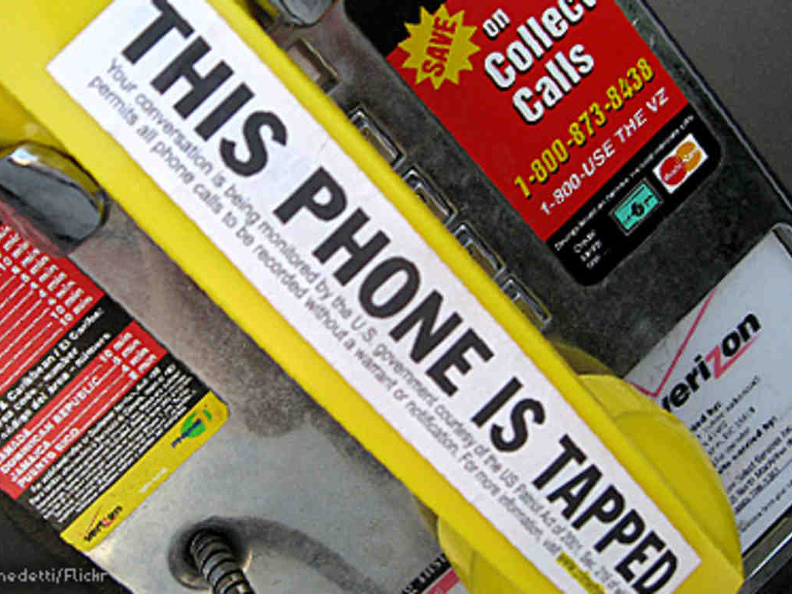
Governmental
Snowden reveals NSA mass surveillance
Law enforcement officers often violate civil liberties
Border agents can conduct in-depth searches of phones and laptops

Slide 5
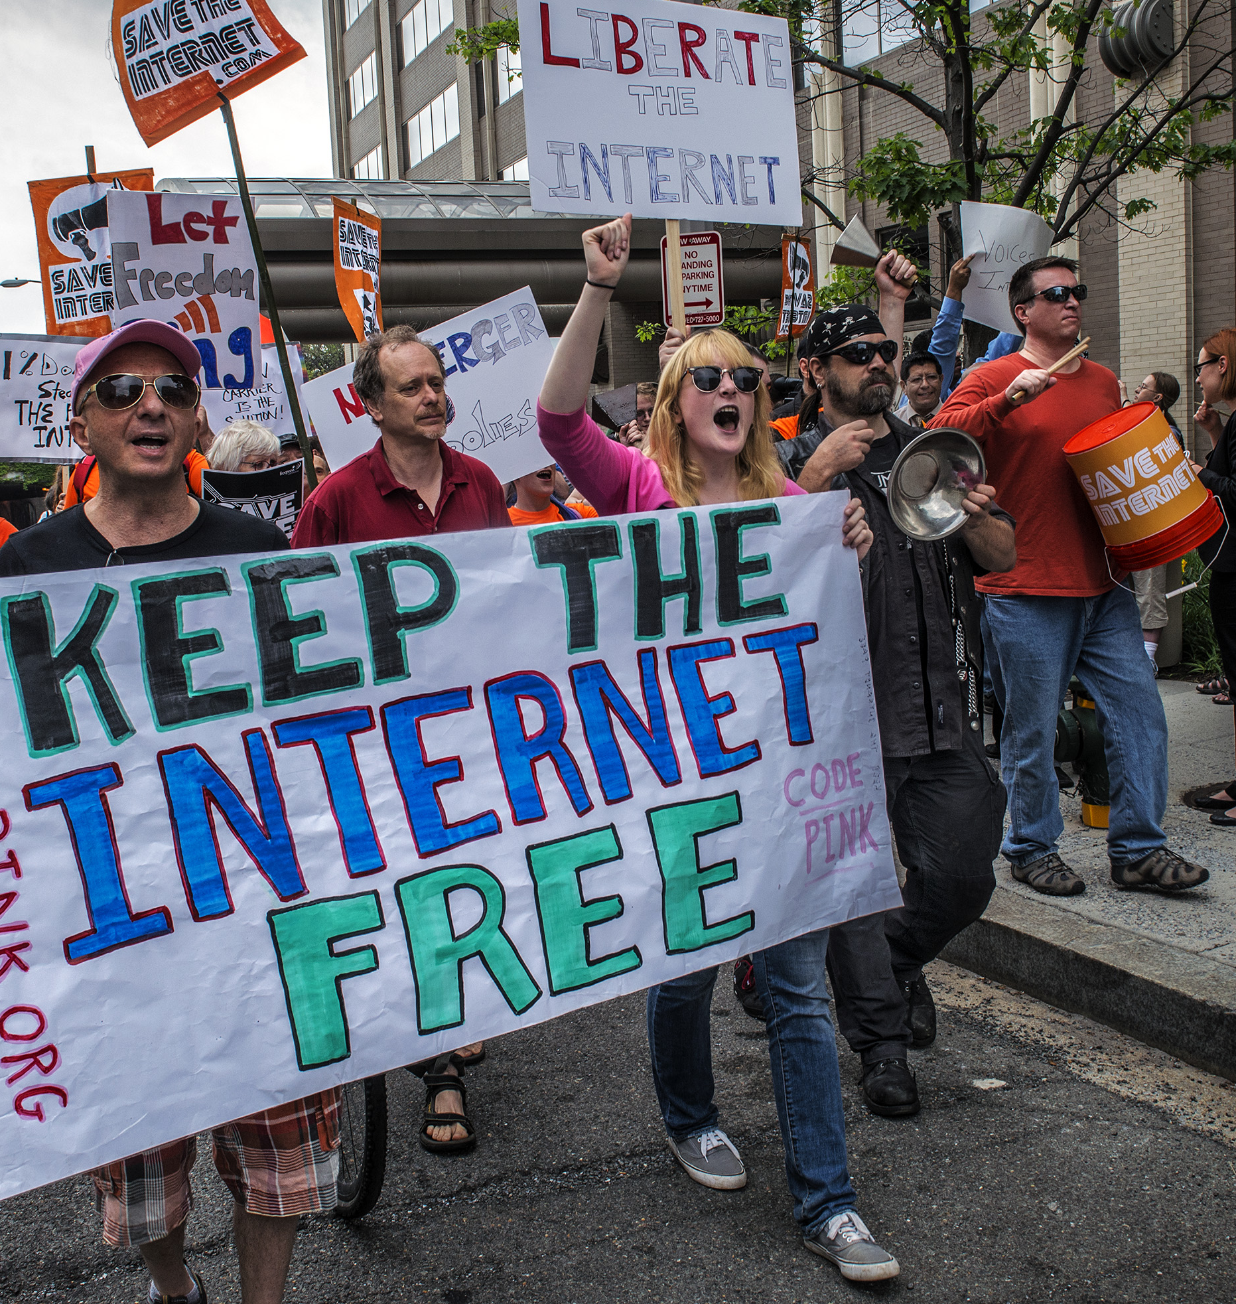
Political
Net Neutrality gutted by regulatory capture
US lacks sufficient data privacy protection laws
There is little enforcement of anti-trust laws

Slide 6
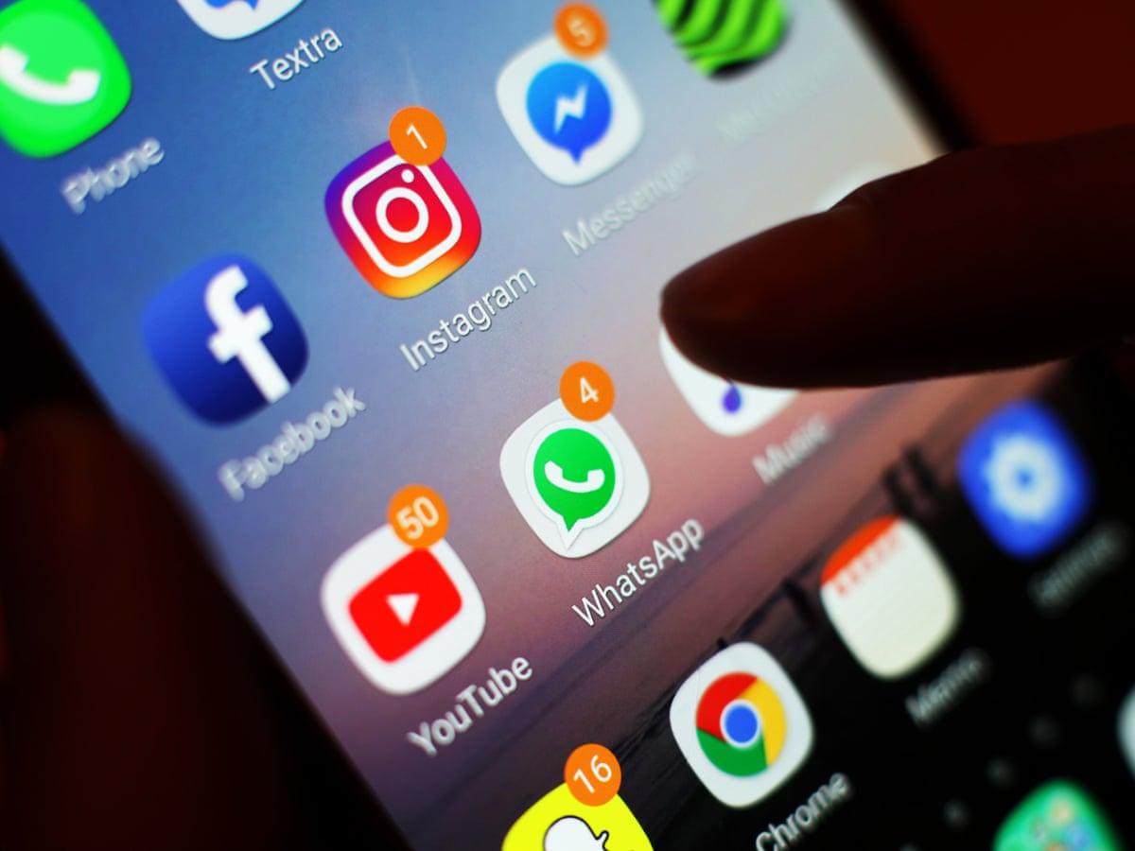
Social media grows at the expense of mental health in youth
Cyber bullying and harassment
Misinformation is ubiquitous
Hateful ideas have louder voices
Hyper-polarized engagements lead to more ad impressions
Social

Slide 7
Social media grows at the expense of mental health in youth
Cyber bullying and harassment
Misinformation is ubiquitous
Hateful ideas have louder voices
Hyper-polarized engagements lead to more ad impressions
Social

Slide 8
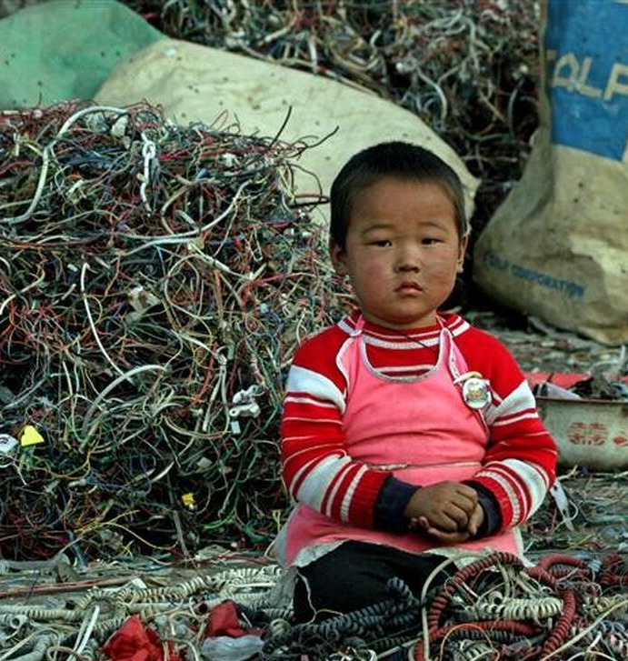
Environmental
Consumption vs. reusability
Mining for new raw materials perpetuates environmental destruction
Planned obsolescence creates tons of e-waste
Bitcoin mining produces tons of CO₂

Slide 9
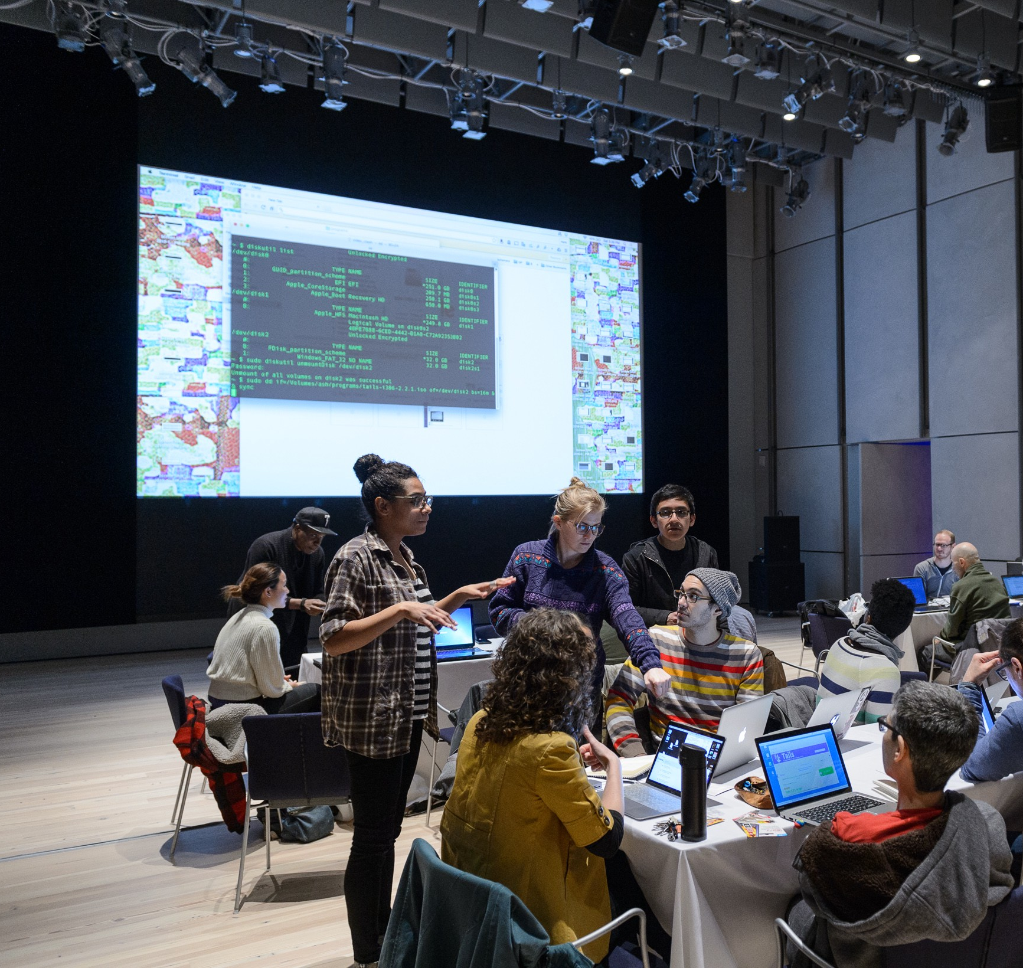
What is
LibreTechnica?
A knowledge sharing resource formed in the spirit of CryptoParty.
What is CryptoParty?
  decentralized movement to share knowledge about protecting yourself in the digital space

Slide 10
Unformatted slide!!!
LibreTechnica is a movement that encourages others to learn and adopt technologies that are developed for the benefit of the commons.
By promoting open-source technologies that are free from and resistant to corporate control, government censorship, political coercion, and environmental harm, we can together heighten and sustain the common good.

Slide 11
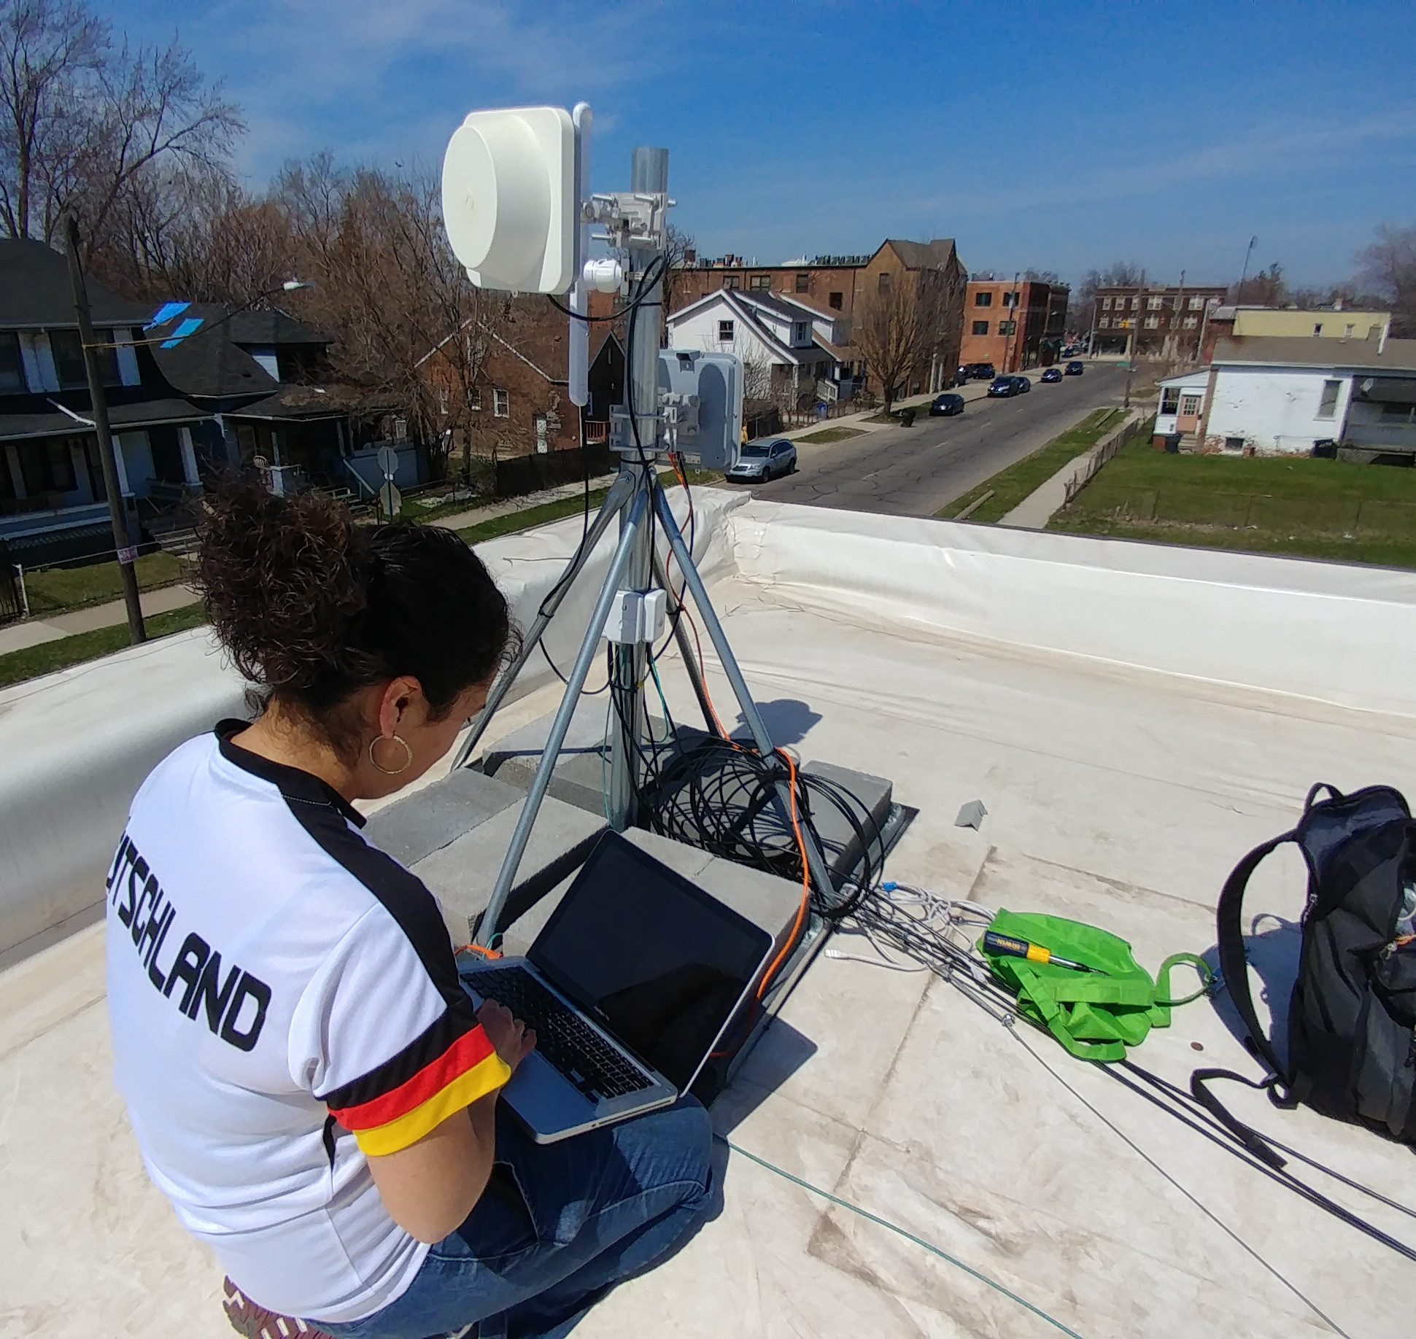
Encourage others to learn and adopt technologies for the benefit of the commons
  Teaching people how to protect their privacy with secure messaging apps and email services
  Introducing computer users to the Linux operating system and other open-source software
  Promoting sustainable technologies, practices, and policies
  Helping small business and non-profit organizations implement free and open-source software for their infrastructure
  Supporting the deployment of independent, community-based network infrastructure
Mission

Slide 12
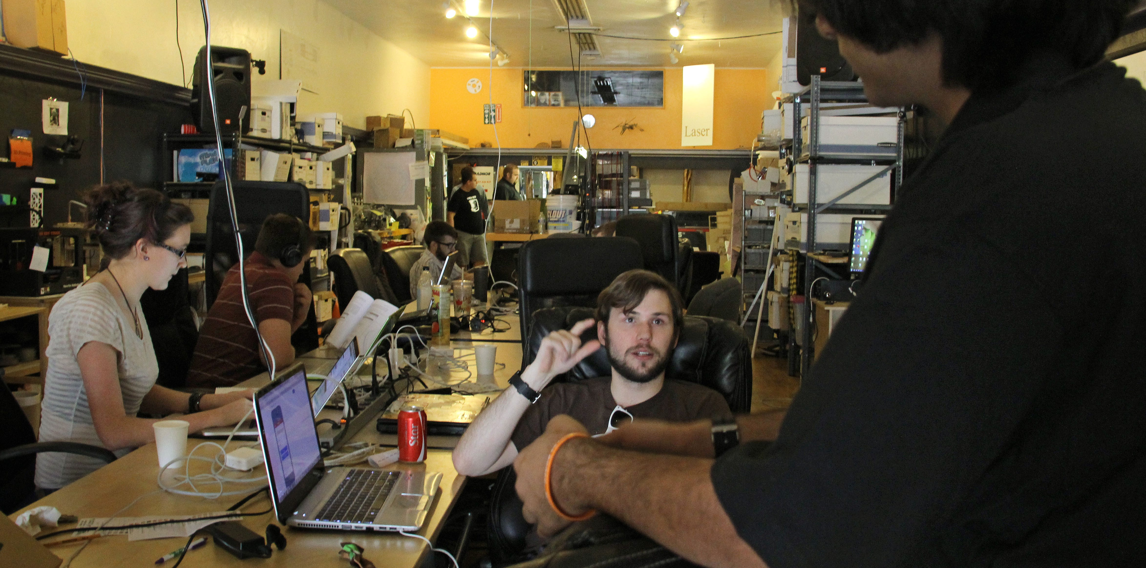
Vision
Our vision is one where the people have full knowledge and control over whom their data serves. Through the democratization of technology, we will weaken the strongholds that corporations have on our data and our lives.

Slide 13
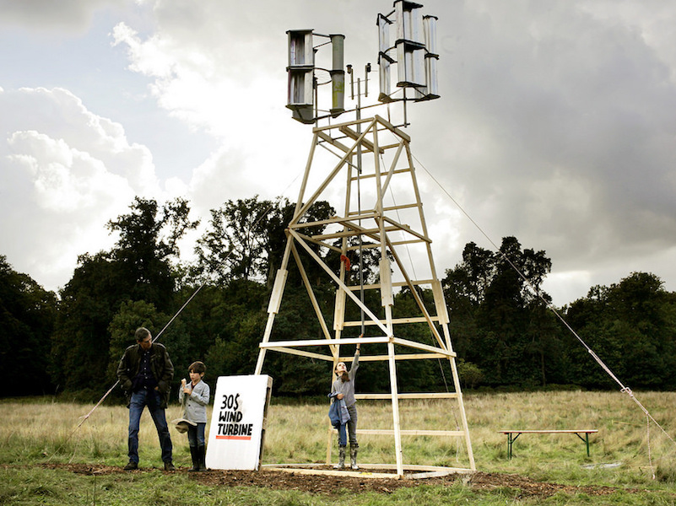
Areas of Focus
Applications
  Open source software and operating systems
Services and Infrastructure
  Decentralized, federated services
Hardware
  Right-to-repair, 3d printing, makerspaces, re-purposing old tech
Connectivity
  Mesh networks, amateur radio
Policy
  While LibreTechnica advocates for policies that favorable to the public at large, the above solutions are intended to work whether or not such policies are adopted.

Slide 14

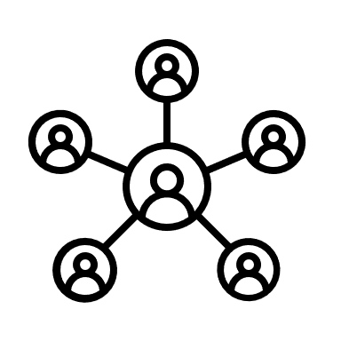


LibreTechnica
LibreTechnica is a movement to promote technologies developed for the benefit of the commons.
Individuals
Organizations
Communities
Open-sources software and operating systems
Privacy tools
Open hardware
3D printing
Self-hosting
Decentralized and federated services
DIY Home Security
Off-grid Power
Makerspaces
Community mesh networks
Municipal broadband
Activism
Services and Infrastructure
Applications
Hardware
Connectivity
Policy

Slide 15



FOSS
Challenge
Privacy
Challenge
Sustainability
Challenge
LibreTechnica
Switch to FOSS
Install Linux
Self-host
Secure messaging
De-Google
Delete Facebook
Re-purpose old hardware
3D print stuff
Repair broken electronics

