Slide 1
Secure BLE
Ana Pandza
Marin Peko

Slide 2
GOALS
Establishment of secure communication between Arduino microcontroller and smartphone device over Bluetooth Low Energy
Comparison of speed and efficiency on different versions of Arduino device
Appliances in many real-world problems

Slide 3
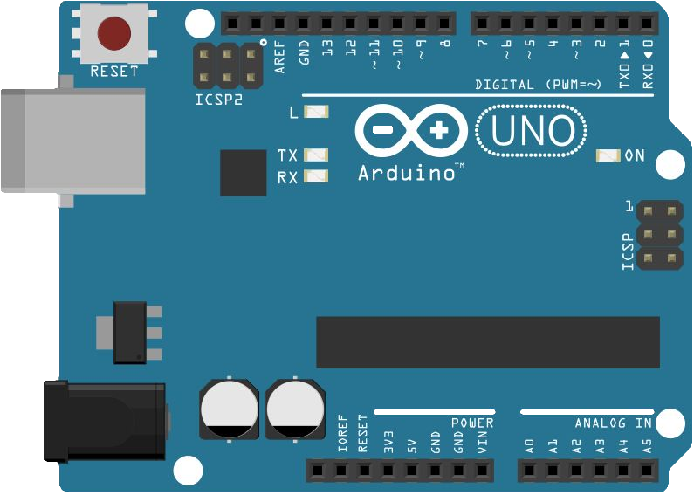

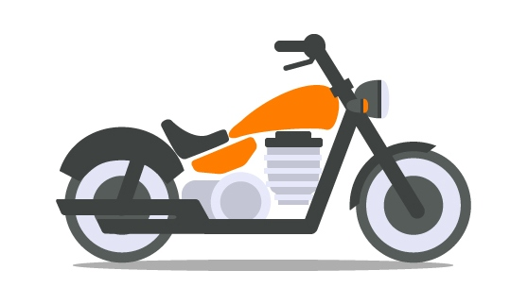
SECURE COMMUNICATION
$<MESSAGE_TYPE>=<MESSAGE_CONTENT>;
PRIVACY
AUTHENTICATION

Slide 4










PRIVACY
DONE
Elliptic - Curve Diffie - Hellman key exchange protocol
Private key
$${PR}_{arduino}$$
Private key
$${PR}_{android}$$
$${PU}_{arduino}$$
Public key
$${PU}_{arduino}$$
$$=$$
$$n_{arduino} ×G$$
Public key
$${PU}_{android}$$
$$=$$
$$n_{android} ×G$$
$${PU}_{android}$$
Compute
$$K$$
$$=$$
$$n_{arduino} ×{PU}_{arduino}$$
Compute
$$K$$
$$=$$
$$n_{android} ×{PU}_{android}$$
Communication

Slide 5
PRIVACY
STATE_START
EVENT_CONNECT_REQ
EVENT_SHARED_SECRET_FAILURE
STATE_KEYS_GENERATION
EVENT_PU_KEY_RECEIVED
EVENT_RESET
STATE_SHARED_SECRET_GENERATION
EVENT_SHARED_SECRET_SUCCESS
STATE_ENCRYPTED_CONNECTION

Slide 6




AUTHENTICATION
IN PROGRESS
Station to Station protocol
$$G^{arduino}$$
Symmetric key
K
=
$$G^{arduino x android}$$
$$G^{android}, {SIG(G^{android},G^{arduino})}_{K}$$
Symmetric key
K
=
$$G^{arduino x android}$$
$${SIG(G^{arduino},G^{android})}_{K}$$

Slide 7
DEMO

Slide 8
Q & A
?

