Slide 1
Secure BLE
Ana Pandza
Marin Peko

Slide 2
GOALS
Establishment of secure communication between Arduino microcontroller and smartphone device over Bluetooth Low Energy
Comparison of speed and efficiency on different versions of Arduino device
Appliances in many real-world problems

Slide 3
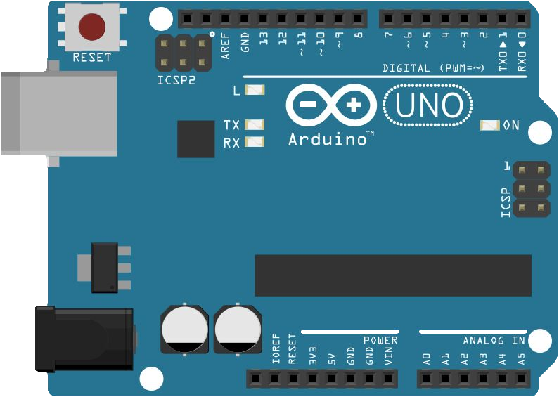

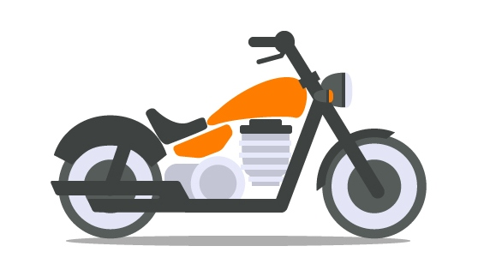
SECURE COMMUNICATION
$<MESSAGE_TYPE>=<MESSAGE_CONTENT>;
PRIVACY
AUTHENTICATION

Slide 4










PRIVACY
DONE
Elliptic - Curve Diffie - Hellman key exchange protocol
$$n^{arduino}$$
$$n^{android}$$
$${PU}_{arduino}$$
Public key
$${PU}_{arduino}$$
$$=$$
$$G^{n^{arduino}}$$
Public key
$${PU}_{android}$$
$$=$$
$$G^{n^{android}}$$
$${PU}_{android}$$
Compute
$$K$$
$$=$$
$${{PU}_{android}}^{n^{arduino}}$$
Compute
$$K$$
$$=$$
$${{PU}_{arduino}}^{n^{android}}$$
Communication

Slide 5



AUTHENTICATION
IN PROGRESS
Station to Station protocol
$${PU}_{arduino}$$
Symmetric key
K
is derived from
shared secret
$${PU}_{android}, {SIG({PU}_{arduino},{PU}_{android})}_{K}$$
Symmetric key
K
is derived from
shared secret
$${SIG({PU}_{arduino},{PU}_{android})}_{K}$$

Slide 6
STATE MACHINE
STATE_START
EVENT_CONNECT_REQ
EVENT_SHARED_SECRET_FAILURE
STATE_KEYS_GENERATION
EVENT_PU_KEY_RECEIVED
STATE_SHARED_SECRET_GENERATION
EVENT_RESET
EVENT_SIGNATURE_NOT_VERIFIED
EVENT_ENCRYPTED_SIGNATURE_RECEIVED
STATE_SIGNATURE_VERIFICATION
EVENT_SIGNATURE_VERIFIED
STATE_ENCRYPTED_CONNECTION

Slide 7
DEMO

Slide 8
Q & A
?

