Slide 1
Secure BLE
Ana Pandza
Marin Peko

Slide 2
GOALS
Establishment of secure communication between Arduino Uno microcontroller and Android application over Bluetooth Low Energy
Speed and efficiency of cryptographic functions on Arduino Uno microcontroller
Applications in many real-world problems

Slide 3
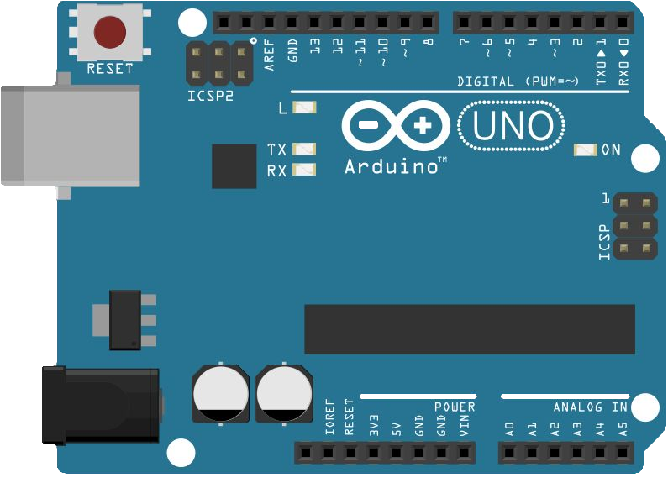


SECURE COMMUNICATION
PRIVACY
AUTHENTICATION

Slide 4










PRIVACY
Elliptic-Curve Diffie-Hellman key exchange protocol
$$n^{arduino}$$
$$n^{android}$$
$${PU}_{arduino}$$
Public key
$${PU}_{arduino}$$
$$=$$
$$G^{n^{arduino}}$$
Public key
$${PU}_{android}$$
$$=$$
$$G^{n^{android}}$$
$${PU}_{android}$$
Compute
$$K$$
$$=$$
$${{PU}_{android}}^{n^{arduino}}$$
Compute
$$K$$
$$=$$
$${{PU}_{arduino}}^{n^{android}}$$
Communication

Slide 5


AUTHENTICATION
Station-to-Station protocol
$${PU}_{arduino}$$
Symmetric key
K
is derived from
shared secret
$${PU}_{android}, \{ {SIG\left({PU}_{arduino},{PU}_{android}\right) \}}_{K}$$
Symmetric key
K
is derived from
shared secret
$${\{ SIG\left({PU}_{arduino},{PU}_{android}\right) \}}_{K}$$

Slide 6
STATE MACHINE
STATE_START
EVENT_CONNECT_REQ
EVENT_SHARED_SECRET_FAILURE
STATE_KEYS_GENERATION
EVENT_PU_KEY_RECEIVED
STATE_SHARED_SECRET_GENERATION
EVENT_RESET
EVENT_SIGNATURE_NOT_VERIFIED
EVENT_ENCRYPTED_SIGNATURE_RECEIVED
STATE_SIGNATURE_VERIFICATION
EVENT_SIGNATURE_VERIFIED
EVENT_DATA
STATE_ENCRYPTED_CONNECTION

Slide 7
MESSAGES
$<MESSAGE_TYPE>=<MESSAGE_CONTENT>;
CONNECT
PU
FAILURE
SIG
SIGVER
SIGNVER
DATA
RESET

Slide 8
ARDUINO UNO
C / C++
Platformio IDE
VS Code
Classes
MessageParser
StateMachine
ECDHKeyExchange
STS
Specifications
Microcontroller | ATmega328P
Flash Memory | 32 KB
SRAM | 2 KB
EEPROM | 1 KB
Clock Speed | 16 MHz

Slide 9
PERFORMANCES
Operation | Time
Generating ECDH key pair | 3259 ms
Generating shared secret | 3241 ms
AES256 key setup | 437 us
AES256 encryption (per byte) | 24 us
AES256 decryption (per byte) | 46 us
SHA256 hashing | 2835 us

Slide 10
ANDROID APPLICATION
C#
Xamarin Forms
Visual Studio IDE
User flow
enable Bluetooth
scan for nearby devices
choose one of the devices
services and characteristics are listed
choose characteristic responsible for exchanging messages

Slide 11
DEMO

Slide 12
Q & A
?

