Slide 1
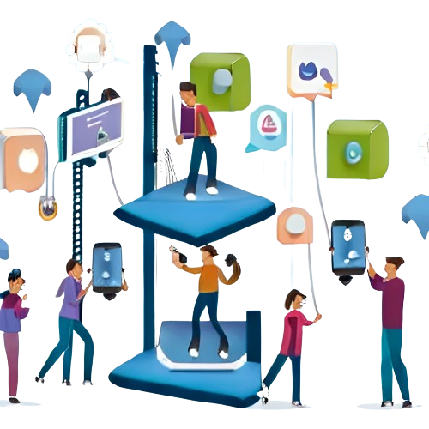

Matteo Licciardino
5° Informatica

Slide 2

The Risks and Dangers of Video Games, Social Networks and Smartphones
The effects of video games, social networks and smartphones on physical and mental health and social impacts. Risk prevention and mitigation.

Slide 3
The Risks of Video Games
1
Violence and Aggression
2
Dependence
3
Limited socialization
Online games can lead to addiction, causing mental health problems and difficulties in social relationships.
Some video games can promote violence and aggression in young people.
Spending too much time playing video games can limit your socialization and interaction with others.

Slide 4

The Risks of Social Networks
Sleep disorders
Spending too much time on social networks can cause sleep disturbances due to excessive exposure to blue light from screens.
Cyberbullying
Social networks can be a fertile ground for cyberbullying, with negative consequences on mental health and online reputation.
Dependence and Isolation
Addiction to social networks can lead to social isolation and a lack of face-to-face interactions.

Slide 5

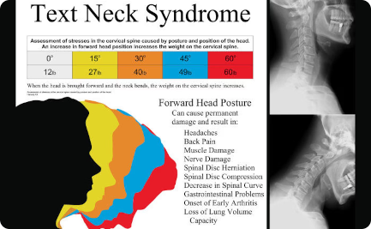

The Risks of Smartphones
Technological Dependence
Physical problems
Privacy and Security
Smartphones can be addictive and interfere with daily life, causing concentration and relationship problems.
Using your smartphone for long periods can cause postural problems such as "text neck" and damage to your eyesight.
Lack of awareness in using smartphones can put the privacy and security of personal data at risk.

Slide 6
Effects on Physical Health
1
Sedentary lifestyle
Spending many hours sitting and playing games or browsing social networks can lead to a sedentary lifestyle.
Obesity
2
Excessive exposure to screens and lack of physical activity can contribute to obesity.
3
Vision problems
Constant eye strain on devices can cause eye strain and long-term vision problems.

Slide 7
Effects on Mental Health
Anxiety and Stress
The constant connection with the virtual world can cause anxiety and stress in managing expectations and social comparisons.
Depression
Addiction to social networks and exposure to negative content can contribute to the onset of depression.
Lack of Self-Esteem
Constant comparison on social networks can lead to low self-esteem and a distorted perception of reality.

Slide 8
Social impacts
Isolation
Distraction
Lack of Intimacy
Too much time spent on devices can cause isolation and limit face-to-face interactions.
Excessive smartphone use can lead to decreased attention in conversations and everyday life.
Device use can distract people from quality, intimate relationships.

Slide 9

Risk Prevention and Mitigation
1
Limit Usage Time
Set time limits for device use and make time for physical activities and social interactions.
2
Promote Awareness
Inform people about the risks associated with excessive use of video games, social networks and smartphones.
3
Creating a Balanced Environment
Promote a balanced lifestyle that includes a variety of interests and activities.

Slide 10
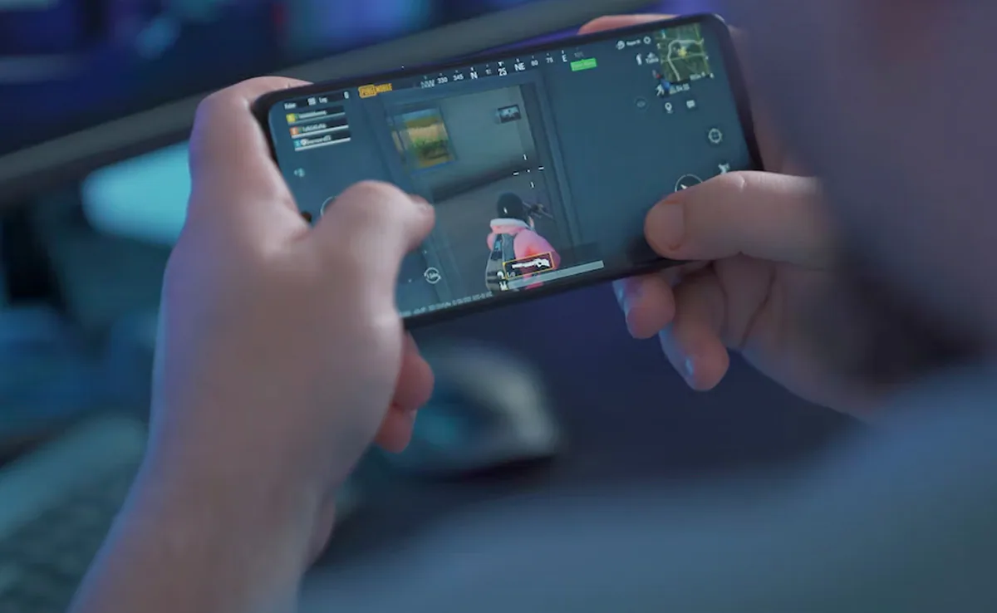
News story
A Chinese father from Shenzhen forced his
11-year-old son to play video games for 17 hours
non-stop after catching him using his phone
in bed until 1.30am. he father, named Huang,
decided to inflict this cruel punishment to teach his son
the dangers of excessive use of technology. He recorded
the lesson and shared the video on Douyin,
the Chinese version of TikTok. In the footage,
the child appears exhausted and is woken up to
continue playing after falling asleep in the chair. The boy
wrote a letter apologizing for his behavior and promising
to go to bed before 11 and limit his use of the phone
and video games. The punishment was only lifted when
the boy cried and agreed to a deal to reduce playing time.
The father believes that his method is effective,
but he advises other parents against following it.
Man Forces 11-Year-Old Son To Play Video
Games For 17 Hours Without Sleep As Punishment
link to the news article

