Slide 1




NEXUSTEAM
THWS Project Defense
NexusTeam
Multi-Platform Communication System
Team: Anna Kornet, Sofiia Khyzhnychenko, Vladyslav Zaplitniy, Halil Hakan Karabay
Notes:
1

Slide 2
PROJECT OVERVIEW
Motivation
Project Overview & Motivation
SYSTEM CONCEPT
NexusTeam is a modern multi-platform communication system providing real-time messaging, file sharing, presence, voice calls, and AI image generation.
CORE PROBLEM
Modern messaging platforms require reliability, security, and scalability — which single-database architectures struggle to deliver efficiently.
ARCHITECTURAL SOLUTION — POLYGLOT PERSISTENCE
Oracle Database: relational data for structured user accounts and security.
MongoDB: document-oriented data for chats, messages, folders, and attachments.
Redis: in-memory caching for high-speed temporary data, sessions, and presence.
REAL-TIME COMMUNICATION
Persistent WebSocket connections replace inefficient REST polling.
NexusTeam — THWS Project
02 / 20
Notes:
2

Slide 3


PROJECT OVERVIEW
Goals & Target Audience
Project Goals & Target Users
PRIMARY OBJECTIVES
Secure user registration and JWT-based authentication.
Support for private & group chats, real-time exchange, editing, and deletion.
File sharing, presence tracking, chat folders, voice calls, and translation.
Clear separation between presentation, business logic, and data access.
INDIVIDUAL & GROUP USERS
Direct messaging and team collaboration.
DESKTOP USERS (WINDOWS)
Native WPF client for deep OS integration.
WEB USERS
Flexible browser-based access without installation.
NexusTeam — THWS Project
03 / 20
Notes:
3

Slide 4
MANAGEMENT
Team Roles
Team Organization & Responsibility Distribution
SK
Sofiia Khyzhnychenko
AK
Anna Kornet
Requirements Management, Architecture, Documentation
User Interface
VZ
Vladyslav Zaplitniy
HHK
Halil Hakan Karabay
Backend and Client Implementation
Testing
NexusTeam — THWS Project
04 / 20
Notes:
4

Slide 5

STACK
Technology Overview
Full Technology Stack
BACKEND
REALTIME COMMUNICATION
ASP.NET Core 8 (C#) — REST API and application logic.
WebSockets for bidirectional event delivery.
DATABASES
Oracle Database: structured user & account data.
MongoDB: document-oriented chats, messages, and attachments.
Redis: in-memory caching, sessions, and presence state.
CLIENTS & INFRASTRUCTURE
WPF (.NET 8)
HTML/CSS/JS
Docker
BCrypt
JWT
Serilog
LiteDB
NexusTeam — THWS Project
05 / 20
Notes:
5

Slide 6
REQUIREMENTS
Scope & Stakeholders
Requirements Management & System Scope
STAKEHOLDERS
End Users • Development Team • Academic Supervisors (THWS) • System Administrators
5 CORE AREAS OF SYSTEM SCOPE
1
2
3
4
5
User Management Registration, Auth, Profiles, Search)
Communication & Chat Management Direct/Group, Folders)
Realtime Functionality WebSockets, Presence, Typing Indicators)
Client Applications WPF Desktop & Web Clients)
Infrastructure & Security Docker, JWT, Rate Limiting, BCrypt)
NexusTeam — THWS Project
06 / 20
Notes:
6

Slide 7
REQUIREMENTS
Functional Requirements (FR-01 to FR-15)
Functional Requirements: Core Messaging & User Flow
User Auth & Profiles
Registration, Login, JWT session management, profile management, global user search.
FR-01 – FR-05
Chat Management
Direct and group chat creation, participant control, user chat folders.
FR-06 – FR-08
Messaging
Send, edit, delete messages; real-time delivery over WebSockets; read/delivered statuses.
FR-09 – FR-13
Messaging
Message replies (threading/quotes), message forwarding with original author attribution, and "Saved Messages" personal cloud chat
FR-09–FR-13
Attachments
Document sharing with format-specific in-app previews
FR-14–FR-15
NexusTeam — THWS Project
07 / 20
Notes:
7

Slide 8
REQUIREMENTS
Extended Features (FR-16 to FR-24)
Real-Time & Extended Functional Capabilities
Realtime Communication
Persistent WebSockets, live typing indicators, presence (Online/Offline), chat state events.
FR-16 – FR-19
Voice Calls
Start, accept, reject, and end voice call signaling.
FR-20 – FR-21
Supporting Services
User preferences storage, AI image generation, in-chat text translation.
FR-22 – FR-24
Voice/Video Calls
P2P / TURN-assisted audio call session management
FR-20–FR-21
Supporting Services
Custom chat themes and personal wallpaper customization
FR-22–FR-24
NexusTeam — THWS Project
08 / 20
Notes:
8

Slide 9
ARCHITECTURE
High-Level Overview
Client-Server Architecture Overview
Clients
WPF / Web
REST API &
WebSockets
ASP.NET Core 8
Backend
Polyglot
Persistence
SECURITY BOUNDARY
Clients NEVER access databases directly; all operations are mediated by the backend.
SINGLE SOURCE OF TRUTH
MULTI-CLIENT SUPPORT
Business logic, validation, authentication, and permission rules remain centralized on the server.
Desktop and Web clients consume the exact same backend endpoints and WebSocket contracts.
NexusTeam — THWS Project
09 / 20
Notes:
9

Slide 10

ARCHITECTURE
Polyglot Persistence
Specialized Database Architecture
1
2
3
Oracle Database
MongoDB
Redis
Stores structured user/account data, guaranteeing ACID compliance and credential uniqueness.
Document database storing chats, message history, attachment metadata, folders, preferences, and generated images.
High-speed in-memory store handling active sessions, user status, typing events, and call signaling state.
NexusTeam — THWS Project
10 / 20
Notes:
10

Slide 11
SERVER
Backend Layered Structure
ASP.NET Core Server Internal Architecture
Controllers Layer
8 REST controllers (Auth, Users, Chats, Messages, Attachments, Preferences, ChatFolders, GeneratedImages).
Service Layer
Encapsulates business logic (AuthService, MessageService, ChatService, CallService, etc.).
Repository Layer
Data access abstraction via IUserRepository (Oracle) and MongoDB repositories.
Dependency Injection
& Middleware
Loose coupling via IoC container; custom middleware for security headers, JWT auth, logging, and error handling.
NexusTeam — THWS Project
11 / 20
Notes:
11

Slide 12

SERVER
Realtime WebSocket Subsystem
Real-Time WebSocket Communication Architecture
ENDPOINT & CONNECTION LIFECYCLE
Routed via /ws; connection is established and authenticated via JWT within a strict timeout window.
WEBSOCKETCONNECTIONMANAGER
Manages active socket sessions and maps connected users to their active channels.
MESSAGE ENVELOPE PROTOCOL
All events use WebSocketMessageEnvelope with explicit event types and serialized JSON payloads.
SUPPORTED EVENTS
New messages
Typing indicators
Read / delivered updates
Presence changes
Call signaling
NexusTeam — THWS Project
12 / 20
Notes:
12

Slide 13

SHARED
Common Models & Contracts
Shared Contracts & Communication Protocol
PURPOSE
Single source of definitions shared between Server, WPF Client, and Web Client to eliminate contract drift.
DTOs & MODELS
WEBSOCKET CONTRACTS
ENUMS & UTILITIES
SavedMessagesDto
MessageAttachmentDto
UserPreferenceDto
ChatFolderDto
UserDto
ChatDto
MessageDto
UserStatusChangedContract
ChatMessageContract
TypingIndicatorContract
MessageReadContract
CallContracts
Custom exception classes
Serialization helpers
UserStatus
ChatType
MessageStatus
NexusTeam — THWS Project
13 / 20
Notes:
13

Slide 14

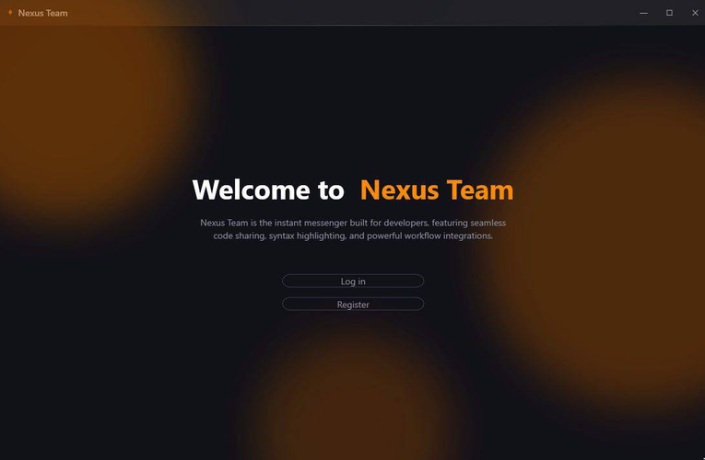
CLIENT
WPF & Web Architecture
Desktop (WPF) and Web Client Architecture
WPF CLIENT (MVVM)
Views: XAML-based screens (ChatView, LoginView, CallWindow, GeneratorView, etc.).
ViewModels: Data binding and command handling (ChatViewModel, CallViewModel, LoginViewModel).
Client Services: MessagingService, AuthenticationService, OfflineMessageQueue, CredentialStorageService (LiteDB).
CallOverlayView / CallViewModel, DocumentPreviewService, WallpaperSelectorView
WEB CLIENT
Lightweight HTML5, CSS3, ES6+ JS client served via Nginx in Docker, communicating with the exact same REST/WS backend.
WebRTC API
NexusTeam — THWS Project
14 / 20
Notes:
14

Slide 15
SECURITY
System Security Architecture
Authentication, Authorization, and Data Protection
Password Hashing
Passwords hashed using BCrypt (work factor 11).
NFR-01
Token Authentication
JWT Access Tokens for API operations + Refresh Tokens for session persistence.
NFR-02 / NFR-03
Authorization
Strict resource ownership checks — users edit/delete only their own messages.
NFR-04
Infrastructure Security
Rate limiting against brute-force/DDoS, authenticated WebSockets, CORS, security headers.
NFR-05 – NFR-07
NexusTeam — THWS Project
15 / 20
Notes:
15

Slide 16
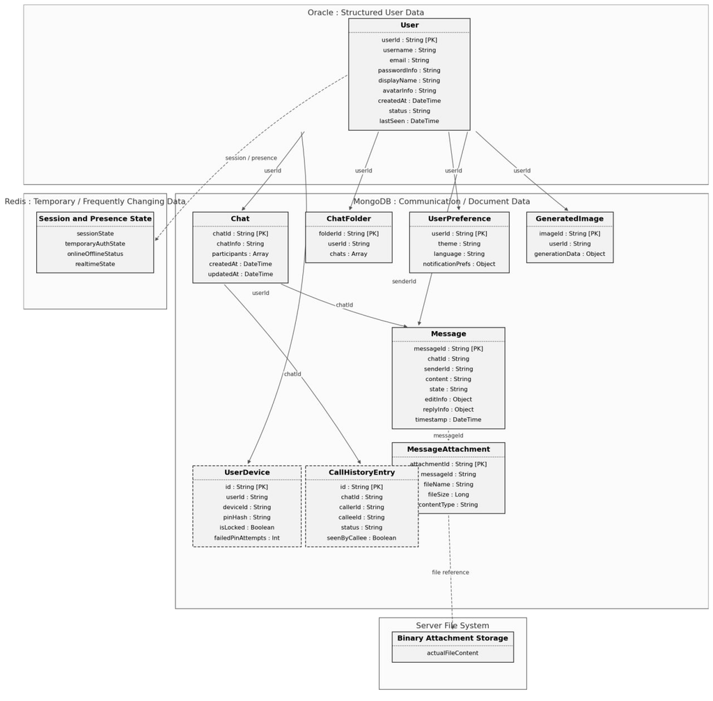
DIAGRAMS
Database Schema
Polyglot Database Schema (Oracle, MongoDB, Redis)
NexusTeam — THWS Project Defense
16 / 20
Notes:
16

Slide 17
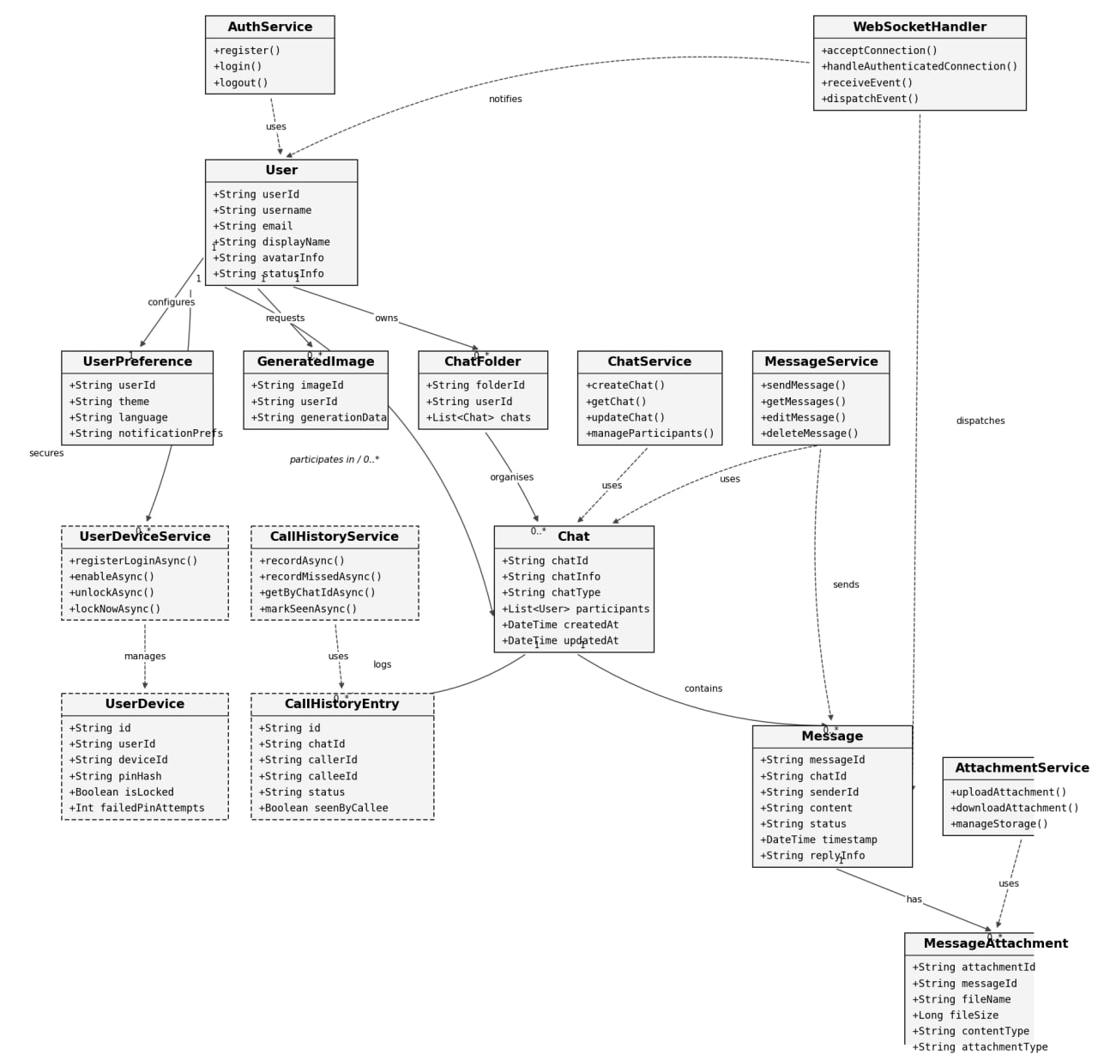
DIAGRAMS
Class Diagram
System Class Diagram
& Service Interaction
NexusTeam — THWS Project Defense
17 / 20
Notes:
17

Slide 18
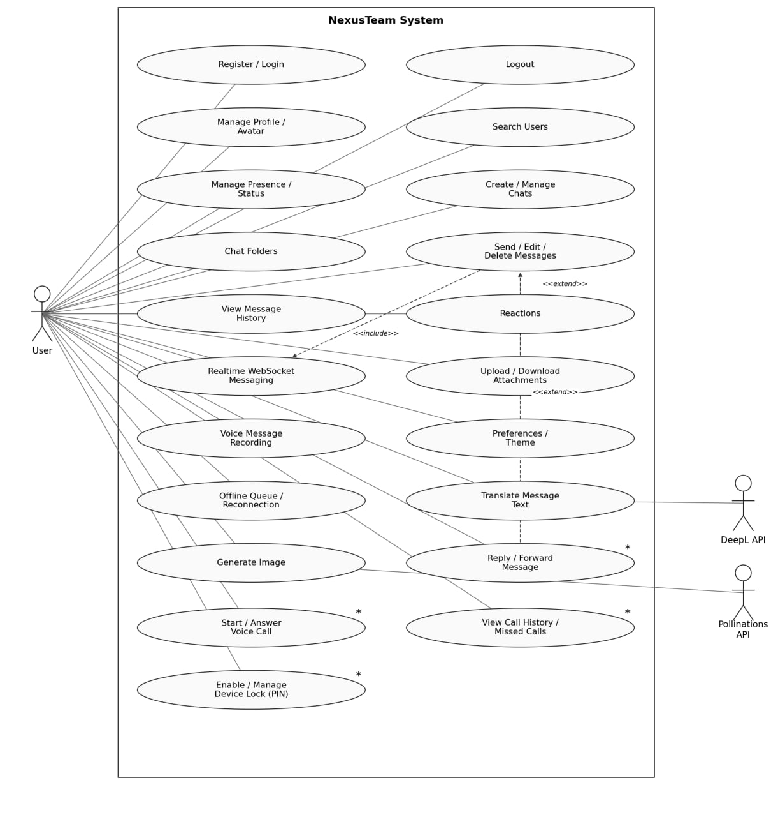
DIAGRAMS
Use Case Diagram
User Interaction
& System Use Cases
NexusTeam — THWS Project
18 / 20
Notes:
18

Slide 19
TESTING
QA Strategy & Cases
Comprehensive Testing Approach
TESTING LEVELS
Functional
API
WebSocket
Security
UI
Integration
End-to-End (E2E)
Authentication
Valid/duplicate registration, invalid credentials, token expiration.
AUTH-01 – AUTH-10
Messaging
Send, edit, delete ownership, emoji support, real-time receipt.
MSG-01 – MSG-10
WebSockets
Authentication timeout, reconnection recovery, presence broadcasts.
WS-01 – WS-10
Security
Unauthorized resource access rejection, rate limiting enforcement.
SEC-01 – SEC-10
NexusTeam — THWS Project
19 / 20
Notes:
19

Slide 20

DEPLOYMENT & CONCLUSION
Final Summary
Docker Deployment, Conclusion, and Future Work
CONTAINERIZED DEPLOYMENT
Docker Compose manages Server, Web Client (Nginx), Oracle, MongoDB (Sharded), Redis, and NexusTeam.DbSeeder.
CONCLUSION
Successfully delivered a fully functional, modular, multi-platform real-time messaging system meeting all academic requirements.
NexusTeam — THWS Project
20 / 20
Notes:
20

Slide 21

THANK YOU FOR YOUR ATTENTION!

