Slide 1
TNB
103 students
5 years old: N = 16
6 years old: N = 40
7 years old: N = 19
8 years old: N = 28
Python, Pandas, Pyplot

Slide 2
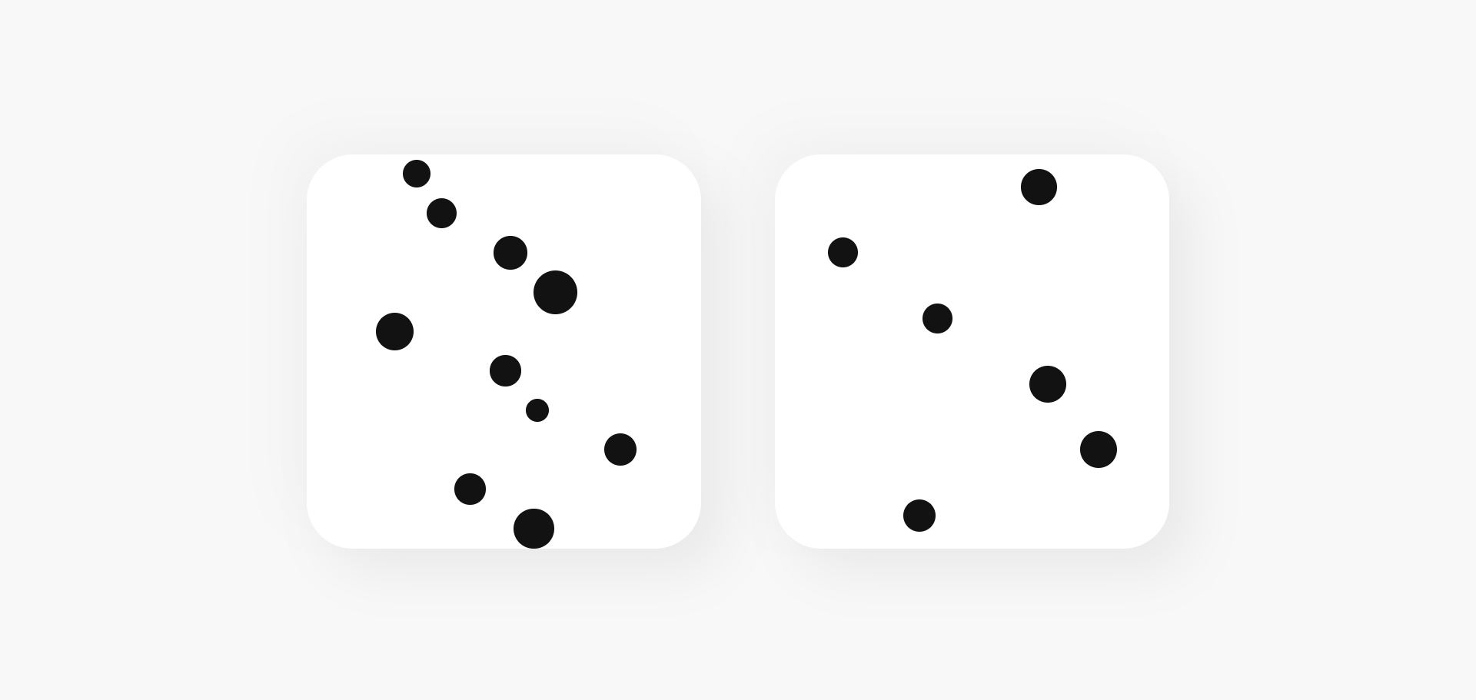
Dots Comparison

Slide 3
Dots Comparison
 | 5 y/o | 6 y/o | 7 y/o | 8 y/o
Accuracy | 0,92 | 0,96 | 0,97 | 0,97
N* | 160 | 390 | 190 | 270
RT M | 4286,54 | 2769,85 | 2539,81 | 2381,33
RT S | 6967,78 | 3020,91 | 2133,38 | 2082,19
N when accurate* | 147 | 373 | 184 | 263
RT when accurate M | 4259,16 | 2801,53 | 2547,46 | 2400,92
RT when accurate SD | 7191,76 | 3072,04 | 2156,43 | 2100,58
* Notice this is #samples, not #users

Slide 4
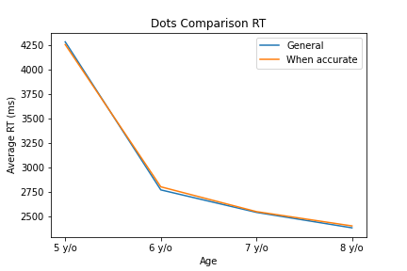
Dots Comparison
Response Time

Slide 5
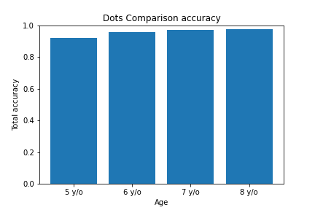
Dots Comparison
Accuracy

Slide 6
Dots Comparison
Response Time by correct answer
 | 5 y/o |  |  | 6 y/o |  |  | 7 y/o |  |  | 8 y/o
Correct* | N | M | SD | N | M | SD | N | M | SD | N | M | SD
3 | 6 | 3349,5 | 1435,39 | 15 | 1939,2 | 1041,86 | 5 | 1930 | 427,44 | 9 | 1931,67 | 516,42
4 | 4 | 2474,25 | 364,51 | 25 | 2051,08 | 1122,63 | 16 | 2023 | 1451,92 | 11 | 2151,36 | 926,75
5 | 15 | 2839,6 | 1541,51 | 37 | 2857,65 | 2843,65 | 11 | 3042,18 | 2352,32 | 26 | 2482,27 | 2100,44
6 | 16 | 3837,75 | 2435,12 | 38 | 2192 | 1731,43 | 21 | 2199,62 | 1584,64 | 39 | 2276,38 | 1572,94
7 | 29 | 4190,28 | 4525,02 | 67 | 3098,87 | 3008,37 | 28 | 2903,5 | 2156,95 | 34 | 2178,71 | 1345,55
8 | 24 | 4791 | 3806,49 | 60 | 2603,18 | 2765,71 | 26 | 3081,54 | 2830,57 | 37 | 2338,78 | 2138,01
9 | 36 | 3492,03 | 3279,89 | 68 | 3119,25 | 3664,53 | 33 | 2383,39 | 1887,28 | 54 | 2658,2 | 2464,34
10 | 30 | 6321,3 | 14247,14 | 80 | 2936,55 | 3646,97 | 50 | 2416,4 | 2173,2 | 60 | 2407,3 | 2517,17
General | 160 | 4286,54 | 6967,78 | 390 | 2769,85 | 3020,91 | 190 | 2539,81 | 2133,38 | 270 | 2381,33 | 2082,19
* Ratio would be better

Slide 7
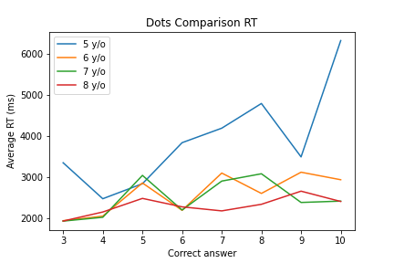
Dots Comparison
Response Time by correct answer

Slide 8
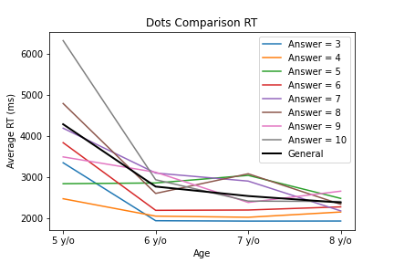
Dots Comparison
Response Time by correct answer

Slide 9
Dots Comparison
Response Time by correct answer when accurately answered
 | 5 y/o |  |  | 6 y/o |  |  | 7 y/o |  |  | 8 y/o
Correct* | N | M | SD | N | M | SD | N | M | SD | N | M | SD
3 | 6 | 3349,5 | 1435,39 | 15 | 1939,2 | 1041,86 | 5 | 1930 | 427,44 | 9 | 1931,67 | 516,42
4 | 4 | 2474,25 | 364,51 | 25 | 2051,08 | 1122,63 | 16 | 2023 | 1451,92 | 11 | 2151,36 | 926,75
5 | 15 | 2839,6 | 1541,51 | 36 | 2923,36 | 2855,03 | 11 | 3042,18 | 2352,32 | 26 | 2482,27 | 2100,44
6 | 14 | 3779,5 | 2591,14 | 37 | 2193,22 | 1754,66 | 21 | 2199,62 | 1584,64 | 38 | 2300,71 | 1586,25
7 | 26 | 4357,77 | 4748,85 | 65 | 3073,94 | 3031,2 | 28 | 2903,5 | 2156,95 | 33 | 2213,15 | 1350,94
8 | 22 | 5058,18 | 3866,35 | 56 | 2609,09 | 2842,86 | 26 | 3081,54 | 2830,57 | 36 | 2397,81 | 2137,56
9 | 32 | 3391,66 | 3386,72 | 67 | 3134,67 | 3689,58 | 30 | 2409,2 | 1969,23 | 53 | 2674,89 | 2484,46
10 | 28 | 5981,43 | 14645,42 | 72 | 3087,21 | 3806,91 | 47 | 2412 | 2205,08 | 57 | 2408,81 | 2575,43
General | 147 | 4259,16 | 7191,76 | 373 | 2801,53 | 3072,04 | 184 | 2547,46 | 2156,43 | 263 | 2400,92 | 2100,58
* Ratio would be better

Slide 10
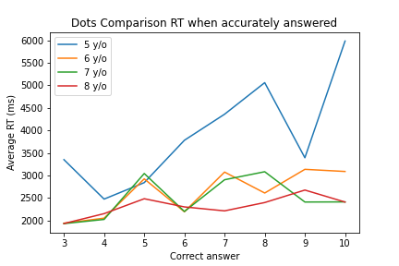
Dots Comparison
Response Time when accurately answered

Slide 11
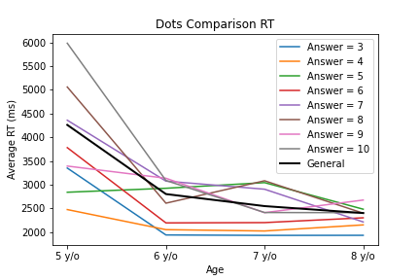
Dots Comparison
Response Time when accurately answered

Slide 12
Dots Comparison
Accuracy by correct answer
 | 5 y/o |  | 6 y/o |  | 7 y/o |  | 8 y/o
Correct* | N | Accuracy | N | Accuracy | N | Accuracy | N | Accuracy
3 | 1 | 1 | 1 | 1 | 1 | 1 | 1 | 1
4 | 1 | 1 | 1 | 1 | 1 | 1 | 1 | 1
5 | 1 | 0,97 | 1 | 1 | 1 | 0,97 | 1 | 1
6 | 0,88 | 0,97 | 1 | 0,97 | 0,88 | 0,97 | 1 | 0,97
7 | 0,9 | 0,97 | 1 | 0,97 | 0,9 | 0,97 | 1 | 0,97
8 | 0,92 | 0,93 | 1 | 0,97 | 0,92 | 0,93 | 1 | 0,97
9 | 0,89 | 0,99 | 0,91 | 0,98 | 0,89 | 0,99 | 0,91 | 0,98
10 | 0,93 | 0,9 | 0,94 | 0,95 | 0,93 | 0,9 | 0,94 | 0,95
General | 0,92 | 0,96 | 0,97 | 0,97 | 0,92 | 0,96 | 0,97 | 0,97
* Ratio would be better

Slide 13
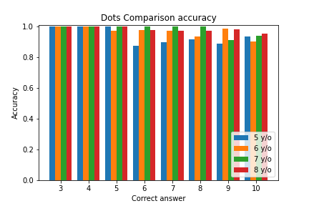
Dots Comparison
Accuracy

Slide 14
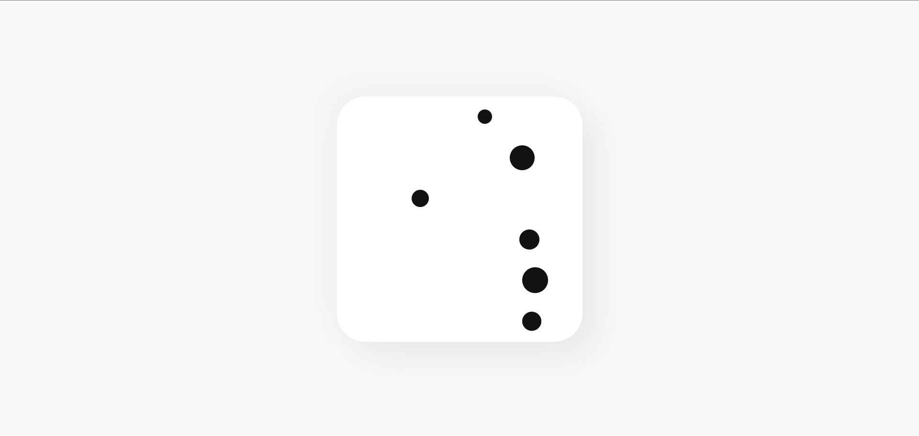
Match Sample

Slide 15
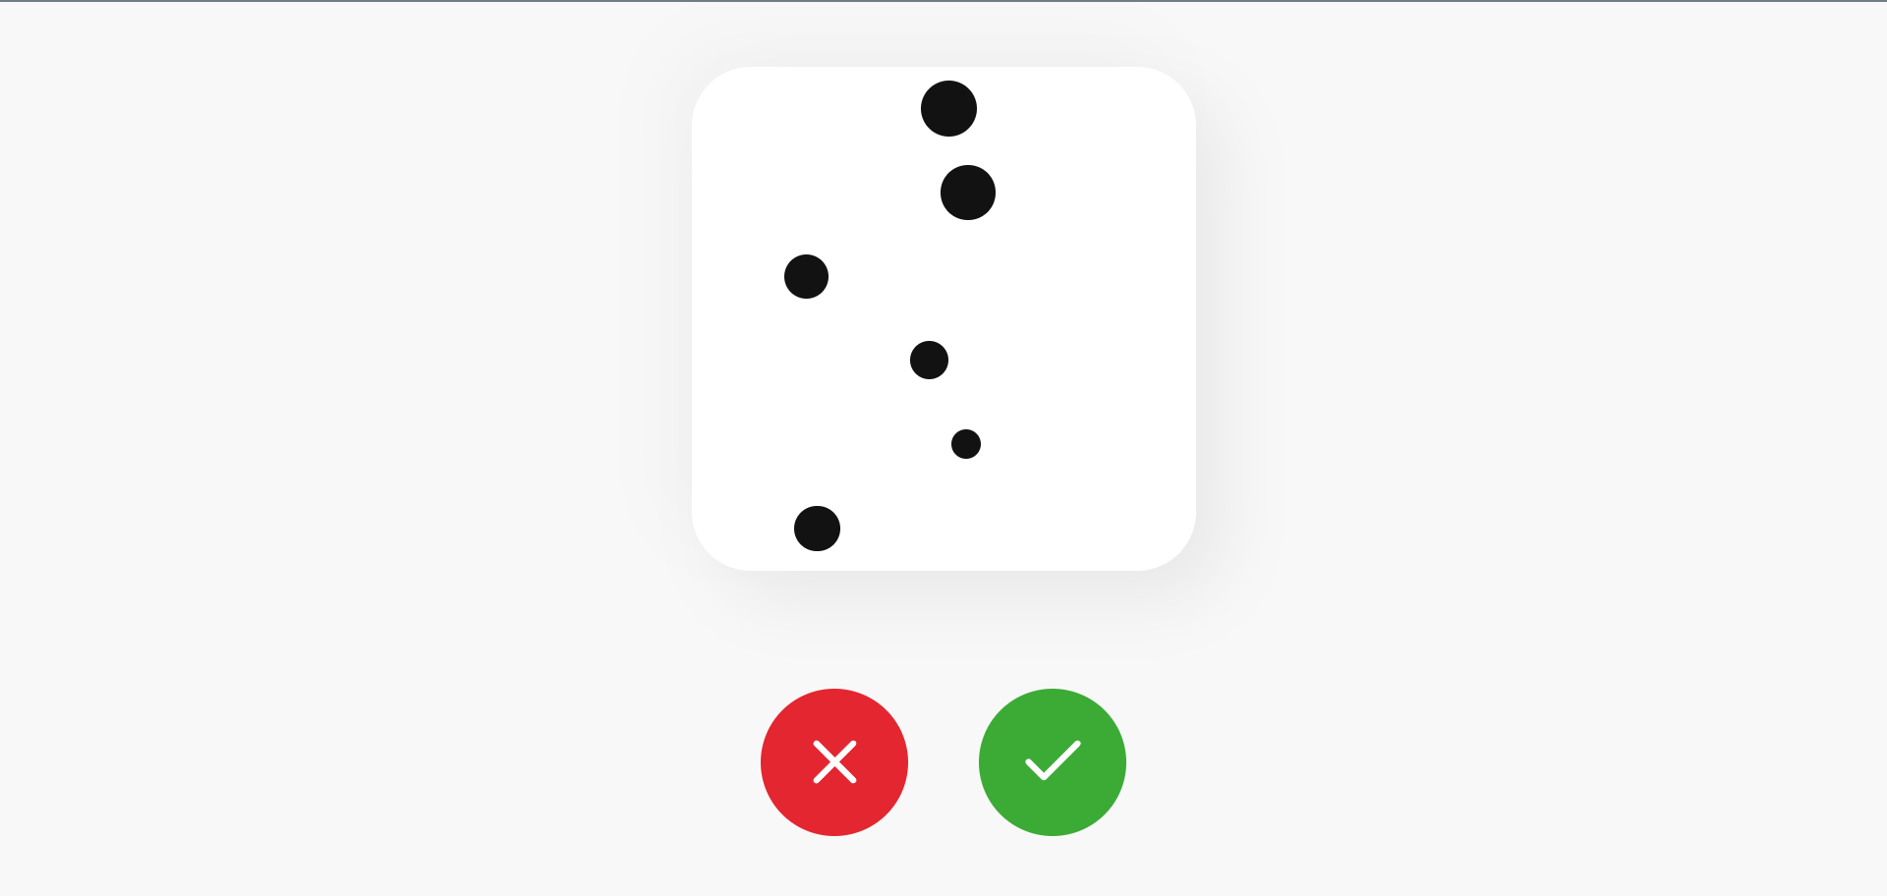
Match Sample

Slide 16
Match Sample
 | 5 y/o | 6 y/o | 7 y/o | 8 y/o
Accuracy | 0,63 | 0,66 | 0,7 | 0,79
N* | 144 | 360 | 171 | 252
RT M | 5223,26 | 4729,71 | 5191,6 | 4484,16
RT S | 3525,6 | 2906,08 | 2574,67 | 2245,71
N when accurate* | 91 | 238 | 120 | 200
RT when accurate M | 5141,85 | 4945,18 | 5204,18 | 4475,56
RT when accurate SD | 3933,32 | 2817,81 | 2627,77 | 1936,55
* Notice this is #samples, not #users
Could not separate by correct answer

Slide 17
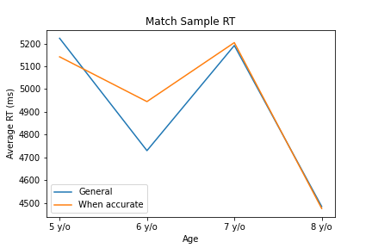
Match Sample
Response Time

Slide 18
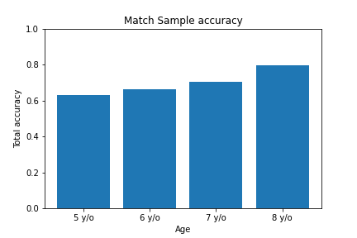
Match Sample
Accuracy

Slide 19
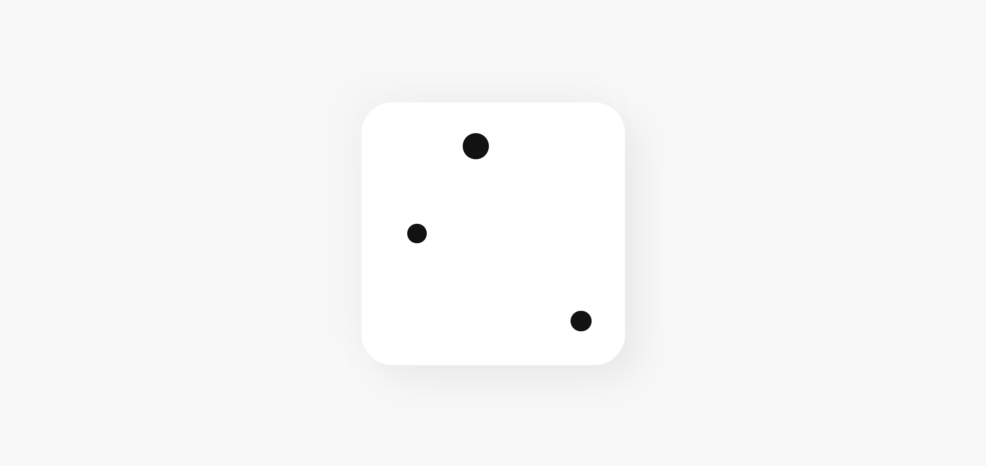
Match Sample Rotate

Slide 20

Match Sample Rotate

Slide 21
Match Sample Rotate
 | 5 y/o | 6 y/o | 7 y/o | 8 y/o
Accuracy | 0,62 | 0,71 | 0,74 | 0,87
N* | 144 | 360 | 171 | 252
RT M | 4888,19 | 4512,24 | 4621,92 | 4430,1
RT S | 2877,78 | 2190,36 | 1962,44 | 1637,48
N when accurate* | 90 | 256 | 127 | 218
RT when accurate M | 4669,48 | 4395,57 | 4559,38 | 4436,1
RT when accurate SD | 2817,66 | 2016,09 | 1993,51 | 1663,68
* Notice this is #samples, not #users
Could not separate by correct answer

Slide 22
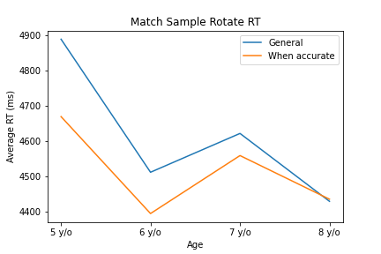
Match Sample Rotate
Response Time

Slide 23
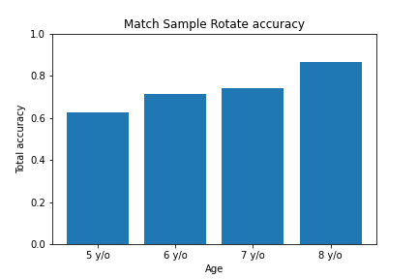
Match Sample Rotate
Accuracy

Slide 24
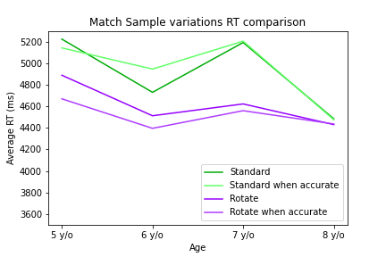
Match Sample variations comparison
Response Time

Slide 25
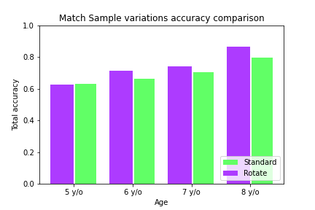
Match Sample variations comparison
Accuracy

Slide 26
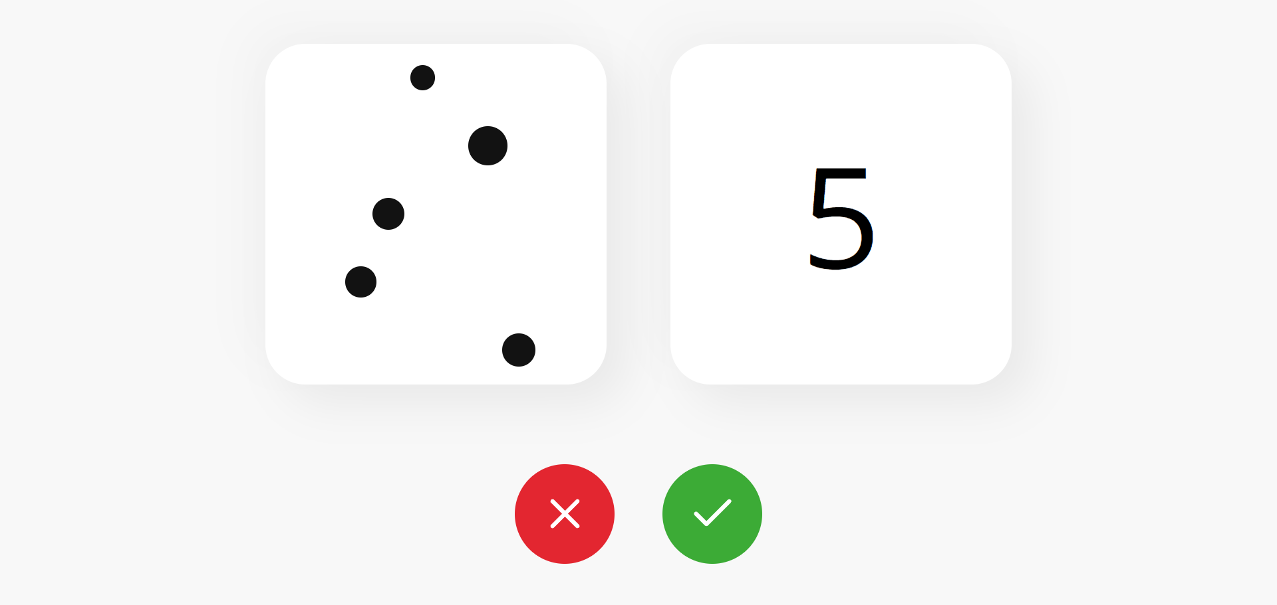
Match Points Number

Slide 27
Match Points Number
 | 5 y/o | 6 y/o | 7 y/o | 8 y/o
Accuracy | 0,93 | 0,92 | 0,94 | 0,94
N* | 150 | 400 | 190 | 240
RT M | 5881,21 | 4067,36 | 4412,73 | 3596,18
RT S | 3352,75 | 2379,09 | 2888,26 | 2302,18
N when accurate* | 139 | 366 | 178 | 225
RT when accurate M | 5835,47 | 4104,29 | 4539,08 | 3551,32
RT when accurate SD | 3266,33 | 2371,32 | 2900,59 | 2282,92
* Notice this is #samples, not #users
Could not separate by correct answer

Slide 28
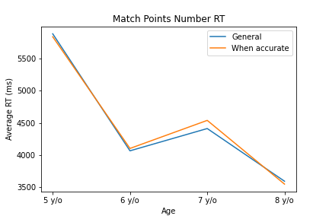
Match Points Number
Response Time

Slide 29
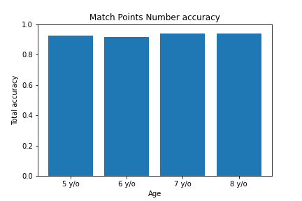
Match Points Number
Accuracy

Slide 30
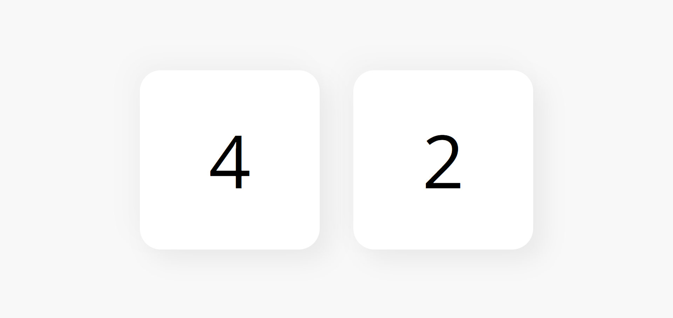
Symbolic Magnitude

Slide 31
Symbolic Magnitude
 | 5 y/o | 6 y/o | 7 y/o | 8 y/o
Accuracy | 0,88 | 0,96 | 0,97 | 0,99
N* | 160 | 400 | 180 | 270
RT M | 3037,56 | 1718,31 | 1496,63 | 1415,34
RT S | 2613,08 | 780,02 | 484,68 | 472,05
N when accurate* | 140 | 384 | 175 | 268
RT when accurate M | 2824,34 | 1713,52 | 1502,31 | 1418,96
RT when accurate SD | 2504,82 | 778,33 | 488,56 | 471,9
* Notice this is #samples, not #users

Slide 32
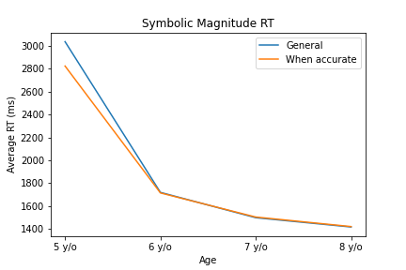
Symbolic Magnitude
Response Time

Slide 33
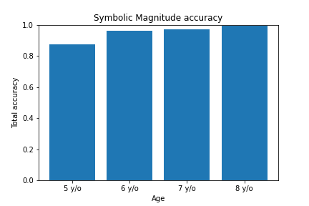
Symbolic Magnitude
Accuracy

Slide 34
Symbolic Magnitude
Response Time by correct answer
 | 5 y/o |  |  | 6 y/o |  |  | 7 y/o |  |  | 8 y/o
Correct* | N | M | SD | N | M | SD | N | M | SD | N | M | SD
3 | 10 | 3823,6 | 4373,39 | 8 | 2524,5 | 1527,2 | 7 | 1584,57 | 337,72 | 3 | 1473,67 | 326,19
4 | 13 | 2427,23 | 923,75 | 22 | 2057,59 | 927,41 | 4 | 1499,25 | 345,46 | 16 | 1536,12 | 279,64
5 | 14 | 2728,86 | 1298,94 | 29 | 1653,17 | 557,23 | 10 | 1538,1 | 341,02 | 21 | 1539,52 | 388,08
6 | 20 | 2564,9 | 1142,82 | 35 | 1735,11 | 899,38 | 22 | 1593 | 462,38 | 39 | 1410,67 | 423,98
7 | 20 | 3883 | 4729,13 | 50 | 1876,3 | 852,61 | 24 | 1490,04 | 478,74 | 37 | 1486,27 | 570,17
8 | 21 | 2441,52 | 1246,34 | 74 | 1766,73 | 712,69 | 30 | 1423,5 | 389,52 | 44 | 1339,3 | 420,94
9 | 29 | 4048,9 | 2882,86 | 91 | 1644,49 | 680,46 | 44 | 1508,86 | 520,84 | 57 | 1427,56 | 527,97
10 | 33 | 2435,36 | 1090,89 | 91 | 1527,32 | 657,19 | 39 | 1462,1 | 569,83 | 53 | 1330,26 | 461,85
General | 160 | 3037,56 | 2613,08 | 400 | 1718,31 | 780,02 | 180 | 1496,63 | 484,68 | 270 | 1415,34 | 472,05
* Ratio would be better

Slide 35
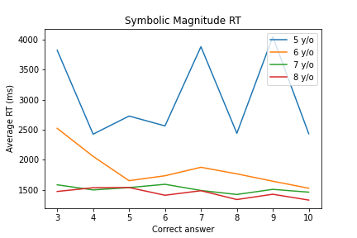
Symbolic Magnitude
Response Time by correct answer

Slide 36
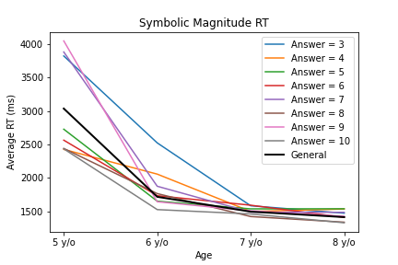
Symbolic Magnitude
Response Time by correct answer

Slide 37
Symbolic Magnitude
Response Time by correct answer when accurately answered
 | 5 y/o |  |  | 6 y/o |  |  | 7 y/o |  |  | 8 y/o
Correct* | N | M | SD | N | M | SD | N | M | SD | N | M | SD
3 | 8 | 4320,25 | 4745,65 | 8 | 2524,5 | 1527,2 | 7 | 1584,57 | 337,72 | 3 | 1473,67 | 326,19
4 | 13 | 2427,23 | 923,75 | 21 | 2078,67 | 944,08 | 4 | 1499,25 | 345,46 | 16 | 1536,12 | 279,64
5 | 13 | 2443,46 | 822,63 | 29 | 1653,17 | 557,23 | 10 | 1538,1 | 341,02 | 21 | 1539,52 | 388,08
6 | 19 | 2536,11 | 1165,41 | 31 | 1757,29 | 946,45 | 21 | 1612,24 | 464,58 | 39 | 1410,67 | 423,98
7 | 15 | 4135,4 | 5391,12 | 48 | 1891,38 | 841,62 | 22 | 1480,32 | 498,88 | 37 | 1486,27 | 570,17
8 | 18 | 2216,72 | 824,95 | 71 | 1751,79 | 719,42 | 30 | 1423,5 | 389,52 | 44 | 1339,3 | 420,94
9 | 21 | 3192,43 | 2196,81 | 86 | 1624,19 | 636,96 | 42 | 1530,57 | 523,29 | 55 | 1445,65 | 528,6
10 | 33 | 2435,36 | 1090,89 | 90 | 1520,9 | 657,99 | 39 | 1462,1 | 569,83 | 53 | 1330,26 | 461,85
General | 140 | 2824,34 | 2504,82 | 384 | 1713,52 | 778,33 | 175 | 1502,31 | 488,56 | 268 | 1418,96 | 471,9
* Ratio would be better

Slide 38
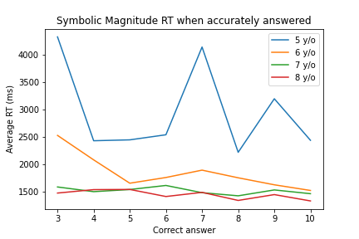
Symbolic Magnitude
Response Time when accurately answered

Slide 39
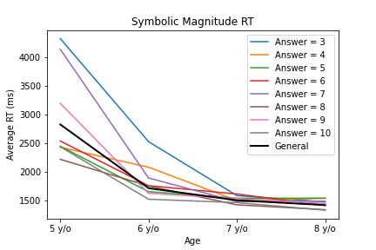
Symbolic Magnitude
Response Time when accurately answered

Slide 40
Symbolic Magnitude
Accuracy by correct answer
 | 5 y/o |  | 6 y/o |  | 7 y/o |  | 8 y/o
Correct* | N | Accuracy | N | Accuracy | N | Accuracy | N | Accuracy
3 | 0,8 | 1 | 1 | 1 | 0,8 | 1 | 1 | 1
4 | 1 | 0,95 | 1 | 1 | 1 | 0,95 | 1 | 1
5 | 0,93 | 1 | 1 | 1 | 0,93 | 1 | 1 | 1
6 | 0,95 | 0,89 | 0,95 | 1 | 0,95 | 0,89 | 0,95 | 1
7 | 0,75 | 0,96 | 0,92 | 1 | 0,75 | 0,96 | 0,92 | 1
8 | 0,86 | 0,96 | 1 | 1 | 0,86 | 0,96 | 1 | 1
9 | 0,72 | 0,95 | 0,95 | 0,96 | 0,72 | 0,95 | 0,95 | 0,96
10 | 1 | 0,99 | 1 | 1 | 1 | 0,99 | 1 | 1
General | 0,88 | 0,96 | 0,97 | 0,99 | 0,88 | 0,96 | 0,97 | 0,99
* Ratio would be better

Slide 41
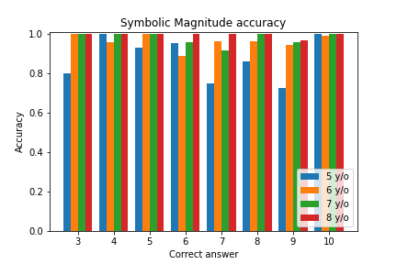
Symbolic Magnitude
Accuracy

Slide 42
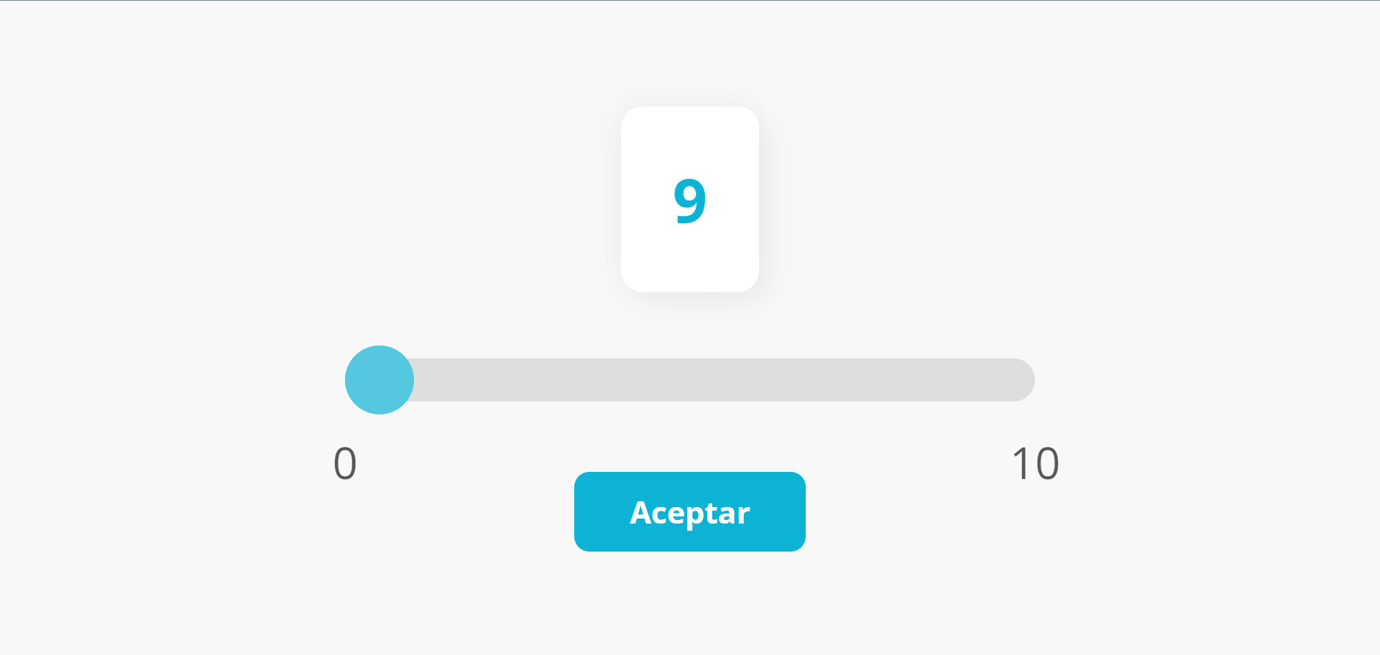
Numeric Line

Slide 43
Numeric Line
 | 5 y/o | 6 y/o | 7 y/o | 8 y/o
Accuracy | 0,51 | 0,57 | 0,61 | 0,75
N* | 160 | 400 | 190 | 260
RT M | 6753,98 | 5380,61 | 6299,11 | 5233
RT S | 3918,05 | 4099,26 | 4780,25 | 3098,46
N when accurate* | 82 | 227 | 116 | 195
RT when accurate M | 6371,1 | 5029,7 | 5651,45 | 4881,18
RT when accurate SD | 3766,98 | 3843,28 | 3549,14 | 2717,56
* Notice this is #samples, not #users

Slide 44
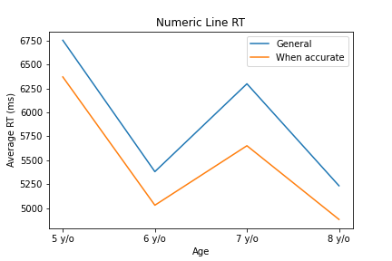
Numeric Line
Response Time

Slide 45
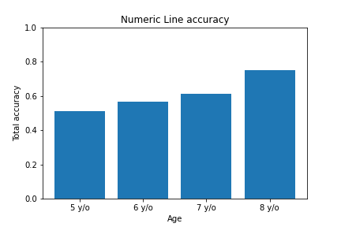
Numeric Line
Accuracy

Slide 46
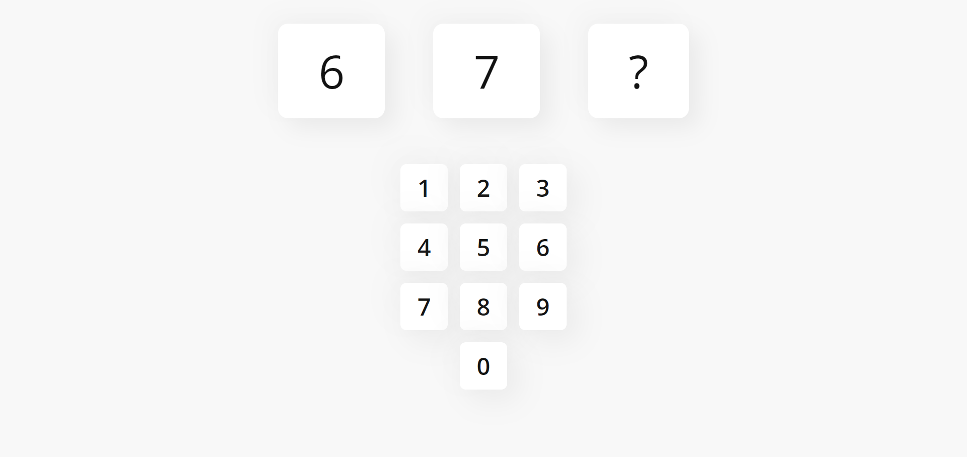
Counting Forward

Slide 47
Counting Forward
 | 5 y/o | 6 y/o | 7 y/o | 8 y/o
Accuracy | 0,9 | 0,93 | 0,98 | 0,87
N* | 144 | 360 | 171 | 252
RT M | 7736,62 | 4295,81 | 3775,83 | 3488,63
RT S | 5991,28 | 2869,85 | 1641,46 | 1808,08
N when accurate* | 130 | 333 | 167 | 219
RT when accurate M | 7461,88 | 4328,22 | 3806,38 | 3406,29
RT when accurate SD | 5415,29 | 2908,23 | 1623,87 | 1442,76
* Notice this is #samples, not #users

Slide 48
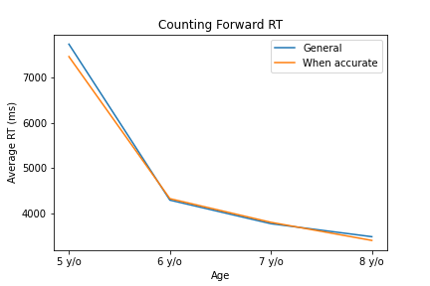
Counting Forward
Response Time

Slide 49
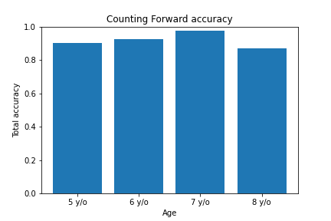
Counting Forward
Accuracy

Slide 50
Counting Forward
Response Time by correct answer
 | 5 y/o |  |  | 6 y/o |  |  | 7 y/o |  |  | 8 y/o
Correct* | N | M | SD | N | M | SD | N | M | SD | N | M | SD
3 | 21 | 6467,33 | 5603,93 | 44 | 4116,23 | 1794,91 | 23 | 3547,78 | 1197,77 | 35 | 2853,97 | 958,98
4 | 20 | 7625 | 3328,06 | 63 | 4503,62 | 4233,1 | 27 | 4054,85 | 2158,94 | 32 | 3579,5 | 1494,97
5 | 18 | 6637,44 | 4831,44 | 61 | 3603,92 | 2651,86 | 27 | 3681,63 | 1195,97 | 34 | 3325,85 | 1277,74
6 | 23 | 7507,57 | 5707,14 | 59 | 3940,63 | 2360,99 | 26 | 3986,15 | 1452,07 | 33 | 3293,12 | 1401,62
7 | 23 | 9591,35 | 5978,89 | 60 | 4195,58 | 2745,2 | 22 | 4303,95 | 2534,04 | 33 | 3500,76 | 1671,31
8 | 20 | 6258,6 | 3004,93 | 38 | 4907,03 | 2094,25 | 22 | 3282,73 | 949,83 | 36 | 3281,33 | 1574,67
9 | 19 | 9886,26 | 9862,73 | 33 | 5683,39 | 2372,11 | 24 | 3526,5 | 1111,9 | 31 | 3376,06 | 1704,81
General | 144 | 7736,62 | 5991,28 | 360 | 4295,81 | 2869,85 | 171 | 3775,83 | 1641,46 | 252 | 3488,63 | 1808,08

Slide 51
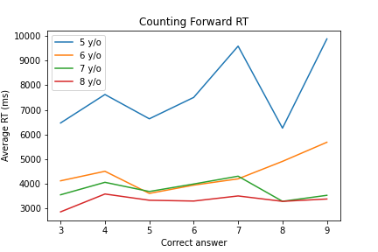
Counting Forward
Response Time by correct answer

Slide 52
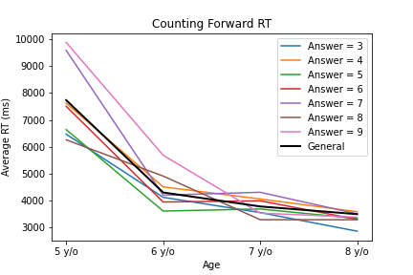
Counting Forward
Response Time by correct answer

Slide 53
Counting Forward
Response Time by correct answer when accurately answered
 | 5 y/o |  |  | 6 y/o |  |  | 7 y/o |  |  | 8 y/o
Correct* | N | M | SD | N | M | SD | N | M | SD | N | M | SD
3 | 20 | 6650,2 | 5680,85 | 43 | 4143,7 | 1806,49 | 23 | 3547,78 | 1197,77 | 33 | 2906,73 | 961,56
4 | 18 | 7296,83 | 3190,52 | 53 | 4636,55 | 4419,48 | 24 | 4369,21 | 2060,2 | 29 | 3721,52 | 1491,03
5 | 15 | 5487,6 | 2214,96 | 58 | 3628,83 | 2674,94 | 27 | 3681,63 | 1195,97 | 31 | 3432,61 | 1247,59
6 | 21 | 7592,29 | 5914,95 | 57 | 3909,98 | 2392,55 | 26 | 3986,15 | 1452,07 | 32 | 3338,31 | 1399,47
7 | 21 | 9741,38 | 6214,94 | 53 | 4241,17 | 2876,4 | 21 | 4252,62 | 2582,47 | 30 | 3725,87 | 1563,5
8 | 19 | 6516,68 | 2858,79 | 35 | 4880 | 2060,58 | 22 | 3282,73 | 949,83 | 34 | 3391,09 | 1526,77
9 | 16 | 8472,5 | 7881,87 | 32 | 5778,16 | 2346,57 | 24 | 3526,5 | 1111,9 | 29 | 3451,41 | 1662,34
General | 130 | 7461,88 | 5415,29 | 333 | 4328,22 | 2908,23 | 167 | 3806,38 | 1623,87 | 219 | 3406,29 | 1442,76

Slide 54
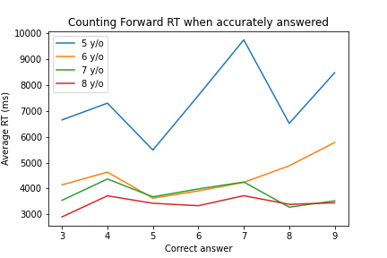
Counting Forward
Response Time when accurately answered

Slide 55
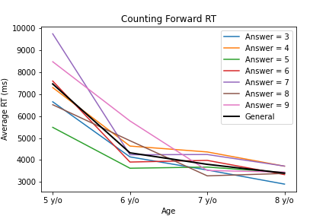
Counting Forward
Response Time when accurately answered

Slide 56
Counting Forward
Accuracy by correct answer
 | 5 y/o |  | 6 y/o |  | 7 y/o |  | 8 y/o
Correct* | N | Accuracy | N | Accuracy | N | Accuracy | N | Accuracy
3 | 0,95 | 0,98 | 1 | 0,94 | 0,95 | 0,98 | 1 | 0,94
4 | 0,9 | 0,84 | 0,89 | 0,91 | 0,9 | 0,84 | 0,89 | 0,91
5 | 0,83 | 0,95 | 1 | 0,91 | 0,83 | 0,95 | 1 | 0,91
6 | 0,91 | 0,97 | 1 | 0,97 | 0,91 | 0,97 | 1 | 0,97
7 | 0,91 | 0,88 | 0,95 | 0,91 | 0,91 | 0,88 | 0,95 | 0,91
8 | 0,95 | 0,92 | 1 | 0,94 | 0,95 | 0,92 | 1 | 0,94
9 | 0,84 | 0,97 | 1 | 0,94 | 0,84 | 0,97 | 1 | 0,94
General | 0,9 | 0,93 | 0,98 | 0,87 | 0,9 | 0,93 | 0,98 | 0,87

Slide 57
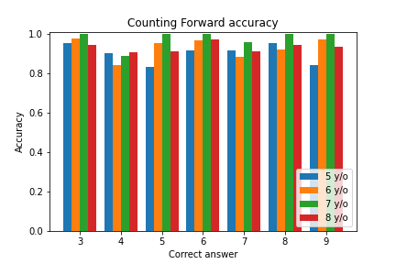
Counting Forward
Accuracy

Slide 58
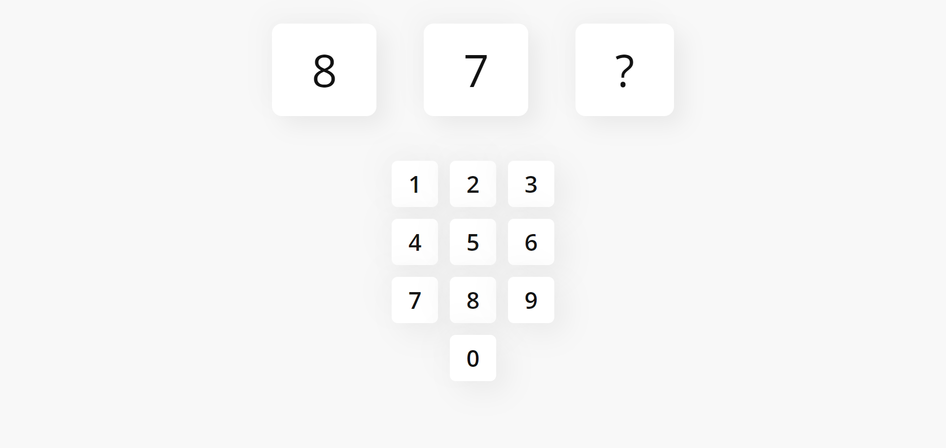
Counting Backward

Slide 59
Counting Backward
 | 5 y/o | 6 y/o | 7 y/o | 8 y/o
Accuracy | 0,77 | 0,89 | 0,96 | 0,9
N* | 304 | 741 | 361 | 456
RT M | 9576,92 | 5101,35 | 4535,13 | 3535,52
RT S | 8201,84 | 4046,47 | 2515,62 | 1848,3
N when accurate* | 235 | 663 | 346 | 412
RT when accurate M | 8852,9 | 4891,88 | 4554,88 | 3608,56
RT when accurate SD | 7384,98 | 3815,35 | 2283,12 | 1766,24
* Notice this is #samples, not #users

Slide 60
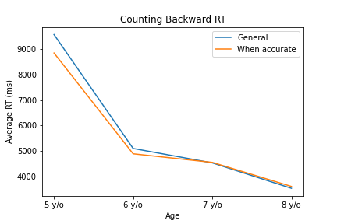
Counting Backward
Response Time

Slide 61
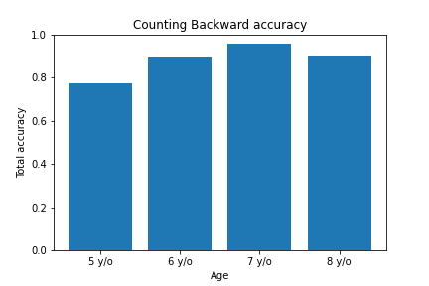
Counting Backward
Accuracy

Slide 62
Counting Backward
Response Time by correct answer
 | 5 y/o |  |  | 6 y/o |  |  | 7 y/o |  |  | 8 y/o
Correct* | N | M | SD | N | M | SD | N | M | SD | N | M | SD
3 | 38 | 8996,71 | 8947,76 | 79 | 5407,1 | 2899,24 | 48 | 4368,92 | 1915,13 | 61 | 3415,1 | 1719,03
4 | 42 | 9684,17 | 6412,66 | 117 | 5272,08 | 4657,17 | 50 | 4228,92 | 2211,55 | 61 | 3808,3 | 1944,95
5 | 39 | 8687,92 | 5624,84 | 122 | 4063,11 | 3652,58 | 54 | 4641,13 | 2284,58 | 58 | 3564,69 | 1971,72
6 | 45 | 9008,27 | 5825,91 | 114 | 4498,5 | 3580,1 | 52 | 4998,29 | 2638,68 | 61 | 3357,23 | 1866,39
7 | 42 | 10117 | 6194,52 | 125 | 4600,83 | 3446,86 | 44 | 5073,61 | 2634,08 | 60 | 3601,28 | 1838,8
8 | 38 | 7829,82 | 6519,62 | 71 | 5537,39 | 3225,92 | 43 | 3726,21 | 1376,48 | 60 | 3308,12 | 1471,02
9 | 19 | 9886,26 | 9862,73 | 33 | 5635,06 | 2432,34 | 24 | 3526,5 | 1111,9 | 29 | 3409,9 | 1813,77
General | 304 | 9576,92 | 8201,84 | 741 | 5101,35 | 4046,47 | 361 | 4535,13 | 2515,62 | 456 | 3535,52 | 1848,3

Slide 63
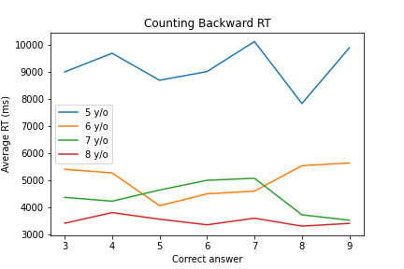
Counting Backward
Response Time by correct answer

Slide 64
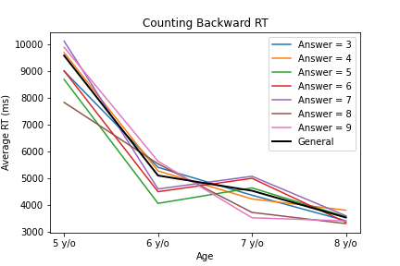
Counting Backward
Response Time by correct answer

Slide 65
Counting Backward
Response Time by correct answer when accurately answered
 | 5 y/o |  |  | 6 y/o |  |  | 7 y/o |  |  | 8 y/o
Correct* | N | M | SD | N | M | SD | N | M | SD | N | M | SD
3 | 30 | 9119,57 | 9441,43 | 73 | 5414,18 | 2956,29 | 46 | 4482,5 | 1875,08 | 55 | 3510,64 | 1721,99
4 | 31 | 8921,42 | 6050,13 | 100 | 5141,95 | 4464,48 | 44 | 4510,32 | 2130,35 | 56 | 3980,02 | 1924,29
5 | 25 | 6990,24 | 3972,57 | 112 | 3773,38 | 3212,35 | 53 | 4672,25 | 2294,67 | 53 | 3604,34 | 1868,47
6 | 38 | 8146,61 | 4979,63 | 104 | 4413,8 | 3607,21 | 51 | 5008,04 | 2663,5 | 59 | 3425,08 | 1858,19
7 | 34 | 9923,76 | 6305,63 | 115 | 4448,16 | 3269,58 | 43 | 5066,44 | 2664,11 | 55 | 3771,02 | 1804,17
8 | 34 | 7856,91 | 6458,24 | 66 | 5440,39 | 3234,18 | 43 | 3726,21 | 1376,48 | 58 | 3409,03 | 1390,15
9 | 16 | 8472,5 | 7881,87 | 32 | 5728,31 | 2411,27 | 24 | 3526,5 | 1111,9 | 26 | 3613,85 | 1699,27
General | 235 | 8852,9 | 7384,98 | 663 | 4891,88 | 3815,35 | 346 | 4554,88 | 2283,12 | 412 | 3608,56 | 1766,24

Slide 66
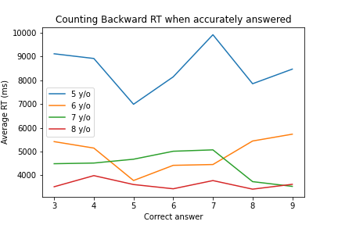
Counting Backward
Response Time when accurately answered

Slide 67
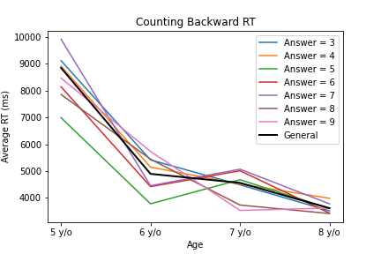
Counting Backward
Response Time when accurately answered

Slide 68
Counting Backward
Accuracy by correct answer
 | 5 y/o |  | 6 y/o |  | 7 y/o |  | 8 y/o
Correct* | N | Accuracy | N | Accuracy | N | Accuracy | N | Accuracy
3 | 0,79 | 0,92 | 0,96 | 0,9 | 0,79 | 0,92 | 0,96 | 0,9
4 | 0,74 | 0,85 | 0,88 | 0,92 | 0,74 | 0,85 | 0,88 | 0,92
5 | 0,64 | 0,92 | 0,98 | 0,91 | 0,64 | 0,92 | 0,98 | 0,91
6 | 0,84 | 0,91 | 0,98 | 0,97 | 0,84 | 0,91 | 0,98 | 0,97
7 | 0,81 | 0,92 | 0,98 | 0,92 | 0,81 | 0,92 | 0,98 | 0,92
8 | 0,89 | 0,93 | 1 | 0,97 | 0,89 | 0,93 | 1 | 0,97
9 | 0,84 | 0,97 | 1 | 0,9 | 0,84 | 0,97 | 1 | 0,9
General | 0,77 | 0,89 | 0,96 | 0,9 | 0,77 | 0,89 | 0,96 | 0,9

Slide 69
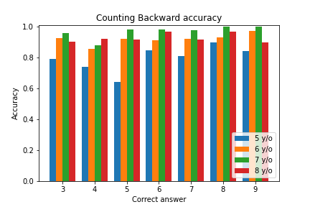
Counting Backward
Accuracy

Slide 70
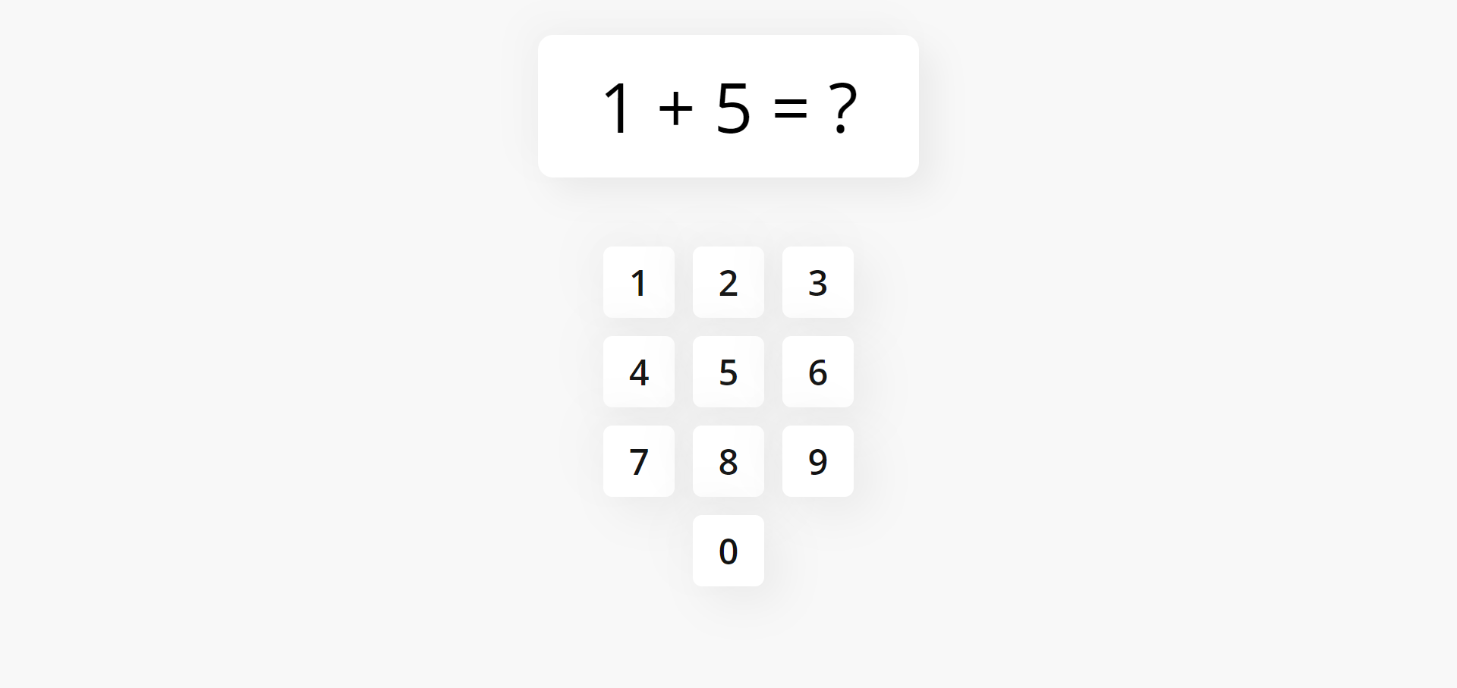
Simple Arithmetic Plus

Slide 71
Simple Arithmetic Plus
 | 5 y/o | 6 y/o | 7 y/o | 8 y/o
Accuracy | 0,74 | 0,9 | 0,95 | 0,94
N* | 160 | 390 | 180 | 280
RT M | 14827,3 | 6731,64 | 5782,57 | 4141,15
RT S | 10366,1 | 6126,12 | 4638,1 | 3057,36
N when accurate* | 119 | 351 | 171 | 262
RT when accurate M | 12922,79 | 6417,07 | 5462,47 | 4133,4
RT when accurate SD | 7774,79 | 5623,42 | 4266,76 | 2838,76
* Notice this is #samples, not #users

Slide 72
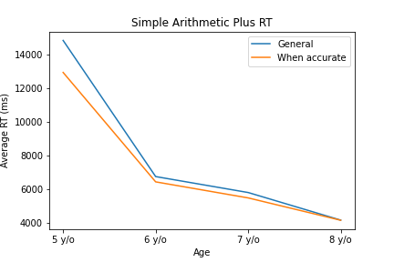
Simple Arithmetic Plus
Response Time

Slide 73
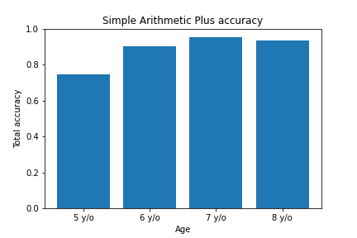
Simple Arithmetic Plus
Accuracy

Slide 74
Simple Arithmetic Plus
Response Time by correct answer
 | 5 y/o |  |  | 6 y/o |  |  | 7 y/o |  |  | 8 y/o
Correct* | N | M | SD | N | M | SD | N | M | SD | N | M | SD
2 | 5 | 7555,8 | 3780,92 | 18 | 2651,39 | 1375,25 | 7 | 2657,86 | 695,99 | 9 | 2170,33 | 668,39
3 | 10 | 10588,1 | 6748,48 | 33 | 4355,94 | 2408,41 | 13 | 5863,62 | 4325,69 | 16 | 3179,69 | 1192,5
4 | 16 | 14584,12 | 8995,06 | 49 | 4289,67 | 3252,08 | 18 | 3685,06 | 3434,17 | 20 | 3294,2 | 1463,34
5 | 30 | 12002 | 5398,9 | 68 | 6063,66 | 5290,64 | 22 | 4691,23 | 3946,74 | 34 | 3681,97 | 2322,49
6 | 26 | 14258,73 | 11175,55 | 75 | 6975,92 | 6086,61 | 26 | 5537,31 | 3559,33 | 47 | 4080,89 | 2869,5
7 | 36 | 16984,39 | 11684,85 | 66 | 8263,88 | 6675 | 40 | 7222,15 | 5476,01 | 69 | 4842,22 | 3503,12
8 | 37 | 17652,35 | 11830,84 | 80 | 9269,26 | 7710,75 | 54 | 6363,63 | 4840,34 | 85 | 4377,96 | 3464,82
General | 160 | 14827,3 | 10366,1 | 390 | 6731,64 | 6126,12 | 180 | 5782,57 | 4638,1 | 280 | 4141,15 | 3057,36
* Specific information would be better

Slide 75

Simple Arithmetic Plus
Response Time by correct answer

Slide 76

Simple Arithmetic Plus
Response Time by correct answer

Slide 77
Simple Arithmetic Plus
Response Time by correct answer when accurately answered
 | 5 y/o |  |  | 6 y/o |  |  | 7 y/o |  |  | 8 y/o
Correct* | N | M | SD | N | M | SD | N | M | SD | N | M | SD
2 | 4 | 6167,5 | 2869,21 | 18 | 2651,39 | 1375,25 | 7 | 2657,86 | 695,99 | 9 | 2170,33 | 668,39
3 | 7 | 8895,29 | 6651,81 | 31 | 4534,1 | 2376,88 | 13 | 5863,62 | 4325,69 | 14 | 2866,21 | 896,55
4 | 11 | 13230,45 | 7019,6 | 46 | 4217,5 | 3166,22 | 18 | 3685,06 | 3434,17 | 18 | 3515,11 | 1372,31
5 | 25 | 10986,84 | 4435,79 | 63 | 6195,79 | 5370,77 | 21 | 4287,71 | 3568,82 | 33 | 3779,7 | 2287,51
6 | 21 | 11485,67 | 6130,12 | 63 | 6214,73 | 5302,66 | 24 | 5376,46 | 3556,33 | 43 | 3787,53 | 1947,14
7 | 27 | 17460,37 | 10147,52 | 56 | 8088,25 | 6716,76 | 38 | 6950,34 | 5371,79 | 67 | 4716,13 | 3148,12
8 | 24 | 13251,67 | 7230,01 | 73 | 8686,37 | 6580,57 | 50 | 5794,6 | 3882,83 | 78 | 4569,78 | 3492,7
General | 119 | 12922,79 | 7774,79 | 351 | 6417,07 | 5623,42 | 171 | 5462,47 | 4266,76 | 262 | 4133,4 | 2838,76
* Specific information would be better

Slide 78

Simple Arithmetic Plus
Response Time when accurately answered

Slide 79

Simple Arithmetic Plus
Response Time when accurately answered

Slide 80
Simple Arithmetic Plus
Accuracy by correct answer
 | 5 y/o |  | 6 y/o |  | 7 y/o |  | 8 y/o
Correct* | N | Accuracy | N | Accuracy | N | Accuracy | N | Accuracy
2 | 0,8 | 1 | 1 | 1 | 0,8 | 1 | 1 | 1
3 | 0,7 | 0,94 | 1 | 0,88 | 0,7 | 0,94 | 1 | 0,88
4 | 0,69 | 0,94 | 1 | 0,9 | 0,69 | 0,94 | 1 | 0,9
5 | 0,83 | 0,93 | 0,95 | 0,97 | 0,83 | 0,93 | 0,95 | 0,97
6 | 0,81 | 0,84 | 0,92 | 0,91 | 0,81 | 0,84 | 0,92 | 0,91
7 | 0,75 | 0,85 | 0,95 | 0,97 | 0,75 | 0,85 | 0,95 | 0,97
8 | 0,65 | 0,91 | 0,93 | 0,92 | 0,65 | 0,91 | 0,93 | 0,92
General | 0,74 | 0,9 | 0,95 | 0,94 | 0,74 | 0,9 | 0,95 | 0,94
* Specific information would be better

Slide 81

Simple Arithmetic Plus
Accuracy

Slide 82

Simple Arithmetic Minus

Slide 83
Simple Arithmetic Minus
 | 5 y/o | 6 y/o | 7 y/o | 8 y/o
Accuracy | 0,48 | 0,81 | 0,92 | 0,9
N* | 320 | 780 | 380 | 540
RT M | 16659,26 | 7664,42 | 7056,29 | 4831,63
RT S | 14357,51 | 7091,21 | 5482,07 | 3675,63
N when accurate* | 155 | 632 | 350 | 488
RT when accurate M | 14524,64 | 6828,63 | 6879,5 | 4800,71
RT when accurate SD | 10962,95 | 6339,17 | 5004,61 | 3529,95
* Notice this is #samples, not #users

Slide 84

Simple Arithmetic Minus
Response Time

Slide 85

Simple Arithmetic Minus
Accuracy

Slide 86
Simple Arithmetic Minus
Response Time by correct answer
 | 5 y/o |  |  | 6 y/o |  |  | 7 y/o |  |  | 8 y/o
Correct* | N | M | SD | N | M | SD | N | M | SD | N | M | SD
2 | 40 | 12447,9 | 9712,71 | 103 | 7766,32 | 7469,67 | 46 | 8012,93 | 7450,64 | 65 | 5271,43 | 3852,1
3 | 40 | 16599,33 | 15307,39 | 78 | 7849,72 | 7714,62 | 45 | 9118,29 | 6454,5 | 56 | 5991,05 | 5779,51
4 | 31 | 19401,45 | 15579,11 | 90 | 6253,26 | 5289,53 | 40 | 6448,7 | 5298,1 | 52 | 5313,4 | 3467,05
5 | 48 | 18027,58 | 20172,09 | 106 | 7004,84 | 5511,98 | 46 | 5468,85 | 3262,29 | 59 | 4469,41 | 3385,25
6 | 37 | 16662,97 | 13529,15 | 99 | 7908,25 | 6283,91 | 40 | 5795,02 | 3593,69 | 64 | 4292,98 | 3097,86
7 | 45 | 16694,62 | 12517,12 | 82 | 9055,62 | 6869,72 | 51 | 7135,1 | 5130,14 | 80 | 4572,89 | 2843,03
8 | 43 | 17409,95 | 11392,6 | 88 | 8863,14 | 7330,78 | 60 | 6253,43 | 4681,98 | 94 | 4272,9 | 3311,35
General | 320 | 16659,26 | 14357,51 | 780 | 7664,42 | 7091,21 | 380 | 7056,29 | 5482,07 | 540 | 4831,63 | 3675,63
* Specific information would be better

Slide 87

Simple Arithmetic Minus
Response Time by correct answer

Slide 88

Simple Arithmetic Minus
Response Time by correct answer

Slide 89
Simple Arithmetic Minus
Response Time by correct answer when accurately answered
 | 5 y/o |  |  | 6 y/o |  |  | 7 y/o |  |  | 8 y/o
Correct* | N | M | SD | N | M | SD | N | M | SD | N | M | SD
2 | 14 | 12779,21 | 9523,91 | 80 | 6444,21 | 6834,6 | 39 | 7417,33 | 4356,79 | 58 | 5179,12 | 3854,65
3 | 12 | 17340,33 | 22537,41 | 59 | 7271,83 | 7892 | 41 | 9280,41 | 6604,6 | 44 | 6317,41 | 6212,94
4 | 14 | 17190,86 | 10869,44 | 75 | 5859,85 | 4884,8 | 40 | 6448,7 | 5298,1 | 44 | 5151,25 | 3365,23
5 | 29 | 14135,9 | 10941,3 | 89 | 6926,96 | 5548,18 | 44 | 5320,3 | 3118,89 | 52 | 4383,83 | 3000,84
6 | 21 | 11485,67 | 6130,12 | 81 | 7137,15 | 5488,57 | 36 | 5742,39 | 3689,79 | 59 | 4104,29 | 2592,67
7 | 29 | 17133,21 | 9897,75 | 65 | 8703,85 | 6995,85 | 49 | 6920,76 | 5026,55 | 79 | 4624,16 | 2823,97
8 | 26 | 12953,54 | 7067,56 | 78 | 8301,44 | 6270,04 | 56 | 5737,5 | 3777,01 | 85 | 4466,95 | 3336,08
General | 155 | 14524,64 | 10962,95 | 632 | 6828,63 | 6339,17 | 350 | 6879,5 | 5004,61 | 488 | 4800,71 | 3529,95
* Specific information would be better

Slide 90

Simple Arithmetic Minus
Response Time when accurately answered

Slide 91

Simple Arithmetic Minus
Response Time when accurately answered

Slide 92
Simple Arithmetic Minus
Accuracy by correct answer
 | 5 y/o |  | 6 y/o |  | 7 y/o |  | 8 y/o
Correct* | N | Accuracy | N | Accuracy | N | Accuracy | N | Accuracy
2 | 0,35 | 0,78 | 0,85 | 0,89 | 0,35 | 0,78 | 0,85 | 0,89
3 | 0,3 | 0,76 | 0,91 | 0,79 | 0,3 | 0,76 | 0,91 | 0,79
4 | 0,45 | 0,83 | 1 | 0,85 | 0,45 | 0,83 | 1 | 0,85
5 | 0,6 | 0,84 | 0,96 | 0,88 | 0,6 | 0,84 | 0,96 | 0,88
6 | 0,57 | 0,82 | 0,9 | 0,92 | 0,57 | 0,82 | 0,9 | 0,92
7 | 0,64 | 0,79 | 0,96 | 0,99 | 0,64 | 0,79 | 0,96 | 0,99
8 | 0,6 | 0,89 | 0,93 | 0,9 | 0,6 | 0,89 | 0,93 | 0,9
General | 0,48 | 0,81 | 0,92 | 0,9 | 0,48 | 0,81 | 0,92 | 0,9
* Specific information would be better

Slide 93

Simple Arithmetic Minus
Accuracy

