Slide 1
TNB – Combined metrics
Content:
LISAS, IES and RCS calculations for each subtest divided by age ↗
Box plots for each metric with each subtest ↗
Correlation matrices of each of the metrics between subtests ↗
To make the visualization easier, the RT and Accuracy slides from the previous presentation were also included.
The first slides include important considerations to better understand the analysis.

Slide 2
Bin Scores
I understood from Huges et al. (2014) and Vandierendonck (2017) that bin scores are used in the task-switching paradigm. Since, as I understand it, the TNB is not a task-switching test, I could not calculate bin scores. Even though I tried, I found some variables required to calculate this metric impossible to obtain. For example:
“Its calculation, as defined in Hughes et al. (2014), assumes that there are two conditions, basically a control and an experimental condition (e.g., task repetition and task switch trials to estimate the task switch cost)”
Vandierendonck (2017)
Does our test have control conditions?

Slide 3
LISAS
“If the number of observations per condition is too small, more stable estimates of the standard deviation can be obtained by grouping conditions, or by taking the standard deviation per subject. In the present paper, the standard deviations are calculated per condition”
Vandierendonck (2018)
I did not do this because:
10 observations/condition seemed ok
I did not find a proper grouping strategy (I can easily do this if we find one)

Slide 4
“General” and “When accurate”
“RT_{j} is the participant’s mean RT in condition j, …, S_{RT} is the participant’s overall RT standard deviation”
Vandierendonck (2017)
“the average correct RT (RTc )”
“S_{RT} refers to the standard deviation of the correct RTs”
Vandierendonck (2018)
Because of this difference, you will find “General” and “When accurate” in LISAS plots. The same happened with IES.

Slide 5
Dots Comparison
 | 5 y/o | 6 y/o | 7 y/o | 8 y/o
LISAS | 6944,367 | 3961,216 | 3587,137 | 3367,666
LISAS when accurate | 6674,142 | 3856,472 | 3581,53 | 3370,423
IES | 4664,131 | 2912,606 | 2630,999 | 2452,991
IES when accurate | 4582,063 | 2936,076 | 2638,374 | 2478,269
RCS | 0,302176 | 0,506873 | 0,445771 | 0,48191
Accuracy | 0,91875 | 0,9575 | 0,968421 | 0,975
RT | 4286,538 | 2769,851 | 2539,811 | 2381,333

Slide 6
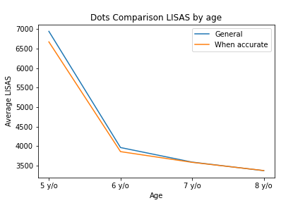
Dots Comparison
LISAS by age

Slide 7
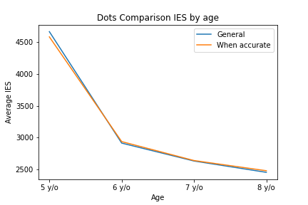
Dots Comparison
IES by age

Slide 8
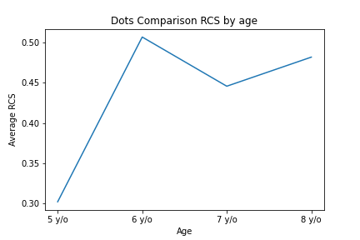
Dots Comparison
RCS by age

Slide 9
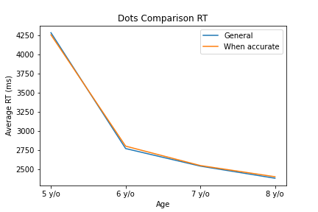
Dots Comparison
RT by age

Slide 10
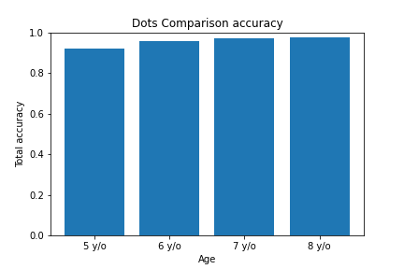
Dots Comparison
Accuracy by age

Slide 11
Match Sample
 | 5 y/o | 6 y/o | 7 y/o | 8 y/o
LISAS | 7586,234 | 7690,458 | 8063,495 | 6804,621
LISAS when accurate | 7747,306 | 7816,242 | 8106,666 | 6563,672
IES | 10374,09 | 8214,887 | 8004,588 | 6021,918
IES when accurate | 10186,77 | 8771,819 | 8507,47 | 6128,404
RCS | 0,126446 | 0,216214 | 0,149472 | 0,183633
Accuracy | 0,604167 | 0,688889 | 0,707602 | 0,785714
RT | 5127,094 | 4725,635 | 5084,611 | 4473,625

Slide 12
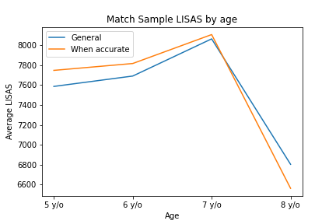
Match Sample
LISAS by age

Slide 13
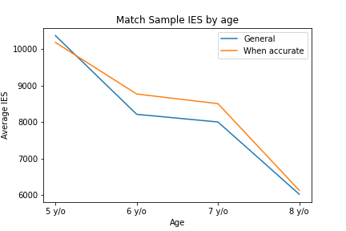
Match Sample
IES by age

Slide 14
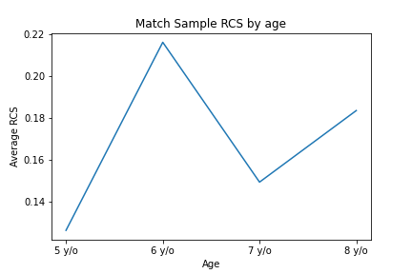
Match Sample
RCS by age

Slide 15
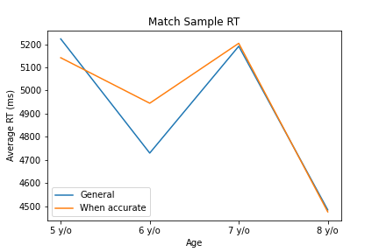
Match Sample
RT by age

Slide 16
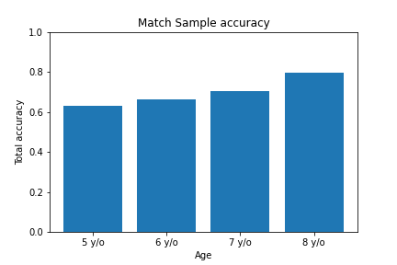
Match Sample
Accuracy by age

Slide 17
Match Sample Rotate
 | 5 y/o | 6 y/o | 7 y/o | 8 y/o
LISAS | 6872,089 | 6173,73 | 6969,992 | 6032,588
LISAS when accurate | 6655,54 | 5901,538 | 6967,504 | 6109,895
IES | 9837,982 | 7153,268 | 6320,489 | 5149,79
IES when accurate | 9463,403 | 7217,091 | 6302,945 | 5304,087
RCS | 0,135383 | 0,175117 | 0,176269 | 0,209213
Accuracy | 0,597222 | 0,722222 | 0,766082 | 0,873016
RT | 4998,65 | 4502,905 | 4574,737 | 4341,257

Slide 18
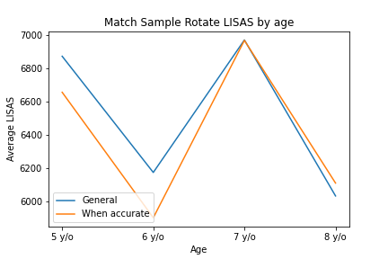
Match Sample Rotate
LISAS by age

Slide 19
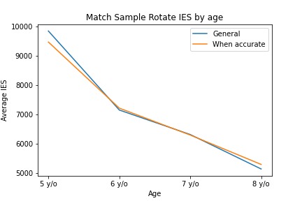
Match Sample Rotate
IES by age

Slide 20
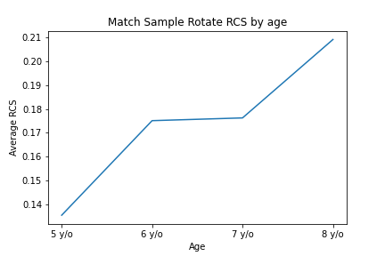
Match Sample Rotate
RCS by age

Slide 21
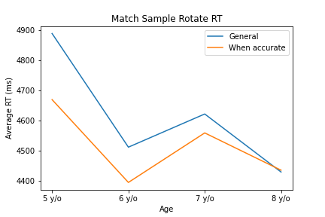
Match Sample Rotate
RT by age

Slide 22
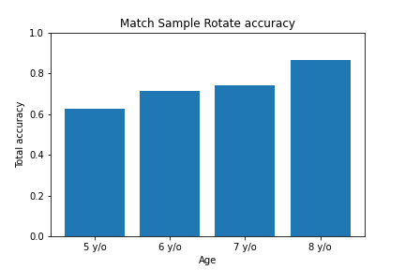
Match Sample Rotate
Accuracy by age

Slide 23
Match Points Number
 | 5 y/o | 6 y/o | 7 y/o | 8 y/o
LISAS | 9697,497 | 5661,006 | 5274,758 | 4916,137
LISAS when accurate | 9481,906 | 5624,878 | 5324,527 | 4822,645
IES | 6450,687 | 4451,822 | 4647,384 | 3867,898
IES when accurate | 6413,652 | 4434,161 | 4686,12 | 3796,119
RCS | 0,167743 | 0,273929 | 0,23943 | 0,284934
Accuracy | 0,926667 | 0,915 | 0,936842 | 0,946429
RT | 5881,213 | 4067,363 | 4412,726 | 3596,179

Slide 24
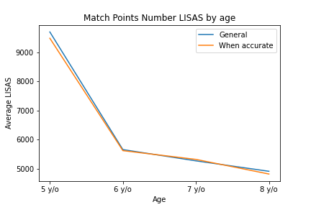
Match Points Number
LISAS by age

Slide 25
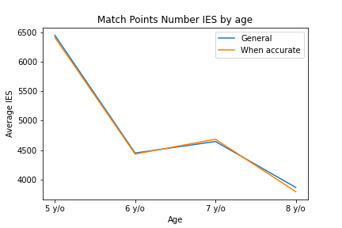
Match Points Number
IES by age

Slide 26
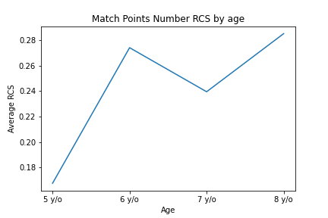
Match Points Number
RCS by age

Slide 27
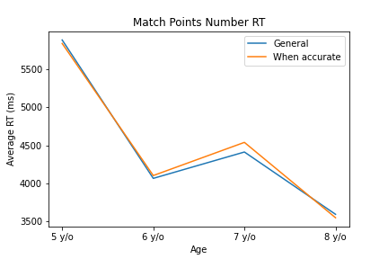
Match Points Number
RT by age

Slide 28
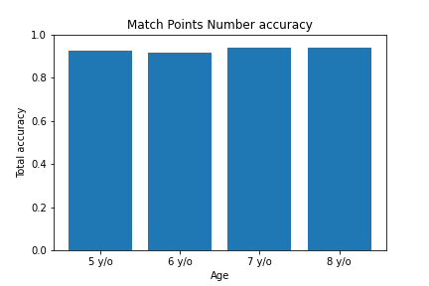
Match Points Number
Accuracy by age

Slide 29
Symbolic Magnitude
 | 5 y/o | 6 y/o | 7 y/o | 8 y/o
LISAS | 4820,769 | 2195,25 | 1826,887 | 1468,055
LISAS when accurate | 4819,507 | 2185,004 | 1844,865 | 1467,879
IES | 4268,909 | 1864,305 | 1546,552 | 1425,349
IES when accurate | 4195,366 | 1905,878 | 1555,43 | 1427,968
RCS | 0,357566 | 0,636999 | 0,670557 | 0,731119
Accuracy | 0,875 | 0,96 | 0,973684 | 0,992857
RT | 3037,556 | 1718,305 | 1496,633 | 1415,337

Slide 30
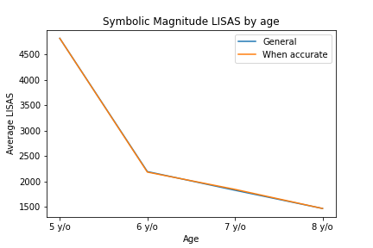
Symbolic Magnitude
LISAS by age

Slide 31
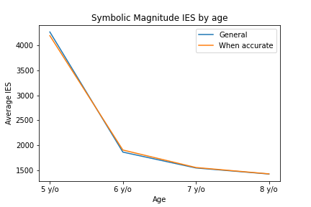
Symbolic Magnitude
IES by age

Slide 32
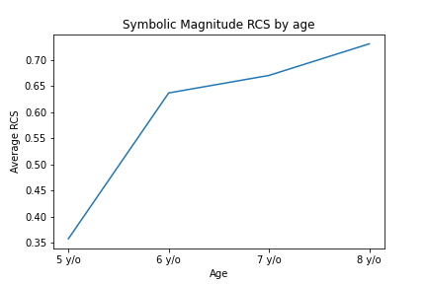
Symbolic Magnitude
RCS by age

Slide 33
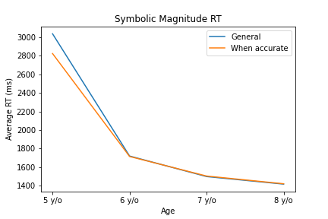
Symbolic Magnitude
RT by age

Slide 34
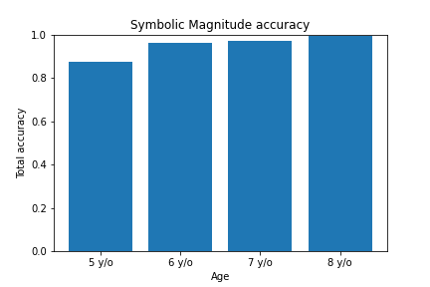
Symbolic Magnitude
Accuracy by age

Slide 35
Numeric Line
 | 5 y/o | 6 y/o | 7 y/o | 8 y/o
LISAS | 10160,83 | 8727,331 | 9480,715 | 7714,335
LISAS when accurate | 9317,224 | 7770,217 | 8139,912 | 7264,673
IES | 19535,35 | 13522,12 | 16119,19 | 10016,51
IES when accurate | 17962,52 | 12134,64 | 13612,76 | 8702,66
RCS | 0,084383 | 0,14759 | 0,118822 | 0,166396
Accuracy | 0,5 | 0,5775 | 0,615789 | 0,771429
RT | 7105,625 | 5556,199 | 6017,024 | 5242,377

Slide 36
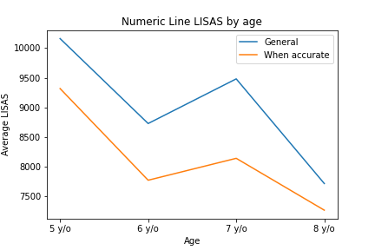
Numeric Line
LISAS by age

Slide 37
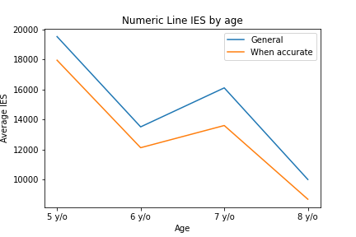
Numeric Line
IES by age

Slide 38
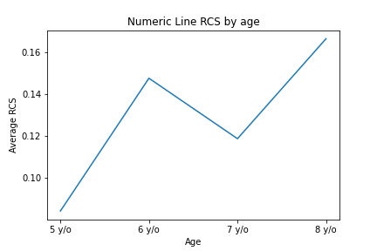
Numeric Line
RCS by age

Slide 39
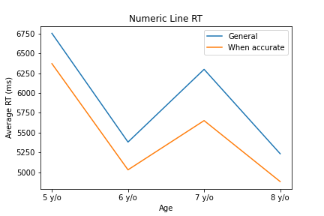
Numeric Line
RT by age

Slide 40
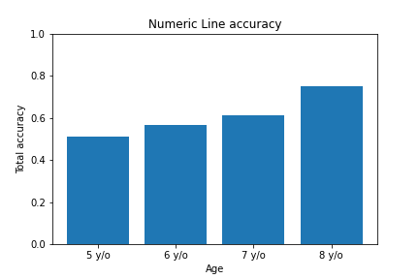
Numeric Line
Accuracy by age

Slide 41
Counting Forward
 | 5 y/o | 6 y/o | 7 y/o | 8 y/o
LISAS | 9964,497 | 6133,554 | 4281,354 | 5942,072
LISAS when accurate | 9602,667 | 6193,104 | 4223,083 | 5204,104
IES | 9868,247 | 4856,562 | 3881,138 | 4135,734
IES when accurate | 9934,138 | 5037,249 | 3923,501 | 4005,805
RCS | 0,137308 | 0,290848 | 0,279963 | 0,261008
Accuracy | 0,902778 | 0,925 | 0,976608 | 0,869048
RT | 7736,625 | 4295,806 | 3775,83 | 3488,631

Slide 42
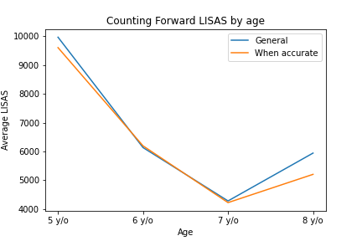
Counting Forward
LISAS by age

Slide 43
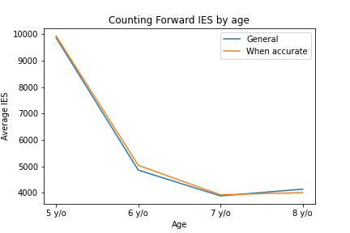
Counting Forward
IES by age

Slide 44
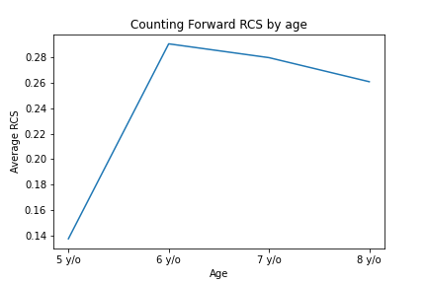
Counting Forward
RCS by age

Slide 45
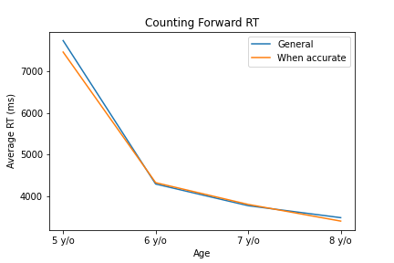
Counting Forward
RT by age

Slide 46
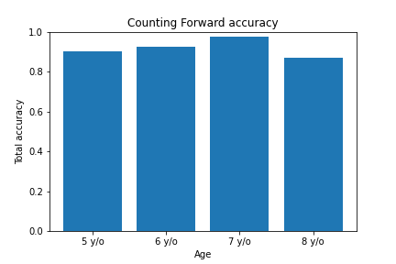
Counting Forward
Accuracy by age

Slide 47
Counting Backward
 | 5 y/o | 6 y/o | 7 y/o | 8 y/o
LISAS | 18276,02 | 10028,93 | 8858,177 | 7424,184
LISAS when accurate | 16992,45 | 9381,126 | 8365,183 | 7118,078
IES | 14414,46 | 6382,03 | 4743,843 | 3977,368
IES when accurate | 13702,42 | 6280,892 | 4767,538 | 4118,096
RCS | 0,098012 | 0,261045 | 0,233978 | 0,267812
Accuracy | 0,773026 | 0,897368 | 0,958449 | 0,917293
RT | 9576,918 | 5101,347 | 4535,13 | 3535,515

Slide 48
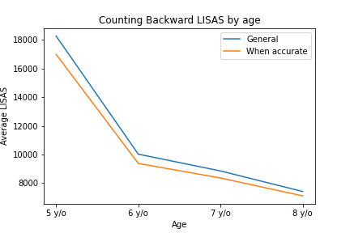
Counting Backward
LISAS by age

Slide 49
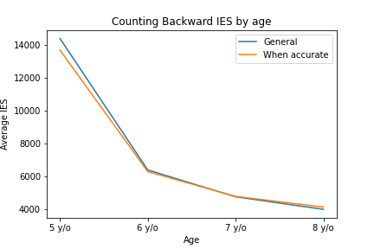
Counting Backward
IES by age

Slide 50
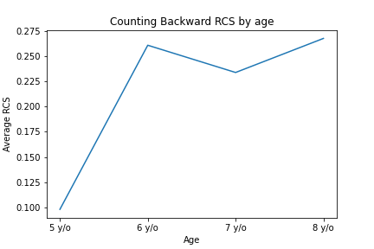
Counting Backward
RCS by age

Slide 51
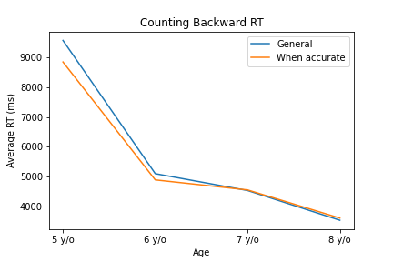
Counting Backward
RT by age

Slide 52
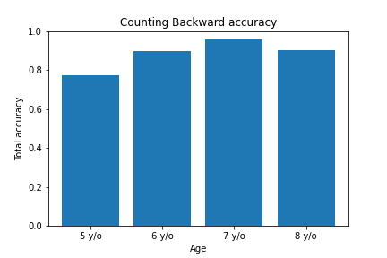
Counting Backward
Accuracy by age

Slide 53
Simple Arithmetic Plus
 | 5 y/o | 6 y/o | 7 y/o | 8 y/o
LISAS | 24750,44 | 10815,15 | 7934,377 | 6144,448
LISAS when accurate | 20781,97 | 9990,543 | 6893,59 | 5774,55
IES | 21065,06 | 7989,253 | 6396,621 | 4474,94
IES when accurate | 18846,73 | 7661,176 | 6120,417 | 4342,655
RCS | 0,059279 | 0,248326 | 0,217268 | 0,260521
Accuracy | 0,74375 | 0,9025 | 0,952632 | 0,935714
RT | 14827,3 | 6731,636 | 5782,567 | 4141,146

Slide 54
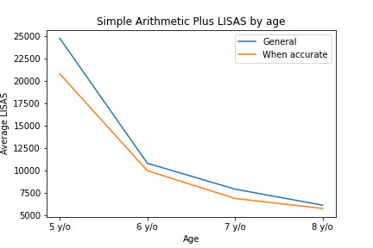
Simple Arithmetic Plus
LISAS by age

Slide 55
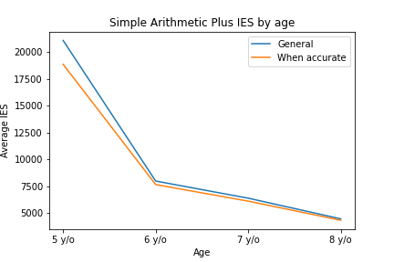
Simple Arithmetic Plus
IES by age

Slide 56
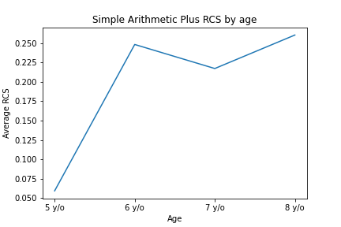
Simple Arithmetic Plus
RCS by age

Slide 57
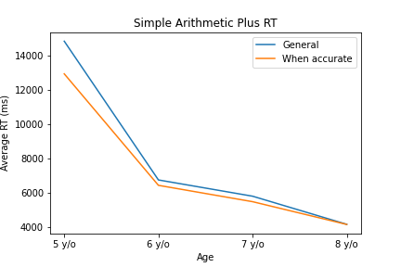
Simple Arithmetic Plus
RT by age

Slide 58
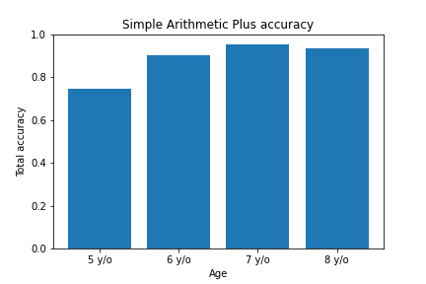
Simple Arithmetic Plus
Accuracy by age

Slide 59
Simple Arithmetic Minus
 | 5 y/o | 6 y/o | 7 y/o | 8 y/o
LISAS | 30330,34 | 16971,28 | 15381,32 | 10411,31
LISAS when accurate | 24260,35 | 15840,9 | 14069,92 | 9955,243
IES | 45609,73 | 12093,93 | 7753,951 | 5410,227
IES when accurate | 35841,02 | 11097,52 | 7566,45 | 5302,148
RCS | 0,031622 | 0,223134 | 0,165025 | 0,203451
Accuracy | 0,484375 | 0,815 | 0,921053 | 0,907143
RT | 16659,26 | 7664,422 | 7056,295 | 4831,63

Slide 60
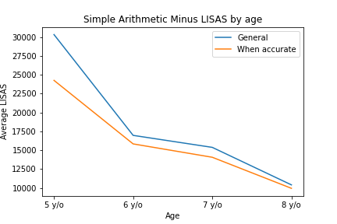
Simple Arithmetic Minus
LISAS by age

Slide 61
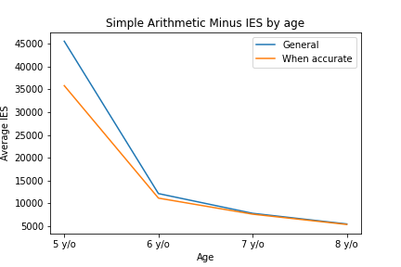
Simple Arithmetic Minus
IES by age

Slide 62
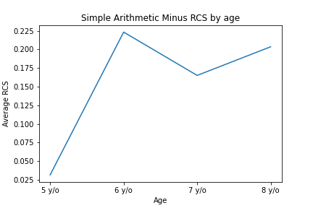
Simple Arithmetic Minus
RCS by age

Slide 63
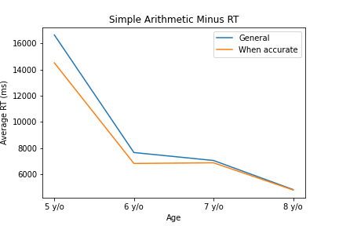
Simple Arithmetic Minus
RT by age

Slide 64
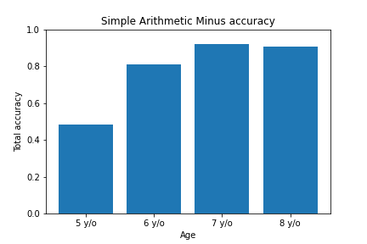
Simple Arithmetic Minus
Accuracy by age

Slide 65

LISAS
Box plot by subtest

Slide 66

LISAS when accurate
Box plot by subtest

Slide 67

IES
Box plot by subtest

Slide 68

IES when accurate
Box plot by subtest

Slide 69

RCS
Box plot by subtest

Slide 70
LISAS correlation matrix
 | Dots Comparison | Match Sample | Match Sample Rotate | Match Points Number | Symbolic Magnitude | Numeric Line | Counting Forward | Counting Backward | Simple Arithmetic Plus | Simple Arithmetic Minus
Dots Comparison | 1 | 0,167773 | 0,218122 | 0,203129 | 0,310356 | 0,247294 | 0,264265 | 0,264042 | 0,282338 | 0,341732
Match Sample | 0,167773 | 1 | 0,422376 | 0,182668 | 0,226466 | 0,257526 | 0,090285 | 0,183146 | 0,199231 | 0,209946
Match Sample Rotate | 0,218122 | 0,422376 | 1 | 0,305978 | 0,172576 | 0,249958 | 0,223728 | 0,118297 | 0,271454 | 0,330502
Match Points Number | 0,203129 | 0,182668 | 0,305978 | 1 | 0,366347 | 0,244644 | 0,297797 | 0,342005 | 0,368977 | 0,361351
Symbolic Magnitude | 0,310356 | 0,226466 | 0,172576 | 0,366347 | 1 | 0,221329 | 0,270757 | 0,444292 | 0,485148 | 0,457904
Numeric Line | 0,247294 | 0,257526 | 0,249958 | 0,244644 | 0,221329 | 1 | 0,247093 | 0,242773 | 0,356356 | 0,380123
Counting Forward | 0,264265 | 0,090285 | 0,223728 | 0,297797 | 0,270757 | 0,247093 | 1 | 0,638079 | 0,500729 | 0,31883
Counting Backward | 0,264042 | 0,183146 | 0,118297 | 0,342005 | 0,444292 | 0,242773 | 0,638079 | 1 | 0,639928 | 0,383913
Simple Arithmetic Plus | 0,282338 | 0,199231 | 0,271454 | 0,368977 | 0,485148 | 0,356356 | 0,500729 | 0,639928 | 1 | 0,59339
Simple Arithmetic Minus | 0,341732 | 0,209946 | 0,330502 | 0,361351 | 0,457904 | 0,380123 | 0,31883 | 0,383913 | 0,59339 | 1

Slide 71
LISAS when accurate correlation matrix
 | Dots Comparison | Match Sample | Match Sample Rotate | Match Points Number | Symbolic Magnitude | Numeric Line | Counting Forward | Counting Backward | Simple Arithmetic Plus | Simple Arithmetic Minus
Dots Comparison | 1 | 0,179859 | 0,233632 | 0,19915 | 0,23464 | 0,221613 | 0,284316 | 0,290623 | 0,253636 | 0,306828
Match Sample | 0,179859 | 1 | 0,420055 | 0,209938 | 0,324372 | 0,218471 | 0,071425 | 0,114207 | 0,216422 | 0,30202
Match Sample Rotate | 0,233632 | 0,420055 | 1 | 0,280896 | 0,106327 | 0,257067 | 0,132187 | 0,140298 | 0,219676 | 0,286138
Match Points Number | 0,19915 | 0,209938 | 0,280896 | 1 | 0,359262 | 0,244984 | 0,284728 | 0,341446 | 0,334081 | 0,307989
Symbolic Magnitude | 0,23464 | 0,324372 | 0,106327 | 0,359262 | 1 | 0,202214 | 0,256827 | 0,351603 | 0,349965 | 0,341146
Numeric Line | 0,221613 | 0,218471 | 0,257067 | 0,244984 | 0,202214 | 1 | 0,17701 | 0,182325 | 0,274277 | 0,288556
Counting Forward | 0,284316 | 0,071425 | 0,132187 | 0,284728 | 0,256827 | 0,17701 | 1 | 0,728093 | 0,566421 | 0,34092
Counting Backward | 0,290623 | 0,114207 | 0,140298 | 0,341446 | 0,351603 | 0,182325 | 0,728093 | 1 | 0,638659 | 0,370913
Simple Arithmetic Plus | 0,253636 | 0,216422 | 0,219676 | 0,334081 | 0,349965 | 0,274277 | 0,566421 | 0,638659 | 1 | 0,590275
Simple Arithmetic Minus | 0,306828 | 0,30202 | 0,286138 | 0,307989 | 0,341146 | 0,288556 | 0,34092 | 0,370913 | 0,590275 | 1

Slide 72
IES correlation matrix
 | Dots Comparison | Match Sample | Match Sample Rotate | Match Points Number | Symbolic Magnitude | Numeric Line | Counting Forward | Counting Backward | Simple Arithmetic Plus | Simple Arithmetic Minus
Dots Comparison | 1 | 0,117638 | 0,314496 | 0,373334 | 0,262139 | 0,254506 | 0,315778 | 0,362505 | 0,321742 | 0,204673
Match Sample | 0,117638 | 1 | 0,438032 | 0,405981 | 0,526977 | 0,125789 | 0,176592 | 0,237485 | 0,528152 | 0,43399
Match Sample Rotate | 0,314496 | 0,438032 | 1 | 0,558948 | 0,52794 | 0,280444 | 0,374738 | 0,43495 | 0,506014 | 0,521703
Match Points Number | 0,373334 | 0,405981 | 0,558948 | 1 | 0,559657 | 0,320312 | 0,575761 | 0,554233 | 0,654608 | 0,577227
Symbolic Magnitude | 0,262139 | 0,526977 | 0,52794 | 0,559657 | 1 | 0,198472 | 0,446767 | 0,582962 | 0,794165 | 0,654606
Numeric Line | 0,254506 | 0,125789 | 0,280444 | 0,320312 | 0,198472 | 1 | 0,315483 | 0,290693 | 0,314919 | 0,181701
Counting Forward | 0,315778 | 0,176592 | 0,374738 | 0,575761 | 0,446767 | 0,315483 | 1 | 0,862256 | 0,706163 | 0,569917
Counting Backward | 0,362505 | 0,237485 | 0,43495 | 0,554233 | 0,582962 | 0,290693 | 0,862256 | 1 | 0,721217 | 0,625897
Simple Arithmetic Plus | 0,321742 | 0,528152 | 0,506014 | 0,654608 | 0,794165 | 0,314919 | 0,706163 | 0,721217 | 1 | 0,937282
Simple Arithmetic Minus | 0,204673 | 0,43399 | 0,521703 | 0,577227 | 0,654606 | 0,181701 | 0,569917 | 0,625897 | 0,937282 | 1

Slide 73
IES when accurate correlation matrix
 | Dots Comparison | Match Sample | Match Sample Rotate | Match Points Number | Symbolic Magnitude | Numeric Line | Counting Forward | Counting Backward | Simple Arithmetic Plus | Simple Arithmetic Minus
Dots Comparison | 1 | 0,11078 | 0,32434 | 0,360996 | 0,225236 | 0,277751 | 0,265192 | 0,30608 | 0,291207 | 0,252718
Match Sample | 0,11078 | 1 | 0,323744 | 0,444011 | 0,458767 | 0,17796 | 0,166296 | 0,21292 | 0,503865 | 0,455731
Match Sample Rotate | 0,32434 | 0,323744 | 1 | 0,476252 | 0,373878 | 0,375173 | 0,264673 | 0,341812 | 0,407335 | 0,405162
Match Points Number | 0,360996 | 0,444011 | 0,476252 | 1 | 0,511156 | 0,323236 | 0,537577 | 0,529388 | 0,673702 | 0,667403
Symbolic Magnitude | 0,225236 | 0,458767 | 0,373878 | 0,511156 | 1 | 0,328308 | 0,345967 | 0,507206 | 0,676208 | 0,685893
Numeric Line | 0,277751 | 0,17796 | 0,375173 | 0,323236 | 0,328308 | 1 | 0,271892 | 0,324156 | 0,359907 | 0,339016
Counting Forward | 0,265192 | 0,166296 | 0,264673 | 0,537577 | 0,345967 | 0,271892 | 1 | 0,904122 | 0,684995 | 0,680492
Counting Backward | 0,30608 | 0,21292 | 0,341812 | 0,529388 | 0,507206 | 0,324156 | 0,904122 | 1 | 0,689065 | 0,705808
Simple Arithmetic Plus | 0,291207 | 0,503865 | 0,407335 | 0,673702 | 0,676208 | 0,359907 | 0,684995 | 0,689065 | 1 | 0,951114
Simple Arithmetic Minus | 0,252718 | 0,455731 | 0,405162 | 0,667403 | 0,685893 | 0,339016 | 0,680492 | 0,705808 | 0,951114 | 1

Slide 74
RCS correlation matrix
 | Dots Comparison | Match Sample | Match Sample Rotate | Match Points Number | Symbolic Magnitude | Numeric Line | Counting Forward | Counting Backward | Simple Arithmetic Plus | Simple Arithmetic Minus
Dots Comparison | 1 | 0,065102 | 0,481411 | 0,660078 | 0,617287 | 0,606064 | 0,598091 | 0,588408 | 0,675951 | 0,678321
Match Sample | 0,065102 | 1 | 0,161972 | 0,097774 | 0,11858 | 0,059059 | 0,13218 | 0,142506 | 0,103775 | 0,094119
Match Sample Rotate | 0,481411 | 0,161972 | 1 | 0,624875 | 0,640429 | 0,52938 | 0,560128 | 0,633979 | 0,648093 | 0,647389
Match Points Number | 0,660078 | 0,097774 | 0,624875 | 1 | 0,71519 | 0,659792 | 0,664807 | 0,635056 | 0,738615 | 0,73265
Symbolic Magnitude | 0,617287 | 0,11858 | 0,640429 | 0,71519 | 1 | 0,660817 | 0,721683 | 0,755063 | 0,798642 | 0,781918
Numeric Line | 0,606064 | 0,059059 | 0,52938 | 0,659792 | 0,660817 | 1 | 0,639524 | 0,642868 | 0,733088 | 0,743574
Counting Forward | 0,598091 | 0,13218 | 0,560128 | 0,664807 | 0,721683 | 0,639524 | 1 | 0,946763 | 0,850083 | 0,885241
Counting Backward | 0,588408 | 0,142506 | 0,633979 | 0,635056 | 0,755063 | 0,642868 | 0,946763 | 1 | 0,881344 | 0,901953
Simple Arithmetic Plus | 0,675951 | 0,103775 | 0,648093 | 0,738615 | 0,798642 | 0,733088 | 0,850083 | 0,881344 | 1 | 0,965909
Simple Arithmetic Minus | 0,678321 | 0,094119 | 0,647389 | 0,73265 | 0,781918 | 0,743574 | 0,885241 | 0,901953 | 0,965909 | 1

