Slide 1
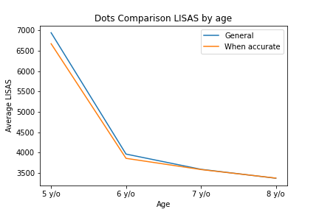
Dots Comparison
LISAS by age

Slide 2
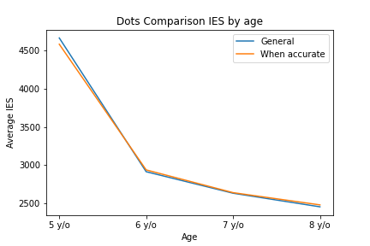
Dots Comparison
IES by age

Slide 3
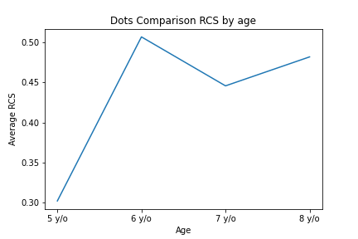
Dots Comparison
RCS by age

Slide 4
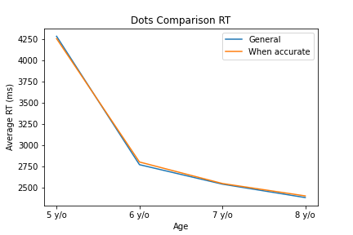
Dots Comparison
RT by age

Slide 5
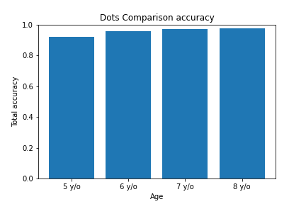
Dots Comparison
Accuracy by age

Slide 6
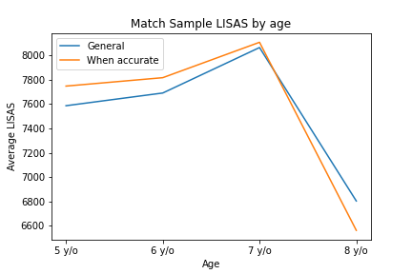
Match Sample
LISAS by age

Slide 7
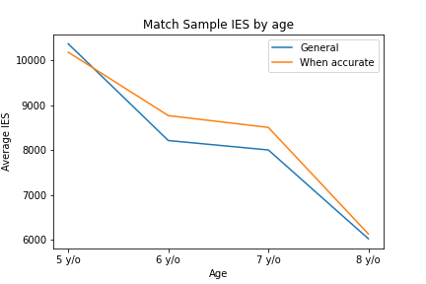
Match Sample
IES by age

Slide 8
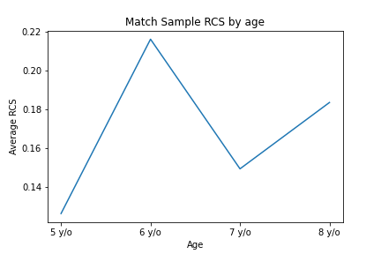
Match Sample
RCS by age

Slide 9
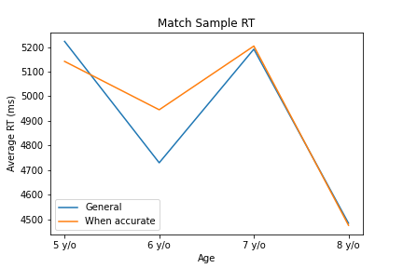
Match Sample
RT by age

Slide 10
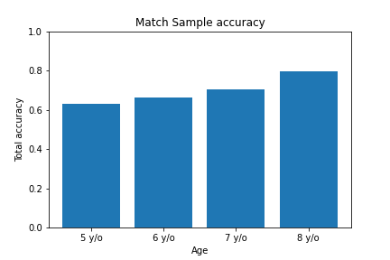
Match Sample
Accuracy by age

Slide 11
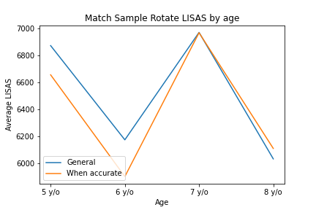
Match Sample Rotate
LISAS by age

Slide 12
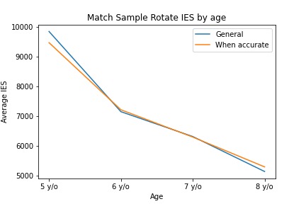
Match Sample Rotate
IES by age

Slide 13
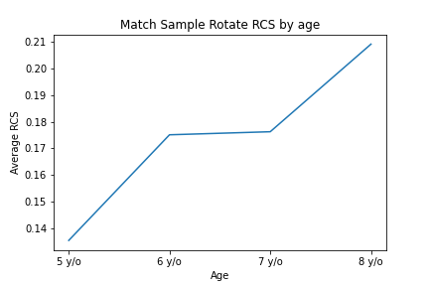
Match Sample Rotate
RCS by age

Slide 14
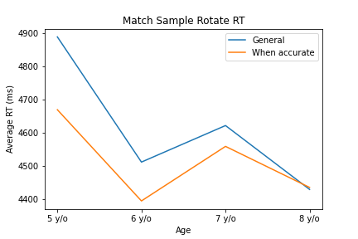
Match Sample Rotate
RT by age

Slide 15
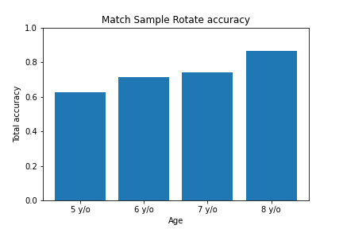
Match Sample Rotate
Accuracy by age

Slide 16
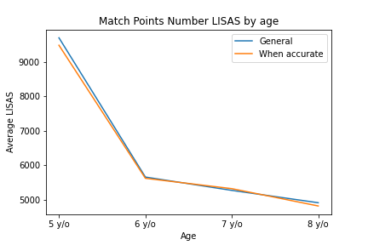
Match Points Number
LISAS by age

Slide 17
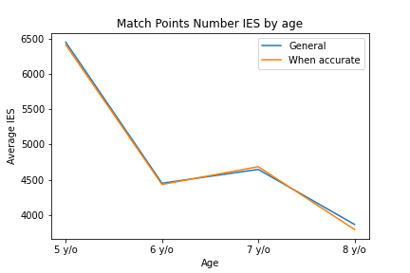
Match Points Number
IES by age

Slide 18
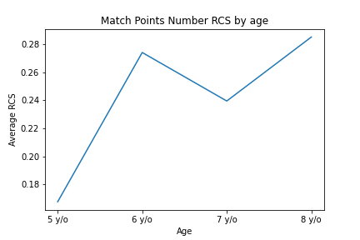
Match Points Number
RCS by age

Slide 19
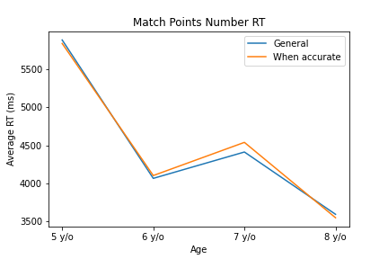
Match Points Number
RT by age

Slide 20
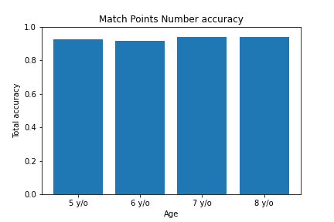
Match Points Number
Accuracy by age

Slide 21
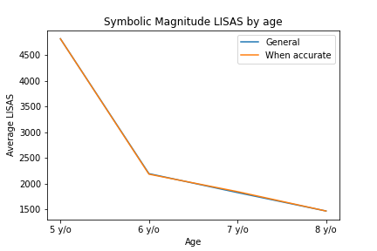
Symbolic Magnitude
LISAS by age

Slide 22
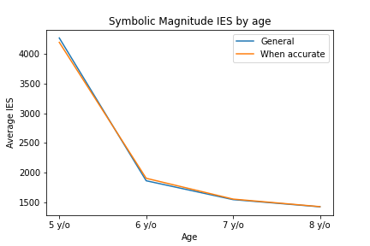
Symbolic Magnitude
IES by age

Slide 23
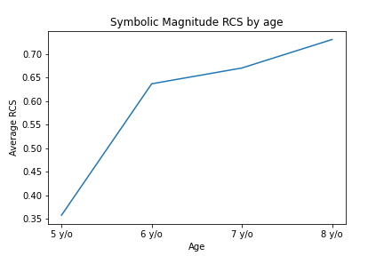
Symbolic Magnitude
RCS by age

Slide 24
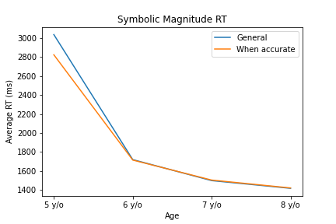
Symbolic Magnitude
RT by age

Slide 25
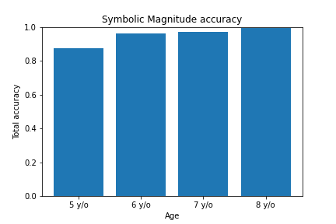
Symbolic Magnitude
Accuracy by age

Slide 26
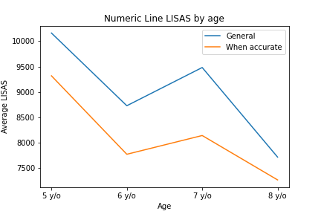
Numeric Line
LISAS by age

Slide 27
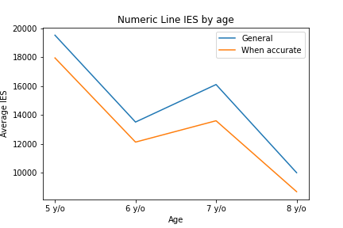
Numeric Line
IES by age

Slide 28
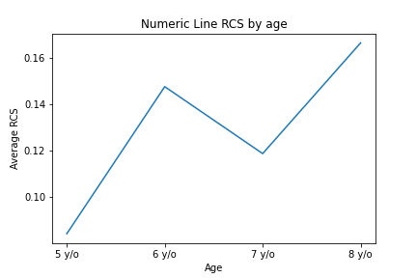
Numeric Line
RCS by age

Slide 29
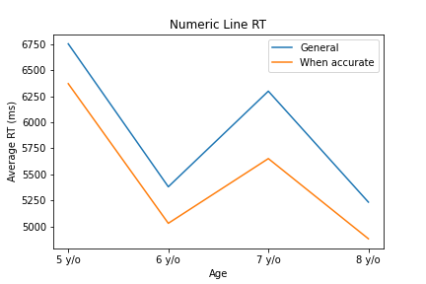
Numeric Line
RT by age

Slide 30
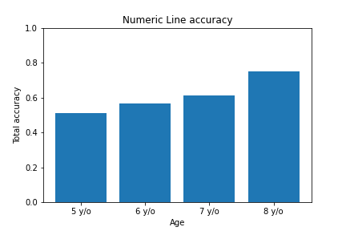
Numeric Line
Accuracy by age

Slide 31
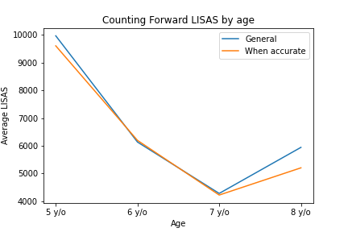
Counting Forward
LISAS by age

Slide 32
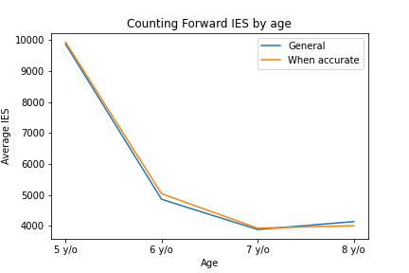
Counting Forward
IES by age

Slide 33
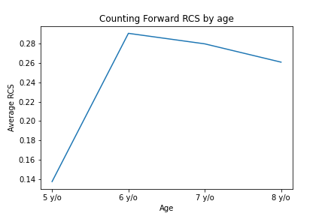
Counting Forward
RCS by age

Slide 34
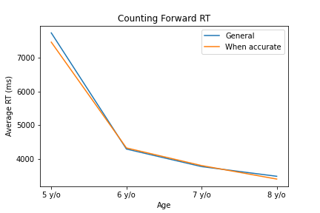
Counting Forward
RT by age

Slide 35
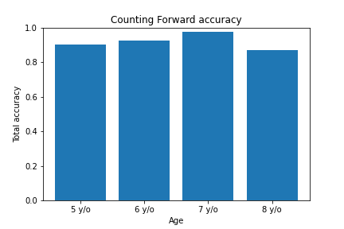
Counting Forward
Accuracy by age

Slide 36
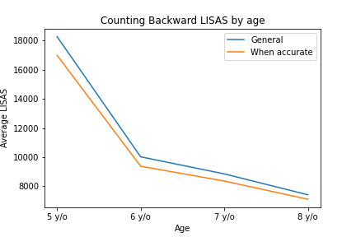
Counting Backward
LISAS by age

Slide 37
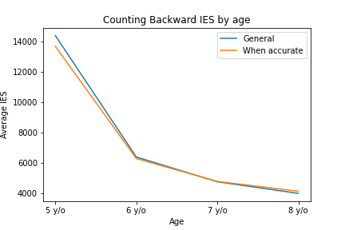
Counting Backward
IES by age

Slide 38
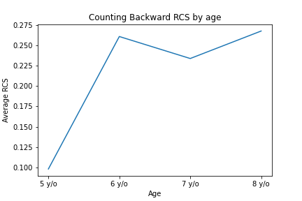
Counting Backward
RCS by age

Slide 39
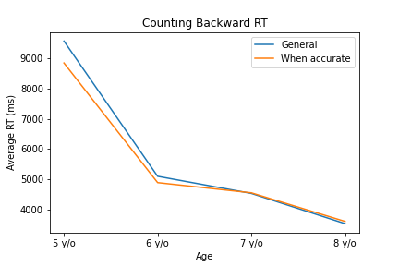
Counting Backward
RT by age

Slide 40
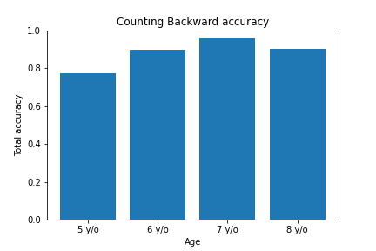
Counting Backward
Accuracy by age

Slide 41
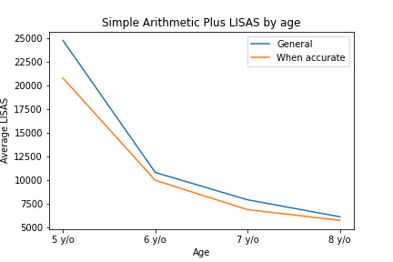
Simple Arithmetic Plus
LISAS by age

Slide 42
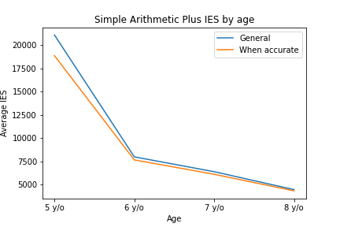
Simple Arithmetic Plus
IES by age

Slide 43
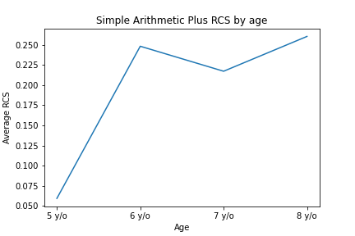
Simple Arithmetic Plus
RCS by age

Slide 44
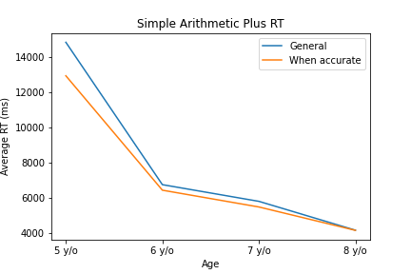
Simple Arithmetic Plus
RT by age

Slide 45
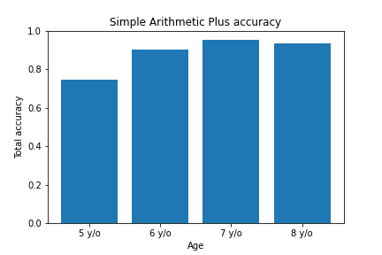
Simple Arithmetic Plus
Accuracy by age

Slide 46
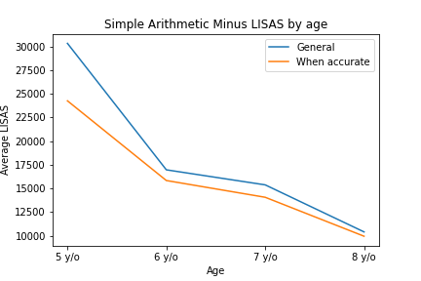
Simple Arithmetic Minus
LISAS by age

Slide 47
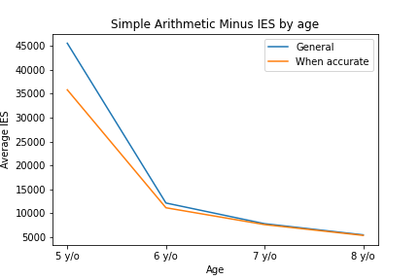
Simple Arithmetic Minus
IES by age

Slide 48
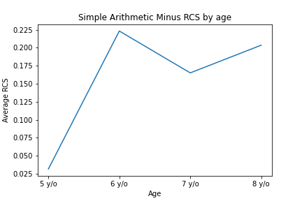
Simple Arithmetic Minus
RCS by age

Slide 49
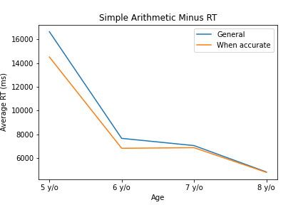
Simple Arithmetic Minus
RT by age

Slide 50
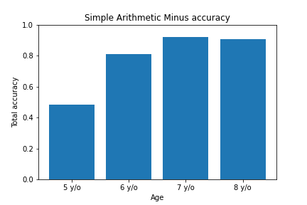
Simple Arithmetic Minus
Accuracy by age

Slide 51

LISAS
Boxplot by subtest

Slide 52

LISAS correct
Boxplot by subtest

Slide 53

IES
Boxplot by subtest

Slide 54

IES correct
Boxplot by subtest

Slide 55

RCS
Boxplot by subtest

Slide 56
Dots Comparison
LISAS by age

Slide 57
Dots Comparison
IES by age

Slide 58
Dots Comparison
RCS by age

Slide 59
Dots Comparison
RT by age

Slide 60
Dots Comparison
Accuracy by age

Slide 61
Match Sample
LISAS by age

Slide 62
Match Sample
IES by age

Slide 63
Match Sample
RCS by age

Slide 64
Match Sample
RT by age

Slide 65
Match Sample
Accuracy by age

Slide 66
Match Sample Rotate
LISAS by age

Slide 67
Match Sample Rotate
IES by age

Slide 68
Match Sample Rotate
RCS by age

Slide 69
Match Sample Rotate
RT by age

Slide 70
Match Sample Rotate
Accuracy by age

Slide 71
Match Points Number
LISAS by age

Slide 72
Match Points Number
IES by age

Slide 73
Match Points Number
RCS by age

Slide 74
Match Points Number
RT by age

Slide 75
Match Points Number
Accuracy by age

Slide 76
Symbolic Magnitude
LISAS by age

Slide 77
Symbolic Magnitude
IES by age

Slide 78
Symbolic Magnitude
RCS by age

Slide 79
Symbolic Magnitude
RT by age

Slide 80
Symbolic Magnitude
Accuracy by age

Slide 81
Numeric Line
LISAS by age

Slide 82
Numeric Line
IES by age

Slide 83
Numeric Line
RCS by age

Slide 84
Numeric Line
RT by age

Slide 85
Numeric Line
Accuracy by age

Slide 86
Counting Forward
LISAS by age

Slide 87
Counting Forward
IES by age

Slide 88
Counting Forward
RCS by age

Slide 89
Counting Forward
RT by age

Slide 90
Counting Forward
Accuracy by age

Slide 91
Counting Backward
LISAS by age

Slide 92
Counting Backward
IES by age

Slide 93
Counting Backward
RCS by age

Slide 94
Counting Backward
RT by age

Slide 95
Counting Backward
Accuracy by age

Slide 96
Simple Arithmetic Plus
LISAS by age

Slide 97
Simple Arithmetic Plus
IES by age

Slide 98
Simple Arithmetic Plus
RCS by age

Slide 99
Simple Arithmetic Plus
RT by age

Slide 100
Simple Arithmetic Plus
Accuracy by age

Slide 101
Simple Arithmetic Minus
LISAS by age

Slide 102
Simple Arithmetic Minus
IES by age

Slide 103
Simple Arithmetic Minus
RCS by age

Slide 104
Simple Arithmetic Minus
RT by age

Slide 105
Simple Arithmetic Minus
Accuracy by age

Slide 106
LISAS
Box plot by subtest

Slide 107
LISAS correct
Box plot by subtest

Slide 108
IES
Box plot by subtest

Slide 109
IES correct
Box plot by subtest

Slide 110
RCS
Box plot by subtest

