Slide 1
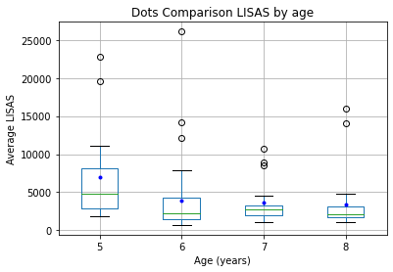
Dots Comparison
LISAS by age

Slide 2
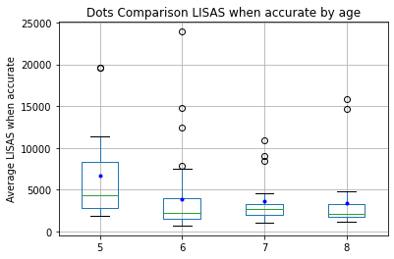
Dots Comparison
LISAS when accurate by age

Slide 3
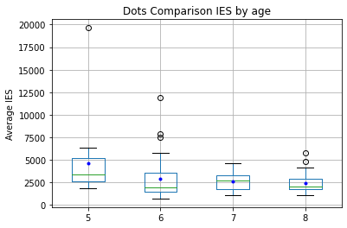
Dots Comparison
IES by age

Slide 4
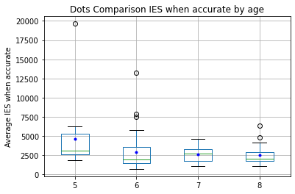
Dots Comparison
IES when accurate by age

Slide 5
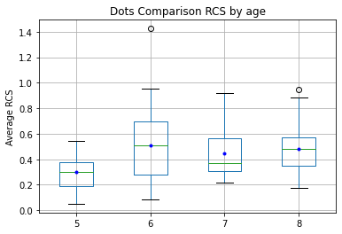
Dots Comparison
RCS by age

Slide 6
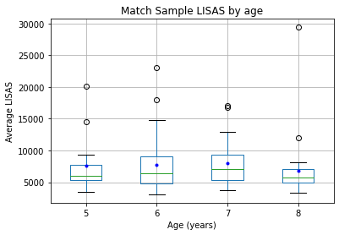
Match Sample
LISAS by age

Slide 7
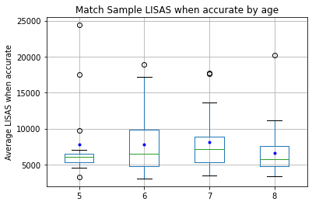
Match Sample
LISAS when accurate by age

Slide 8
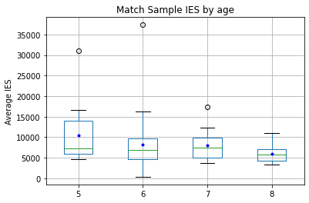
Match Sample
IES by age

Slide 9
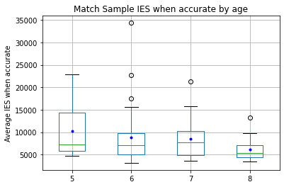
Match Sample
IES when accurate by age

Slide 10
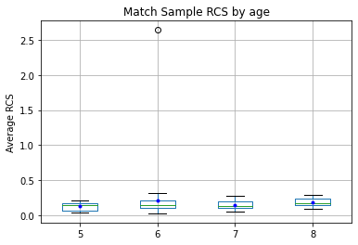
Match Sample
RCS by age

Slide 11
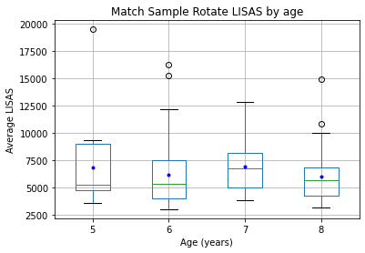
Match Sample Rotate
LISAS by age

Slide 12
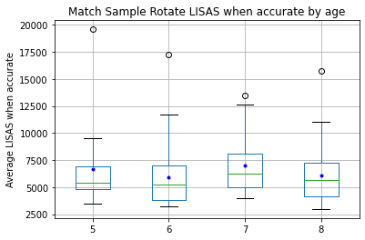
Match Sample Rotate
LISAS when accurate by age

Slide 13
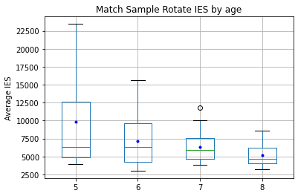
Match Sample Rotate
IES by age

Slide 14
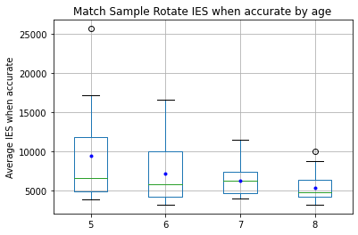
Match Sample Rotate
IES when accurate by age

Slide 15
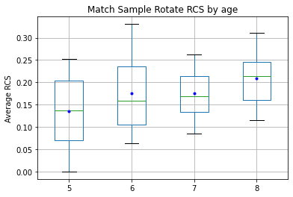
Match Sample Rotate
RCS by age

Slide 16
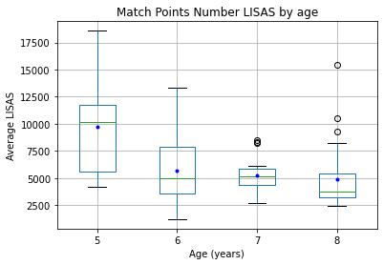
Match Points Number
LISAS by age

Slide 17
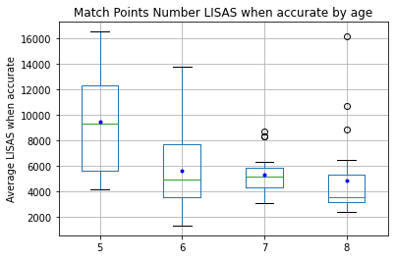
Match Points Number
LISAS when accurate by age

Slide 18
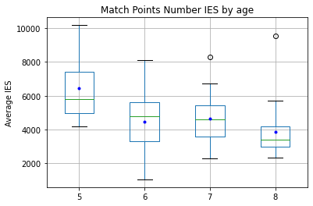
Match Points Number
IES by age

Slide 19
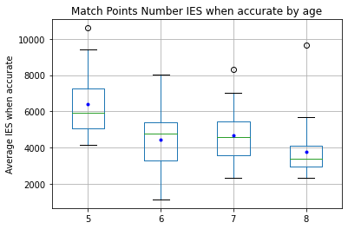
Match Points Number
IES when accurate by age

Slide 20
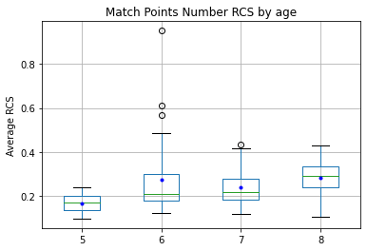
Match Points Number
RCS by age

Slide 21
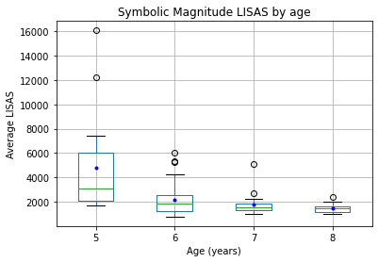
Symbolic Magnitude
LISAS by age

Slide 22
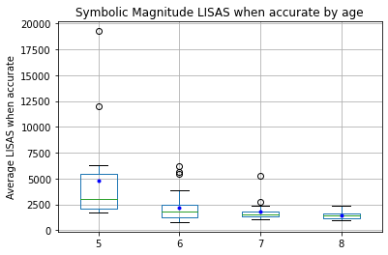
Symbolic Magnitude
LISAS when accurate by age

Slide 23
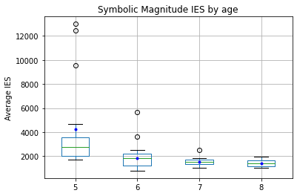
Symbolic Magnitude
IES by age

Slide 24
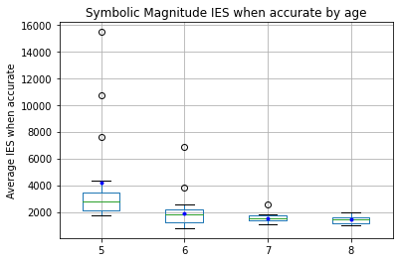
Symbolic Magnitude
IES when accurate by age

Slide 25
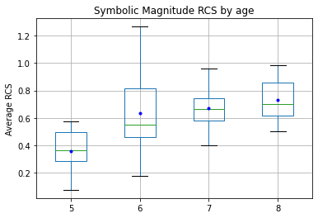
Symbolic Magnitude
RCS by age

Slide 26
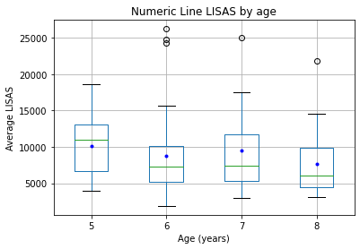
Numeric Line
LISAS by age

Slide 27
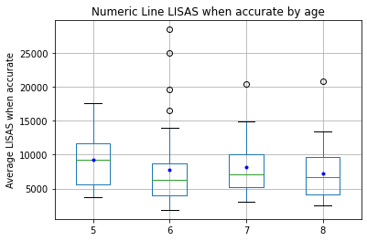
Numeric Line
LISAS when accurate by age

Slide 28
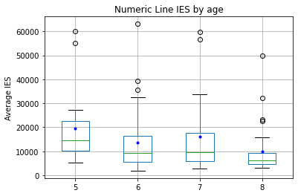
Numeric Line
IES by age

Slide 29
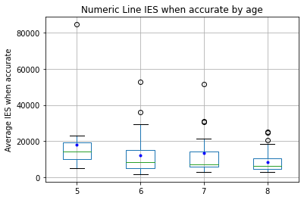
Numeric Line
IES when accurate by age

Slide 30
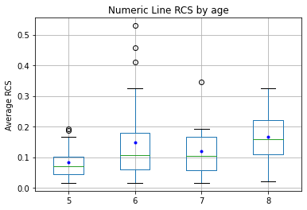
Numeric Line
RCS by age

Slide 31
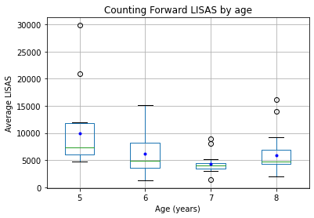
Counting Forward
LISAS by age

Slide 32
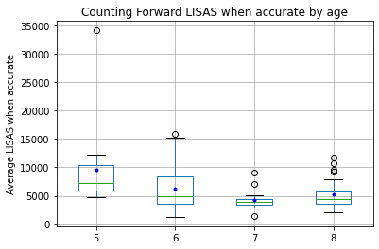
Counting Forward
LISAS when accurate by age

Slide 33

Counting Forward
IES by age

Slide 34
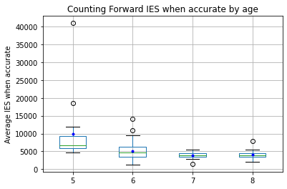
Counting Forward
IES when accurate by age

Slide 35
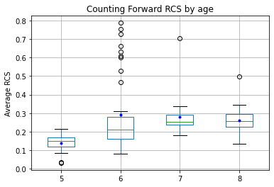
Counting Forward
RCS by age

Slide 36
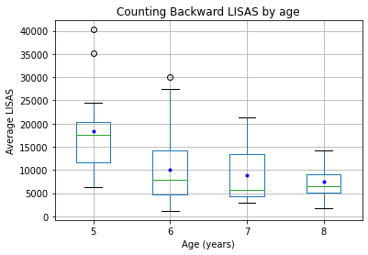
Counting Backward
LISAS by age

Slide 37
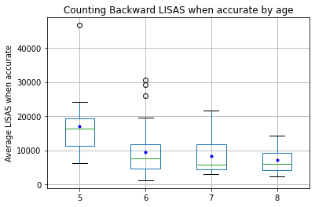
Counting Backward
LISAS when accurate by age

Slide 38
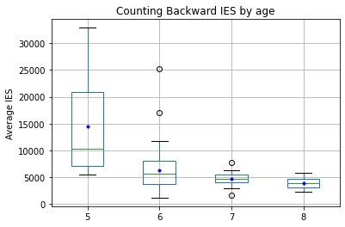
Counting Backward
IES by age

Slide 39
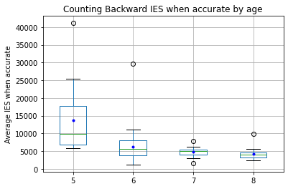
Counting Backward
IES when accurate by age

Slide 40
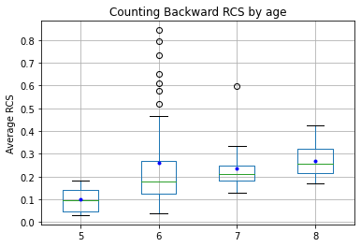
Counting Backward
RCS by age

Slide 41
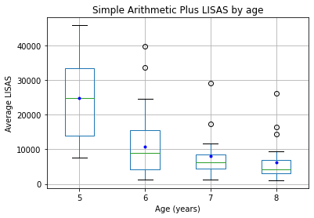
Simple Arithmetic Plus
LISAS by age

Slide 42
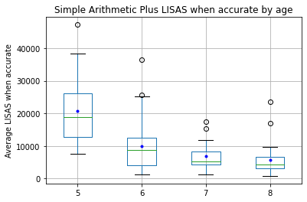
Simple Arithmetic Plus
LISAS when accurate by age

Slide 43
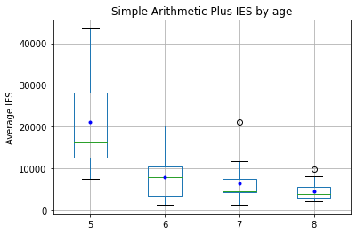
Simple Arithmetic Plus
IES by age

Slide 44
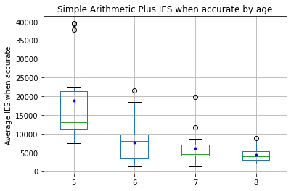
Simple Arithmetic Plus
IES when accurate by age

Slide 45
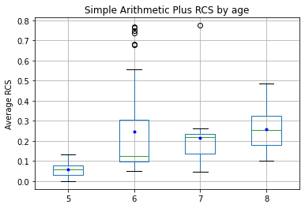
Simple Arithmetic Plus
RCS by age

Slide 46
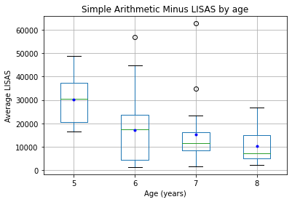
Simple Arithmetic Minus
LISAS by age

Slide 47
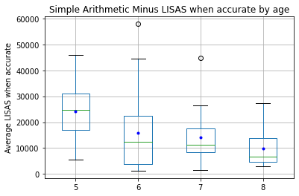
Simple Arithmetic Minus
LISAS when accurate by age

Slide 48
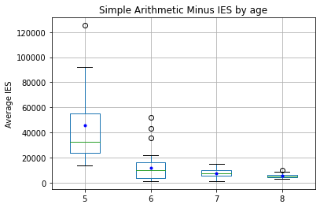
Simple Arithmetic Minus
IES by age

Slide 49
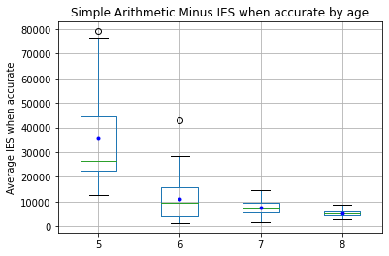
Simple Arithmetic Minus
IES when accurate by age

Slide 50
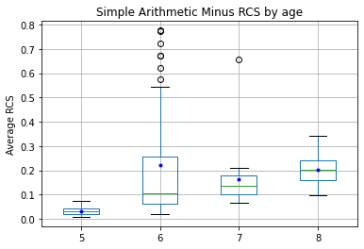
Simple Arithmetic Minus
RCS by age

