Slide 1
Green Street Crime
Lida Tetyusheva

Slide 2
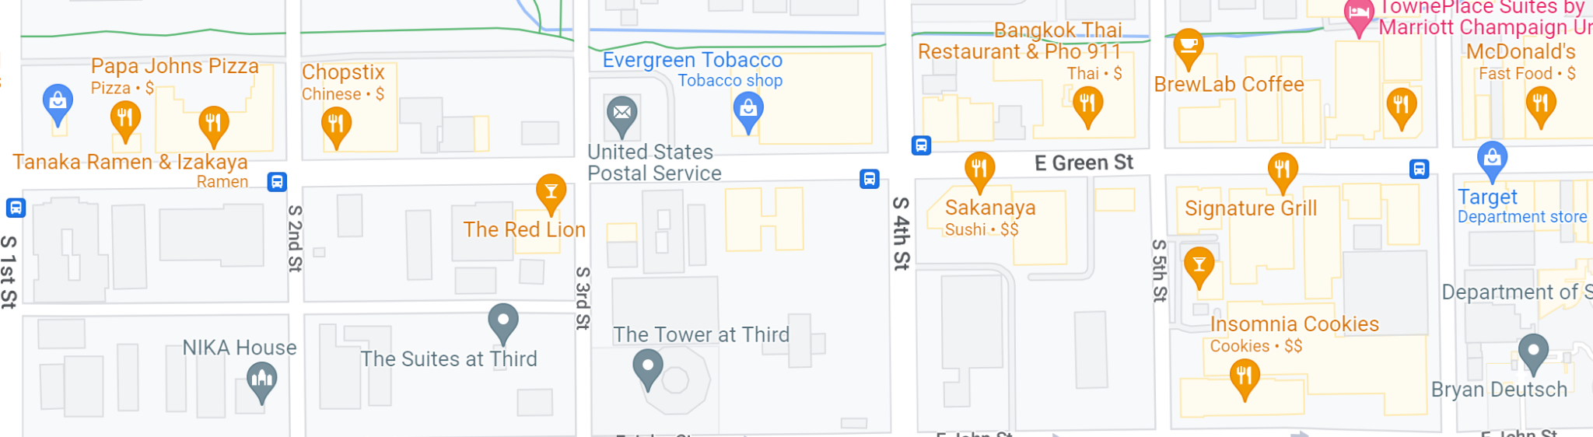
Why Green Street?
Bars (red)
Apartment Complexes
Tobacco Stores (green) and Nuera
Liquor Stores (blue)
Restaurants
“Downtown Area”
Notes:
How many of you have witnessed a crime on Green Street?
First, I chose this dataset because the illini alerts make me more aware of crime on campus and I have heard of friends and acquaintances experiencing crime often.

Slide 3
Data Description
10 Columns: Date, Time, Month, Year, Crime Description, Crime Category, Place Description, Weapons Code 1, Weapons Description 1, Mapping Address
Years: 2013-2022
Variables added:
Area(public or private)
Hub(Green or Urbana)
“Urbana”
112,136 rows
12 columns
“Green”
1,845 rows
12 columns

Slide 4

What is Green Street crime like? How does it compare to Urbana?

Slide 5

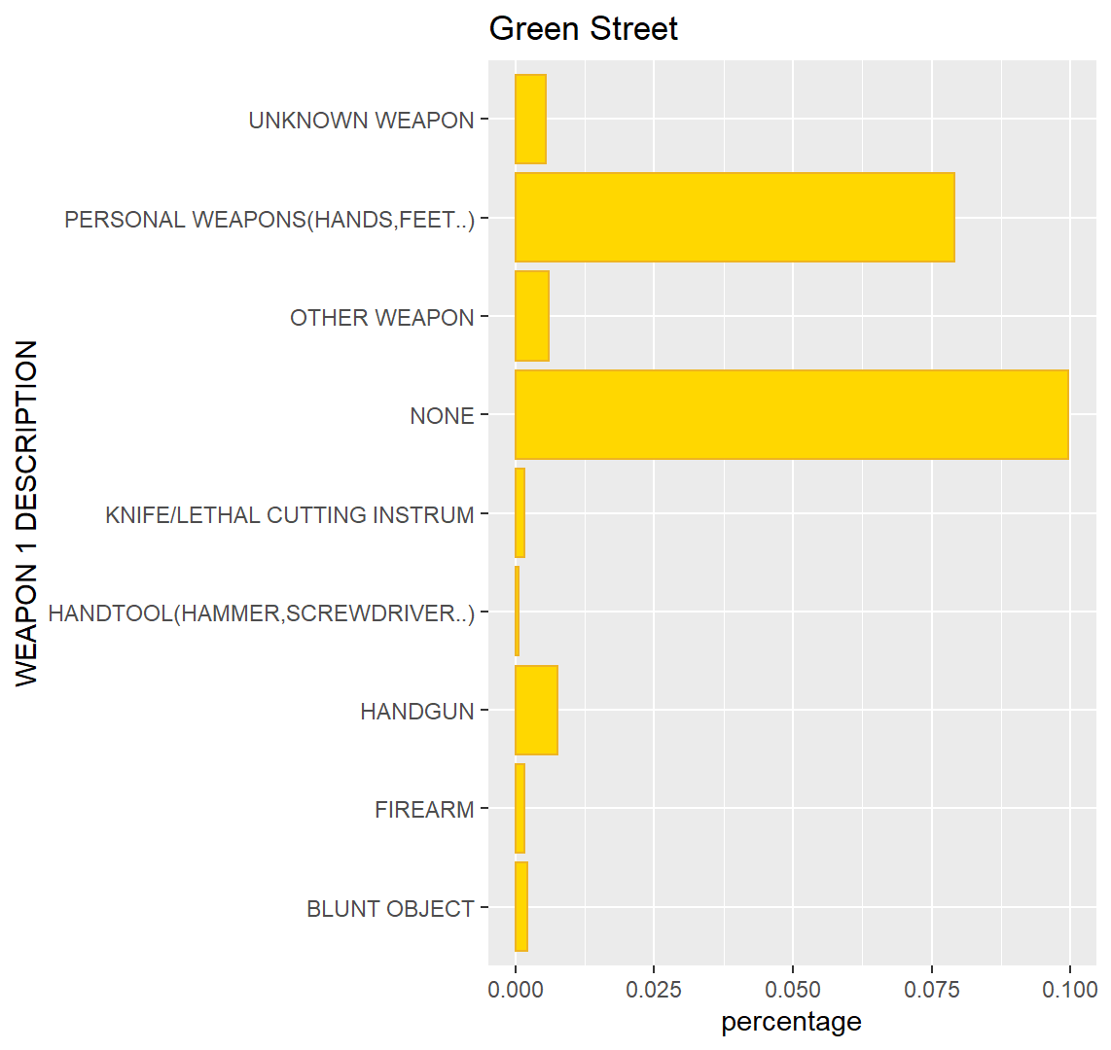
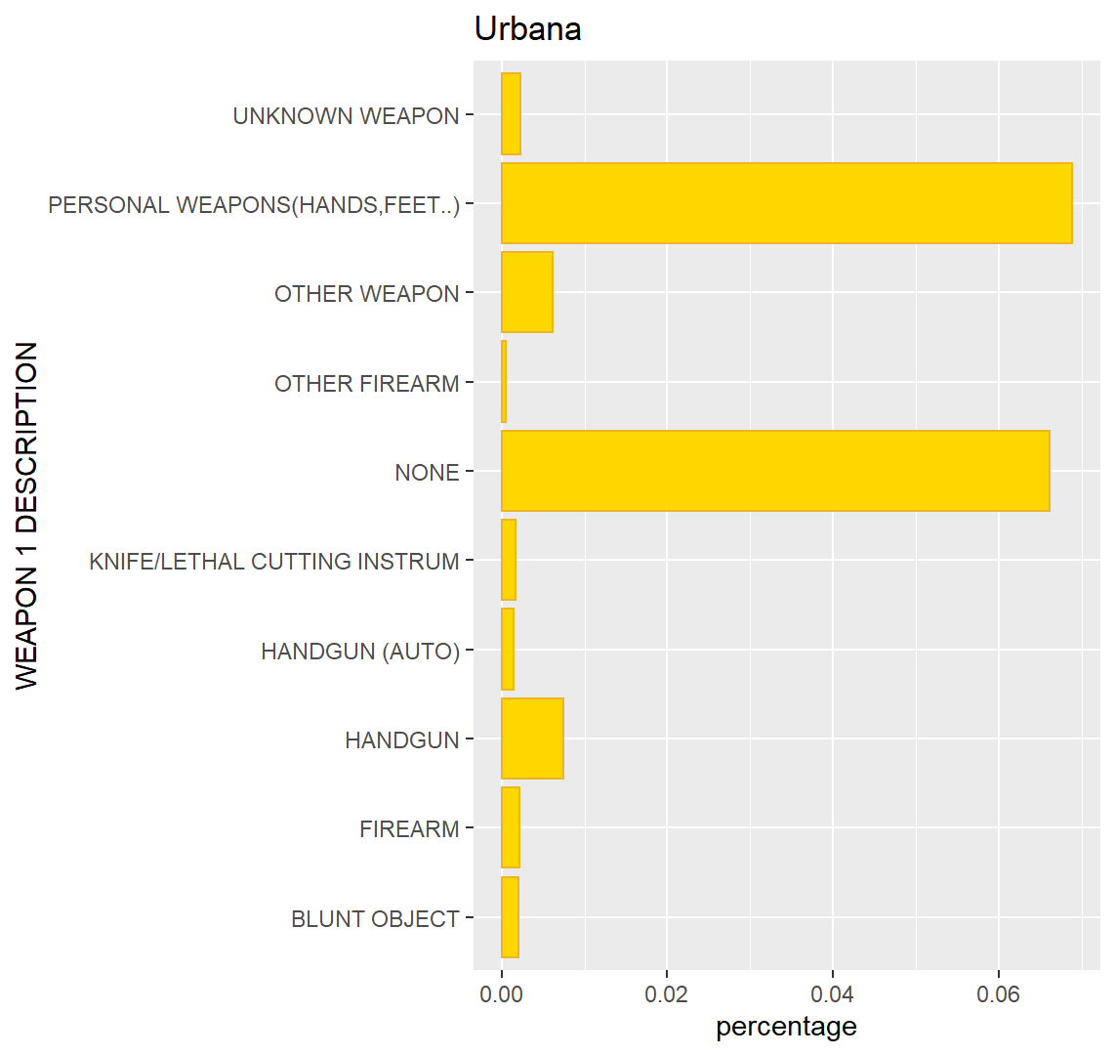
Weapons - bar graphs
Notes:
Doesn’t seem to be much difference in the top nine weapons being used in crimes, however what is not shown is that the urbana dataset has a lot more types of weapons

Slide 6
Weapons - Two proportions z-test
Null: Prob(Green) = Prob(Urbana)
Alternative: Prob(Green) ≠ Prob(Urbana)
P-value = 1.204e-07
Null: Prob(Green) = Prob(Urbana)
Alternative: Prob(Green) > Prob(Urbana)
P-value = 6.021e-08
20.43% of crimes in Green involve weapons 15.86% of crimes in Urbana involve weapons
Notes:
Assuming that the NONE description actually involves a weapon

Slide 7
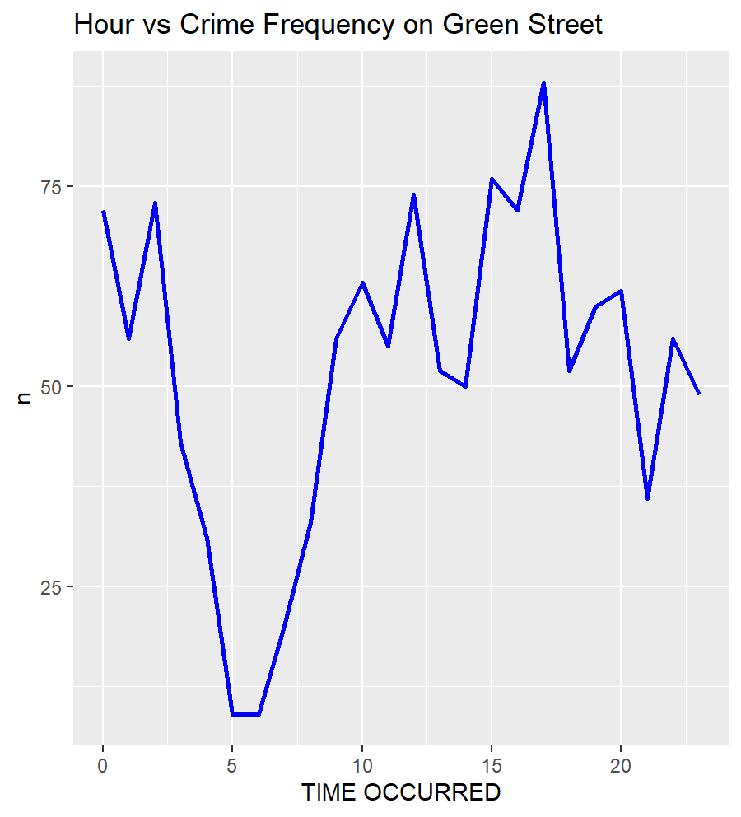
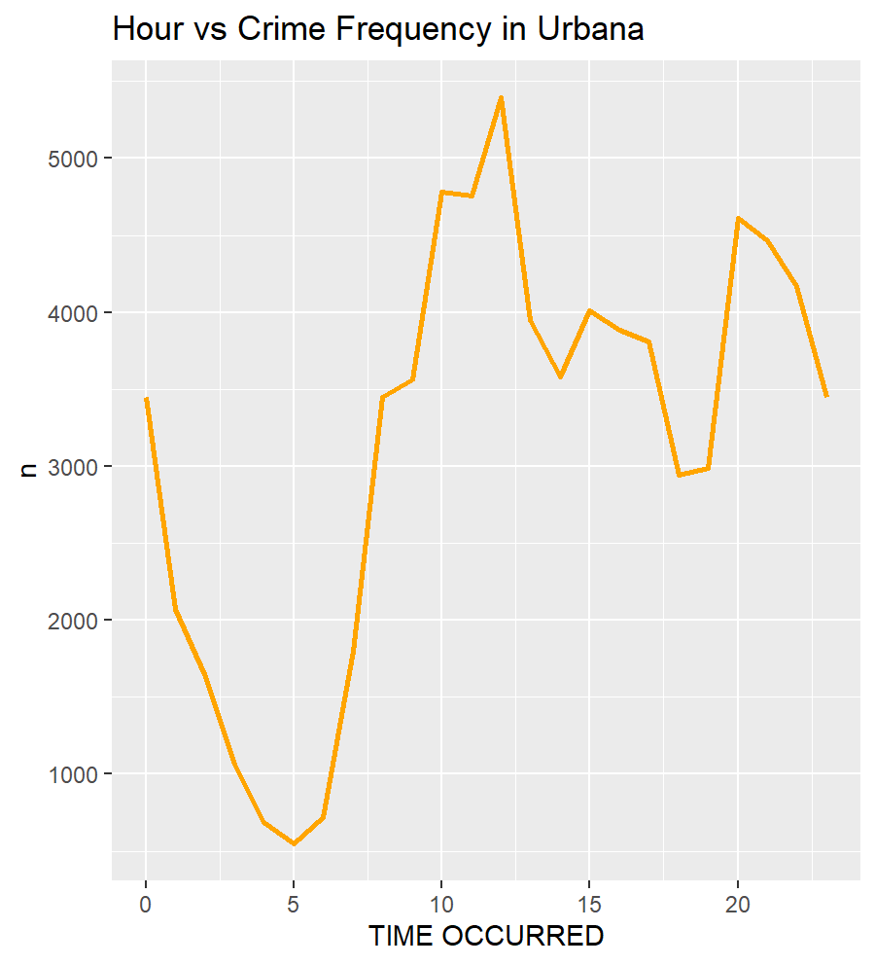

Slide 8

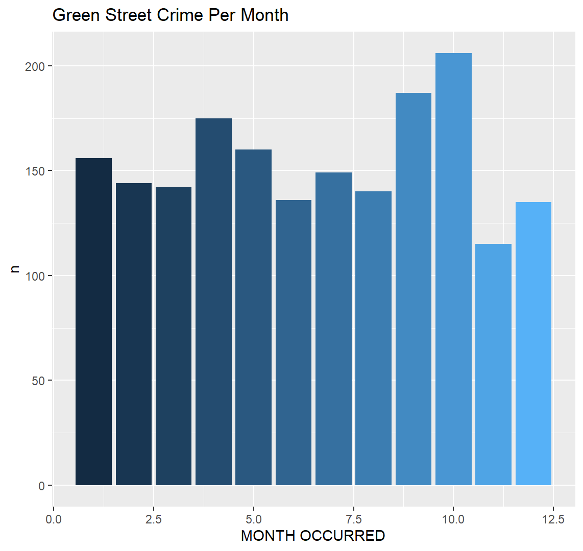
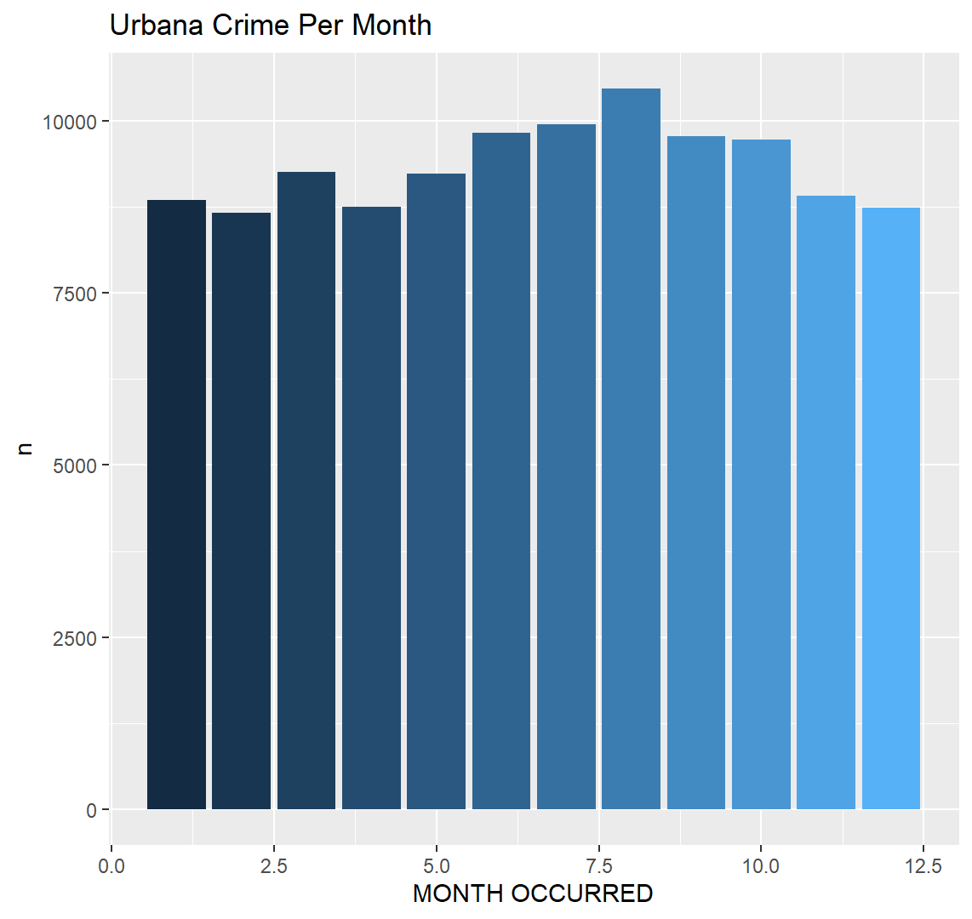
Month vs. # of Crimes

Slide 9
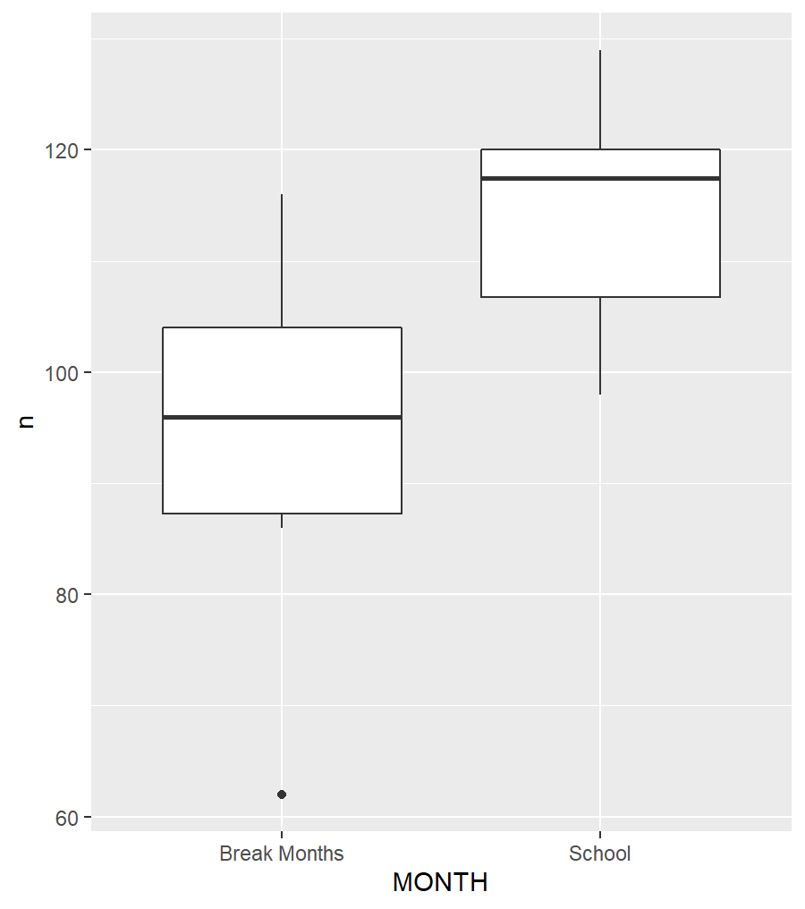
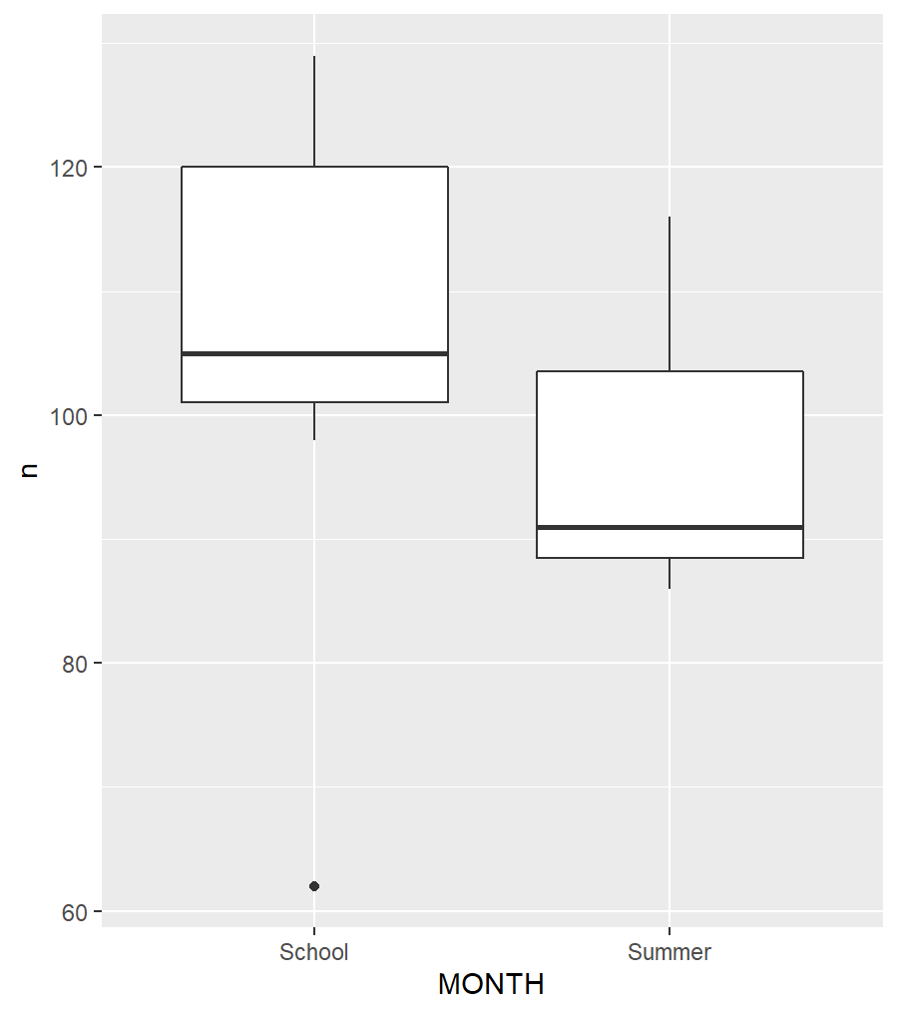
Mean # of Crimes

Slide 10
Anova Test for Significance of Effect Month has on amount of Crime
Summer Months vs. School Months
NOT significant. P-value = .522 > .05
School Break Months vs. School Months
Significant! P-value = .0422 < .05
Two-Sample T-test for Means at 95% Confidence
School Break Months vs. School Months
Significant! P-value = .02365 < .05
Notes:
This is a broad generalization as I didn’t narrow it down to exact weeks of the school breaks, so in the future I will see if I can compare between weeks during the year.
The anova tests show that the month period (“school breaks” and “school months”) have a significant effect on the number of crimes
The t-test is significant, so this means that we can assume that the mean number of crimes during school break months are less than school months.

Slide 11




What Next?
Does Partying affect Crime on Green Street?
Bubble map
Narrow down tests to week by week
Time of Crimes

