Slide 1
Holidays vs Crime In Urbana
Lida Tetyusheva

Slide 2
According to Alcohol.org … (https://alcohol.org/statistics-information/holiday-binge-drinking/ )
Holidays involving the most drinking are:
Cinco De Mayo
St. Patrick’s Day
Christmas to New Years
Thanksgiving Week
Fourth of July
Halloween
Notes:
I chose to only focus on these holidays because they have strong drinking trends and medium to high popularity in the U.S.

Slide 3
“Urbana” Dataset
13 Columns: Incident, Date, Time, Month, Year, Crime Category, Place Description, Weapons Code 1, Weapons Description 1, Mapping Address, Time reported, Time arrived
Years: 1970-2022
Variables added:
Area(public or private)
330,522 Rows
“Holiday” Dataset
15 Columns: Incident, Date, Time, Month, Year, Crime Category, Place Description, Weapons Code 1, Weapons Description 1, Mapping Address, Time Reported, Time Arrived
Years: 1970-2022
Variables added:
Area(public or private)
Event(specifying holiday)
Response Time(in minutes)
16,464 Rows

Slide 4

What is Urbana crime like during Holidays?
Notes:
For this presentation, I will be aiming to answer this question by comparing Urbana crime during the holidays to national trends and studies.

Slide 5
“no minor holiday
had any significant impact on criminal behavior. Only major, or ‘national’ holidays … were found to show significant relationships with crime rates.”
Only study I found that explored crime rates during the holidays (done in Minneapolis)
Notes:
While researching if other studies had been done on this, this source I found was from a study done in Minneapolis looking at the years 1985-87-88. I wanted to see if the Urbana Policing dataset follows this conclusion.

Slide 6
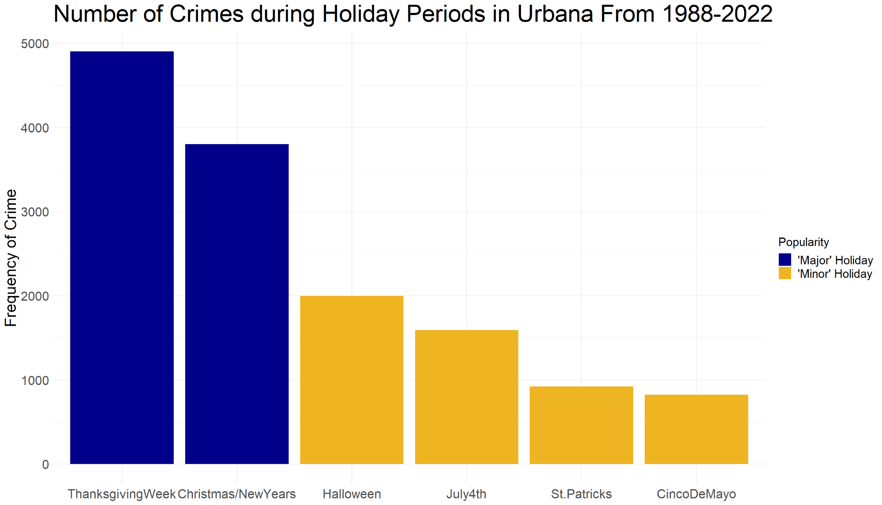
Which Holiday period has the most crime?
Notes:
Looking at this graph, it appears that the major holiday periods have more crime than minor holiday periods.

Slide 7
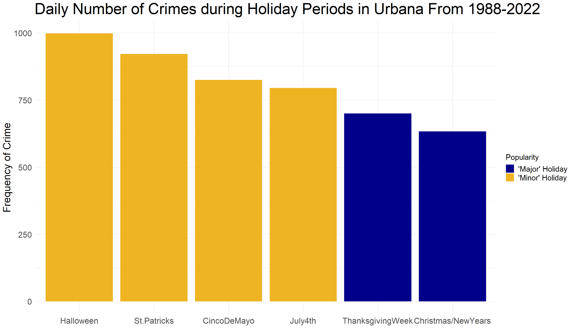
Which Holiday period has the most crimes when looking at average frequency by day?
Notes:
But when we find the average frequency of crime per day during the Holiday period, we see that the trend seems to be the opposite of the conclusion in the previous graph and the Minneapolis study. Campus students could have an influence on overall Urbana Crime because major holidays are normally during school breaks.

Slide 8
Sources:
http://www.sherrytowers.com/crime_and_holidays.pdf
https://bestlifeonline.com/most-common-holiday-crimes/m
Many law firm websites emphasize the rise of these crimes during holidays
Frequent Crimes During Holidays in U.S.
Theft (identity, burglary, etc.)
DUI
Assault/Domestic Dispute
Battery/Domestic Violence

Slide 9
Frequency of Top Crime Categories during Holidays (not including Traffic Offenses and Accidents)
Crime Category Description | Number of Occurrences
Theft | 1516
Battery | 1010
Domestic Dispute | 928
Criminal Damage | 894
Burglary | 634
Disorderly Conduct | 518
Notes:
I decided to not include traffic offenses and accidents in this analysis and focus on crime that involve more intention or impulse. First three categories match up with national consensus. Disorderly conduct could be related to drinking trends during the holidays, but DUI is nowhere to be seen in the top crimes.

Slide 10
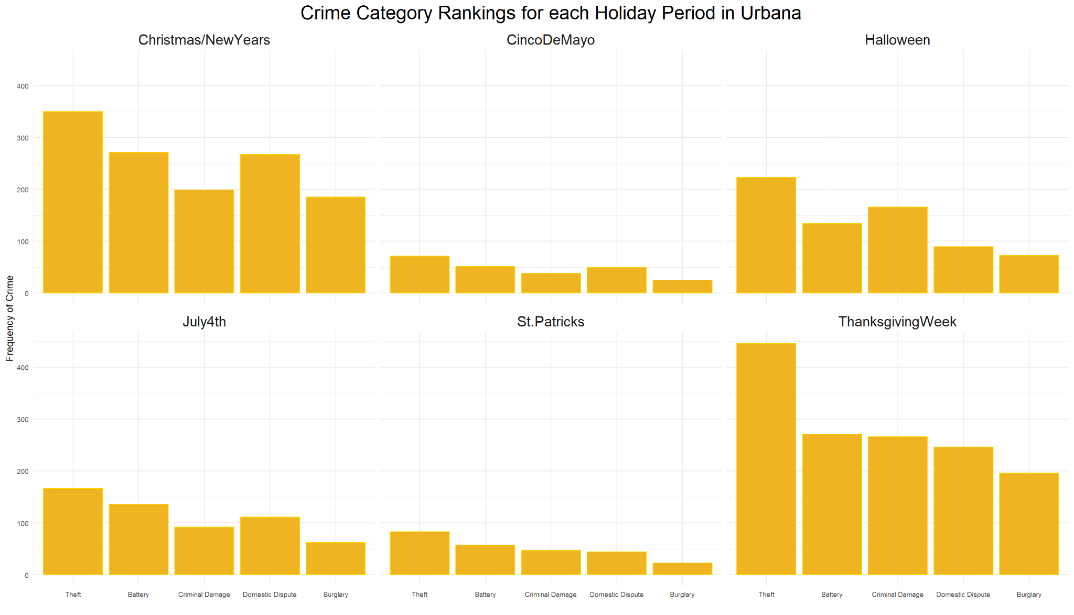

Slide 11
Theft

Slide 12
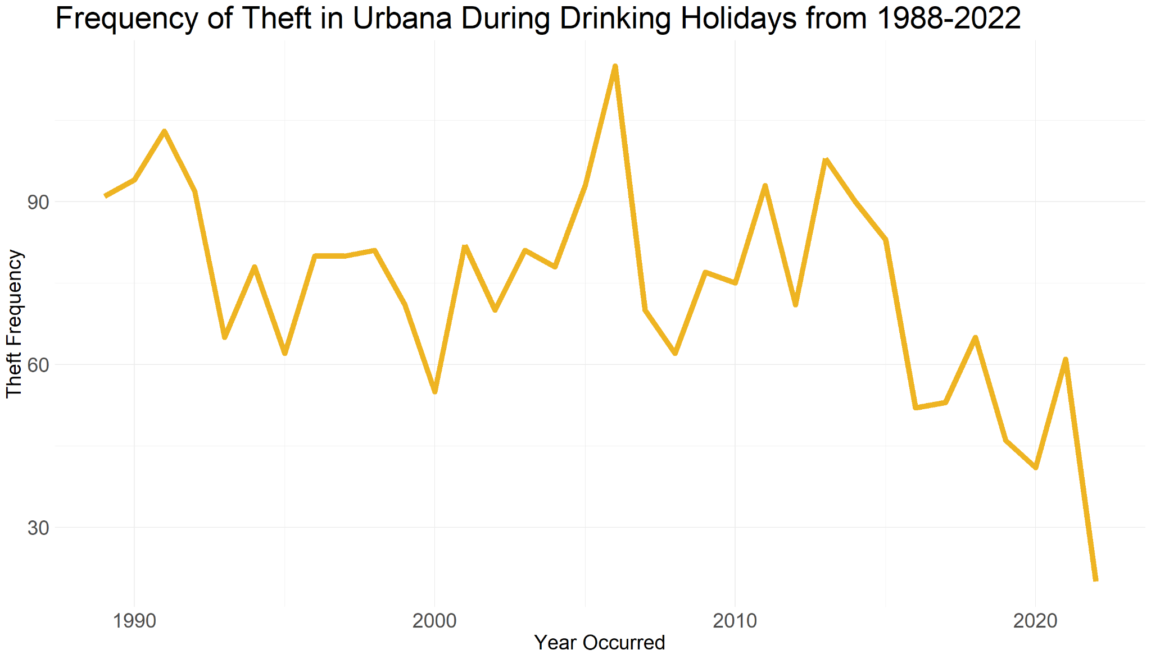
What is the frequency of Theft over the years during holidays in Urbana?
Notes:
Since I chose these holidays based on their relation to drinking, I narrowed it down to substance-related crimes to see if there was a big difference.

Slide 13
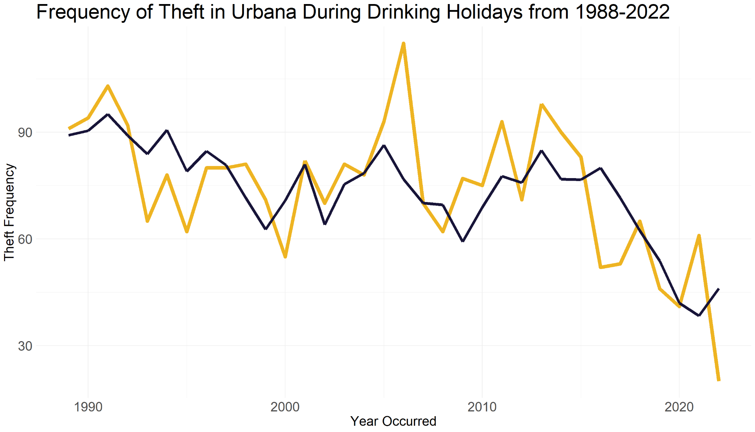
What is the frequency of Theft over the years during holidays compared to regular days in Urbana
Notes:
The trend of theft frequency doesn’t seem to have much difference between holiday times and regular days

Slide 14
Crimes involving Theft - two prop. z-test
15.9% during Holidays 14.1% otherwise
P-value = 1.266e-10 < .05 so crimes involving theft are statistically more frequent during holidays

Slide 15
2. DUI

Slide 16
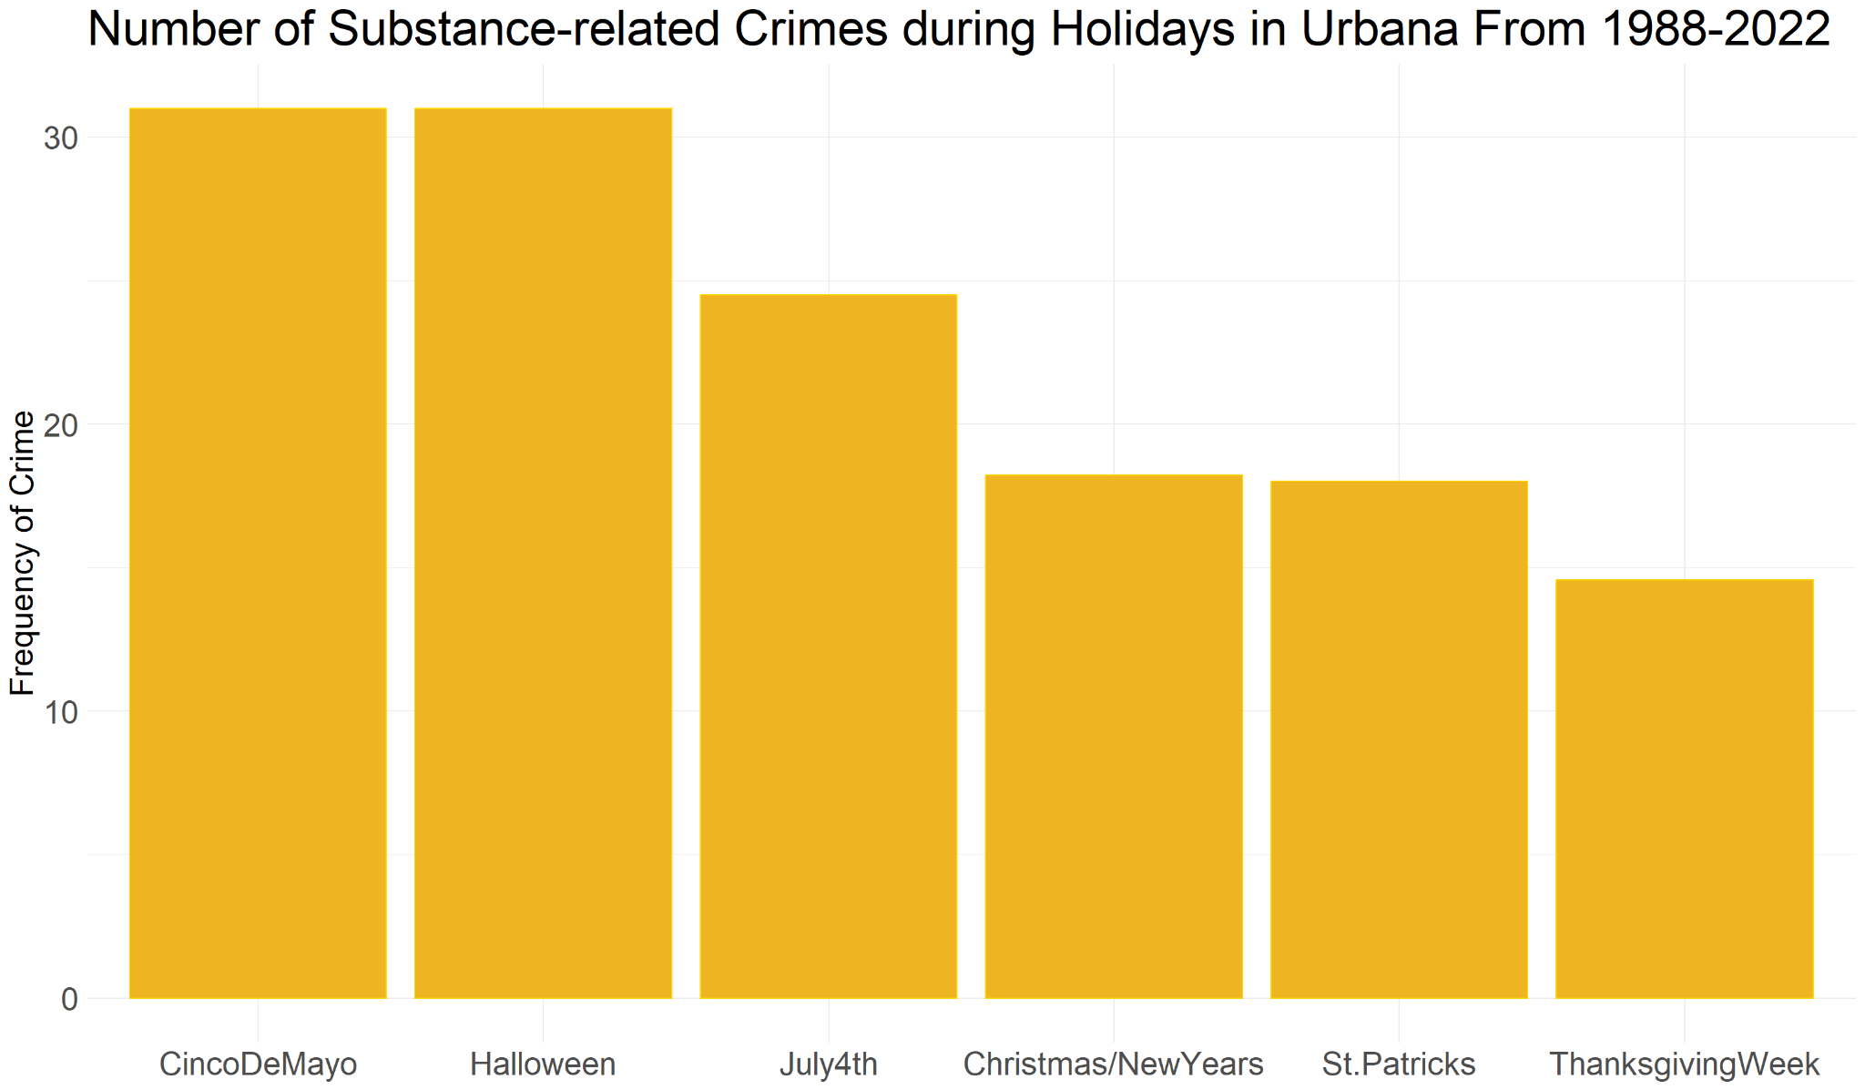
Which Holiday has the most substance-related crimes?
Notes:
First I decided to look at substance related crimes before looking at just DUI’s. This includes meth offenses, cannabis offenses, and liquor offenses.

Slide 17
Substance-related Crimes - two prop. z-test
.266% during Holidays .263% otherwise
P-value = .425 > .05 so substance-related crimes are NOT statistically more frequent during holidays

Slide 18
Drinking Under the Influence - two prop. z-test
.59% during Holidays .40% otherwise
P-value = .0001845 < .05 so crimes where driver was under the influence are statistically more frequent during holidays
Notes:
However, when i narrow it down to just DUI offenses, it is significantly more frequent during holidays

Slide 19
3. Assault/
Domestic Dispute

Slide 20
Assault/Domestic Dispute - two prop. z-test
6.5% during Holidays 5.1% otherwise
P-value = 4.873e-16 < .05 so we can say that assault/domestic dispute crime rates increase significantly during holidays
Notes:
However, when i narrow it down to just DUI offenses, it is significantly more frequent during holidays

Slide 21
4. Battery/
Domestic Violence

Slide 22
Battery/Domestic Violence - two prop. z-test
6.6% during Holidays 5.5% otherwise
P-value = 5.062e-17 < .05 so we can say battery/domestic violence crime rates increase significantly during holidays
Notes:
However, when i narrow it down to just DUI offenses, it is significantly more frequent during holidays

Slide 23
Conclusion
Findings match up with national consensus:
Theft more frequent during holidays
DUI’s more frequent during holidays
Assault/Domestic Dispute more frequent during Holidays
Battery/Domestic Violence more frequent during Holidays
Notes:
What you can learn from this is make sure you take extra caution with your belongings during the holidays and don’t cause any fights during thanksgiving dinner!

