Slide 1
Predicting the Compressive Strength of Concrete
Lida Kuang
August 8th,2018

Slide 2
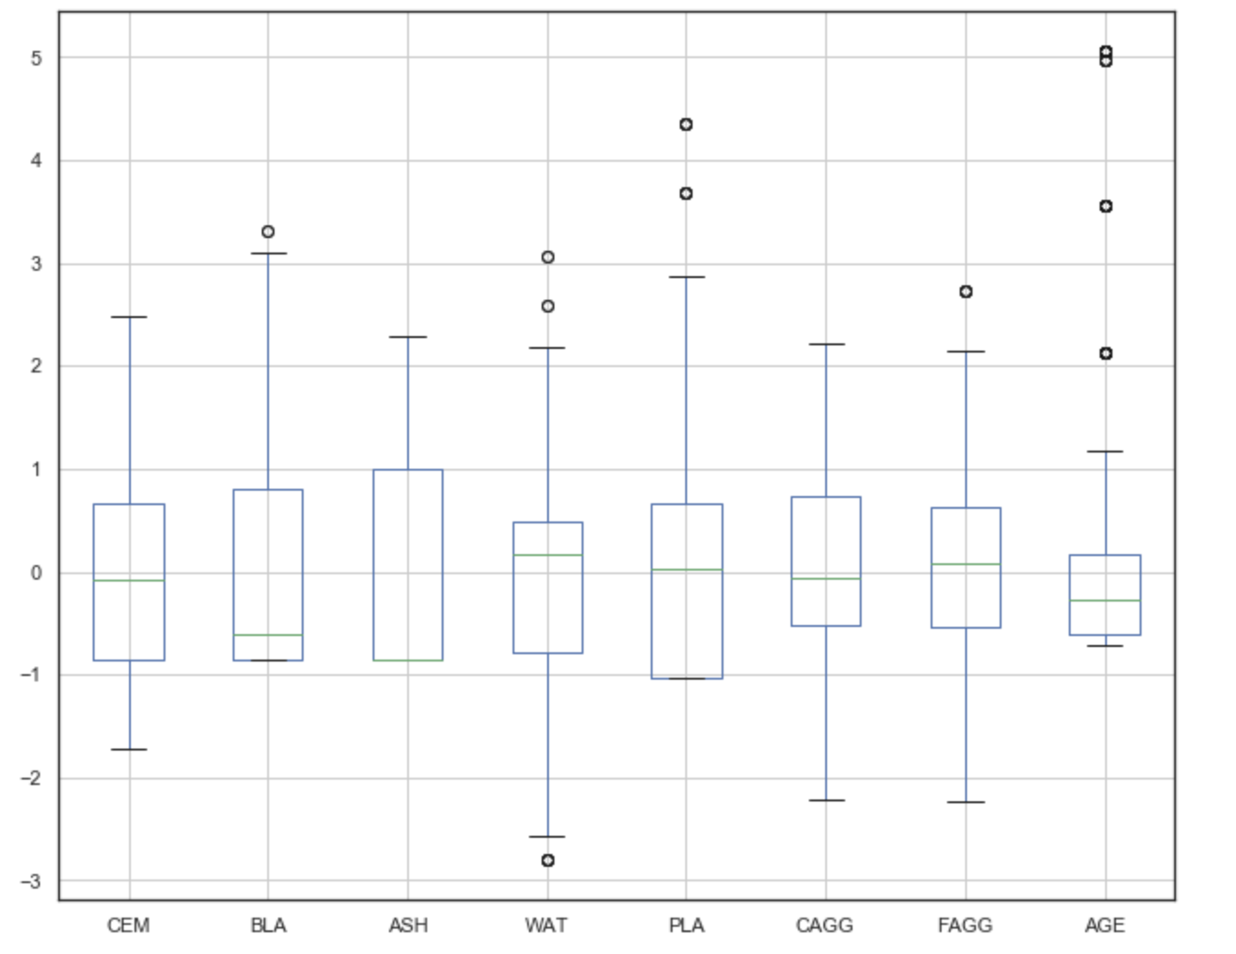
Preprocessing
Distribution

Slide 3
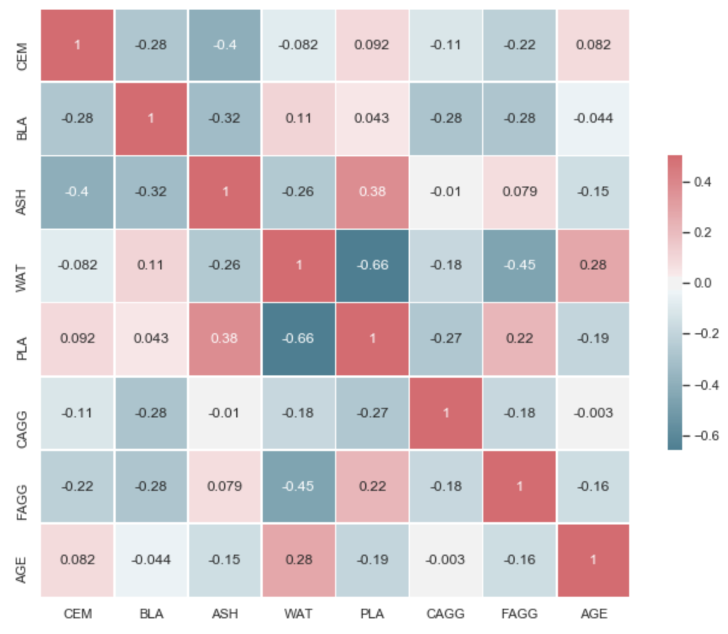
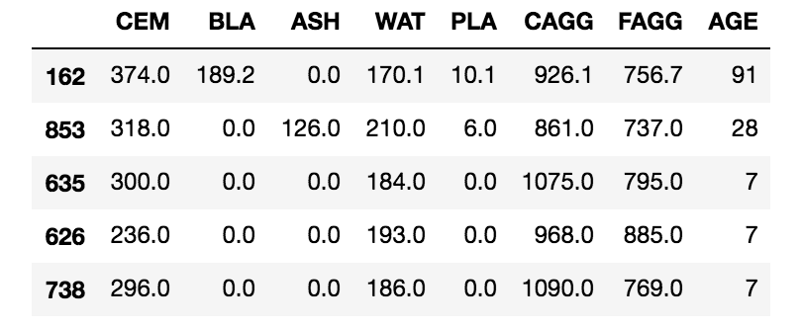
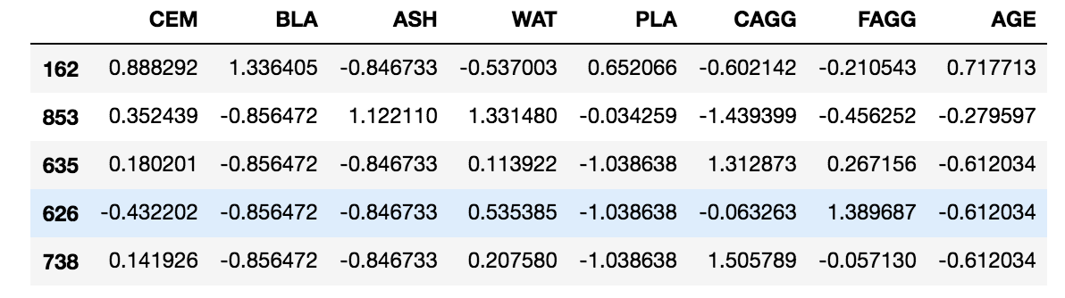
Preprocessing
Correlation
Normalization

Slide 4
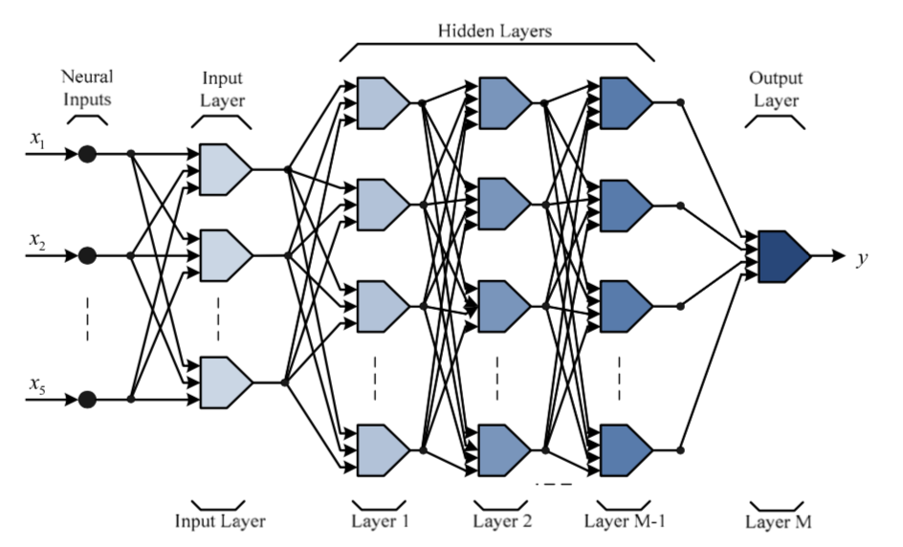
Multiple Layer Neural Network
MFNN structure

Slide 5
Multiple Layer Neural Network
Algorithms
SGD(Stochastic gradient descent)
Levenberg Marquardt function

Slide 6
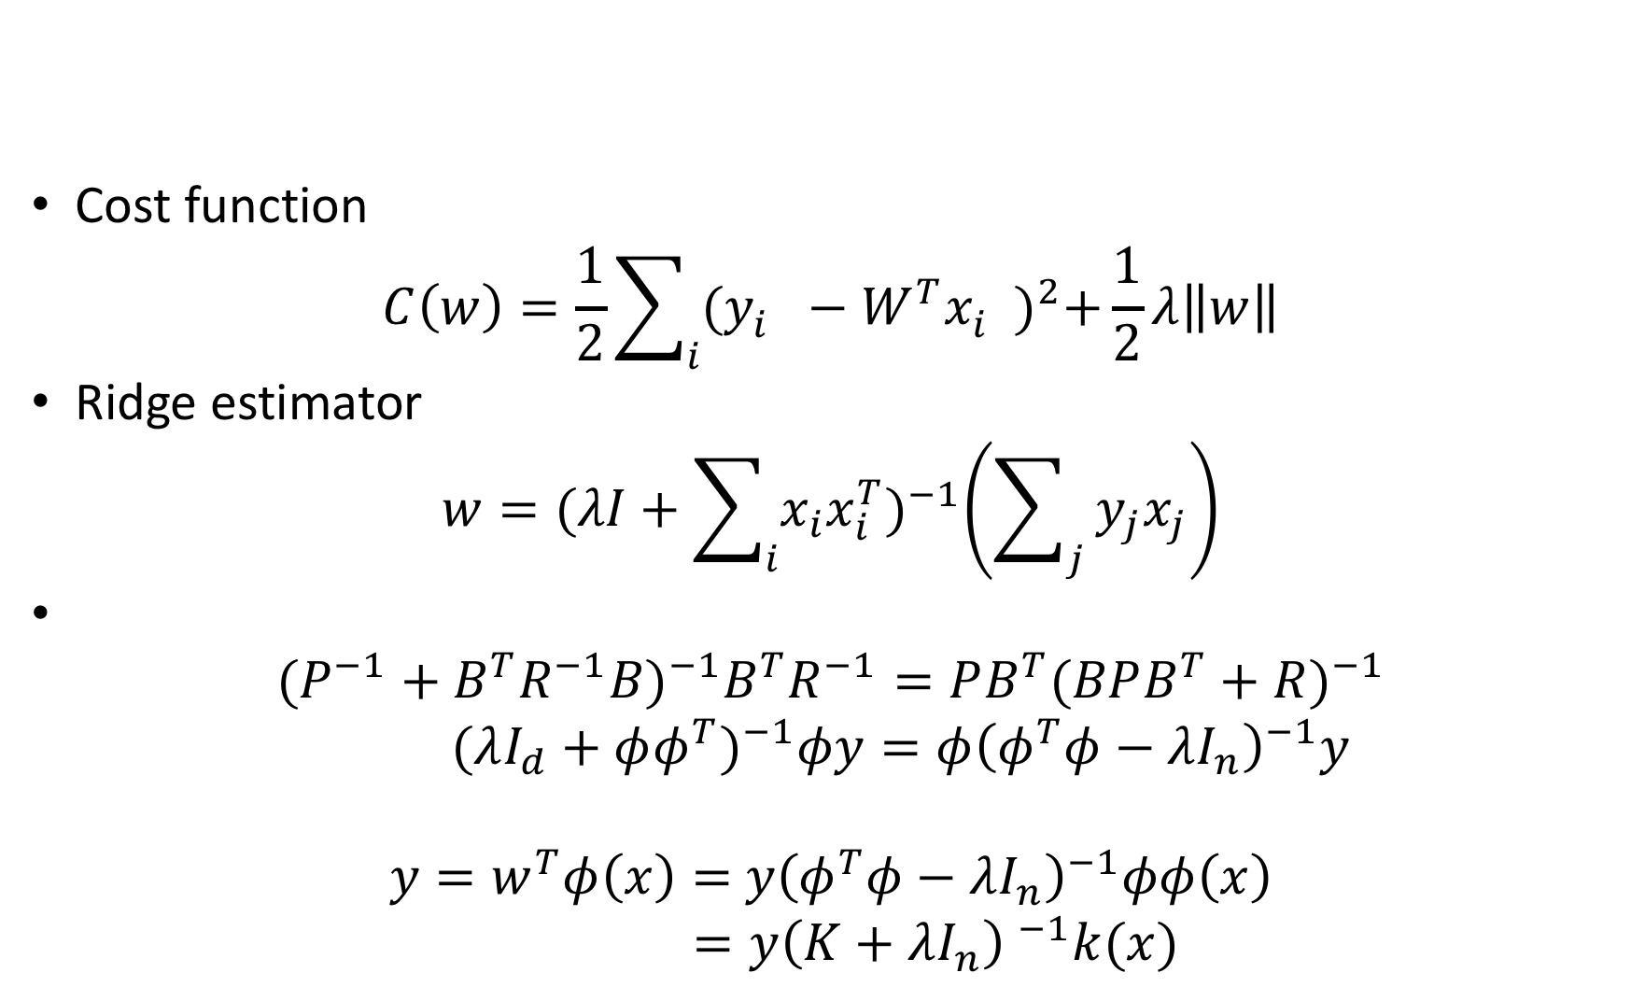
Kernel Ridge Regression
Cost function
$$C\left(w\right)=\frac{1}{2}\sum_{i}{{(y_{i}^{}−W^{T}x_{i}^{})}^{2}+\frac{1}{2}λ\left\|w\right\|}$$
Ridge estimator
$$w={(λI+\sum_{i}{x_{i}x_{i}^{T}})}^{−1}\left(\sum_{j}{y_{j}x_{j}}\right)$$
$${(P^{−1}+B^{T}R^{−1}B)}^{−1}B^{T}R^{−1}=PB^{T}{(BPB^{T}+R)}^{−1}$$
${(λI_{d}+φφ^{T})}^{−1}φy=φ{\left(φ^{T}φ−λI_{n}\right)}^{−1}y$
$y=w^{T}φ\left(x\right)=$ ${y\left(φ^{T}φ−λI_{n}\right)}^{−1}φφ\left(x\right)$
$=y{\left(K+λI_{n}\right) }^{−1}k(x)$

Slide 7
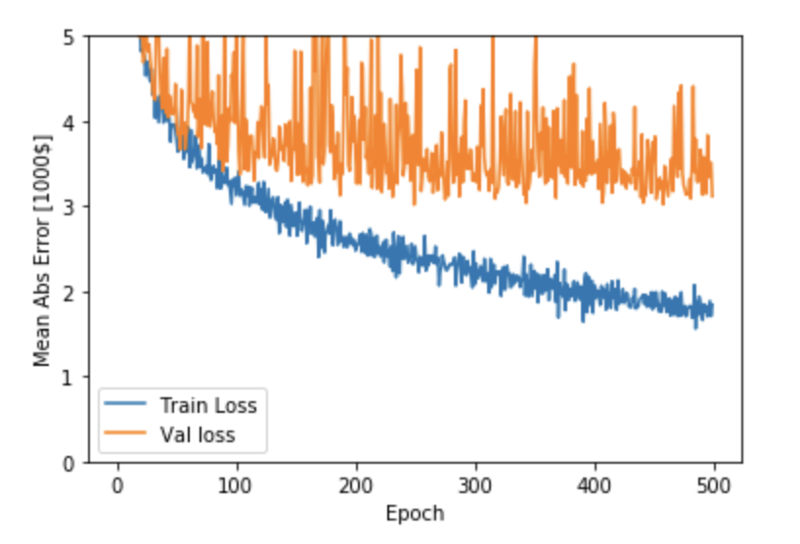
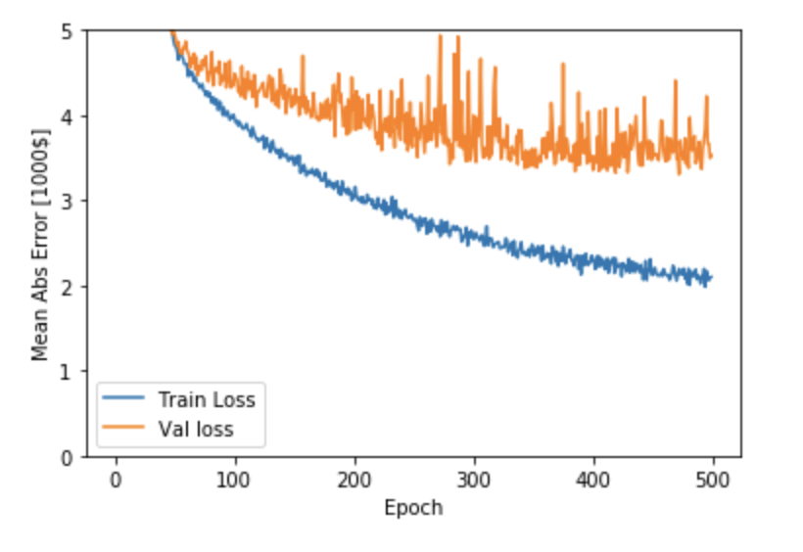
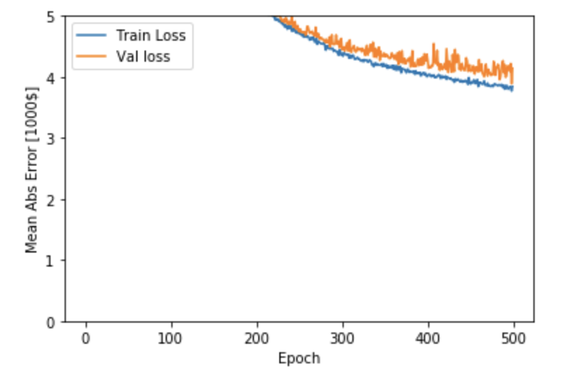
Result----Neural Network
Compare results of layer number
5-layer-NN
R2 score: 0.91180
MSE: 23.10260
3-layer-NN
R2 score: 0.84249
MSE: 41.25606
5-layer-with less nodes
R2 score: 0.84631
MSE: 40.25470

Slide 8
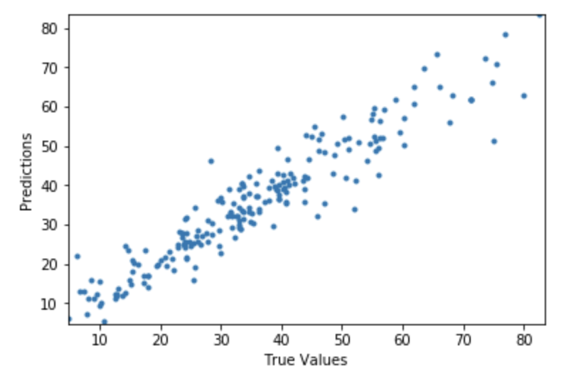
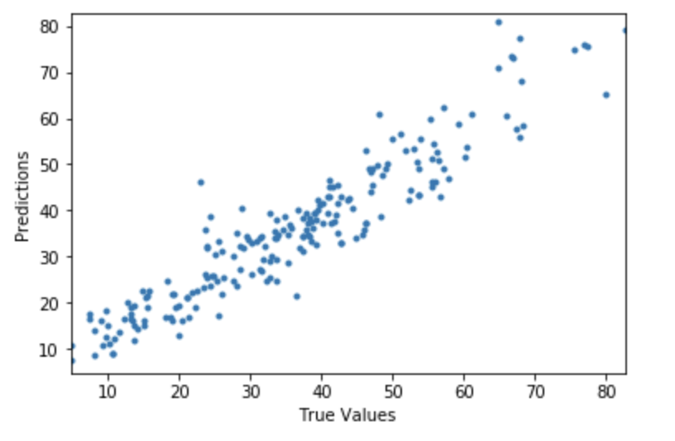
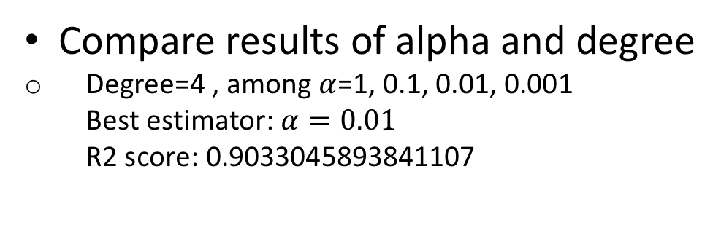
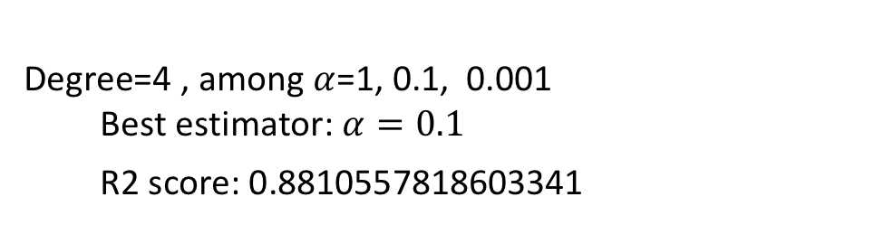
Result----Kernel Ridge Regression
Compare results of alpha and degree
Degree=4 , among $α$=1, 0.1, 0.01, 0.001
Best estimator: $α=0.01$
R2 score: 0.9033045893841107
Degree=4 , among $α$=1, 0.1, 0.001
Best estimator: $α=0.1$
R2 score: 0.8810557818603341

Slide 9
Reference
Max Welling, “Kernel ridge Regression,” Department of Computer Science University of Toronto 10 King’s College Road Toronto, Canada.
Predicting the Compressive Strength of Concrete using Neural Network and Kernel Ridge Regression
An introduction to statistical learning with applications in R
TF using with 2 hides NN: https://www.tensorflow.org/tutorials/keras/basic_regression
Feedforward Neural Network: https://en.wikipedia.org/wiki/Feedforward_neural_network
CG: http://matlab.izmiran.ru/help/toolbox/nnet/backpr59.html
A Scaled Conjugate Gradient Algorithm for Fast Supervised Learning, MARTIN FODSLETTE MEILLER : http://citeseerx.ist.psu.edu/viewdoc/download?doi=10.1.1.294.6699&rep=rep1&type=pdf

Slide 10
Thank you

